Slide 1
數位IC設計
System on a Chip (SoC)

Slide 2
Introduction
Chip: tens of millions of transistors or more
Design shifts from ASIC/board to system
SW
PCB
SW
PCB
uP
ROM
FPGA
ATM
MPEG
ROM
ASIC
System on a Board
System-on-a chip is possible
(the whole system is built in
a single chip)
SW
SW
SOC
uP
Core
SRAM
FPGA
ROM
A/D Block
MPEG
ATM
System on a chip
ROM
Glue Logic

Slide 3
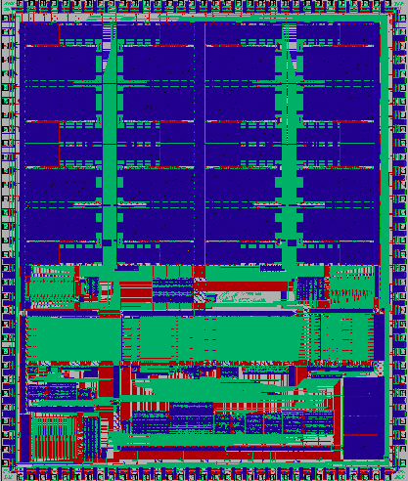
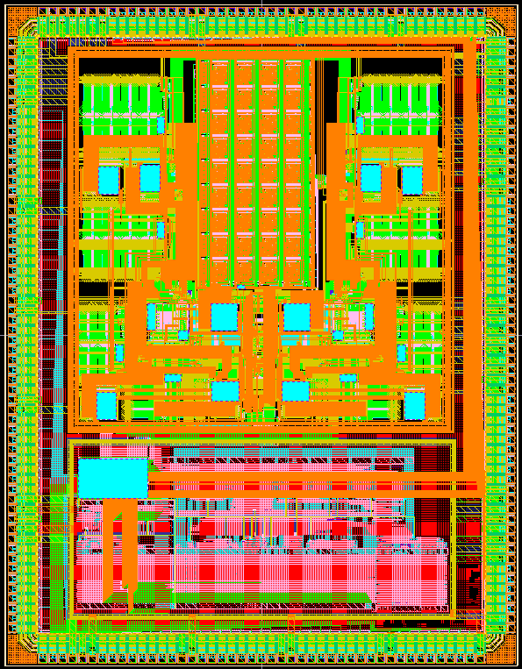
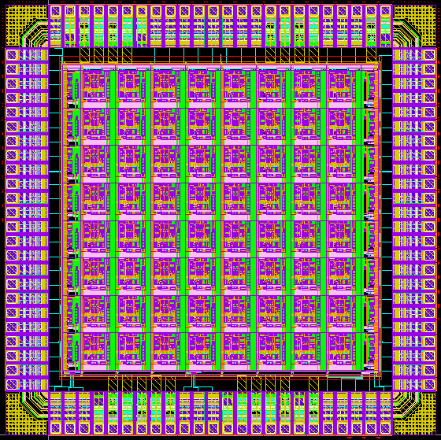
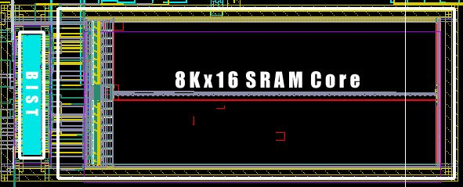
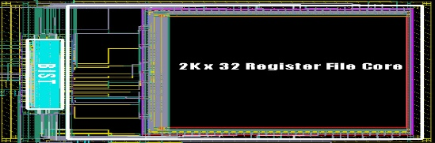
SoC Example
R
O
M
CPU
FPGA
DSP
D
R
A
M
Switch
Fabric
SRAM
Flash

Slide 4
SoC Design
Common problems for SoC:
Time-to-market pressures
Quality of results, in performance, area and power
Verification and testing becomes difficult
Development team consists of experts of different areas
SOC includes embedded processor cores and significant software (a key part)
Mixed hardware and software, logic and memory, digital and analog circuits
Old design methodologies must change
Block-based design that emphasizes design reuse is necessary
- the use of pre-designed and pre-verified modules
- cores (a well designed circuit) become very attractive and important
IP (Silicon Intellectual Properties, 矽智產), Macro, Core, Block

Slide 5
Silicon Intellectual Properties (1/2)
Intellectual Property
Pre-design and pre-verified blocks or circuits
Competitive in functionality, size, power, or performance
Well characterized (Silicon verified)
Integratable (documents, executable models, confirmed to standards)
Test strategy
Examples:
  Processor: MIPS R-3000
  Memory: single-port SRAM, dual-port SRAM, ROM
  Communication: Pager decoder (POCSAG & FLEX)
  Others: GPS decoder

Slide 6
Silicon Intellectual Properties (2/2)
Soft IP or Soft Macro (“code”)
  HDL description
  Flexible, i.e., can be changed to fit into an application
  Technology independent: may be re-synthesized across processes
  Example: Processor cores
Firm IP or Firm Macro (“code+structure”)
  Gate-level netlist to be placed and routed
  Library dependent
  Example: GPS decoder & Pager decoder
Hard IP or Hard Macro (“physical”)
  Ready for “drop in”
  Tuned finely based on block size
  Include layout and timing (technology dependent)
  Example: SRAM

Slide 7
A Possible SoC Design
processor :
8-bit 8051 to a 64-bit RISC...
memory :
SRAM, DRAM...
interface :
PCI, Ethernet, USB, A/D, D/A...
data transformation :
DSP, MPEG, network router...
A possible SoC Design:
peripherals
processor
memory
controller
memory
I/O
interface
data
transformation
I/O
interface
Each component might be a IP

Slide 8


Design Flow of SoC (1/3)
EDA
Vendor
You are here
Library
Vendor
Design
House
Foundry
Assembly
&Test
IP
Vendor
System
House

Slide 9



Design Flow of SoC (2/3)
C/C++
Requirements
System
Architect
Marketing & Sales
Specification
C/C++
HDL
Software
Designer
Hardware
Designer
Executable IP Spec

Slide 10
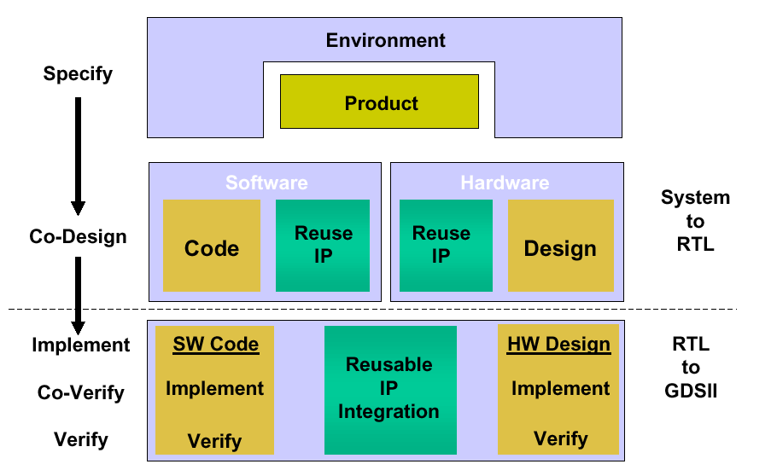
Design Flow of SoC (3/3)
  “H/W and S/W development concurrently : functionality, timing, physical design, and verification”

Slide 11
Specification
Specification Problem
1. The first part of the design process
2. It is very difficult to develop a complete and clear spec. quickly
for SOC design
3. Clear and early documenting is very important
Specification Requirements
Hardware:
1. Functionality 2. Timing
3. Performance 4. Interface to SW
5. Physical design issues such as area and power
Software:
1. Functionality 2. Timing
3. Performance 4. Interface to HW
5. SW structure and kernel

Slide 12
Key Points for Reusable Design
Design for use:
Good code
Good documentation and thorough commenting
Robust scripts
Well-designed verification environment
Design for reuse:
Robust design
Designed to solve a general problem
Designed for use in multiple technologies
(soft IPs: for different libraries; hard IPs: for different technology)
4. Designed for simulation with different simulators (HDLs)
5. Verified independently
6. Fully documented in terms of appropriate applications
and restrictions

Slide 13
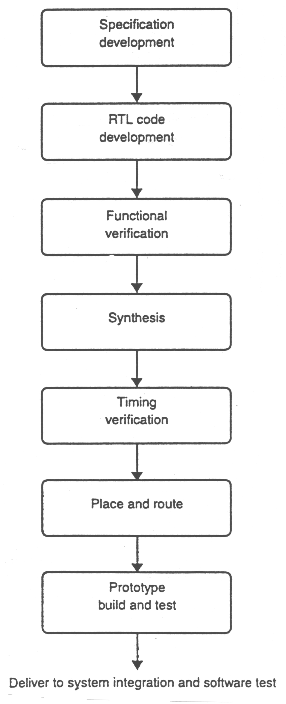
System Design Flow
Waterfall vs. Spiral
Waterfall: the project transition from phase to phase in a step function, never returning to the activities of the previous phase
The whole process is done by different design teams
Work well in the design up to 100k gates and down to .5u
Work bad for large, deep submicron designs
Large systems must develop the hardware and software concurrently to ensure correct system functionality
Physical design issues must be considered early to meet the performance goals

Slide 14
Spiral Design Flow (1/2)
Spiral: work on multiple aspects of the design simultaneously,
incrementally improving in each area
Parallel and concurrent development of hardware and software
Parallel verification and synthesis of modules
Floorplaning and routing in the synthesis process.
Modules developed only if a predefined hard or soft macro is
not available.
5. Planned iteration throughout
To implement SOC, spiral development model is adopted.
In other words, a mixture of top-down and bottom-up methodologies is used

Slide 15
Spiral Design Flow (2/2)
SYSTEM DESIGN AND VERIFICATION
PHYSICAL
TIMING
HARDWARE
SOFTWARE
Physical
specification:
area, power,
clock tree
design
Timing
specification:
I/O timing,,
clock
frequency
Hardware
specification:
Algorithm
development
& macro
decomposition
Software
specification:
Application
prototype
development
Preliminary
floorplan
Block timing
specification
Block
selection/design
Application
prototype
testing
Time
Updated
floorplans
Block
synthesis
Block
verification
Application
development
Updated
floorplans
Top-level
HDL
Application
testing
Trial
placement
Top-level
synthesis
Top-level
verification
Application
testing
Final place and route
Tapeout

Slide 16
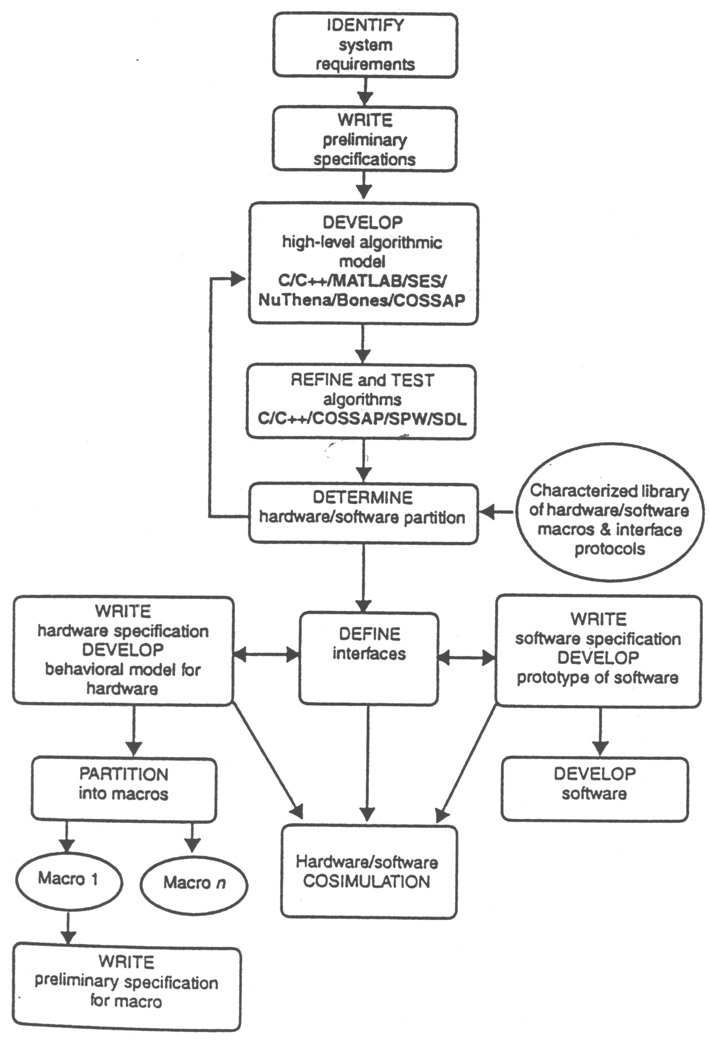
System Design Process
Most contents referred to “Reuse
methodology manual for system-on-a-chip designs,” Kluwer Academic, Michael Keating.

