Slide 1
Project Progress Hardware-Software Codesign and Ternary Neural Network Applying Batch Normalization Technique on an FPGA
Nguyen Vu Le Minh nguyenvuleminh2205@gmail.com Computer Architecture IC Design Laboratory, Computer Science and Information Engineering Department National Cheng Kung University
2020-06

Slide 2
Outline
Introduction
Background
Methods
Experimental Results

Slide 3
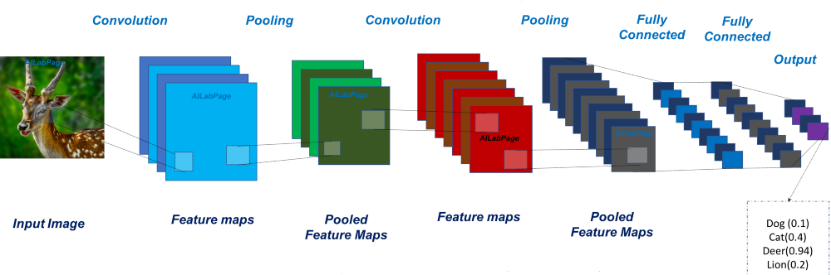
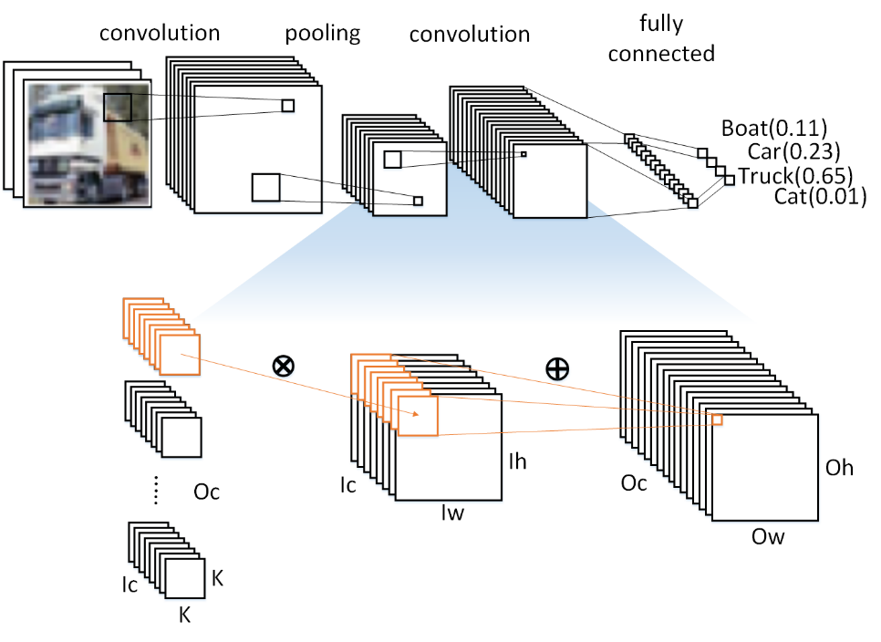
Introduction
Notes:
In recent years, there has been a growing interest in the study of convolutional neural networks (CNNs), which consists of the 2D convolutional layers and a deep neural network, is widely used.
Owing to the high accuracy and good performance, CNNs have been widely adopted in many applications such as image classification, face recognition,

Slide 4
Introduction
Motivation
The limited computational resources, reuse resources for the inference operations across multiple clock cycles, at the price of a larger latency.
Compressing the model by reducing the number of operations needed in the inference step or their cost.
Proposed Method
Low Precision Neural Network
Library-based Framework
Notes:
For any CNN algorithm implementation, there are a lot of potential solutions that result in an enormous design space for exploration.
The main aims in this work focus on tuning model and designing a system how to solve some complex algorithms in CNN, can the limited computational resources, reuse resources for the inference operations across multiple clock cycles, at the price of a larger latency. And Compressing the model by reducing the number of operations needed in the inference step or their cost.
So, in my project, given 2 method that are Low precision neural network which to can reduce memory space requirements by applying Ternary Neural Network.
Moreover, Design a library-based framework to support the most popular CNN model ingredients and an interface to tuning the precisions of weights and activations, to investigate their impacts on the overall classification accuracy.

Slide 5
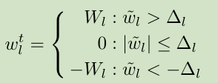

Background
Ternary Neural Network (TNN)
Ternary weight networks , with weights constrained to +1, 0 and -1 along with a scaling factor.
Notes:
The research works have consider reduced the DNN model size and computation complexity by quantizing the weights and activations to low bit-widths
Ternary weight networks which is applied in my project, there are weights constrained to +1, 0 and -1 along with a scaling factor, to increase the capacity of model expression, and achieved approximated accuracy of full precision weight networks.
To calculate the weight into ternary, we have to find the threshold in this equal. If the weight is positive threshold and negative delta, the value will be 1 and -1 corresponding. When delta is 0, the weight will be zero

Slide 6

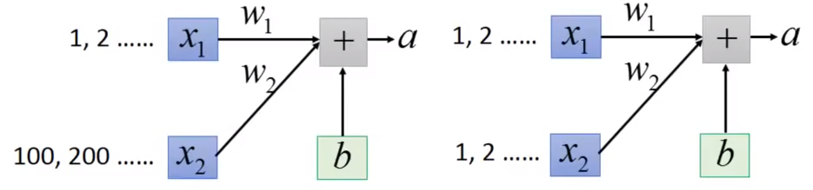
Background
Batch Normalization
Improve speed ,higher learning rates and accuracy
Corrects the difference in the distribution
Less classification error in BNN
Notes:
Batch normalization is a recently popularized method for accelerating the training of BNN.
But in my proposal I want to apply on TNN. Because It can help improve speed ,higher learning rates and accuracy.
The BN finds parameters γ and β in order to regularize the variance to 1 and the average to 0 for each mini-batch.
In this paper, Using BN which corrects the difference in the distribution by a shift and a scaling operations.

Slide 7
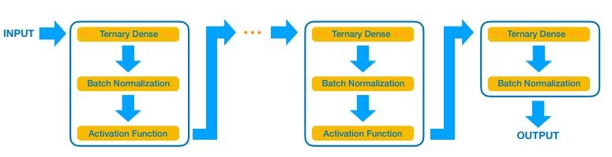
Methods
Ternary Neuron Network with Batch Normalization
It can reduce memory space requirements by using lower-precision data.
Allows one to reduce the computing resources of a given model for inference.
A multilayer perceptron (MLP) consist of a sequence of blocks with a Ternary dense, batch normalization(BN), and activation layer.
Notes:
TNN are extreme examples of quantized neural networks. A network is quantized when the numerical representation of its parameters is a fixed precision.
Quantization allows one to reduce the computing resources of a given model for inference and it can be tuned to reduce memory space requirements
In this work, I focus on ternaried to a multilayer perceptron (MLP) . The basic structure for the adopted architectures is shown in this picture. Each model consists of a sequence of blocks, each composed of a dense, batch normalization(BN)[8], and activation layer. It can be implemented at small resource cost, which makes this choice particularly convenient for fast inference on edge devices.
**************************
The BN layer shifts the output of the dense layers to the range of values in which the activation function is nonlinear, enhancing the network’s capability of modeling nonlinear responses. For ternaried tanh, a BN + activation layer sequence can be implemented at small resource cost, which makes this choice particularly convenient for fast inference on edge devices.

Slide 8
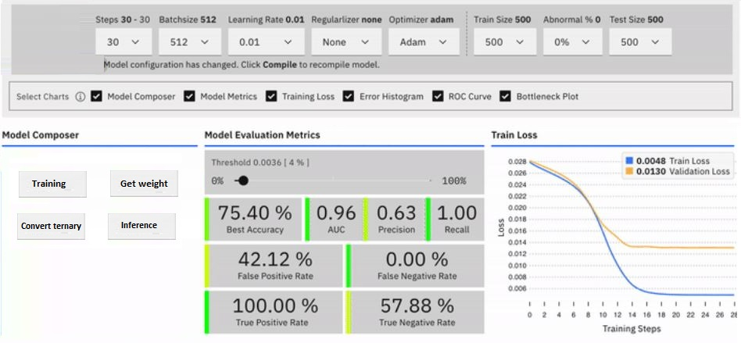
Methods
Library-based Framework
Tuning the precisions of weights and activations, to investigate their impacts on the overall classification accuracy.
In general, the library-based framework provides a user-friendly interface to deploy custom CNN models on FPGAs, used as co-processing accelerators or as digital circuits in resource-constrained, low-latency computing environments.
Notes:
As a starting point, I study the Ternary Neural Net-work (TNN), and specifically focus on tuning the precisions of weights and activations by a library-base framework
Aim of this method is to support the most popular CNN model ingredients and an interface to the most popular DL training libraries, directly (e.g., for TensorFlow [9], Keras [10], and PyTorch[11])
In general, the library-based framework provides user-friendly interface is shown in picture to deploy custom CNN models on FPGAs, used as co-processing accelerators

Slide 9
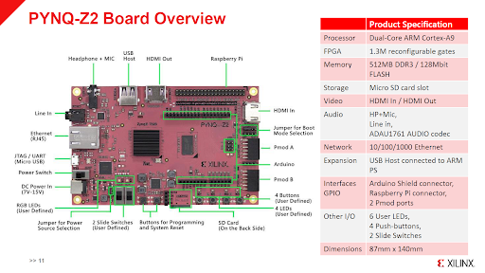
Experimental Results
Notes:
Among these platforms, FPGA is especially suitable as the hardware accelerator owing to its flexibility and efficiency. FPGA-based CNN accelerators can use a minimum precision which reduces the hardware resources and increases the clock frequency, while the GPU cannot do it.
It is an excellent candidate for in my project.

Slide 10
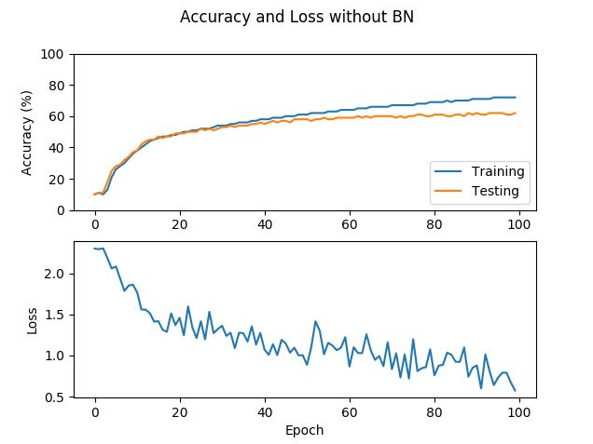
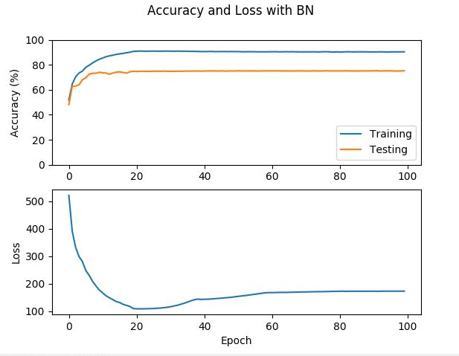
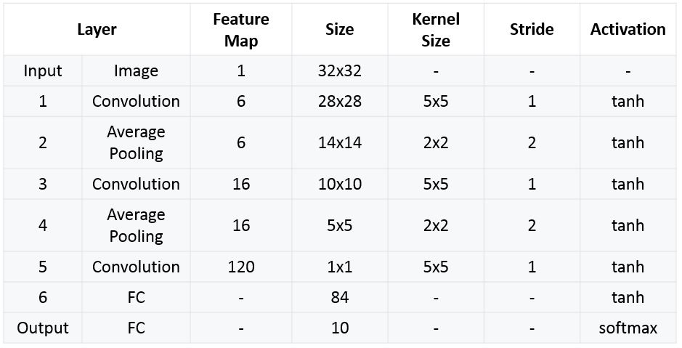
Experimental Results
Fig.1: Without Batch Normalization
Fig.2: With Batch Normalization
Table 1: Structure LeNet-5 CNN
Notes:
In my project, I used the Cifar-10 dataset, and designed the LeNet-5 CNN by structure is shown in the table
Especially, since the TNN without the BN , the average output value is unbalanced.
As a result, the activation would be also unbalanced and accuracy is around 70% for training and around 60% for testing, it is shown in picture 1.
By applying batch normalization method shown in Fig 2, the classification error can be improved with accuracy 92% for training and accuracy is 75% for testing.

Slide 11
Thanks for your listening

