Slide 1
Computer Graphics
School of Computer Science
University of Seoul
Minho Kim

Slide 2
OpenGL

Slide 3
3D Graphics API
What do we want?
Portability, performance, flexibility, extendability, etc.
How would you design it?
  Objects description
  Camera types
  Lighting models
  Rendering algorithms

Slide 4
OpenGL
Open Graphics Library
http://www.opengl.org/about/overview/
“The Design of the OpenGL Graphics Interface” (1994)
Currently managed by Khronos group

Slide 5
OpenGL
Graphics pipeline
Low level (not descriptive)
  GLU, GLUT
Primitives: triangles, lines, points
States / modes
Matrix stacks to manage hierarchical structure
Blinn-Phong shading model for lighting

Slide 6
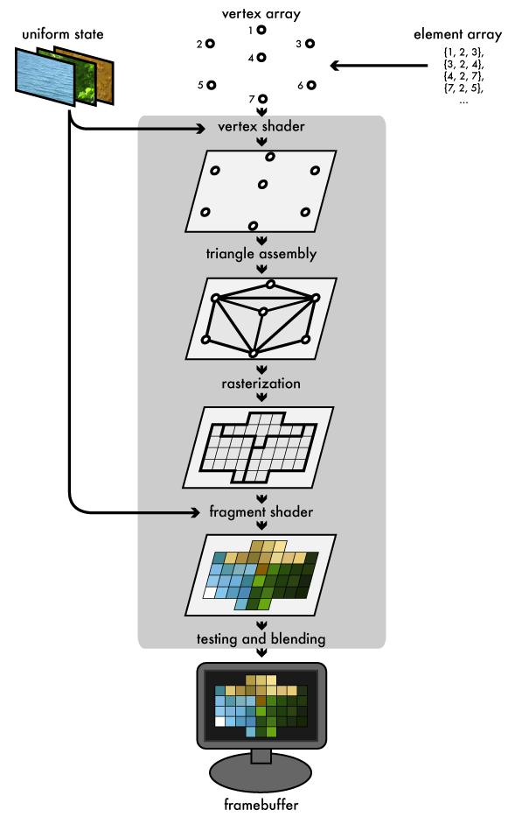
OpenGL graphics pipeline
(image courtesy of Joe Groff)

Slide 7
Resources
http://www.opengl.org
“An intro to modern OpenGL” by Joe Groff
http://www.opengl.org/wiki
OpenGL Tutor by Nate Robin
The red book (free for ver.1.1)

Slide 8
The Red Book (ver. 1.1)
Chapter 1. Introduction to OpenGL
Chapter 2. State Management and Drawing Geometric Objects
Chapter 3. Viewing
Chapter 4. Color
Chapter 5. Lighting
Chapter 6. Blending, Antialiasing, Fog, and Polygon Offset
Chapter 7. Display Lists → obsolete
Chapter 8. Drawing Pixels, Bitmaps, Fonts, and Images
Chapter 9. Texture Mapping
Chapter 10. The Framebuffer
Chapter 11. Tessellators and Quadrics
Chapter 12. Evaluators and NURBS
Chapter 13. Selection and Feedback
Chapter 14. Now That You Know

