Slide 1
Computer Graphics
School of Computer Science
University of Seoul
Minho Kim

Slide 2
Rendering

Slide 3
How It Works...In Nature
See http://en.wikipedia.org/wiki/Ray_casting
Why don't we just simulate the process? What can be the problem?

Slide 4
Rendering
See “Rendering (computer graphics)” at Wikipedia
  Scanline rendering and rasterization
    Object order algorithm
    OpenGL, DirectX, etc.
  Ray casting
    Image order algorithm
    Simpler than ray tracing
    Wolfenstein 3D
  Ray tracing
    Photorealistic
  Radiocity
    Captures 'ambience'
    Viewpoint independent

Slide 5
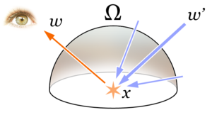
Rendering Equation
The key theoretical concept in rendering

