Slide 1
COMBINING SOURCE SEPARATION
WITH AUDIO COMPRESSION
Presentation

Slide 2
OUR TEAM
Nguyen Quang Minh – 202414642
Ha Quang Minh – 202414646

Slide 3
PROBLEM & MOTIVATION
Problem
Motivation
Large files need high storage & bandwidth
MP3/AAC reduces size but degrades quality
High-frequency details are often lost
Audio compressed as a single signal
Separate audio into stems first
Compress each component independently
Vocals: clarity | Drums: impact | Bass: depth
Result: better quality + flexible bitrate

Slide 4
APPROACH
1
2
3
4
Source Separation
Compression
Reconstruction
Evaluation
Split audio into
Vocals / Drums / Bass / Other
Encode each stem
with optimal bitrate
Decode & combine
all components
Compare quality vs.
direct compression

Slide 5
SYSTEM DESIGN
1. Input Audio
Original audio file
2. Source Separation
Vocals / Drums / Bass
3. Compression & Decode
Compress each stem separately
4. Reconstruction
Combine into final output
Input Audio
↓
Source Separation
↓
Vocals | Drums | Bass
↓ ↓ ↓
Compression × 3
↓ ↓ ↓
Reconstruction
↓
Output Audio

Slide 6
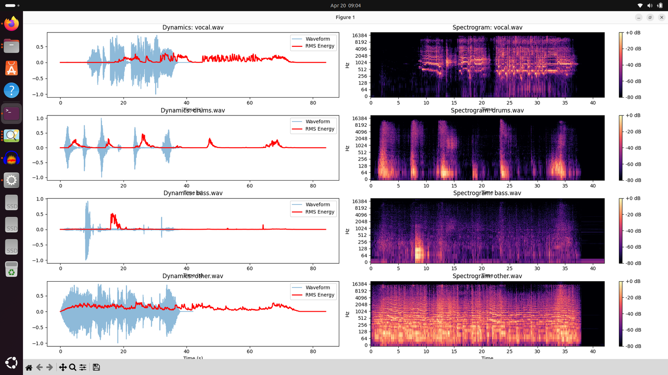
DEMO SCREENSHOTS

Slide 7
RESULTS
Audio Quality
Compression Gain
Clearer vocals after separation
Less distortion in reconstructed audio
Better preservation of key components
Smaller file size
More efficient bitrate allocation
Better quality at lower bitrates

Slide 8
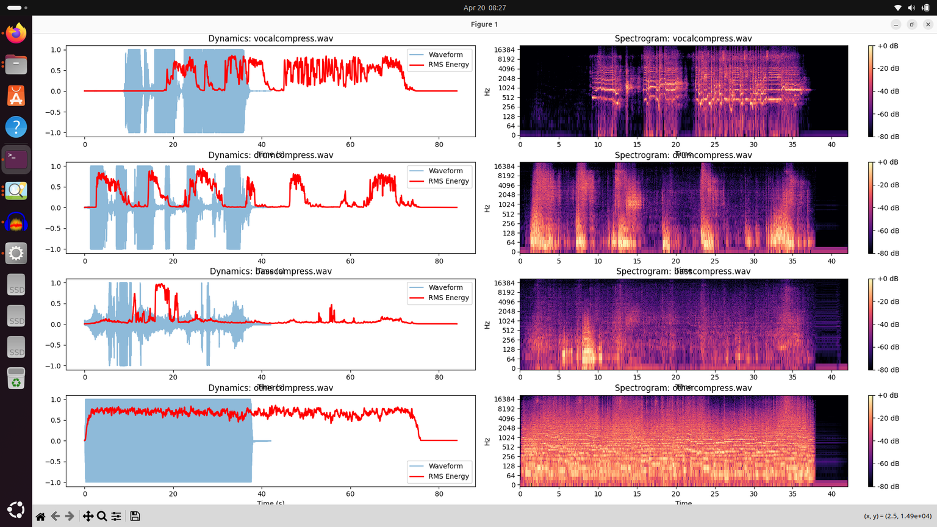
VISUALIZATION
Better frequency preservation | Less high-frequency loss after separation-based compression

Slide 9
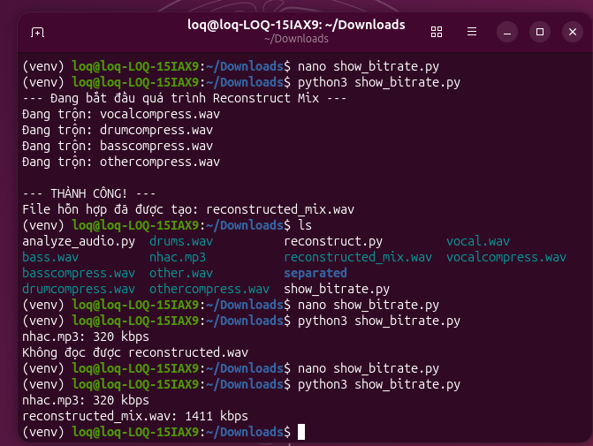
RESULT: MIXED AUDIO
Balanced levels across all elements
Vocals are clear and well-positioned
Bass and drums controlled and defined
Wider and more structured stereo field
Overall: clean, smooth, professional

Slide 10
CONCLUSION
Proposed method: source separation + per-stem compression
Results: improved perceptual quality, especially for vocals
Better performance at lower bitrates with flexible allocation
Limitations:
Separation is not perfect – artifacts may occur
Higher computational cost than direct compression
Source separation is a promising direction for audio codecs

Slide 11
THANK YOU
FOR LISTENING

