Slide 1
Pham Van Minh
BH01037

Slide 2
agenda
INTRODUCTION
DESIGN SPECIFICATION FOR DATA STRUCTURES
STACK AND QUEUE
SORTING ALGORITHMS
NETWORK SHORTEST PATH ALGORITHMS
STUDENT MANAGEMENT APPLICATION
ALGORITHM EFFICIENCY

Slide 3

Introduction

Slide 4
The Building Blocks of Computer Science
Data structures and algorithms are fundamental to computer science.
They provide efficient ways to organize, store, and process data.
Understanding them is crucial for developing efficient and optimized software.

Slide 5

Design Specification for Data Structures

Slide 6
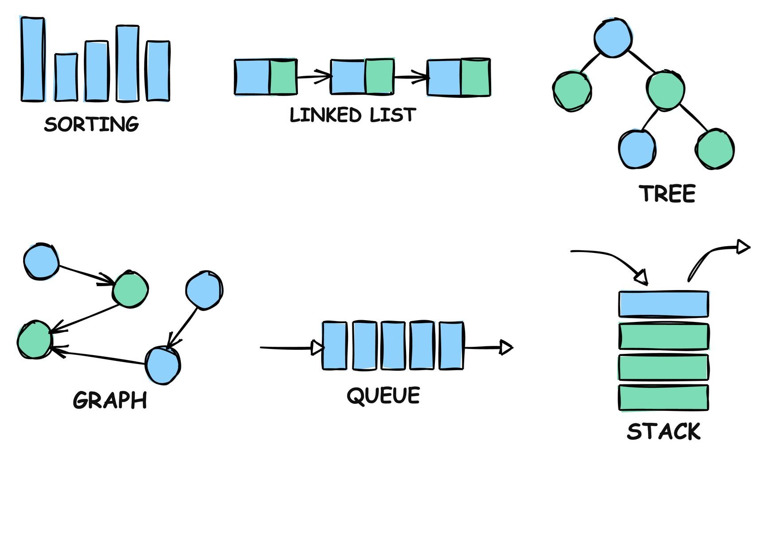
What are Data Structures?
Identifying Data Structures
A data structure is a specialized format for organizing, processing, retrieving, and storing data in a computer.
Common Types:
Arrays
Linked Lists
StacksQueues
Trees
Graphs

Slide 7
Operations on Data Structures
Defining Operations
Each data structure supports specific operations.
Examples:
Arrays: Insertion, deletion, searching, sorting.
Linked Lists: Insertion, deletion, traversal.
Stacks: Push, pop, peek.
Queues: Enqueue, dequeue.

Slide 8
Specifying Input Parameters
Input Parameters
Clearly define the type and range of input values for each operation.
Example: For an "insert" operation in an array:
value: The data element to be inserted (e.g., integer, string).
index: The position where the element should be inserted (integer, within the array bounds).

Slide 9
Ensuring Correctness
Pre- and Post-conditions
Pre-conditions: Conditions that must be true before an operation can be executed.
Post-conditions: Conditions that will be true after the operation is successfully completed.
Example: For a "pop" operation on a stack:
Pre-condition: The stack must not be empty.
Post-condition: The top element is removed, and the size of the stack is reduced by one.

Slide 10
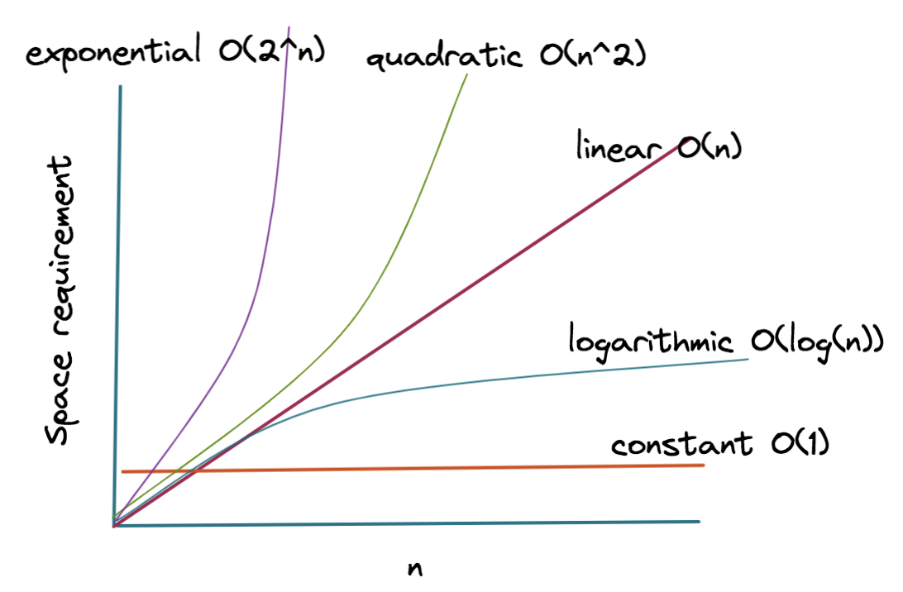
Efficiency Matters
Time and Space Complexity
Time Complexity: How the runtime of an operation grows with the input size (e.g., O(n), O(log n)).
Space Complexity: How much memory an operation requires (e.g., O(1), O(n)).

Slide 11
Putting it into Practice
Examples and Code Snippets
Time Complexity: How the runtime of an operation grows with the input size (e.g., O(n), O(log n)).
Space Complexity: How much memory an operation requires (e.g., O(1), O(n)).

Slide 12
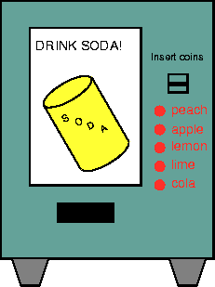
Abstract Data Types: Hiding the Details
What is an Abstract Data Type (ADT)?
An ADT is a high-level description of a data structure that focuses on what it does, not how it does it.
It defines a set of operations that can be performed on the data, without specifying the underlying implementation.

Slide 13
Stack and Queue

Slide 14
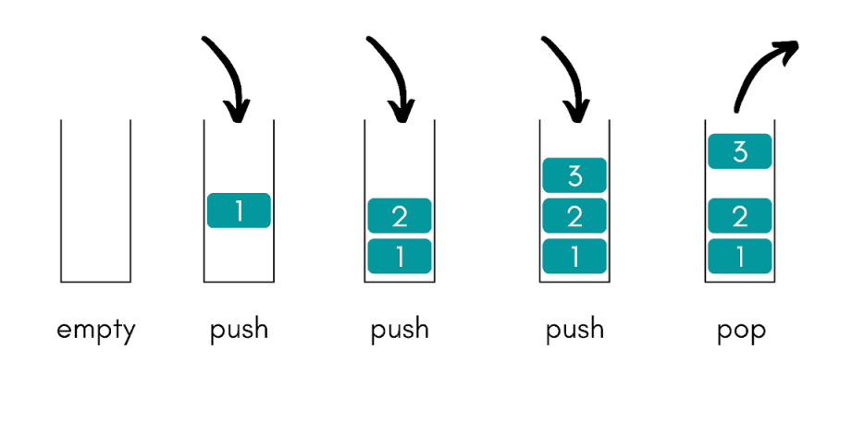
The LIFO Data Structure
Stack ADT
A stack follows the Last-In, First-Out (LIFO) principle. Imagine a stack of plates; you can only add or remove plates from the top.
It defines a set of operations that can be performed on the data, without specifying the underlying implementation.
Operations:
push(item): Adds an item to the top of the stack.
pop(): Removes and returns the item from the top.
peek(): Returns the top item without removing it.

Slide 15
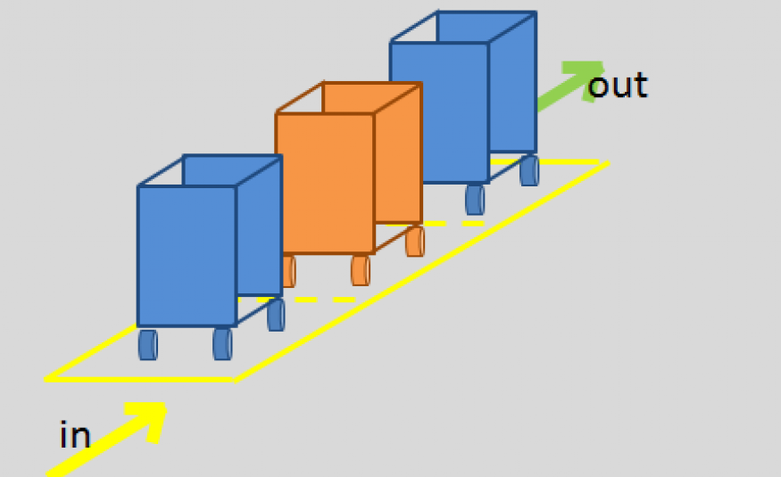
First-In, First-Out
Queue ADT
Definition: A queue where elements are added at the rear and removed from the front.
Analogy: A line of people waiting for a service.

Slide 16
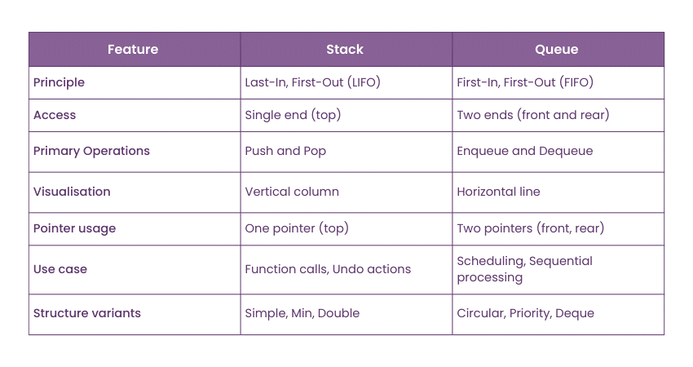
Comparing Stack and Queue
Stack vs. Queue

Slide 17
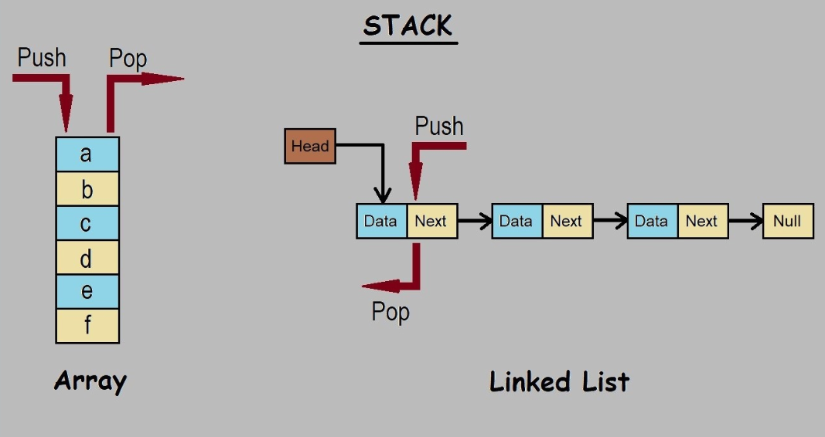
Implementation Choices
Implementing Stack and Queue
Both stacks and queues can be implemented using:
Arrays: A fixed-size, contiguous block of memory.
Linked Lists: A dynamic data structure where elements are linked together using pointers.

Slide 18
Sorting algorithms

Slide 19
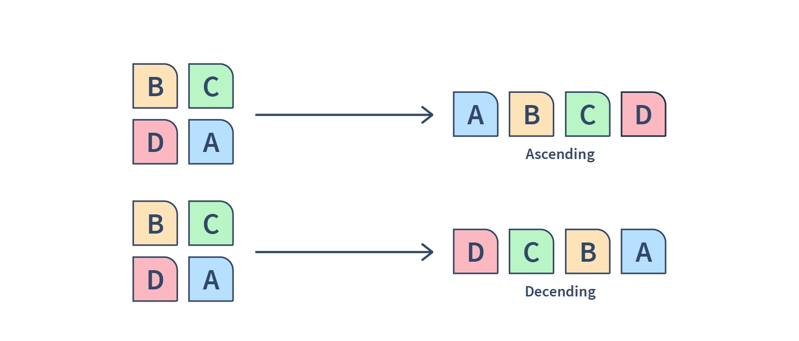
Putting Things in Order
Sorting Algorithms
Introduction: Sorting algorithms arrange data in a specific order (ascending or descending)
.Algorithms for Comparison: Choose two common sorting algorithms (Bubble Sort and Quick Sort).

Slide 20
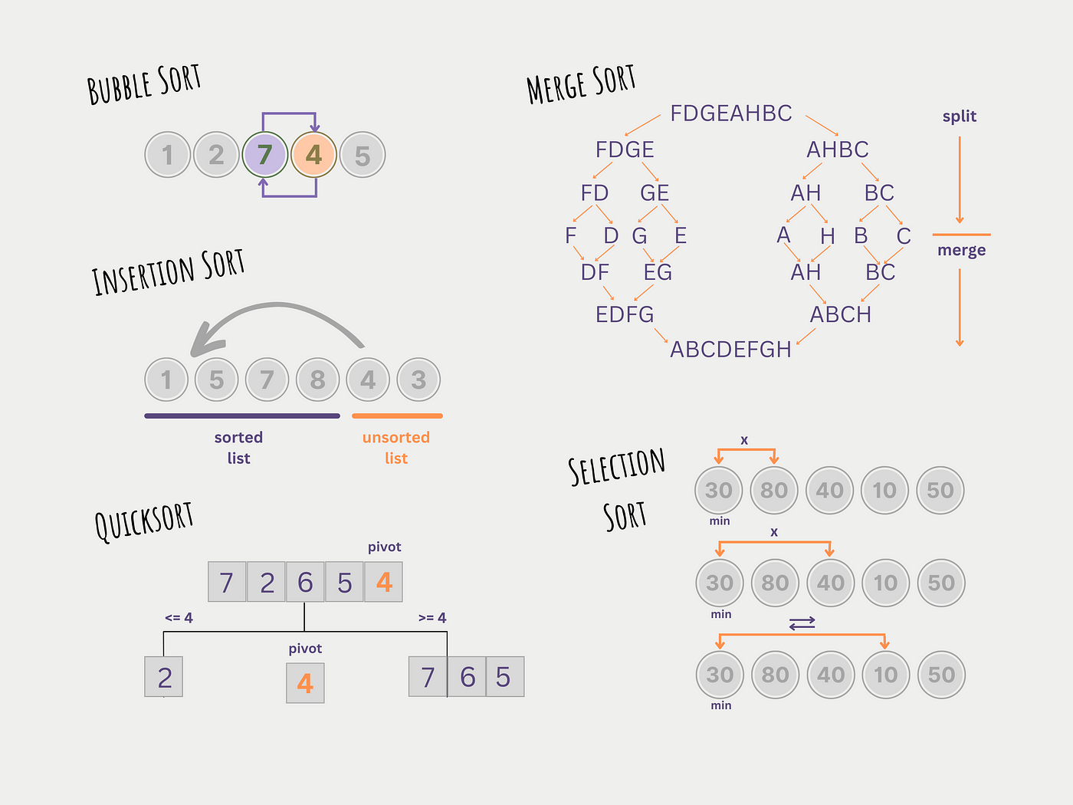
Sorting Algorithms

Slide 21
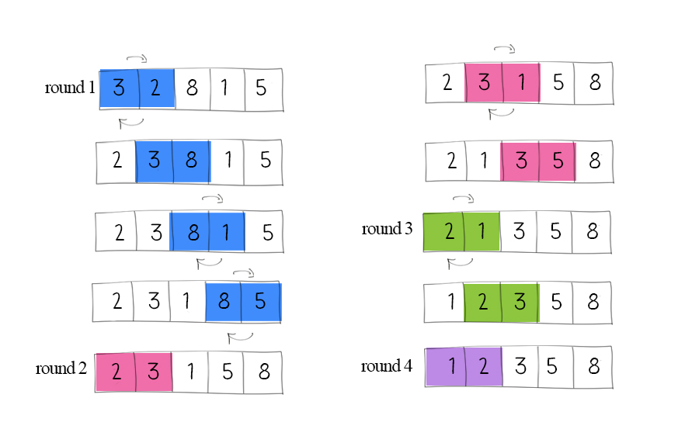
Bubble Sort: A Simple Sorting Approach
Algorithm 1: Bubble Sort
Bubble Sort works by repeatedly stepping through the list, comparing adjacent elements and swapping them if they are in the wrong order.
This process is repeated until no more swaps are needed, indicating that the list is sorted.

Slide 22
Implements in Java
Algorithm 1: Bubble Sort
public void bubbleSort(int[] arr) {
int n = arr.length;
for (int i = 0; i < n-1; i++) {
for (int j = 0; j < n-i-1; j++) {
if (arr[j] > arr[j+1]) {
int temp = arr[j];
arr[j] = arr[j+1];
arr[j+1] = temp;
}
}
}
}

Slide 23
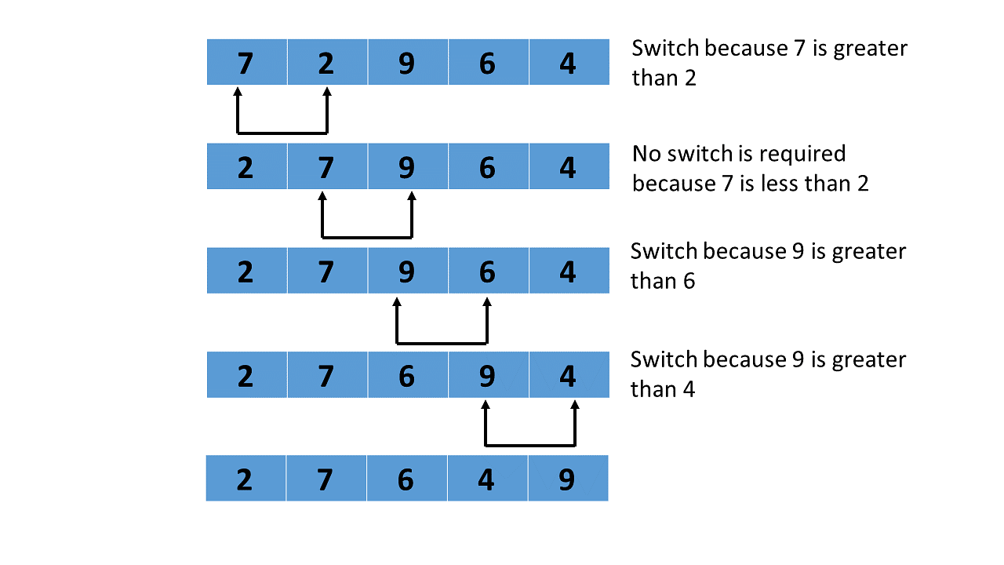
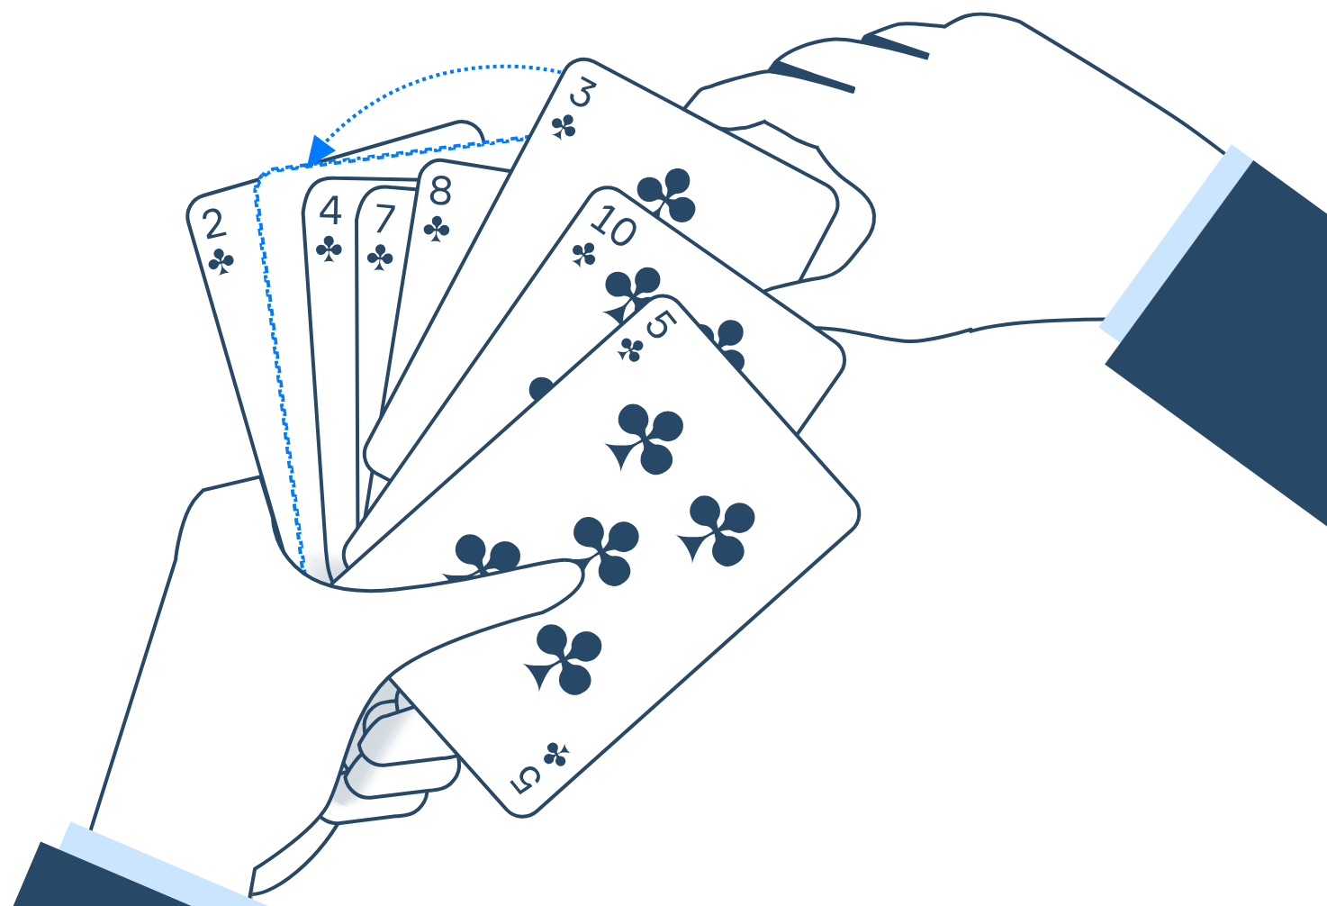
Bubble Sort: Visualization
Algorithm 1: Bubble Sort

Slide 24
Quick Sort: Dividing and Conquering with a Pivot
Algorithm 2: Quick Sort
Quick Sort doesn't build a sorted list one item at a time. Instead, it uses a "divide and conquer" strategy to sort the input array. Here's how it works:
Choose a Pivot: Select an element from the array. This element is called the "pivot." There are different strategies for choosing a pivot (first element, last element, random element, median-of-three, etc.).
Partition: Rearrange the array so that all elements smaller than the pivot are placed before it, and all elements greater than the pivot are placed after it. The pivot is now in its final sorted position.
Recursion: Apply Quick Sort recursively to the subarray to the left of the pivot and the subarray to the right of the pivot.

Slide 25
Implements in Java
Algorithm 2: Quick Sort
static int partition(int[] arr, int low, int high) { int pivot = arr[high]; int i = low - 1; for (int j = low; j <= high - 1; j++) { if (arr[j] < pivot) { i++; swap(arr, i, j); } } swap(arr, i + 1, high); return i + 1; } static void swap(int[] arr, int i, int j) { int temp = arr[i]; arr[i] = arr[j]; arr[j] = temp; }

Slide 26
Implements in Java
Algorithm 2: Quick Sort
static void quickSort(int[] arr, int low, int high) { if (low < high) { int pi = partition(arr, low, high); quickSort(arr, low, pi - 1); quickSort(arr, pi + 1, high); } }

Slide 27
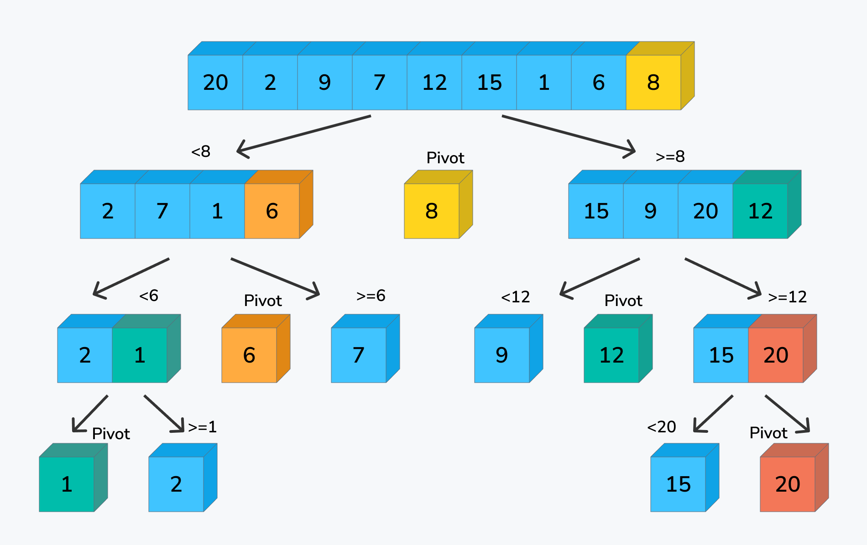
Quick Sort: Visualization
Algorithm 2: Quick Sort

Slide 28
Comparing Bubble and Quick Sort
Comparison
Feature | Bubble Sort | Quick Sort
Method | Compares and swaps adjacent pairs of elements | Divide and conquer (pivot, partition, recursion)
Time Complexity (Average) | O(n²) | O(n log n)
Time Complexity (Worst) | O(n²) | O(n²)
Space Complexity | O(1) | O(log n) (average), O(n) (worst)
Stability | Stable | Unstable (by default)
Implementation Ease | Very easy | More difficult
Performance on Small Data | Reasonable | Good
Performance on Large Data | Poor | Very good

Slide 29
Network Shortest Path Algorithms

Slide 30
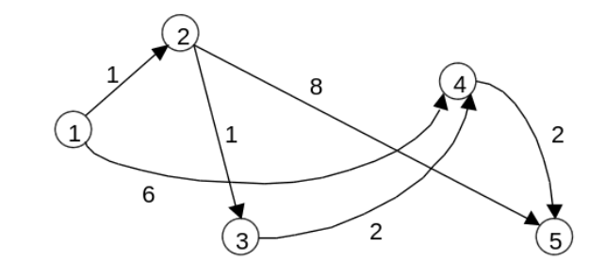
Shortest Path Algorithms
Introduction
In many real-world scenarios, we need to find the shortest path between two points in a network. This is where network shortest path algorithms come in.
Examples: GPS navigation (finding the fastest route), network routing (optimizing data flow), transportation planning (minimizing travel time).

Slide 31
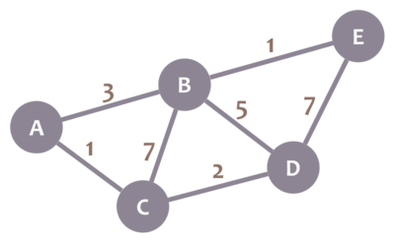
Dijkstra's Algorithm
Dijkstra's Algorithm
Dijkstra's algorithm is a classic and efficient algorithm for finding the shortest paths from a single source node to all other nodes in a weighted graph with non-negative edge weights.
It works by iteratively selecting the unvisited node with the smallest tentative distance and updating the distances of its neighbors.

Slide 32
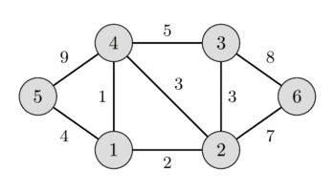
Idea: Gradually connect vertices to form a minimum spanning tree.
Prim's Algorithm
Choose a starting vertex: Select any vertex as the root.
Find the minimum edge: Among the edges connecting the selected vertex to unselected vertices, choose the edge with the smallest weight.
Add a new vertex: Add the vertex connected by the selected edge to the spanning tree
.Repeat: Repeat steps 2 and 3 until all vertices belong to the spanning tree.

Slide 33
Student Management Application

Slide 34
Introducing the Student Management Application
Student Management Application
Soft Development ABK is pleased to introduce a comprehensive student information management solution!
Outstanding features:
Input: ID, full name, and grades of each student.
Output: ID, full name, grades, and corresponding academic ranking.
Diverse functions: Easily add, edit, delete, sort, and search for student information.

Slide 35
A Solid Foundation with Abstract Data Types (ADT)
Student Management Application
What is ADT? ADT is a mathematical model for a data type, focusing on the operations that can be performed on that data, regardless of the specific implementation method.
Benefits of ADT:
Encapsulation: Hiding implementation details, increasing security.
Abstraction: Simplifying usage, users only need to focus on functionality.
Modularization: Breaking down the program into independent modules, facilitating maintenance and development.
ADTs used:
Student ADT: Stores information for each student (ID, full name, grades, ranking).
StudentStack ADT: A stack data structure to manage the student list.

Slide 36
Main Functions
Student Management Application
Add Student:
Allows input of new student information.
Automatically calculates and updates academic ranking.
Ensures the uniqueness of student IDs.
Edit Student Information:
Searches for students by ID.
Edits student information (full name, grades).
Automatically updates ranking after modifying grades
Delete Student:
Removes student information from the list.
Handles cases of deleting non-existent students.

Slide 37
Sorting and Searching
Student Management Application
Sort Students:
Uses the Merge Sort algorithm to sort the student list by grades.
Advantages of Merge Sort:
Efficient with O(n log n) complexity.
Stable, maintaining the original order of elements with the same value.
Search for Students:
Implements the Linear Search algorithm to search for students by ID.
Flexible choice: Can be replaced with Binary Search if the student list is sorted.

Slide 38

Console Interface
Student Management Application
Key functionalities accessible via the console:
Add Student: Input student details (ID, name, marks) and add them to the system.Edit Student: Modify existing student information by searching with their ID.
Delete Student: Remove a student record using their unique ID.
Sort Students by Marks: Arrange the student records in ascending or descending order based on their marks.
Search Student by ID: Quickly locate and display the information of a specific student.
Display All Students: View a comprehensive list of all students stored in the system.

Slide 39
Rigorous Error Handling and Testing
Student Management Application
Error Handling:
Input validation: Validates input data to ensure validity (e.g., ID must be a positive integer, grades must be between 0 and 10).
Exception handling: Handles exceptions that may occur during program execution (e.g., NullPointerException, ArrayIndexOutOfBoundsException).
Testing:
Performs tests with various datasets to ensure the application works correctly in all cases.
Records test results for tracking and analysis.

Slide 40
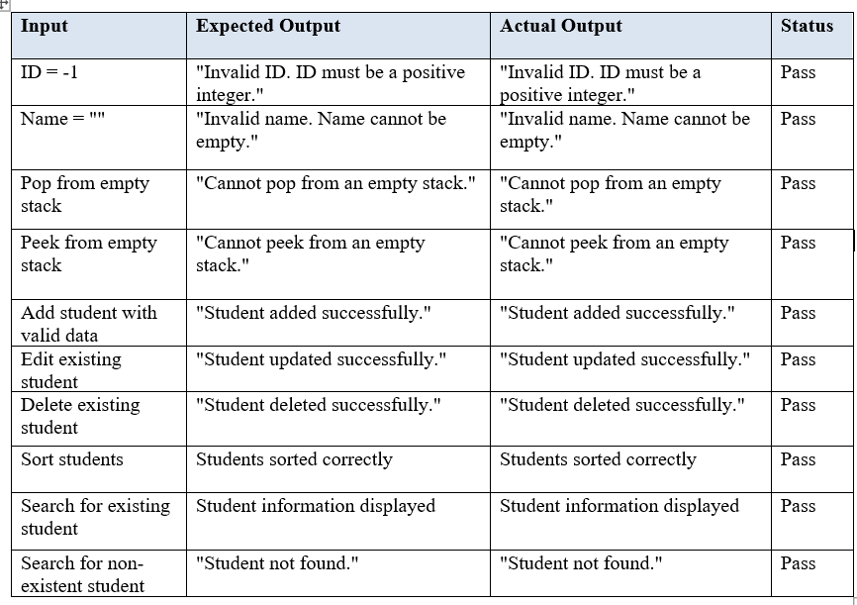
Test Result
Student Management Application

Slide 41
Algorithm Efficiency

Slide 42
Performance is Key!
Algorithm Efficiency - Why It Matters
User Expectations: Users expect applications to be responsive and efficient. Slow performance can lead to frustration and dissatisfaction.
Resource Consumption: Inefficient algorithms can consume excessive processing power and memory, impacting overall system performance.
Scalability: As datasets grow, the efficiency of algorithms becomes even more critical. A poorly chosen algorithm can cripple an application's ability to handle larger workloads.
The Bottom Line: Algorithm efficiency directly impacts user experience, resource utilization, and the scalability of your applications.

Slide 43
How do we know if an algorithm is efficient?
Measuring Algorithm Efficiency
Time Complexity:
Focuses on how the runtime of an algorithm increases as the input size grows.Expressed using Big O notation (e.g., O(n), O(n log n), O(n^2)).
Provides a theoretical understanding of an algorithm's efficiency.
Empirical Measurement:
Involves running the algorithm with various input sizes and recording the actual execution time.
Offers practical insights into performance in real-world scenarios.
Complements theoretical analysis with concrete data.

Slide 44
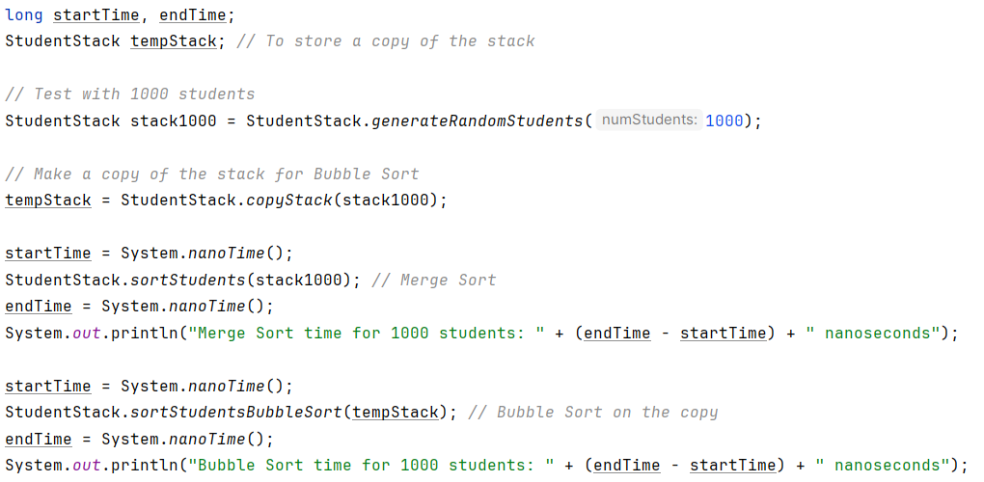
Putting Theory into Practice
Code Deep Dive - Empirical Measurement in Action

Slide 45
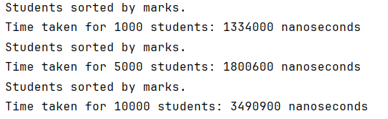
Test Result
Code Deep Dive - Empirical Measurement in Action (Continue)
Putting it to the Test:
We used System.nanoTime() to precisely measure the execution time of both sorting algorithms.
This allowed us to compare their performance with different numbers of students (e.g., 1000, 5000, 10000).
Test Result:

Slide 46
Choose Wisely!
The Impact of Algorithm Choice
The Results:
Merge Sort consistently outperformed Bubble Sort, especially as the number of students increased.
The difference in execution time became more pronounced with larger datasets.
Merge Sort's Advantage:
Its lower time complexity (O(n log n)) makes it significantly more efficient for larger datasets.
This translates to faster sorting, quicker response times, and a smoother user experience.
The Importance of Informed Decisions:
Understanding algorithm efficiency is crucial for selecting the right tool for the job.
By choosing efficient algorithms, you can optimize application performance and ensure scalability.

Slide 47
thank you
Pham Minh van
phamvanminh1723@gmail.com

