Slide 1
First meeting of Deep Lunch Study Group
Machine Learning Basics
October 19, 2016
Pham Quang Nhat Minh (Tokuda Minh)
FPT Technology Research Institute (FTRI)

Slide 2
Outline
What is Deep Lunch?
Why Deep Lunch?
How does Deep Lunch work?
Machine Learning Basics
Vocabulary for Deep Learning
Practice exercises
  Implement Perceptron algorithm
  Install Theano
  First example with Theano

Slide 3
What is Deep Lunch?
A Deep Learning study group @FPT
Study basics about Deep Learning
  Both theory and practice aspects
Offline meeting at lunch time
Peer-to-peer study group
  Teach/explain topics for others
  Learn from others

Slide 4
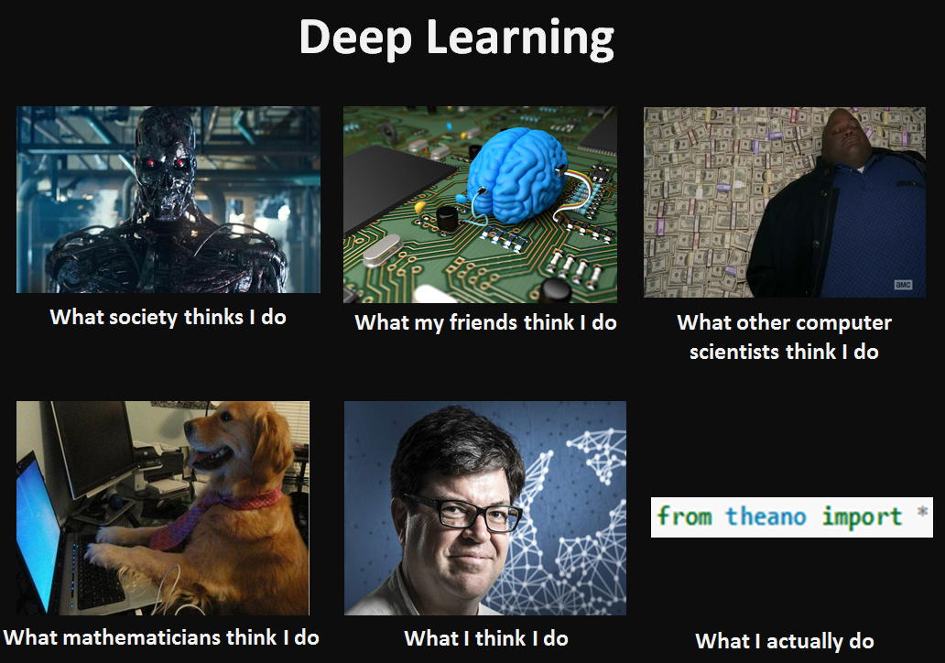

Slide 5
Why Deep Lunch?
Deep Learning is currently hot topic in Machine Learning
Everyone talks about Deep Learning but…
  Not everyone really understands it
Beyond using deep learning library
  Know and understand basics
  Understand how it works and how it does not work
  Use deep learning more efficiently
  Can modify and extend functions of deep learning library

Slide 6
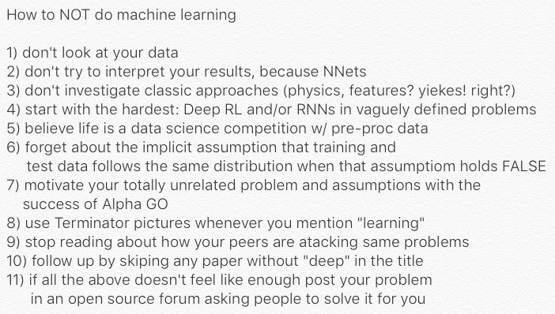
The image is credited by Eder Santana @edersantana

Slide 7
How does Deep Lunch work?
Weekly offline meeting (or once per two weeks?)
A member will be a chairman in each offline meeting
Participants read materials about assigned topics and teach/explain to others
We are neither teachers nor students
  Or we are both teachers and students

Slide 8
Discussion
Should we do weekly meeting or less frequent?
Study level: should we study in details almost every concepts of deep learning or just understand their main ideas?
  The former way requires longer time to study but may strengthen your knowledge more than the latter way.
Use Theano or Tensorflow or both?
  Theano: more easily to customize networks at low-level
  Tensorflow: I do not have information

Slide 9
Outline
What is Deep Lunch?
Why Deep Lunch?
How does Deep Lunch work?
Machine Learning Basics
Vocabulary for Deep Learning
Practice exercises
  Implement Perceptron algorithm
  Install Theano
  First example with Theano

Slide 10
Machine Learning Basics
Definition of machine learning
Linear Regression
Logistic Regression
Softmax regression
Stochastic Gradient Descent

Slide 11
Definition of machine learning
Tom Mitchell (1997): “A computer program is said to learn from experience E with respect to some class of tasks T and performance measure P, if its performance at tasks in T, as measured by P, improves with experience E.”
Three components:
  Task T
  Performance measure P
  Experience E

Slide 12
The task T
Classification
  Specify which of k categories some input belongs to
  We need to produce a function
  E.g., classify a news article into {sport, education, politics,…}, object recognition,…
Classification with missing inputs
Regression: predict a numerical value given some input

Slide 13
The task T
Transcription: transform some kind of data into discrete, textual form
  Optical character recognition
  Process address numbers (Google Street Views)
  Speech recognition
Machine Translation
Structured output
  Several values that are tightly inter-related
  Syntax Parsing, Image caption generation

Slide 14
The task T
Anomaly detection
Synthesis and sampling
Imputation of missing values
Denoising
Density estimation or probability mass function estimation
  Learn probability density function (or mass function) from data

Slide 15
The Performance Measure, P
Depend on the task T
Classification, Classification with missing inputs, Transcriptions
  Accuracy
  Error rate
Density estimation
  Average log-probability
Use test set for evaluation
  Test set is separated from training data

Slide 16
The Experience, E
Experience E is in general in the form of a data set
  A collection of examples (data points)
Machine learning algorithms can be categorized into supervised and unsupervised learning based on what kind of experience we have
Unsupervised learning algorithms
  A data set contains many features and we learn useful properties of the data set
Supervised learning algorithms
  Each example is associated with a target or a label

Slide 17
The Experience, E
The experience E may be not in the form of a fixed data set
  Reinforcement learning algorithms
Representation of a data set
  Design matrix: different example in each row, each column corresponds to a different feature
  A set of elements: feature vectors may have variant sizes

Slide 18
Example: Linear regression
Living area (feet^2) | #bedrooms | Price (1000$s)
2104 | 3 | 400
1600 | 3 | 330
2400 | 3 | 369
1416 | 2 | 232
3000 | 4 | 540
... | ... | ...

Slide 19
Example: linear regression
Input: a feature vector x in R^{n}
Output: y is a linear function of input
The task, T: is to predict y from the input x
The performance measure, P
  Mean square error of the model on the test set

Slide 20
Machine Learning Basics
Definition of machine learning
Linear Regression
Logistic Regression
Softmax regression
Stochastic Gradient Descent

Slide 21
Linear regression
Part I, cs 229 lecture note: http://cs229.stanford.edu/notes/cs229-notes1.pdf
Practice exercise: http://tinyurl.com/hckz2rr

Slide 22
Machine Learning Basics
Definition of machine learning
Linear Regression
Logistic Regression
Stochastic Gradient Descent
Softmax regression

Slide 23
Logistic Regression
See the lecture 6: logistic regression (Andrew Ng’s machine learning course on cousera)
Practice: Classifying MNIST digits using Logistic Regression
  http://deeplearning.net/tutorial/logreg.html#logreg

Slide 24
Stochastic Gradient Descent
First, we need to understand the basic gradient descent algorithm:
  See the lecture of Andrew Ng, linear regression and logistic regression.
  Other reading:
    https://spin.atomicobject.com/2014/06/24/gradient-descent-linear-regression/
    http://cs231n.github.io/optimization-1

Slide 25
Stochastic Gradient Descent
Suggested readings:
  Learning with large data sets (video lecture), by Andrew Ng: http://tinyurl.com/jcc4ycv
  On overview of gradient descent optimization algorithms, by Sebastian Ruder: http://tinyurl.com/zf7aqsd
  Section 5.9, Stochastic Gradient Descent: http://www.deeplearningbook.org/contents/ml.html
Libraries/packages:
  Stochastic Gradient Descent (SGD) library in scikit-learn: http://scikit-learn.org/stable/modules/sgd.html

Slide 26
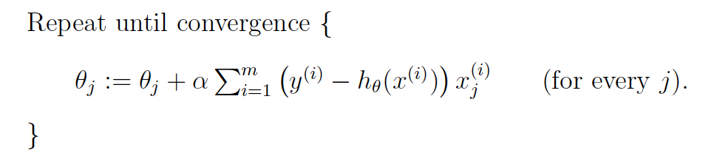
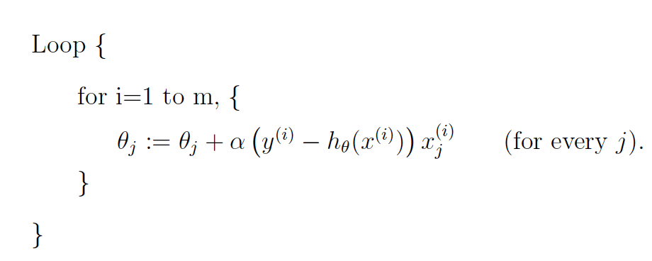
Stochastic Gradient Descent
Batch gradient descent
Stochastic Gradient Descent

Slide 27
Machine Learning Basics
Definition of machine learning
Linear Regression
Logistic Regression
Stochastic Gradient Descent
Softmax regression

Slide 28
Outline
What is Deep Lunch?
Why Deep Lunch?
How does Deep Lunch work?
Machine Learning Basics
Vocabulary for Deep Learning
Practice exercises
  Implement Perceptron algorithm
  Install Theano
  First example with Theano

Slide 29
Machine Learning Basics
Definition of machine learning
Linear Regression
Logistic Regression
Stochastic Gradient Descent
Softmax regression

Slide 30
Vocabulary for Deep Learning
See slide of Graham Neubig: https://www.phontron.com/slides/neubig14deeplunch11.pdf
Prediction problems
Linear classifiers
Feature function
Perceptron algorithm
Sigmoid function (Logistic function)
Logistic regression
Stochastic gradient descent
Gradient of the sigmoid function

Slide 31
Vocabulary for Deep Learning
See slide of Graham Neubig: https://www.phontron.com/slides/neubig14deeplunch11.pdf
Neural networks
Multi-layer perceptrons
Hidden Layer Activation Functions
Deep Networks
Back-propagation algorithm
Vanishing Gradients
Layerwise training
Autoencoders

Slide 32
Vocabulary for Deep Learning
See slide of Graham Neubig: https://www.phontron.com/slides/neubig14deeplunch11.pdf
Dropout
Recurrent Neural Networks
Convolutional Neural Networks
Recursive Neural Networks
Deep belief networks
  Restricted Boltzmann machines
  Contrastive estimation
Batch/mini-batch update strategies
Long short-term memory (LSTM)
Learning on GPUs

Slide 33
Outline
What is Deep Lunch?
Why Deep Lunch?
How does Deep Lunch work?
Machine Learning Basics
Vocabulary for Deep Learning
Practice exercises
  Implement Perceptron algorithm
  Install Theano
  First example with Theano

