Slide 1
COUNTRIES and NATIONALITIES
CÁC QUỐC GIA VÀ QUỐC TỊCH

Slide 2
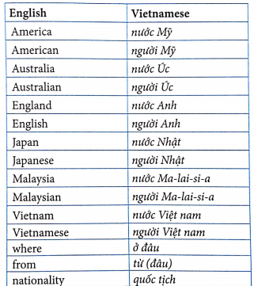

Slide 3

Where are you from?
I’m from Viet nam
What nationality are you?
I’m Vietnamese
I/Viet nam/Vietnamese

Slide 4
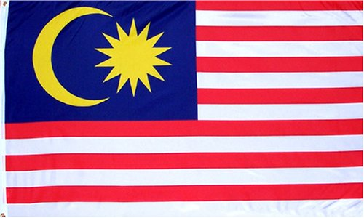
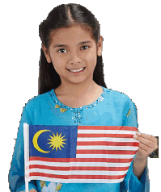
Where is Lily from?
She is from Malaysia.
What nationality is she?
She is Malaysian
Lily/Malaysia/Malaysian

Slide 5

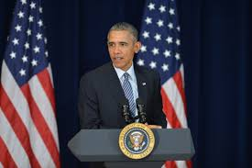
Where is Obama from?
He is from America
What nationality is he?
He is American
Obama/America/American

Slide 6


Anna/Peter/England/English
Where are Anna and Peter from?
They are from England/ The UK
What nationality are they ?
They are English

Slide 7


Where is Shinichi from?
He is from Japan
Which nationality is he?
He is Japanese
Shinichi/Japan/Japanese

Slide 8

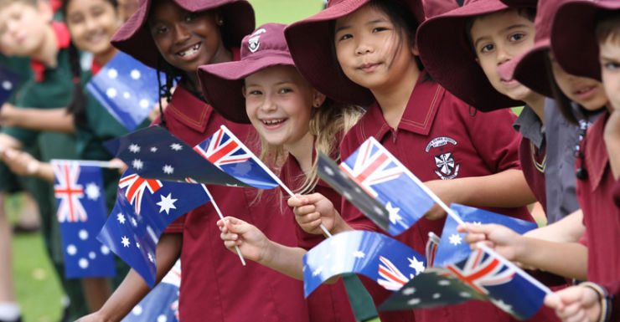
Where are they from?
They are from Australia
What nationality are they?
They are Australian
They/ Australia/Australian

Slide 9

Thank you for your attention

