Slide 1
BookFlow: Catalog and API Contract
• Phạm Văn Tú · 52400252
• REST / GraphQL / SOAP comparison
• A connected Catalog with safe concurrent edits
BookFlow · Phạm Văn Tú · 52400252 1/10
Notes:
Target: 25 seconds
My part of BookFlow is the Catalog and its API contract. I will explain why we chose a resource-oriented HTTP API, how Categories, Books and Copies are modeled, and how the UI handles real failures. The implementation uses React, Express and PostgreSQL. The evidence shown here is from executed local checks, rather than claims about features that are still planned.

Slide 2
Model the physical library, not just a list
• Category classifies a title
• Book stores metadata; Copy stores a unique barcode
• Archiving preserves history
BookFlow · Phạm Văn Tú · 52400252 2/10
Notes:
Target: 30 seconds
A title is different from an individual physical copy. Several copies can share book metadata, while each copy has its own barcode and condition. This separation lets us calculate availability without duplicating title information. Requests pass through a controller, a service and a repository. The service owns the transaction and writes the audit entry using the same database client as the mutation.

Slide 3
REST, GraphQL and SOAP: compare the same task
• REST: resources, methods and HTTP validators
• GraphQL: typed field selection; resolver and query limits
• SOAP: XML messaging and operation contracts
• No performance ranking without an equivalent benchmark
BookFlow · Phạm Văn Tú · 52400252 3/10
Notes:
Target: 55 seconds
These approaches are not identical kinds of standard. REST is an architectural style. GraphQL specifies a typed query language and execution model. SOAP specifies an XML messaging framework. For a book card, our REST endpoint returns a defined book representation. A GraphQL design could let the client request only title, author and category name, but would still need authorization and bounded query execution. A SOAP design could define a GetBooks operation and its XML contract. We chose HTTP resources because the team can demonstrate clear methods, statuses, validation and OpenAPI tooling. This is a qualitative comparison: we did not build equivalent GraphQL and SOAP servers or measure their speed. REST does not require JSON, and SOAP is not limited to HTTP.

Slide 4
A contract the browser can use
• GET reads; POST creates; PUT replaces; PATCH changes a subset
• 201 + Location for creation; 204 without a response body
• 400 invalid · 403 forbidden · 409 conflict
• OpenAPI + Postman describe implemented operations
BookFlow · Phạm Văn Tú · 52400252 4/10
Notes:
Target: 40 seconds
The contract is more than a list of URLs. Creating a book requires all writable metadata, rejects unknown fields and returns status 201 with a Location and an ETag. PUT requires the complete editable representation, while PATCH accepts an allowed nonempty subset. Deleting a book archives it and returns 204. Errors use Problem Details with a request ID, so the client and logs can refer to the same failure. OpenAPI distinguishes implemented endpoints from planned ones, and the Postman collection provides concrete request examples.

Slide 5
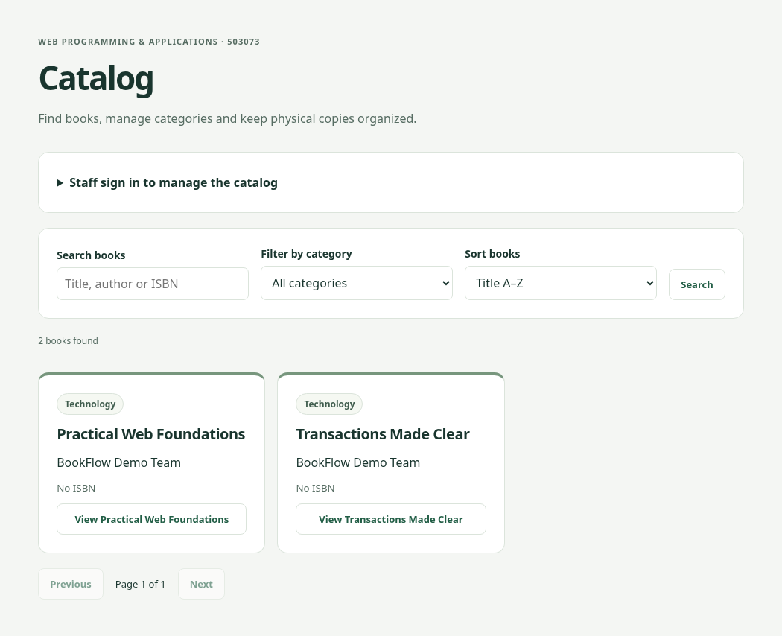
Public UI and staff access
• Search title / author / ISBN
• Filter, allowlisted sort and bounded pagination
• Public reads; LIBRARIAN/ADMIN mutations
• Server permissions are authoritative
BookFlow · Phạm Văn Tú · 52400252 5/10
Notes:
Target: 35 seconds
A visitor can search by title, author or ISBN, filter by category and choose a sort order. The server maps sort names to fixed SQL columns, and all user values are parameters. The page shows loading, empty and retry states. Staff sign-in exposes management forms, but hiding buttons is only a user-interface choice: the API independently verifies the token and reads the current role and status from the database. A member calling a staff mutation receives 403.

Slide 6
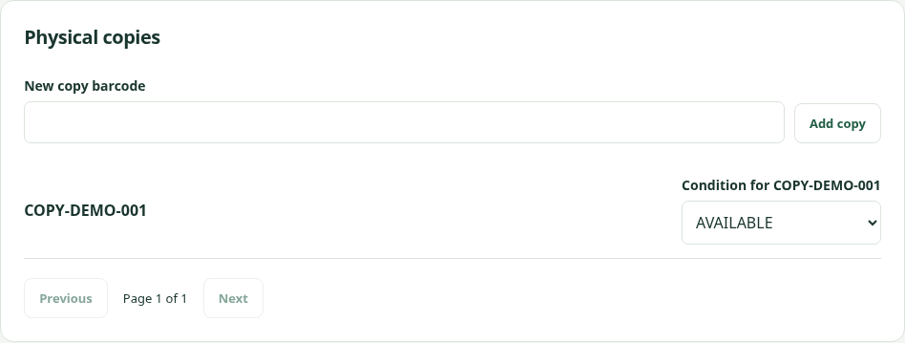
Demonstrate a real management flow
• Create a category and book
• Add a physical copy; change condition
• Availability changes independently of metadata
• Duplicate barcode returns 409
BookFlow · Phạm Văn Tú · 52400252 6/10
Notes:
Target: 50 seconds
In the live Catalog, I first create a category and then a book that references it. Next I add a copy with a unique barcode. The initial condition is AVAILABLE. Changing it to MAINTENANCE reduces the available count; restoring it increases that count. Availability also excludes copies with an open loan. If I try to reuse the barcode, the server returns 409 and the UI keeps the error visible. These are real HTTP and database operations. The rehearsal uses an isolated test schema, so it does not change our development data.

Slide 7
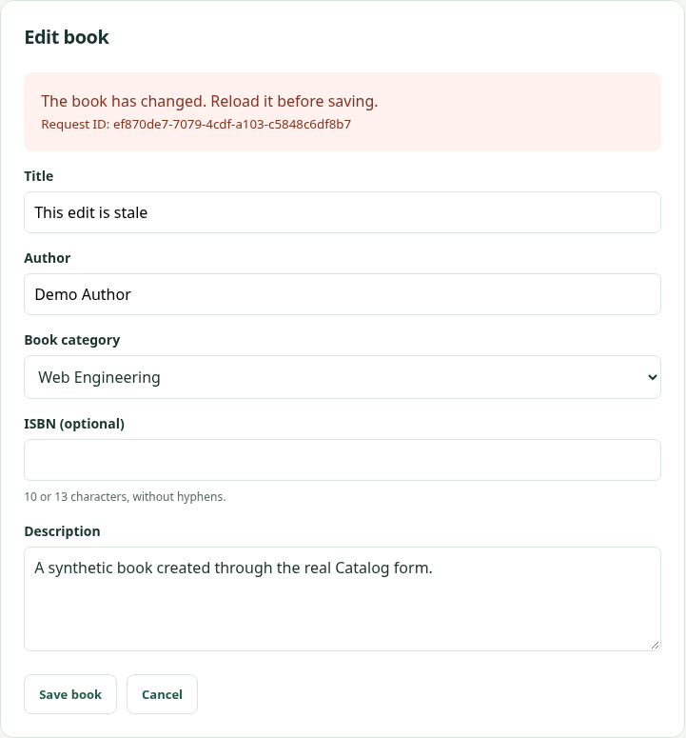
Two editors: detect a stale version
• GET returns a strong metadata ETag
• Mutation sends If-Match
• One writer advances v1 → v2
• A stale writer receives 412 and reloads
BookFlow · Phạm Văn Tú · 52400252 7/10
Notes:
Target: 45 seconds
A book’s metadata version becomes a strong ETag. When a form saves, it sends that value in If-Match. Inside a transaction, the service locks the book row, checks the version and updates the metadata. If another request has already saved, the old form receives 412 instead of overwriting the newer data. Missing If-Match receives 428. I demonstrate this by changing the book through a second real API request while the first form is open. The UI then asks me to reload before saving again.

Slide 8
Protect history and open loans
• Archive a title; do not erase its history
• Referenced categories cannot be deleted
• Open loans block archive and copy-condition changes
• Audit commits with the mutation
BookFlow · Phạm Văn Tú · 52400252 8/10
Notes:
Target: 35 seconds
Archiving hides a book from public access while retaining its copies and historical relationships. A category referenced by an active or archived book cannot be deleted. An open loan blocks archiving and changing the condition of its copy. The Catalog locks the relevant book or copy before checking loans. The future Loans service must follow the same lock order. Our database tests simulate a competing borrower and verify that the Catalog waits, then rejects an unsafe change. Audit failures also roll back the mutation.

Slide 9
Evidence: separate local checks from CI
• 59 foundation tests + 52 integration + 10 browser = 121 passed
• 24 Catalog integration cases
• Desktop/mobile flows, errors and conflict recovery
• No invented performance or production claims
BookFlow · Phạm Văn Tú · 52400252 9/10
Notes:
Target: 30 seconds
The recorded validation has 121 passing tests: 59 foundation tests, 52 integration tests and 10 browser tests. Twenty-four integration cases specifically cover the Catalog. The browser cases run on desktop and mobile and exercise real creation, editing, copy conditions, archive and error recovery. Integration tests use independent schemas in a test database. These are local results. I do not describe them as GitHub CI, a production deployment, a performance benchmark or proof that the Loans module has been completed.

Slide 10
Integration and remaining group work
• Catalog is implemented; loan flows remain separate
• Refresh/logout and full account UI remain planned
• Combine chapters and apply the Faculty template
• Record all three members in English; total ≤20 minutes
BookFlow · Phạm Văn Tú · 52400252 10/10
Notes:
Target: 15 seconds
This completes the Catalog contribution, not the entire group submission. We still need to integrate the other modules, apply the official Faculty template and record all three members speaking English within twenty minutes. The editable slides, report chapter, source and test evidence are ready for that group review.

