Slide 1
Nhóm: 17 Chapter 18: Irredundant Intervals
Thành viên:
Y Thu My Niê (2110908)
Võ Minh Quân (21110618)
Lưu Hoàng Phúc (21110602)
Lớp: DASA230179_22_1_09
Giảng viên: Huỳnh Xuân Phụng

Slide 2

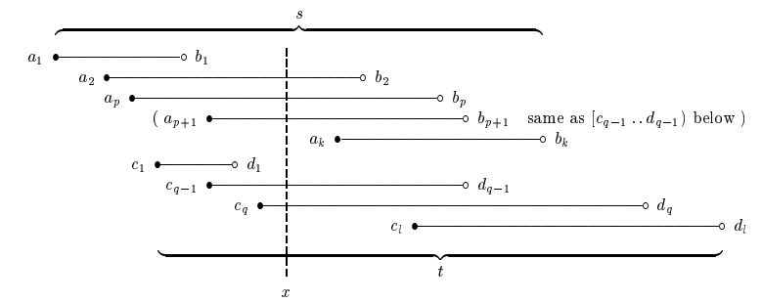
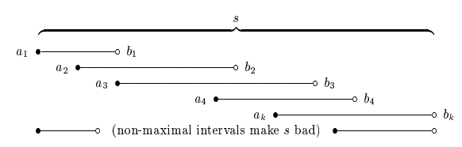

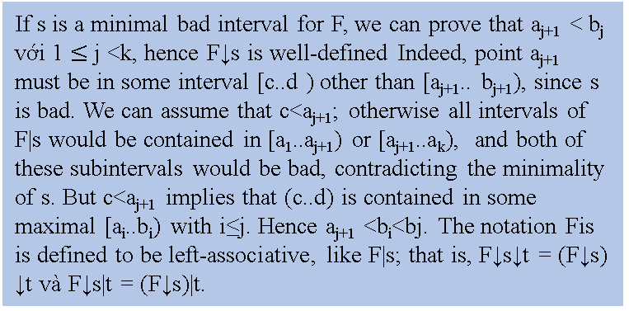
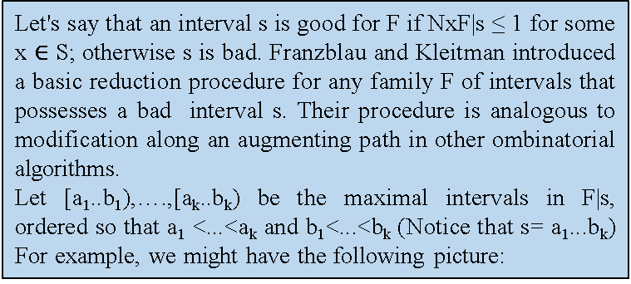
Nhóm 17_Lớp 09
Lưu Hoàng Phúc
Y Thu My Niê
Võ Minh Quân
Chapter 18: Irredundant Intervals
Introduction
This expository note presents simplifications of a theorem due to Györi and an algorithm due to Franzblau and Kleitman: Given a family F of m intervals on a linearly ordered set of n elements, we can construct in O(m + n)­­­­­­² steps an irredundant subfamily having maximum cardinality, as well as a generating family having minimum cardinality.
Let's say that an interval s is good for F if NxF|s ≤ 1 for some x $∈$ S; otherwise s is bad. Franzblau and Kleitman introduced a basic reduction procedure for any family F of intervals that possesses a bad interval s. Their procedure is analogous to modification along an augmenting path in other ombinatorial algorithms.
Let [a₁..b₁),….,[a_{k}..b_{k}) be the maximal intervals in F|s, ordered so that a₁ <...<a_{k} and b₁<...<b_{k} (Notice that s= a₁...b_{k}) For example, we might have the following picture:
If s and t are minimal bad intervals for F and s ≠ t, we have F↓s↓t = F↓t↓s.
Theory
A family of sets is called redundant if it is not irredundant. Any family that contains a redundant subfamily is redundant, since any family contained in an irredundant family is irredundant.
If F is a family of sets and s is an arbitrary set, let F|s denote the sets of F that are contained in s This operation is left-associative by convention:
F|s|t = (F|s)|t = F| (s ∩ t).
Lemma. A finite family F is redundant if and only if there is a nonempty set as such that every point of s belongs to at least two members of F|s. (The set s need not belong to F.)
Corollary. A finite family F of intervals on a line is redundant if and only if there is an interval s such that every point of s belongs to at least two intervals of F|s. (The set s need not belong to F.)
Comments and extensions.
The program just presented incorporates several refinements to the implementation sketched by Franzblau and Kleitman, and the author hopes that readers will enjoy finding them in the code. The Stanford Graph Base provides convenient data structures, by means of which it was possible to make the program short and sweet.
If s is a minimal bad interval for F, we can prove that a_{j+1} < b_{j} với 1 $≤$ j <k, hence F↓s is well-defined Indeed, point a_{j+1} must be in some interval [c..d ) other than [a_{j+1}.. b_{j+1}), since s is bad. We can assume that c<a_{j+1}; otherwise all intervals of F|s would be contained in [a₁..a_{j+1}) or [a_{j+1}..a_{k}), and both of these subintervals would be bad, contradicting the minimality of s. But c<a_{j+1} implies that (c..d) is contained in some maximal [a_{i}..b_{i}) with i≤j. Hence a_{j+1} <b_{i}<bj. The notation Fis is defined to be left-associative, like F|s; that is, F↓s↓t = (F↓s) ↓t và F↓s|t = (F↓s)|t.

Slide 3
Chapter 18: Irredundant Intervals
This expository note presents simplifications of a theorem due to Györi and an algorithm due to Franzblau and Kleitman: Given a family F of m intervals on a linearly ordered set of n elements, we can construct in O(m + n)­­­­­­² steps an irredundant subfamily having maximum cardinality, as well as a generating family having minimum cardinality.

Slide 4

1. Introduction
Let's say that a family of sets is irredundant if its members sequence with the following property: Each set contains a point that isn't in any of the preceding sets.
If F is a family of sets, we write F^{U} for the family of all nonempty unions of elements of F. When F and G are families with F $⊆$ G^{U}, we say that G generates F. If F is irredundant and G generates F, we obviously have |F|$≤$|G|, because each set in the sequence requires a new generator.
The purpose of this note is to describe the beautiful algorithm of Franzblau and Kleitman in full detail. Indeed, the CWEB source file that generated this document is a computer program that can be used in connection with the Stanford GraphBase [8] to find maximum irredundant subfamilies and minimum generating families of any given collection of intervals. Perhaps this new exposition will shed new light on the class of optimization problems for which an efficient algorithm exists.

Slide 5
2.Theory
A family of sets is called redundant if it is not irredundant. Any family that contains a redundant subfamily is redundant, since any family contained in an irredundant family is irredundant.
If F is a family of sets and s is an arbitrary set, let F|s denote the sets of F that are contained in s This operation is left-associative by convention:
F|s|t = (F|s)|t = F| (s ∩ t).
Lemma. A finite family F is redundant if and only if there is a nonempty set as such that every point of s belongs to at least two members of F|s. (The set s need not belong to F.)
Corollary. A finite family F of intervals on a line is redundant if and only if there is an interval s such that every point of s belongs to at least two intervals of F|s. (The set s need not belong to F.)

Slide 6
Henceforth we will restrict consideration to finite families F of intervals on a linearly ordered set. It suffices, in fact, to deal with integer elements; we will consider subintervals of the n-element set [0..n). (The notation [a.. b) stands here for the set of all integers a such that a $≤$ x< b.)
If F is a family of sets and x is a point, we will write N_{x}F for the number of sets that contain x. The corollary just proved can therefore be stated as follows: "F is irredundant if and only if every interval s ⊆ ∪F contains a point x with N_{x}F|s < 1." This characterization provides a polynomial-time test for irredundancy.
Henceforth we will restrict consideration to finite families F of intervals on a linearly ordered set. It suffices, in fact, to deal with integer elements; we will consider subintervals of the n-element set [0..n). (The notation [a.. b) stands here for the set of all integers a such that a ≤ x< b.)
If F is a family of sets and x is a point, we will write N_{x}F for the number of sets that contain x. The corollary just proved can therefore be stated as follows: "F is irredundant if and only if every interval s ⊆ ∪F contains a point x with N_{x}F|s < 1." This characterization provides a polynomial-time test for irredundancy.
Irredundant intervals have an interesting connection to the familiar computer-science concept of binary search trees (see, for example, [7, §6.2.2]): A family of intervals is irredundant if and only if we can associate its intervals with a binary tree whose nodes are each labeled with an integer x and an interval containing x. All nodes in the left subtree of such a node correspond to intervals that are strictly less than x, in the sense that all elements of those intervals are < x; all nodes in the right subtree correspond to intervals that are strictly greater than r. The root of the binary tree corresponds to the interval that is last in the assumed irredundant ordering. Its distinguished integer x is an element that appears in no other interval.
Given such a tree, we obtain a suitable irredundant ordering by traversing it recursively from the leaves to the root, in postorder [6, §2.3.1]. Conversely, given an irredundant ordering, we can construct a binary tree recursively, proceeding from the root to the leaves.

Slide 7
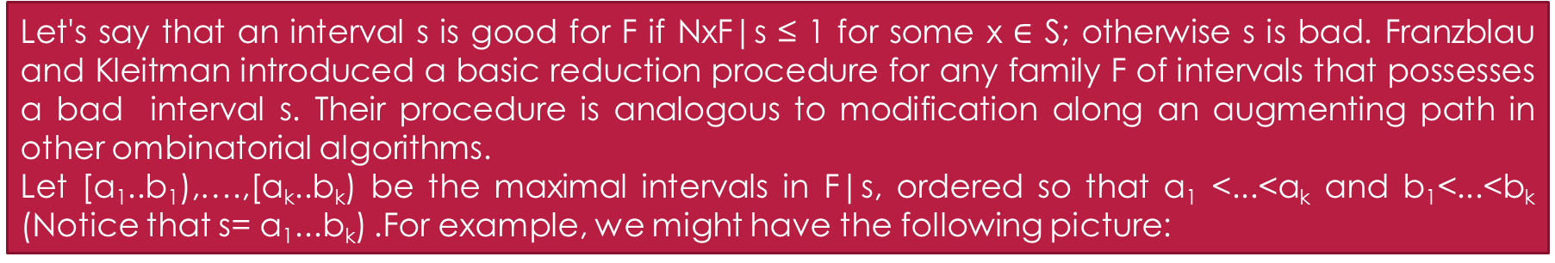
An example might be helpful at this point. Suppose n = 9 and f1 = [0..8), f2 = [0..7), f3 = [1..6), f4 = [1..5), f5 = [3..9), f6 = [2..9). Then {f1, f2, f3, f4, f5} and {f1, f3, f5, f6} are irredundant. (Indeed, a family of intervals is irredundant whenever its members have no repeated left endpoints or no repeated right endpoints.) These subfamilies are in fact maximally irredundant-they become redundant when any other interval of the family is added. Therefore maximal irredundant subfamilies need not have the same cardinality; irredundant subfamilies do not form the independent sets of a matroid. On the other hand, irredundant sets of intervals do have matroid-like properties.
Let's say that an interval s is good for F if NxF|s ≤ 1 for some x $∈$ S; otherwise s is bad. Franzblau and Kleitman introduced a basic reduction procedure for any family F of intervals that possesses a bad interval s. Their procedure is analogous to modification along an augmenting path in other ombinatorial algorithms.
Let [a₁..b₁),….,[a_{k}..b_{k}) be the maximal intervals in F|s, ordered so that a₁ <...<a_{k} and b₁<...<b_{k} (Notice that s= a₁...b_{k}) .For example, we might have the following picture:

Slide 8
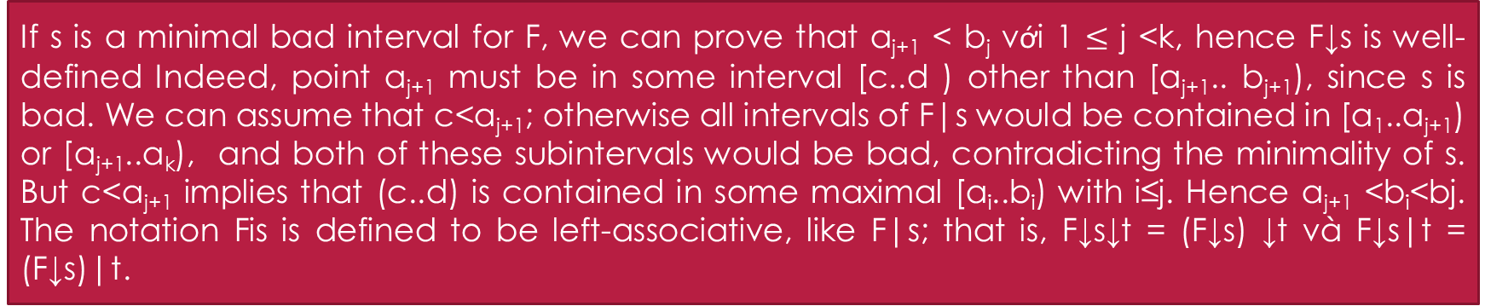
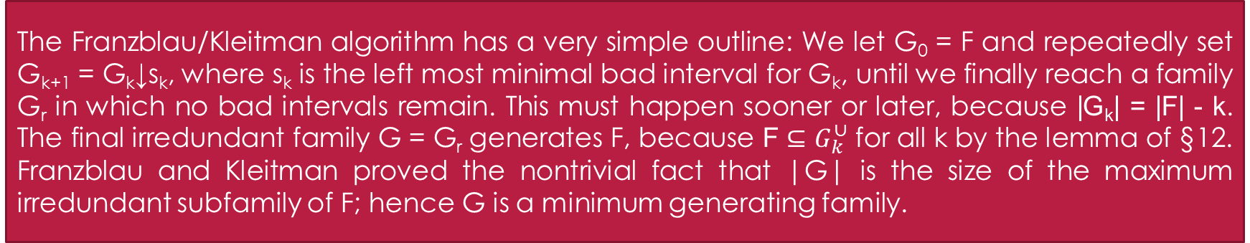
If s is a minimal bad interval for F, we can prove that a_{j+1} < b_{j} với 1 $≤$ j <k, hence F↓s is well-defined Indeed, point a_{j+1} must be in some interval [c..d ) other than [a_{j+1}.. b_{j+1}), since s is bad. We can assume that c<a_{j+1}; otherwise all intervals of F|s would be contained in [a₁..a_{j+1}) or [a_{j+1}..a_{k}), and both of these subintervals would be bad, contradicting the minimality of s. But c<a_{j+1} implies that (c..d) is contained in some maximal [a_{i}..b_{i}) with i≤j. Hence a_{j+1} <b_{i}<bj. The notation Fis is defined to be left-associative, like F|s; that is, F↓s↓t = (F↓s) ↓t và F↓s|t = (F↓s)|t.
Lemma. If s is a minimal bad interval for F, we have F$⊆$(F↓s)^{U}.
Lemma. Suppose s is a minimal bad interval for F, while t is a good interval. Then t is good also for F↓s.
Corollary. If s is a minimal bad interval for F, we have N_{x}F↓s = N_{x}F-N_{x}s.
The Franzblau/Kleitman algorithm has a very simple outline: We let G₀ = F and repeatedly set G_{k+1} = G_{k}↓s_{k}, where s_{k} is the left most minimal bad interval for G_{k}, until we finally reach a family G_{r} in which no bad intervals remain. This must happen sooner or later, because |G_{k}| = |F| - k. The final irredundant family G = G_{r} generates F, because F $⊆$ $G_{k}^{∪}$ for all k by the lemma of §12. Franzblau and Kleitman proved the nontrivial fact that |G| is the size of the maximum irredundant subfamily of F; hence G is a minimum generating family.

Slide 9
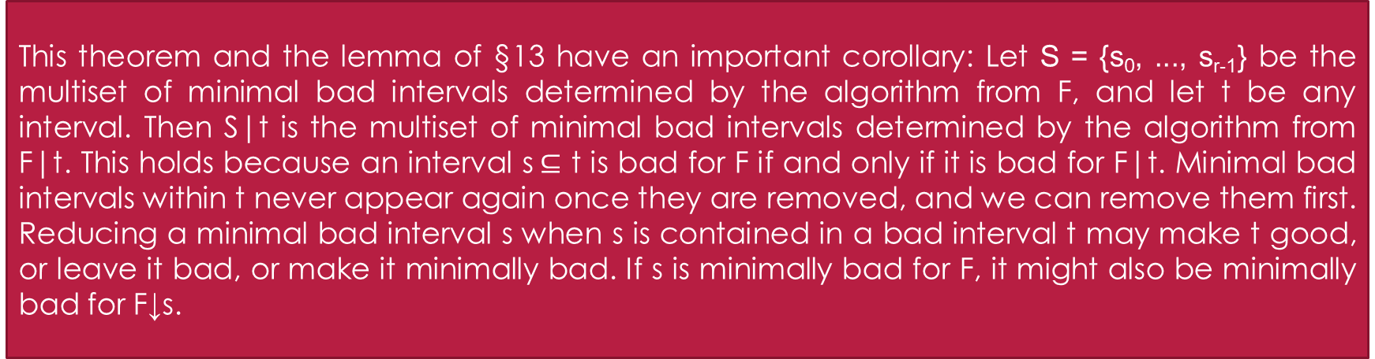
Theorem. The same final family G = G_{r}, is obtained when s_{k} is chosen to be an arbitrary (not necessarily leftmost) minimal bad interval of G_{k} in the reduction algorithm. Moreover, the same multiset {s₀,. . , s_{r-1}} of minimal bad intervals arises, in some order, regardless of the choices made at each step.
This theorem and the lemma of §13 have an important corollary: Let S = {s₀, ..., s_{r-1}} be the multiset of minimal bad intervals determined by the algorithm from F, and let t be any interval. Then S|t is the multiset of minimal bad intervals determined by the algorithm from F|t. This holds because an interval s$⊆$ t is bad for F if and only if it is bad for F|t. Minimal bad intervals within t never appear again once they are removed, and we can remove them first. Reducing a minimal bad interval s when s is contained in a bad interval t may make t good, or leave it bad, or make it minimally bad. If s is minimally bad for F, it might also be minimally bad for F↓s.

Slide 10
Now we are ready for the coup de grace and the pièce de résistance: After the reduction algorithm has computed the irredundant generating family G = G_{r} and the multiset S of minimal bad intervals, we can construct an irredundant subfamily F’ of F with |F’| = |G| by constructing a binary search tree as described in §9. The procedure is recursive, starting with an initial interval t = [0..n) that contains F: The tree defined for F|t is empty if F|t is empty. Otherwise it has a root node labeled with x and with any interval of F|t containing x, where x is an integer such that N_{x}G^{(t)}= 1; here G^{(t)} is the final generating set that is obtained when the reduction procedure is applied to F|t. A suitable interval containing x exists, because every element of G^{(t)} is an intersection of intervals in F|t. The left subtree of the root node is the binary search tree for F|(t⋂[0 .. x)); the right subtree is the binary search tree for F|(t⋂[x + l .. n)).
The number of nodes in this tree is |G|. For if x is the integer in the label of the root, G has one interval containing x, and its other intervals are G|[0 .. x) and G|[x + 1 .. n). The family G^{(t)} is not the same as G|t; but we do have |G^{(t)}| = |G|t| when t has the special form [0 .. x) hoặc [x + 1 .. n), because in such cases F↓s|t has the same cardinality as F|t when s is a minimal bad interval and s⊄t. For example, if t = [0 .. x) and b_{j}<x <b_{j+1}, we have F↓s|t = F|t \ {[a₁ .. b₁), ..., [a_{j} .. b_{j})} ⋃ {[a₂. . b₁), ..., [a_{j + l} .. b_{j})}.

Slide 11
It is not necessary to compute each G^{(t)} from scratch by starting with Fit and applying the reduction algorithm until it converges, because the binary tree construction algorithm requires only a knowledge of the incidence function N_{x}G^{(t)}. This function is easy to compute, because N, N_{x}F↓s = N_{x}F - N_{x}s by §14; therefore N_{x}G^{(t)} = N_{x}F↓t - N_{x}S|t.
All the basic ideas of Franzblau and Kleitman's algorithm have now been explained. But we must still carry out a careful analysis of some fine points of reduction that were claimed in the proof of the main theorem. If s and t are distinct minimal bad intervals, the lemma of §13 implies that no bad subintervals of t appear in F↓s; we also need to verify that t itself remains bad.

Slide 12
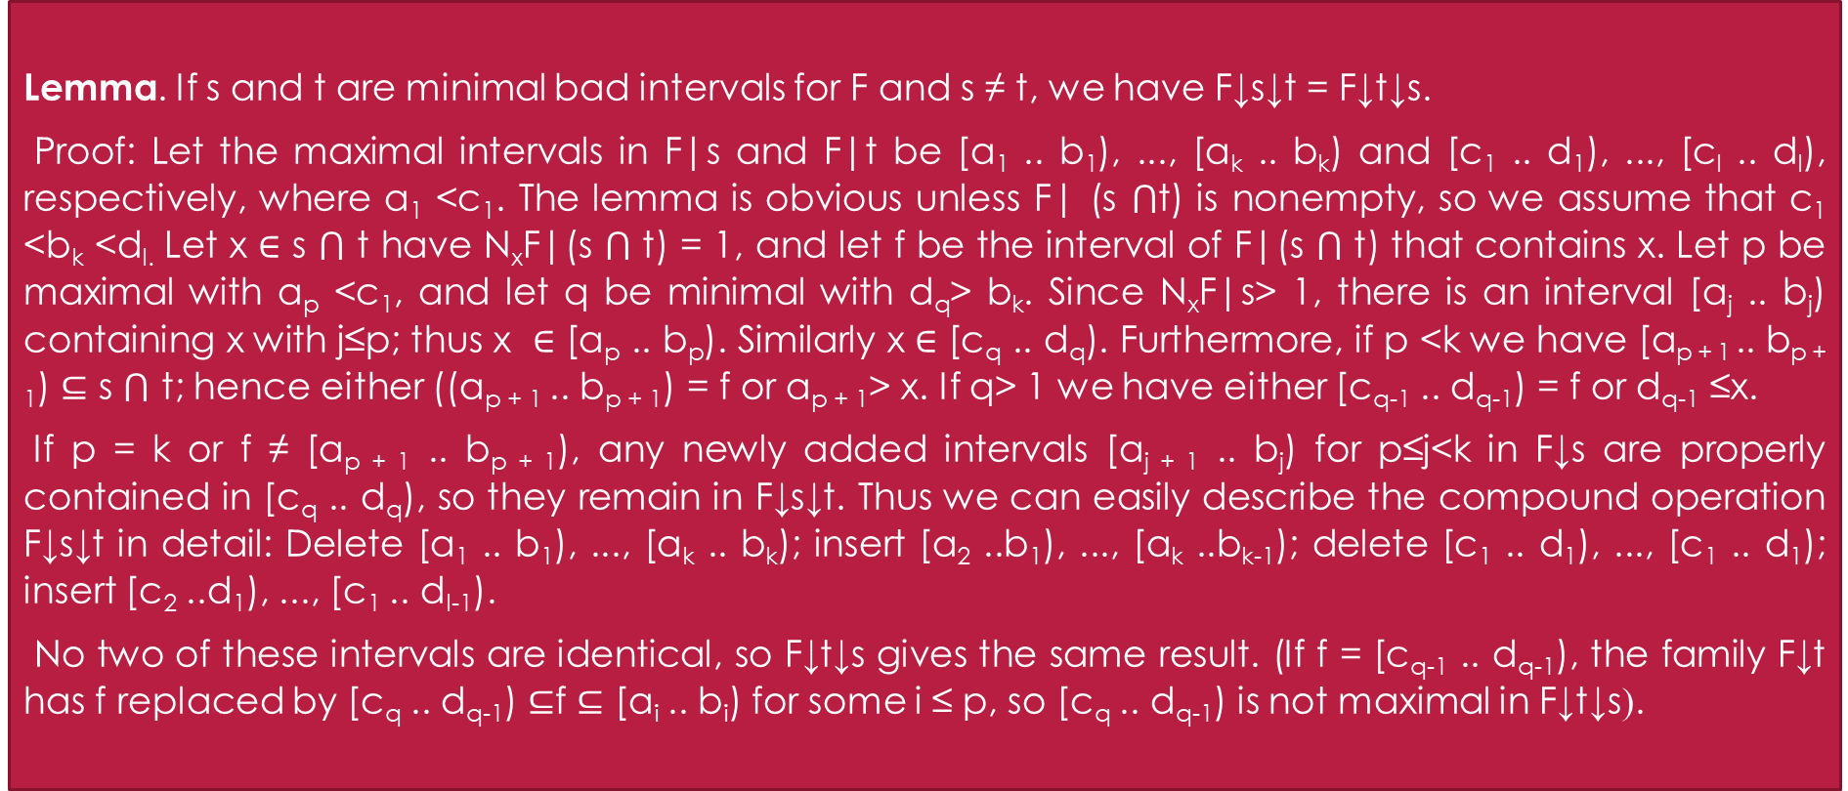
Lemma. If s and t are minimal bad intervals for F and s ≠ t, we have F↓s↓t = F↓t↓s.
Proof: Let the maximal intervals in F|s and F|t be [a₁ .. b₁), ..., [a_{k} .. b_{k}) and [c₁ .. d₁), ..., [c_{l} .. d_{l}), respectively, where a₁ <c₁. The lemma is obvious unless F| (s ⋂t) is nonempty, so we assume that c₁ <b_{k} <d_{l.} Let x ∈ s ⋂ t have N_{x}F|(s ⋂ t) = 1, and let f be the interval of F|(s ⋂ t) that contains x. Let p be maximal with a_{p} <c₁, and let q be minimal with d_{q}> b_{k}. Since N_{x}F|s> 1, there is an interval [a_{j} .. b_{j}) containing x with j≤p; thus x ∈ [a_{p} .. b_{p}). Similarly x ∈ [c_{q} .. d_{q}). Furthermore, if p <k we have [a_{p + 1} .. b_{p + 1}) $⊆$ s ⋂ t; hence either ((a_{p + 1} .. b_{p + 1}) = f or a_{p + 1}> x. If q> 1 we have either [c_{q-1} .. d_{q-1}) = f or d_{q-1} ≤x.
If p = k or f ≠ [a_{p + 1} .. b_{p + 1}), any newly added intervals [a_{j + 1} .. b_{j}) for p≤j<k in F↓s are properly contained in [c_{q} .. d_{q}), so they remain in F↓s↓t. Thus we can easily describe the compound operation F↓s↓t in detail: Delete [a₁ .. b₁), ..., [a_{k} .. b_{k}); insert [a₂ ..b₁), ..., [a_{k} ..b_{k-1}); delete [c₁ .. d₁), ..., [c₁ .. d₁); insert [c₂ ..d₁), ..., [c₁ .. d_{l-1}).
No two of these intervals are identical, so F↓t↓s gives the same result. (If f = [c_{q-1} .. d_{q-1}), the family F↓t has f replaced by [c_{q} .. d_{q-1}) ⊆f ⊆ [a_{i} .. b_{i}) for some i ≤ p, so [c_{q} .. d_{q-1}) is not maximal in F↓t↓s).

Slide 13
The remaining case f = [a_{p + 1} .. b_{p + 1}) = [c_{q-1} .. d_{q-1}) needs to be considered specially, since we can't delete this interval twice. The following picture might help clarify the situation:

Slide 14
Suppose g is an interval of F|t that is contained in [c_{j} .. d_{j}) if and only if j = q -1. Then g contains a point <c_{q}. If x ∈ g we have g = f. since g ⊆ s ⋂ t. Otherwise g ⊆ [c_{q-1} .. x) [c_{q-1} .. b_{p}) = [a_{p + 1} .. b_{p}). It follows that the maximal intervals of F↓s|t are:
These intervals are replaced in F↓s↓t by:
Thus F↓s↓t is formed almost as in the previous case, but with [a_{p + 1} .. b_{p}) and [c_{q} .. d_{q-1}) replaced by [c_{q} .. b_{p}). And we get precisely the same intervals in Fits. (Is there a simpler proof?)

Slide 15
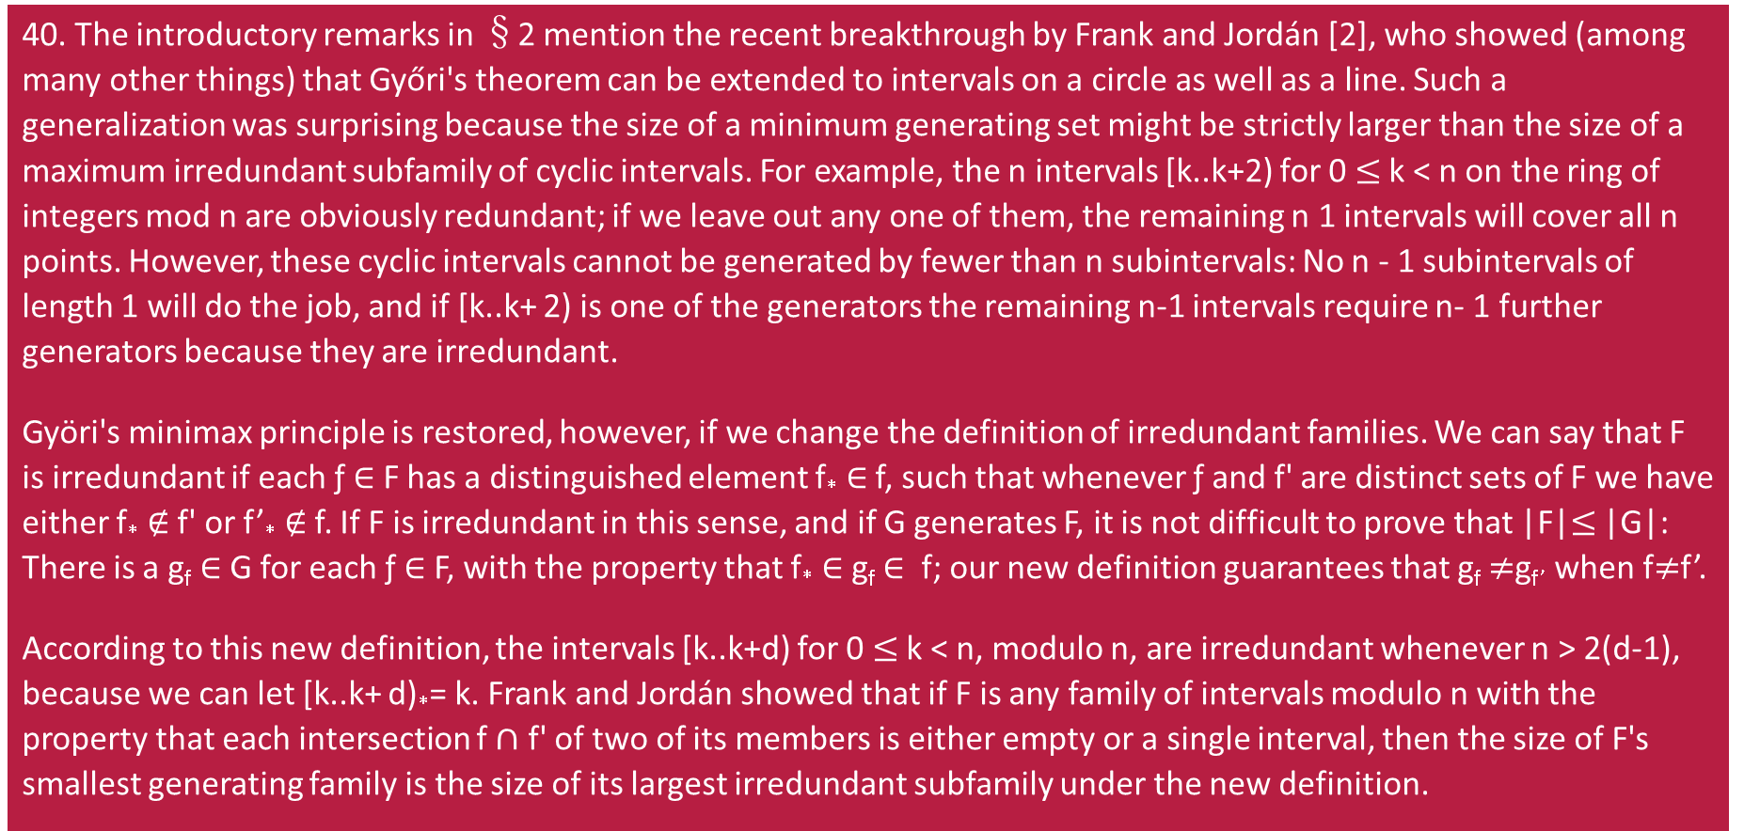
Development
40. The introductory remarks in §2 mention the recent breakthrough by Frank and Jordán [2], who showed (among many other things) that Győri's theorem can be extended to intervals on a circle as well as a line. Such a generalization was surprising because the size of a minimum generating set might be strictly larger than the size of a maximum irredundant subfamily of cyclic intervals. For example, the n intervals [k..k+2) for 0 $≤$ k < n on the ring of integers mod n are obviously redundant; if we leave out any one of them, the remaining n 1 intervals will cover all n points. However, these cyclic intervals cannot be generated by fewer than n subintervals: No n - 1 subintervals of length 1 will do the job, and if [k..k+ 2) is one of the generators the remaining n-1 intervals require n- 1 further generators because they are irredundant.
Györi's minimax principle is restored, however, if we change the definition of irredundant families. We can say that F is irredundant if each ƒ $∈$ F has a distinguished element f* $∈$ f, such that whenever ƒ and f' are distinct sets of F we have either f* $∉$ f' or f’­* $∉$ f. If F is irredundant in this sense, and if G generates F, it is not difficult to prove that |F|$≤$ |G|: There is a g_{f} $∈$ G for each ƒ $∈$ F, with the property that f* $∈$ g_{f} $∈$ f; our new definition guarantees that g_{f} $≠$g_{f’} when f$≠$f’.
According to this new definition, the intervals [k..k+d) for 0 $≤$ k < n, modulo n, are irredundant whenever n > 2(d-1), because we can let [k..k+ d)*= k. Frank and Jordán showed that if F is any family of intervals modulo n with the property that each intersection f $∩$ f' of two of its members is either empty or a single interval, then the size of F's smallest generating family is the size of its largest irredundant subfamily under the new definition.

Slide 16
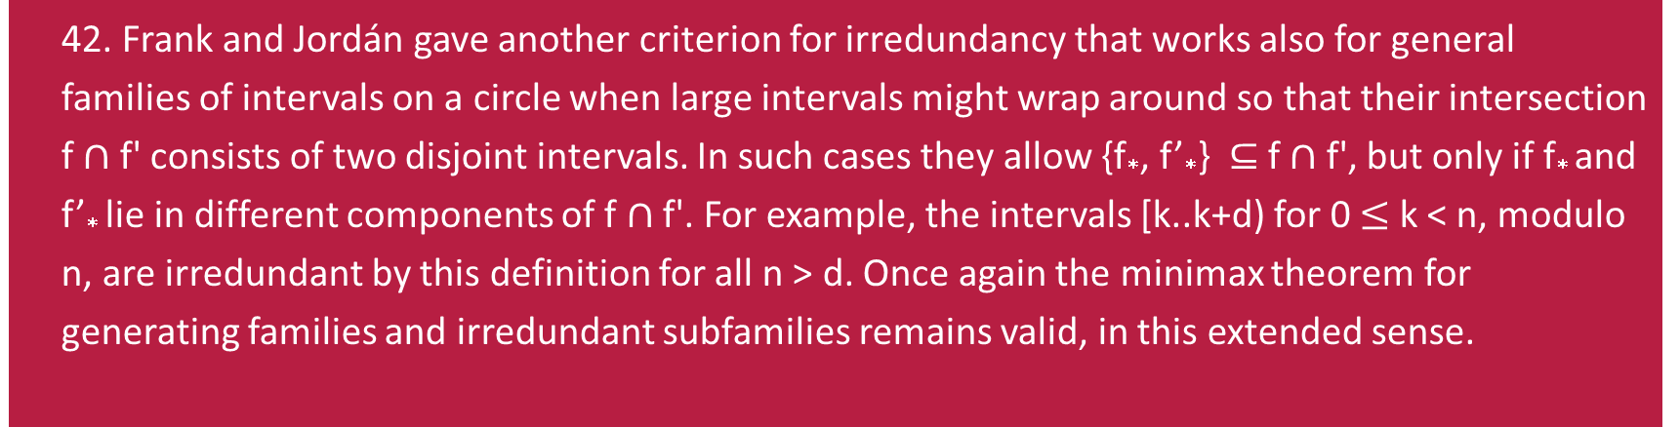
42. Frank and Jordán gave another criterion for irredundancy that works also for general families of intervals on a circle when large intervals might wrap around so that their intersection f $∩$ f' consists of two disjoint intervals. In such cases they allow {f*, f’*} $⊆$ f $∩$ f', but only if f* and f’* lie in different components of f $∩$ f'. For example, the intervals [k..k+d) for 0 $≤$ k < n, modulo n, are irredundant by this definition for all n > d. Once again the minimax theorem for generating families and irredundant subfamilies remains valid, in this extended sense.
Application
The algorithm is of special interest because it solves a problem analogous to finding a maximum independent set, but on a class of objects that is more general than a matroid.

Slide 17
THE END
Thanks for listening!

