Slide 1
The business outcomes you are designing for are as follows:
Analyze how much time is spent per ride
Based on date and time factors such as day of week and time of day
Based on which station is the starting and / or ending station
Based on age of the rider at time of the ride
Based on whether the rider is a member or a casual rider
Analyze how much money is spent
Per month, quarter, year
Per member, based on the age of the rider at account start
EXTRA CREDIT - Analyze how much money is spent per member
Based on how many rides the rider averages per month
Based on how many minutes the rider spends on a bike per month

Slide 2
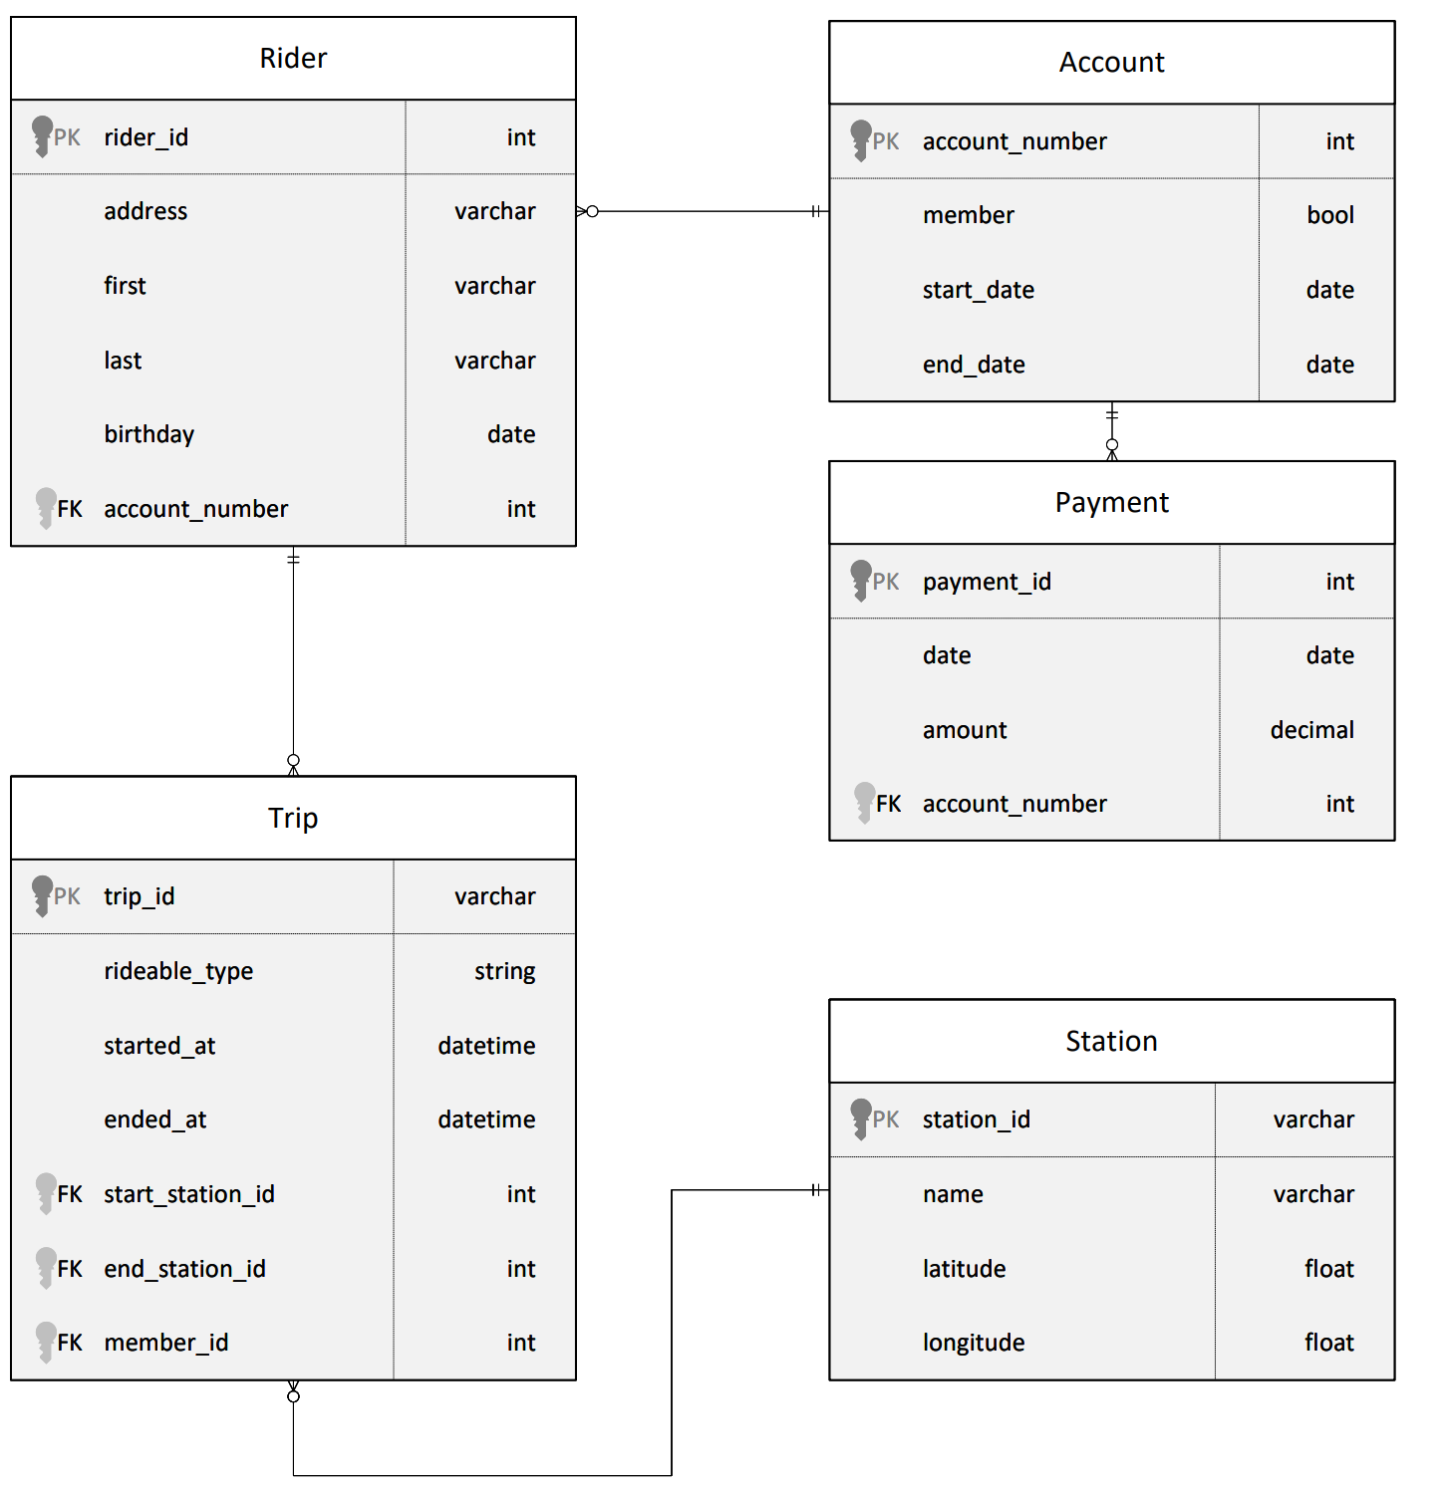
ERD

Slide 3
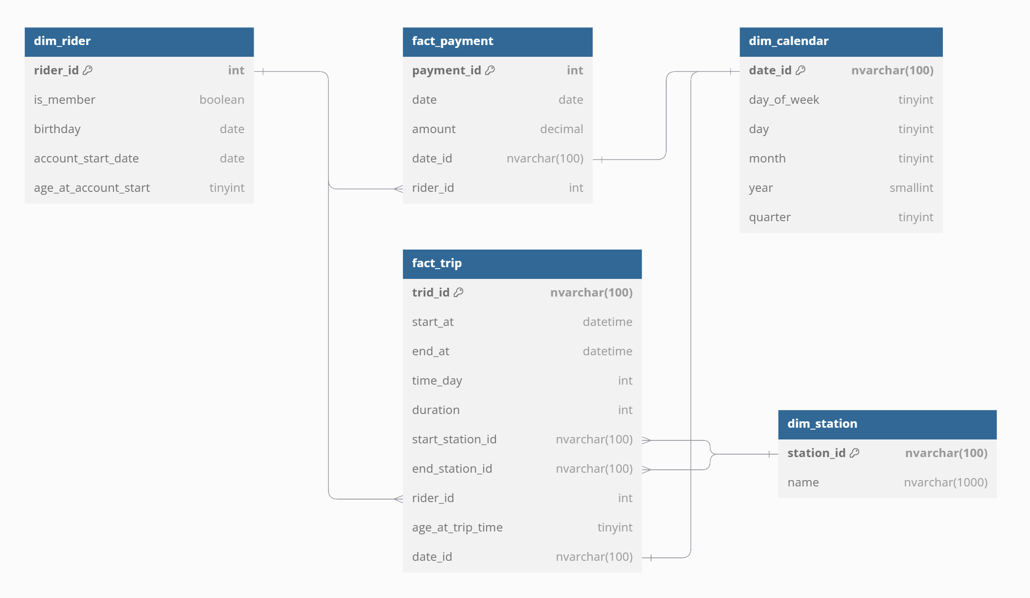
Star Schema

