Slide 1
Numerical Summary
Phuc Nguyen

Slide 2
New dataset, what to do?
Ask what is ultimate purpose to get the data?
Stay focus, time is most important resource
Have a decent amount of time to know the domain
20% domain knowledge → 80% analytics result
Follow SOLVE steps

Slide 3
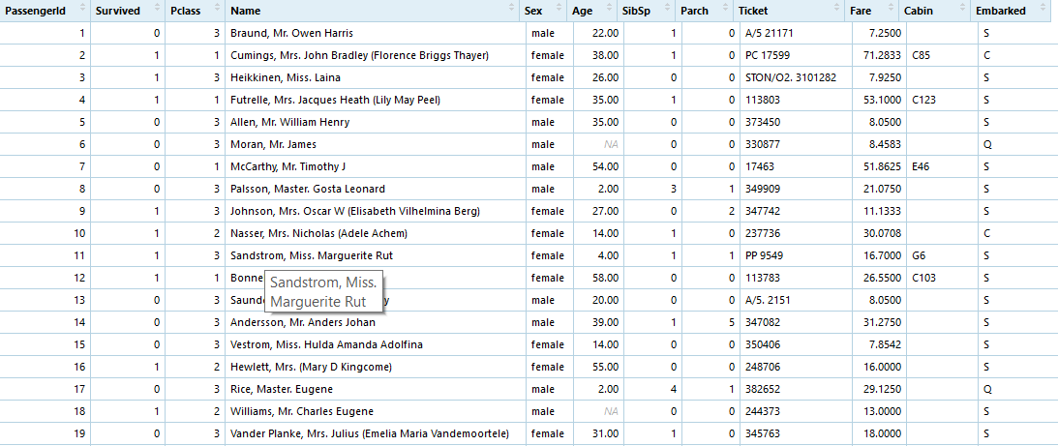
SOLVE
Size
Observation Key
Length
QUESTION?
Variable Distribution

Slide 4
SOLVE
S | Size | How many variables in data?
O | Observation Key | What one data row represent?
L | Length | How many observations data have?
V | Variable Distribution | How each variable distribute?
E | Question | List out any question you have so far.

Slide 5
Explore Size
Name of each variable
What is the data type of each variable, is it good type?
“1234586.798” should be 1,234,586.798
43323 should be 2018-08-11
What is the meaning of each variable?
Documentation
Ask the source

Slide 6
Explore Observation Key
Find the key variable
Does one row get along with unique value of any variable?
Any variable name like “Key”, “ID” ??
If there is no single key, then combination of several variables
A ‘flight’ table may not have flight_id variable, but have unique plane_id and track_number for each row
Why key variable is important?
No meaning analysis and model can be made without it.

Slide 7
Explore Length
How many observations in this data ? (yes, that’s why Observation Key come first)
Is this the all observations possible?
If data has only part of all possible, why?
Is data only a sample?
How do we pick what’s in data?
Can we have more data?
Why Length is important?
In statistics / machine learning / AI, outcome quality usually improve with length of data.

Slide 8
Explore Variable Distribution
If variable is categorical, each category consists of how many observations (again, explore Observation Key first)
Always keep an eye for missing data
Does the number make sense with what you know?
Can you fact check?
(for Titanic, go to titanicfacts.net)
If variable is number, what distribution?
Again, keep an eye for missing data, a lot missing data can change real distribution a lot.
Is the distribution normal, left skewed, exponential? Does it make any sense with meaning of the variable?

Slide 9
Think in Question
After digging S-O-L-V, it is depends on you to place questions, which can
Resolve any issue inside data, i.e. missing, noise data
Decide if data is enough quantity / quality to proceed
Repeat SOLVE if you get stuck at some point later.

Slide 10
Key take away
Focus on the goal
Get domain knowledge
Do SOLVE
Do not skip steps
Be careful & diligent
Beware of time, time is most important resource.

