Slide 1
Fundamentals and Benefits of CI/CD

Slide 2
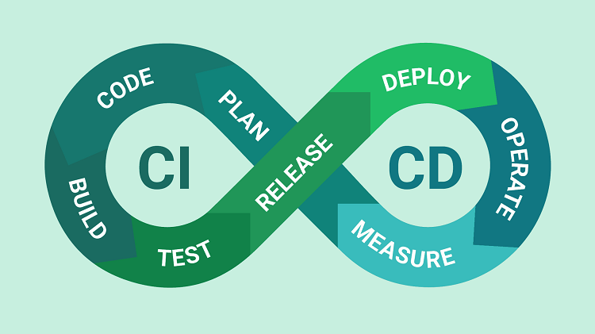
What is CI/CD?

Slide 3
Continuous integration
This is all about the source code
Compile
Transpile
Lint
Unit tests
Static Code Analysis
Dependency Security

Slide 4
Continuous Deployment
This is all about built code and deployment
Create infrastructure
Provision
Deploy
Smoke tests
Rollback
Promotion

Slide 5
Why CI/CD?
Increase revenue
New value-generating features released more quickly
Less time to market
Decrease costs
Less human error
Faster deployment
Mean time to resolution shorter
Increase productivity
Routine processes are now automated
Lower risk
Faults are now faster and easier to be detected

