Slide 1
Training C++ Session 1: C++11 (Created by the.vu@lge.com)
Introduce about C++ language
Brief of new features in C++ 11 in comparing with C++98
Make detail about each feature (code example)
Some notices when using C++ 11 in Linux and Window
Questions and Answers

Slide 2
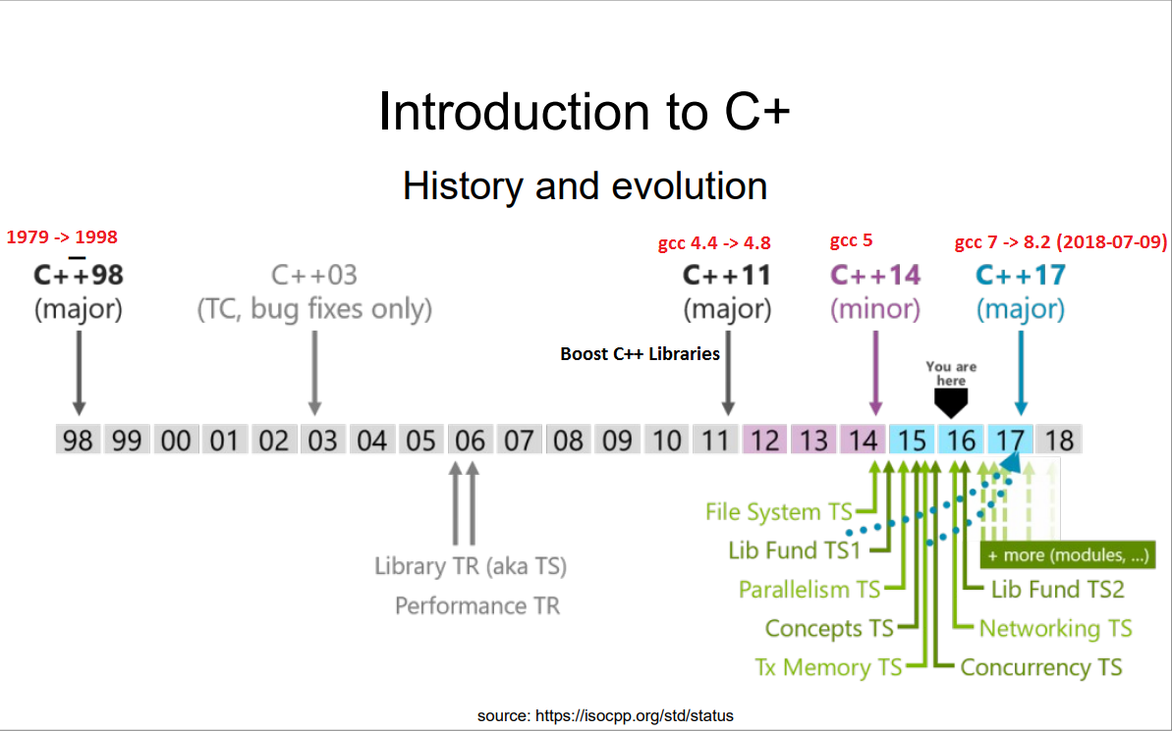
I. Introduce about C++
Notes:
https://gcc.gnu.org/projects/cxx-status.html#cxx11

Slide 3
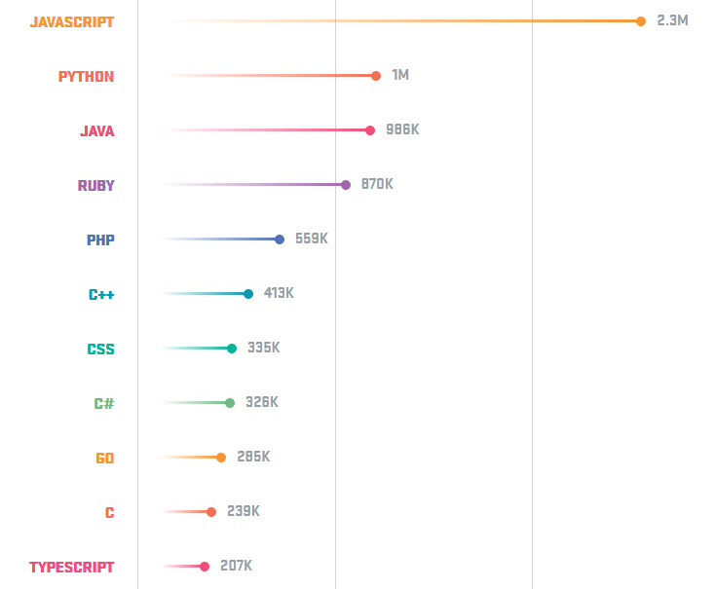
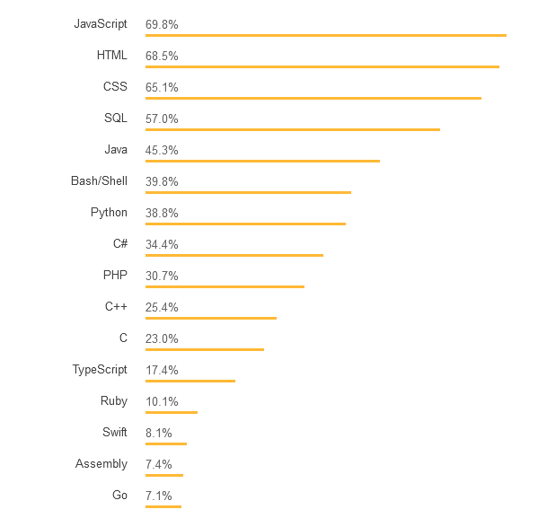
The popularity of the programming languages. (2017)
GitHub
StackOverFlow
Notes:
C++ is used for operating systems, games, embedded software, autonomous cars and medical technology, as well as many other applications. Companies like Facebook and Google use C++.
https://hackernoon.com/top-3-most-popular-programming-languages-in-2018-and-their-annual-salaries-51b4a7354e06
https://aptech.vn/kien-thuc-tin-hoc/qua-trinh-phat-trien-cua-ngon-ngu-lap-trinh.html

Slide 4
New header *.h
C library
<cstdbool>
<cuchar>
<cstdint>
<cinttypes>
<ctgmath>
<cfenv>
Containers
<array>
<forward_list>
<unordered_map>
<unordered_set>
Multi-theading
<automic>
<condition_variable>
<future>
<mutex>
<thread>
Other
<chrono>
<codecvt>
<initializer_list>
<random>
<ratio>
<regex>
<tuple>
<system_error>
<typeindex>
<type_traits>
Note: there are lots of little upgrade to other headers such as
<cstdlib>, <cwchar>,
<deque>, <list>, <map>,<queue>, <set>, <stack>, <vector>
<algorithm>, <bitset>, <complex>, <exception>, <functional>, <memory>, <string>, <utility>
Notes:
<cstdbool> : The purpose in C of this header is to add a bool type and the true and false values as macro definitions.
<cuchar> : This header provides support for 16-bit and 32-bit characters, suitable to be encoded using UTF-16 and UTF-32.
<cstdint>: This header defines a set of integral type aliases with specific width requirements, along with macros specifying their limits and macro functions to create values of these types.
<cinttypes> : Header with library support for width-based integral types.
<ctgmath> : This header simply includes <cmath> and <ccomplex>.
<cfenv> : This header declares a set of functions and macros to access the floating-point environment, along with specific types
<array> : Header that defines the fixed-size array container class
<forward_list> : Header that defines the forward_list container class
<unordered_map> : Header that defines the unordered_map and unordered_multimap container classes
<unordered_set> : Header that defines the unordered_set and unordered_multiset container classes
<chrono> : The elements in this header deal with time. This is done mainly by means of three concepts: (Durations, Time points, Clocks)
<codecvt> : Standard facets to convert between UTF character encodings.
<initializer_list> : Header that defines the initializer_list class template.
<random> : This header introduces random number generation facilities.
<ratio> : This header declares the ratio class template and several auxiliary types to operate with them.
<regex> : Regular expressions are a standardized way to express patterns to be matched against sequences of characters.
<typeindex> : This header defines the type_index class and a specialization of hash for this type.
<type_traits> : This header defines a series of classes to obtain type information on compile-time.

Slide 5
The Biggest Changes in C++11
C++ 11 syntax
Lambda Expressions
Automatic Type Deduction and decltype
Uniform Initialization Syntax
Deleted and Defaulted Functions
nullptr
Delegating Constructors
Rvalue References
C++11 Standard Library
Threading Library
New Smart Pointer Classes
New C++ Algorithms
Notes:
http://www.cplusplus.com/reference/clibrary/
http://www.cplusplus.com/reference/stl/
http://www.cplusplus.com/reference/iolibrary/
http://www.cplusplus.com/reference/multithreading/
http://www.cplusplus.com/reference/std/

Slide 6
Notes:
https://hackernoon.com/top-3-most-popular-programming-languages-in-2018-and-their-annual-salaries-51b4a7354e06

