Slide 1
Training C++ Session 1: C++11 (Created by the.vu@lge.com)
Introduce about C++ language
Brief of new features in C++ 11 in comparing with C++98
Make detail about each feature (code example)
Some notices when using C++ 11 in Linux and Window
Questions and Answers

Slide 2
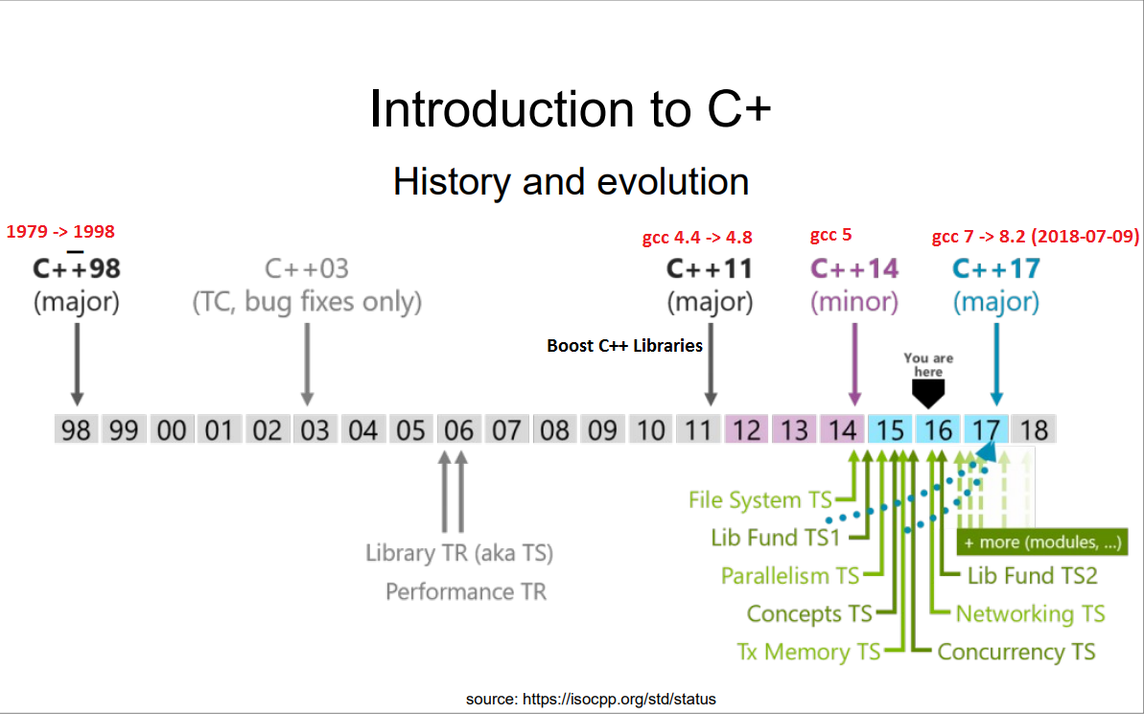
I. Introduce about C++
Notes:
https://gcc.gnu.org/projects/cxx-status.html#cxx11

Slide 3
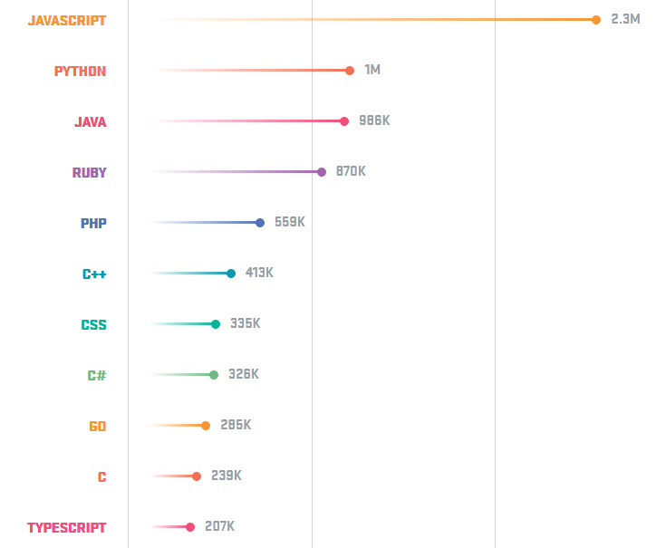
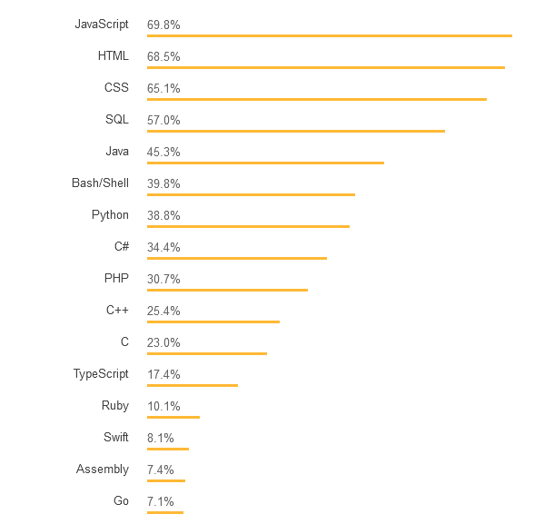
The popularity of the programming languages. (2017)
GitHub
StackOverFlow
Notes:
C++ is used for operating systems, games, embedded software, autonomous cars and medical technology, as well as many other applications. Companies like Facebook and Google use C++.
https://hackernoon.com/top-3-most-popular-programming-languages-in-2018-and-their-annual-salaries-51b4a7354e06
https://aptech.vn/kien-thuc-tin-hoc/qua-trinh-phat-trien-cua-ngon-ngu-lap-trinh.html

Slide 4
New header *.h
C library
<cfenv>
<cinttypes>
<cstdbool>
<cstdint>
<ctgmath>
<cuchar>
Containers
<array>
<forward_list>
<unordered_map>
<unordered_set>
Multi-theading
<automic>
<condition_variable>
<future>
<mutex>
<thread>
Other
<chrono>
<codecvt>
<initializer_list>
<random>
<ratio>
<regex>
<tuple>
<system_error>
<typeindex>
<type_traits>
Notes:
<cfenv> :

Slide 5
The Biggest Changes in C++11
C++ 11 syntax
Lambda Expressions
Automatic Type Deduction and decltype
Uniform Initialization Syntax
Deleted and Defaulted Functions
nullptr
Delegating Constructors
Rvalue References
C++11 Standard Library
Threading Library
New Smart Pointer Classes
New C++ Algorithms
Notes:
http://www.cplusplus.com/reference/clibrary/
http://www.cplusplus.com/reference/stl/
http://www.cplusplus.com/reference/iolibrary/
http://www.cplusplus.com/reference/multithreading/
http://www.cplusplus.com/reference/std/

Slide 6
Notes:
https://hackernoon.com/top-3-most-popular-programming-languages-in-2018-and-their-annual-salaries-51b4a7354e06

