Slide 1
Training C++ Session 1: C++11 (Created by the.vu@lge.com)
Introduce about C++ language
Brief of new features in C++ 11 in comparing with C++98
Make detail about each feature (code example)
Questions and Answers
Ha Noi, 5 Nov 2018

Slide 2
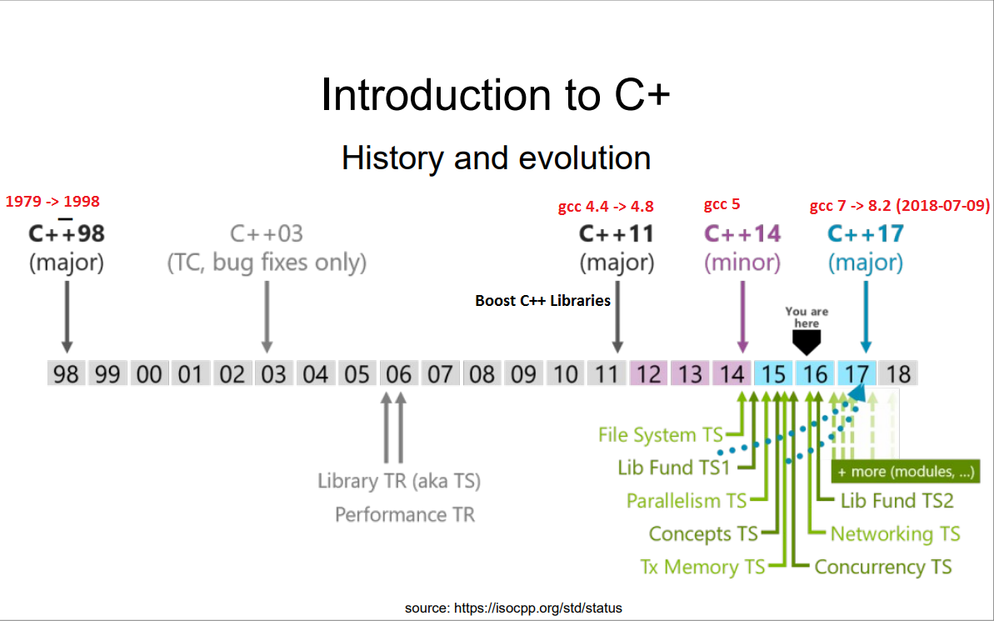
I. Introduce about C++
Notes:
https://gcc.gnu.org/projects/cxx-status.html#cxx11

Slide 3
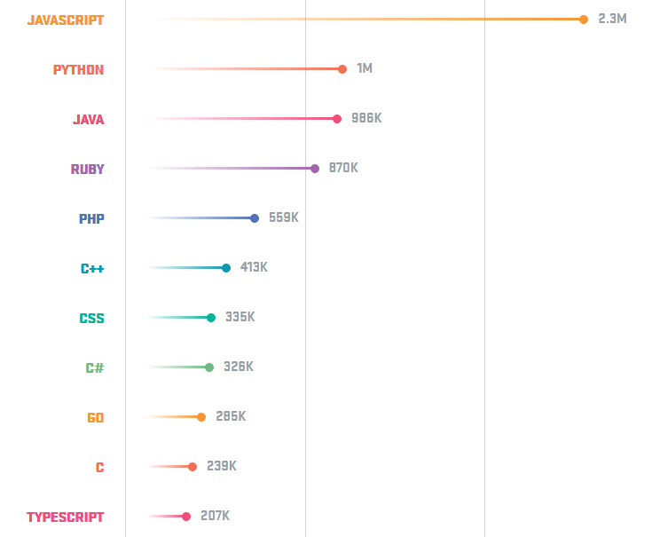
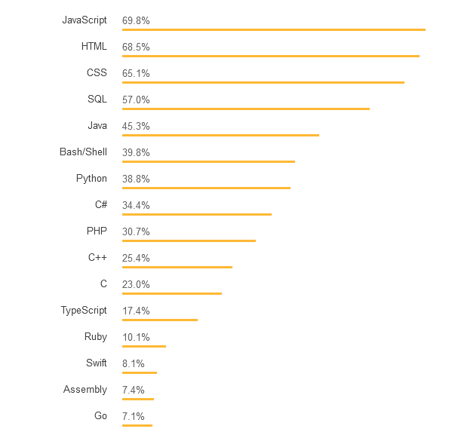
The popularity of the programming languages. (2017)
GitHub
StackOverFlow
Notes:
C++ is used for operating systems, games, embedded software, autonomous cars and medical technology, as well as many other applications. Companies like Facebook and Google use C++.
https://hackernoon.com/top-3-most-popular-programming-languages-in-2018-and-their-annual-salaries-51b4a7354e06
https://aptech.vn/kien-thuc-tin-hoc/qua-trinh-phat-trien-cua-ngon-ngu-lap-trinh.html

Slide 4
New header *.h
II. Brief of new features in C++ 11 in comparing with C++98
C library
<cstdbool>
<cuchar>
<cstdint>
<cinttypes>
<ctgmath>
<cfenv>
Containers
<array>
<forward_list>
<unordered_map>
<unordered_set>
Multi-theading
<automic>
<condition_variable>
<future>
<mutex>
<thread>
Other
<chrono>
<codecvt>
<initializer_list>
<random>
<ratio>
<regex>
<tuple>
<system_error>
<typeindex>
<type_traits>
Note: there are lots of little upgrade to other headers such as
<cstdlib>, <cwchar>,
<deque>, <list>, <map>,<queue>, <set>, <stack>, <vector>
<algorithm>, <bitset>, <complex>, <exception>, <functional>, <memory>, <string>, <utility>
Notes:
<cstdbool> : The purpose in C of this header is to add a bool type and the true and false values as macro definitions.
<cuchar> : This header provides support for 16-bit and 32-bit characters, suitable to be encoded using UTF-16 and UTF-32.
<cstdint>: This header defines a set of integral type aliases with specific width requirements, along with macros specifying their limits and macro functions to create values of these types.
<cinttypes> : Header with library support for width-based integral types.
<ctgmath> : This header simply includes <cmath> and <ccomplex>.
<cfenv> : This header declares a set of functions and macros to access the floating-point environment, along with specific types
<array> : Header that defines the fixed-size array container class
<forward_list> : Header that defines the forward_list container class
<unordered_map> : Header that defines the unordered_map and unordered_multimap container classes
<unordered_set> : Header that defines the unordered_set and unordered_multiset container classes
<chrono> : The elements in this header deal with time. This is done mainly by means of three concepts: (Durations, Time points, Clocks)
<codecvt> : Standard facets to convert between UTF character encodings.
<initializer_list> : Header that defines the initializer_list class template.
<random> : This header introduces random number generation facilities.
<ratio> : This header declares the ratio class template and several auxiliary types to operate with them.
<regex> : Regular expressions are a standardized way to express patterns to be matched against sequences of characters.
<typeindex> : This header defines the type_index class and a specialization of hash for this type.
<type_traits> : This header defines a series of classes to obtain type information on compile-time.

Slide 5
Important Changes in C++11
New C++ 11 syntax
auto variable
nullptr
Range-based for loops
decltype
Uniform Initialization & Initializer Lists
Override and final
Strongly-typed enums
Lambdas
static_assert and type traits
Move semantics & rvalue reference
New C++11 feature
Threading Library++11 Standard Library
New Smart Pointer Classes
New C++ Algorithms
Notes:
http://www.cplusplus.com/reference/clibrary/
http://www.cplusplus.com/reference/stl/
http://www.cplusplus.com/reference/iolibrary/
http://www.cplusplus.com/reference/multithreading/
http://www.cplusplus.com/reference/std/

Slide 6
III. Detail about each feature (code example)
Auto Variable
Earlier Version
int i = 42; long long l = 42LL; void (*p)(int, float, char) = foo; // void foo(int, float, char) vector<string>::iterator it = v.begin() // v has type vector<string>
C++11
auto i = 42; // i has type int auto l = 42LL; // l has type long long auto p = &foo; // p is pointer point to void foo function auto it = v.begin() // v has type vector<string> auto l =[] (int x) -> bool { return true; }; template<class T, class U> auto add(T t, U u)-> decltype(t + u) { return t + u; } auto var; // ERROR: can’t deduce the type of var
Notes:
https://hackernoon.com/top-3-most-popular-programming-languages-in-2018-and-their-annual-salaries-51b4a7354e06

Slide 7
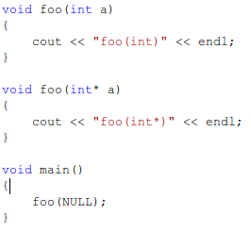

NULLPTR
New keyword
Avoid implicit conversion to integral types
Has type std::nullptr_t

Slide 8
Range-based for loops
So-called “foreach” loop
Example 1:
for (auto i : {1,2,3,4,5})
{
std::cout <<i << std::endl;
}
Example 2:
int arr[] = {1,2,3,4,5};
for(int& e : arr)
{
e = e * e;
}

Slide 9
Range-based for loops (CONT.)
Example 3:
std::vector<int> v = { 3, 1, 4 };
for (auto it=v.begin(); it!=v.end(); it++)
{
// Do something
}
New: Non-member begin() and end()
Example 4:
std::vector<int> v = { 3, 1, 4 };
for (auto it=std::begin(v); it!=std::end(v); it++)
{
// Do something
}

Slide 10
decltype
Get type of an expression
Can be used in definition
Example:
void f(const vector<int>& a, vector<float>& b)
{
int k= 33;
decltype(k) j = k * 2;//equal int j = k * 2;
decltype(1.2f) a = k* 2;//equal float a = k *2;
typedef decltype(a[0]*b[0]) Tmp;
for (int i=0; i<b.size(); ++i)
{
Tmp* p = new Tmp(a[i]*b[i]);
// ...
}
// ...
}

Slide 11
Uniform Initialization & Initializer Lists
Initializer lists are not just for arrays
C++11 allows {}-initializer lists for all initialization
C++11 supports in-class initialization
E.g.
std::list<double> v = { 1.5, 2, 3.456, 99.99 };
std::vector<std::string> cities {"Hanoi", "London"};
int j{}; // j is initialized by 0
int* q{}; // q is initialized by nullptr

Slide 12
Uniform Initialization & Initializer Lists (cont)
class C
{
int a;
int b;
int arr[4];
public:
C() : arr{1,2,3,4}{} //C++11, member array initializer
C(int i, int j) : a(i), b(j){}
};
void main()
{
C c {0,0}; //C++11 only. Equivalent to: C c(0,0);
int* a = new int[3] { 1, 2, 0 }; /C++11 only
}

Slide 13
Uniform Initialization & Initializer Lists (cont)
Prevent narrowing:
int x1(5.3); // OK, but x1 becomes 5
int x2 =5.3; // OK, but x2 becomes 5
int x3{5.0}; // ERROR: narrowing
int x4 ={5.3}; // ERROR: narrowing
char c1{7}; // OK: even though 7 is an int, this is not narrowing
char c2{99999}; // ERROR: conversion from 'int' to 'char' requires a
//narrowing conversion
std::vector<int> v1 { 1,2, 4, 5}; // OK
std::vector<int> v2 { 1,2.3, 4,5.6 }; // ERROR: narrowing doubles to ints
Notes:
For reference, see 8.5.4/6 of n3225
A narrowing conversion is an implicit conversion:
- from a floating-point type to an integer type, or
- from long double to double or float, or from double to float, except where the source is a constant expression and the actual value after conversion is within the range of values that can be represented (even if it cannot be represented exactly), or
- from an integer type or unscoped enumeration type to a ﬂoating-point type, except where the source is a constant expression and the actual value after conversion will fit into the target type and will produce the original value when converted back to the original type, or
- from an integer type or unscoped enumeration type to an integer type that cannot represent all the values of the original type, except where the source is a constant expression and the actual value after conversion will fit into the target type and will produce the original value when converted back to the original type.

Slide 14
Uniform Initialization & Initializer Lists (cont)
#include <initializer_list>
void f(std::initializer_list<int> args)
{
for (auto p=args.begin(); p!=args.end(); ++p)
cout << *p << "\n";
}
f({1,2.0f});//error: invalid narrowing conversion from "double" to "int"
f({23,345,4567,56789});
f({}); // the empty list
f{1,2}; // error: function call ( ) missing

Slide 15
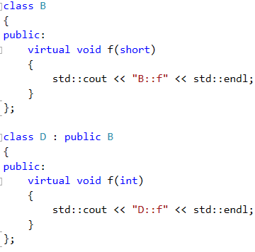
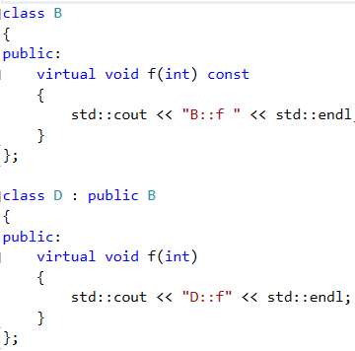


Override and final
Example: Class D wants to override f() from class B

Slide 16
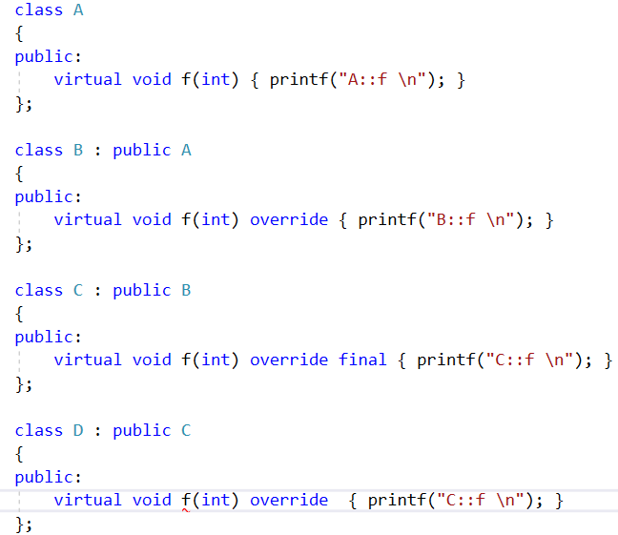
Override and final (cont.)
Solution:
ERROR: cannot override 'final' function

Slide 17


Strongly-typed enums
C++ | C++11
E.g. - Value: int | E.g. - Value: any signed / unsigned integral type (default: int)
Error

Slide 18
Lambdas
Syntax:
[capture](parameters) -> return-type {body}
[capture]
[a,&b] a captured by value, b captured by reference
[this] captures the this pointer by value
[&] captures all automatic variables in the body of the lambda by reference
[=] captures all automatic variables in the body of the lambda by value
[] captures nothing

Slide 19
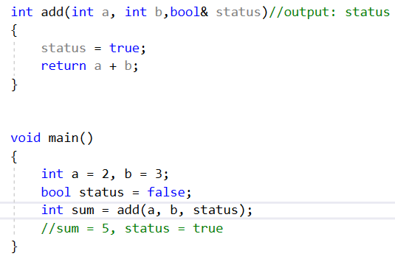
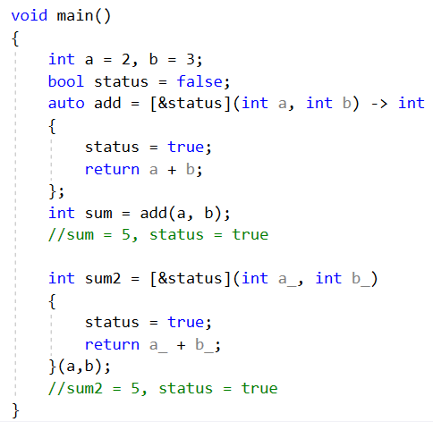
Lambdas (cont.)
C++ 98
C++11 (using Lambdas)

Slide 20

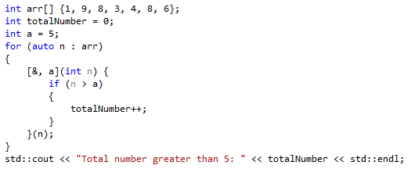
Lambdas (cont.)
Examples:

Slide 21
Smart pointers
Required header: <memory>
shared_ptr
weak_ptr
unique_ptr

Slide 22
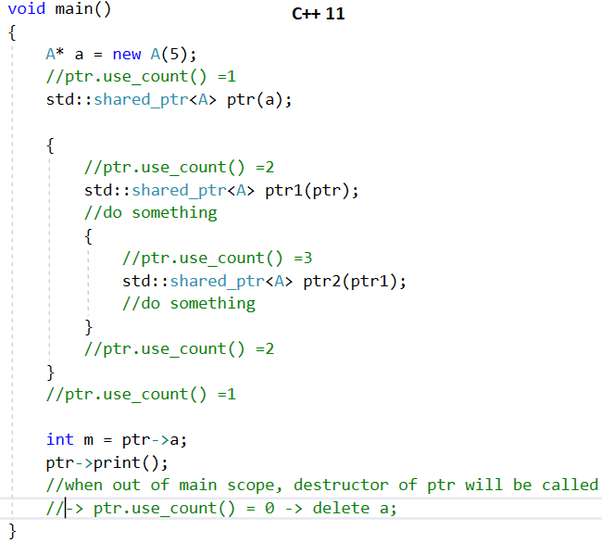
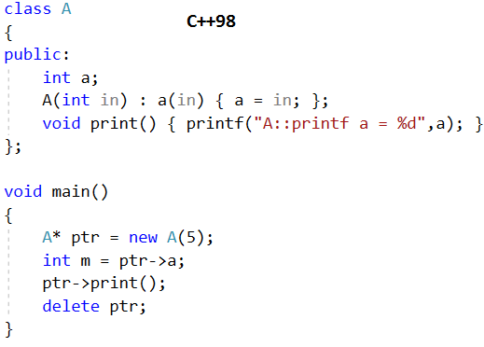
Smart pointers - shared_ptr
Represent shared ownership of some data
Is an automatic reference counter
Allows user-defined deleter
Notes:
A shared_ptr is used to represent shared ownership; that is, when two pieces of code needs access to some data but neither has exclusive ownership (in the sense of being responsible for destroying the object). A shared_ptr is a kind of counted pointer where the object pointed to is deleted when the use count goes to zero.

Slide 23

Smart pointers - shared_ptr (cont.)
Problems with arrays: shared_ptr automatic called delete instead of delete[] when releasing memory
Solution:
Use user-defined deleter
Use default_delete:
Note: Do not create shared_ptr of array type
std::unique_ptr<int[]> p(new int[10]); //OK
std::shared_ptr<int[]> p(new int[10]); //ERROR: does not compile

Slide 24


Smart pointers - shared_ptr (cont.)
Misuse of shared-ptr:
Solution:
Compile OK, but runtime error

Slide 25
Smart pointers - weak_ptr
Holds a reference to an object managed by a shared_ptr
Does not contribute to the reference count
Used to break dependency cycles

Slide 26
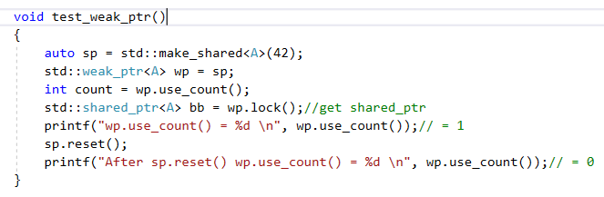
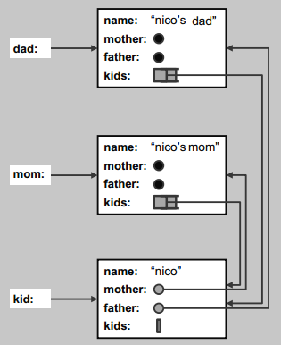
Smart pointers - weak_ptr (cont.)
Example:
Person
+ name (string) + mother (Person) + father (Person) + kids (vector<Person)

Slide 27
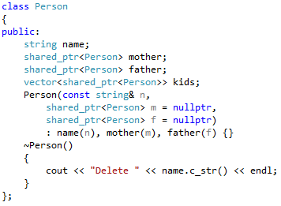
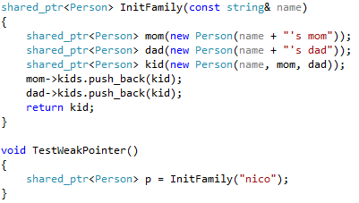
Smart pointers - weak_ptr (cont.)
Example:
p.use_count() = 3
Shared pointers never release

Slide 28
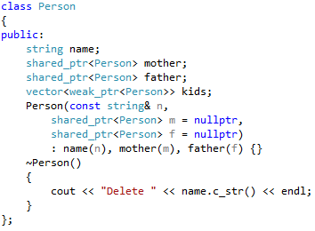
Smart pointers - weak_ptr (cont.)
Solution:
Different access:
p->mother->kids[0]->name // for shared_ptr
p->mother->kids[0].lock()->name // for weak_ptr

Slide 29
Smart pointers - unique_ptr
Provides strict ownership
Is not CopyConstructible / CopyConstructible
Is MoveConstructible / MoveAssignable
Usage:
Providing exception safety
Passing ownership to a function
Returning ownership from a function
Storing pointers in containers
Notes:
Use unique_ptr when if you want to have single ownership(Exclusive) of resource. Only one unique_ptr can point to one resource. Since there can be one unique_ptr for single resource its not possible to copy one unique_ptr to another.

Slide 30
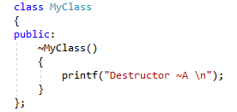
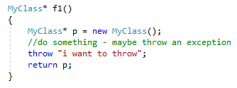
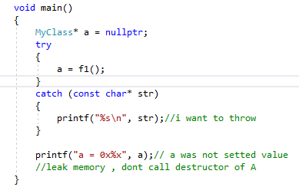
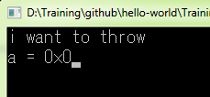
Smart pointers - unique_ptr (cont.)
Example:
Exception unsafe
Don’t run “return p; => nobody manage p => leak memory”

Slide 31
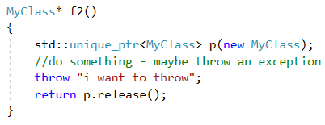
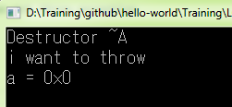
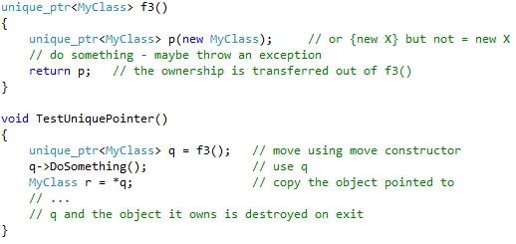
Smart pointers - unique_ptr (cont.)
Solution:
Or:

Slide 32
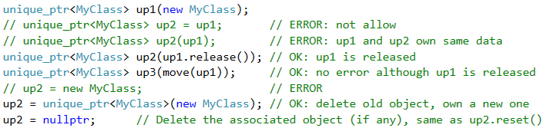
Smart pointers - unique_ptr (cont.)
Allocate and release:
Dealing with arrays:

Slide 33
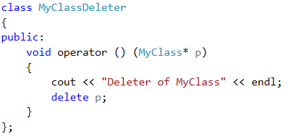
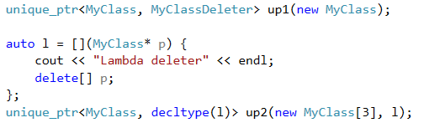
Smart pointers - unique_ptr (cont.)
Using deleter:

Slide 34
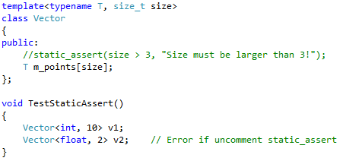
static_assert and type traits
static_assert performs an assertion check at compile-time

Slide 35
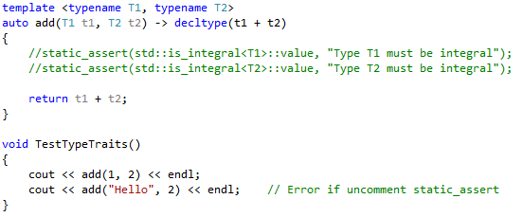
static_assert and type traits (cont.)
<type_traits> defines a series of classes to obtain type information on compile-time:
Helper classes
Type traits
Type transformations

Slide 36
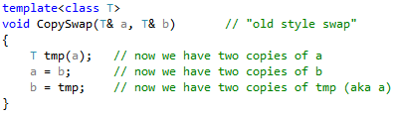
Move semantics & rvalue reference
Example:
It may be expensive to copy T
We only want to “move” the values around

Slide 37
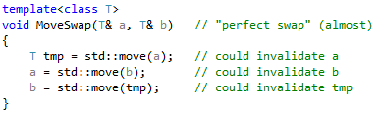
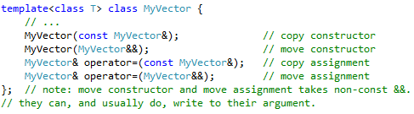
Move semantics & rvalue reference (cont.)
Solution:
“move constructors” and “move assignments”:

Slide 38
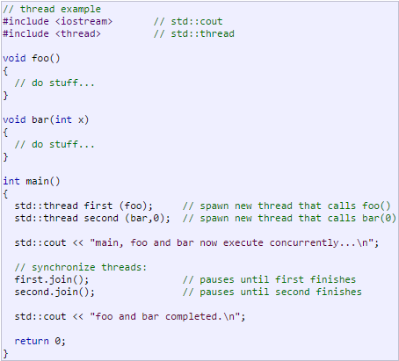
Thread
Allow multiple pieces of code to run asynchronously and simultaneously.

Slide 39
Thread - atomic
std::atomic prevents data races between threads.
Data
Thread 1
Thread 2
Write
Read

Slide 40
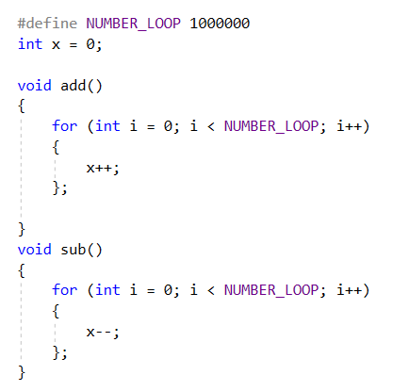
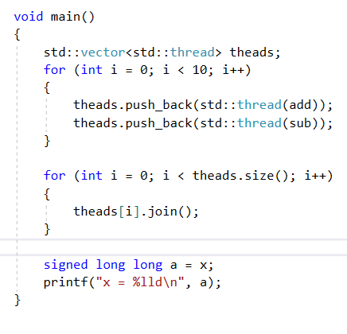

Thread - atomic (cont.)
Don’t use automic

Slide 41
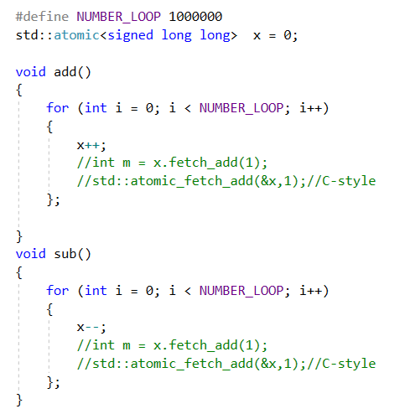
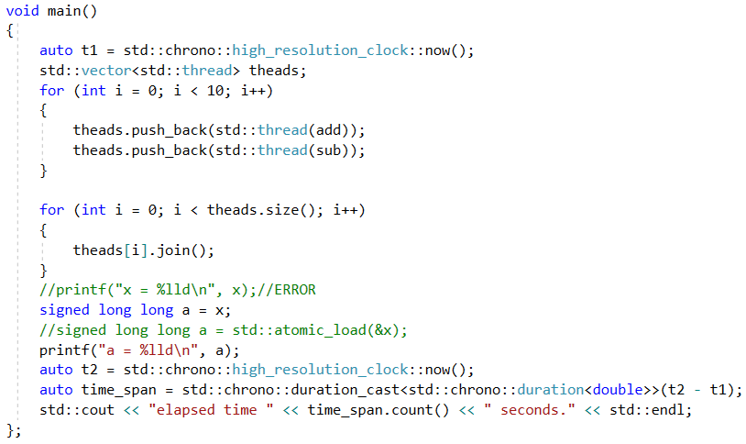

Thread - atomic (cont.)
Use automic
x = 0

Slide 42
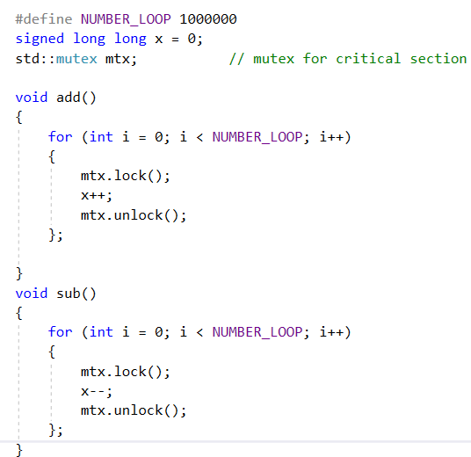
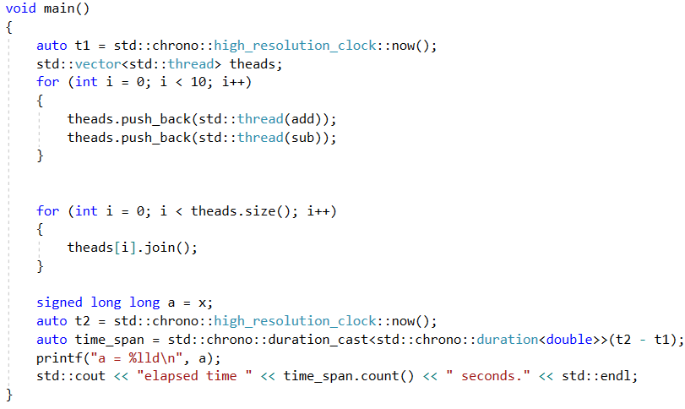

Thread - mutex
std::mutex protect shared data from being simultaneously accessed by multiple threads.
x = 0

Slide 43
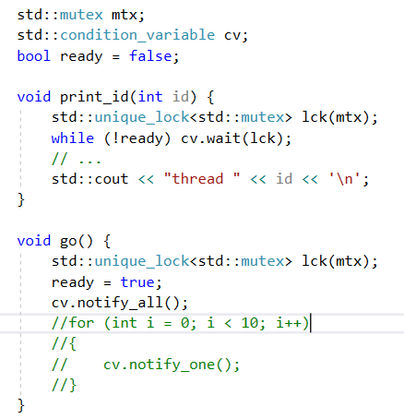
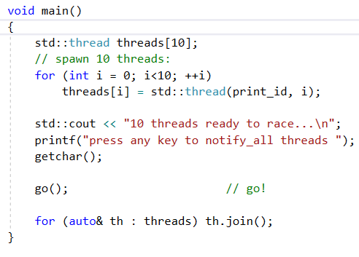
Thread- condition variable
A condition variable is an object able to block the calling thread until notified to resume.

Slide 44
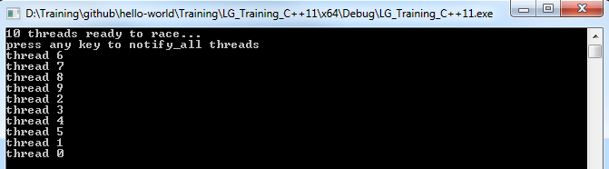
Thread- condition variable(cont.)

Slide 45
Thread – future
Many times we encounter a situation where we want a thread to return a result
Now question is how to do this?
1.) Old Way : Share data among threads using pointer
Pass a pointer to the new thread and this thread will set the data in it. Till then in main thread keep on waiting using a condition variable. When new thread sets the data and signals the condition variable, then main thread will wake up and fetch the data from that pointer. To do a simple thing we used a condition variable, a mutex and a pointer i.e. 3 items to catch a returned value. Now suppose we want this thread to return 3 different values at different point of time then problem will become more complex. Could there be a simple solution for returning the value from threads. The answer is yes using std::future, checkout next solution for it.

Slide 46
Thread – future
2.) C++11 Way : Using std::future and std::promise
std::future is a class template and its object stores the future value. Now what the hell is this future value. Actually a std::future object internally stores a value that will be assigned in future and it also provides a mechanism to access that value i.e. using get() member function. But if somebody tries to access this associated value of future through get() function before it is available, then get() function will block till value is not available. std::promise is also a class template and its object promises to set the value in future. Each std::promise object has an associated std::future object that will give the value once set by the std::promise object. A std::promise object shares data with its associated std::future object.

Slide 47
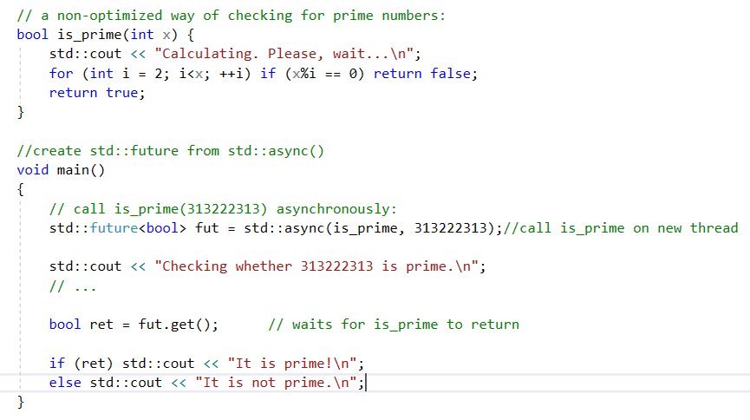
Thread – future (std::async)
A future is an object that can retrieve a value from some provider object or function, properly synchronizing this access if in different threads.

Slide 48
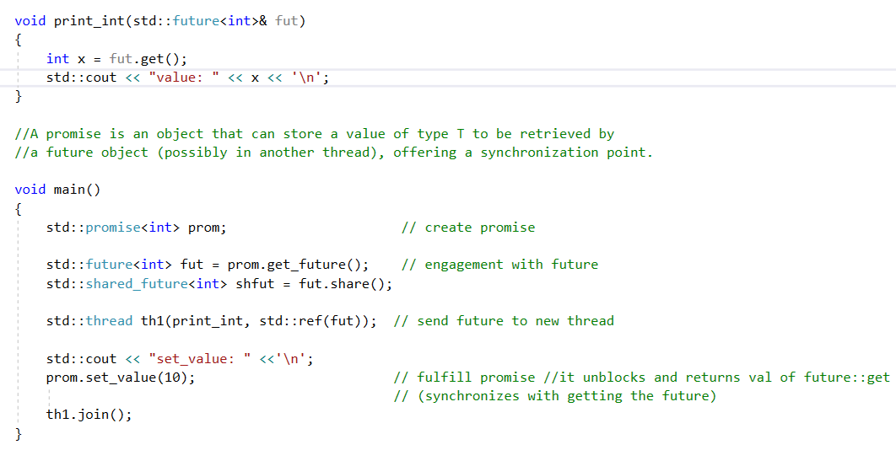
Thread – future (std::promise)

Slide 49
Reference link:
http://www.cplusplus.com/reference/clibrary/
http://www.cplusplus.com/reference/stl/
http://www.cplusplus.com/reference/multithreading/
http://www.cplusplus.com/reference/std/
https://thispointer.com/c11-multithreading-part-8-stdfuture-stdpromise-and-returning-values-from-thread/

Slide 50
Thank you

