Slide 1
Training C++ Session 1: C++14 (Created by the.vu@lge.com)
Introduce about C++ language
Brief of new features in C++ 14 in comparing with C++11
Make detail about each feature (code example)
Questions and Answers
Ha Noi, 15 Nov 2018

Slide 2
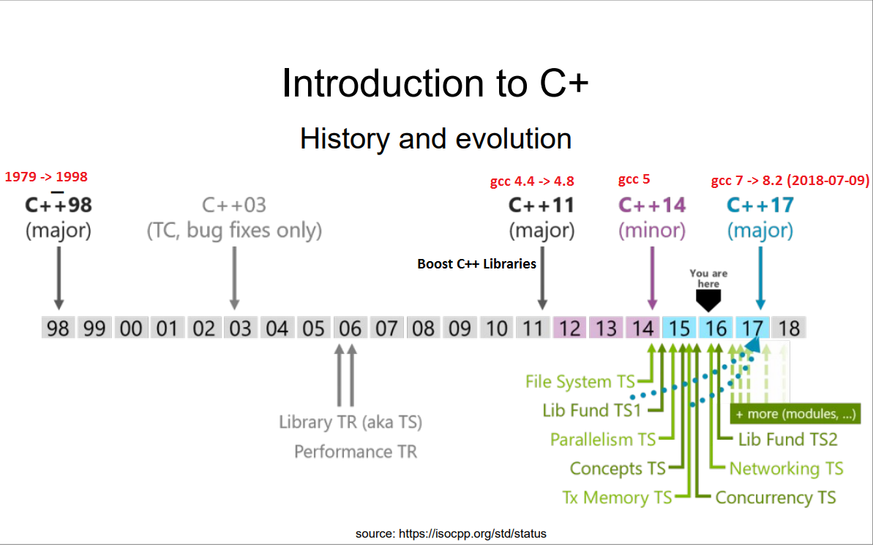
I. Introduce about C++
Notes:
https://gcc.gnu.org/projects/cxx-status.html#cxx11

Slide 3
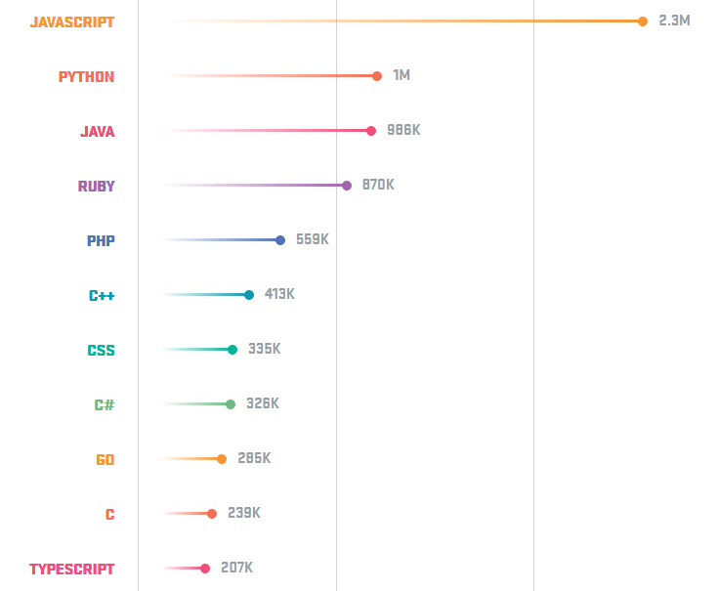
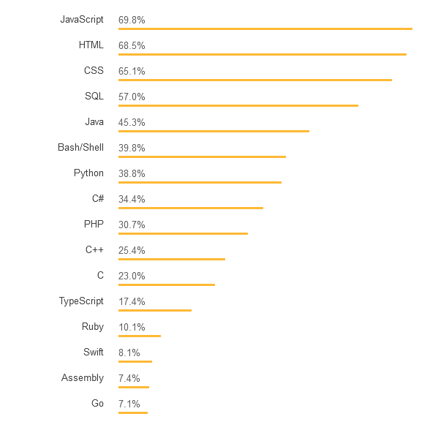
The popularity of the programming languages. (2017)
GitHub
StackOverFlow
Notes:
C++ is used for operating systems, games, embedded software, autonomous cars and medical technology, as well as many other applications. Companies like Facebook and Google use C++.
https://hackernoon.com/top-3-most-popular-programming-languages-in-2018-and-their-annual-salaries-51b4a7354e06
https://aptech.vn/kien-thuc-tin-hoc/qua-trinh-phat-trien-cua-ngon-ngu-lap-trinh.html

Slide 4
II. Brief of new features in C++ 14 in comparing with C++11
New C++ 14 syntax
binary literals
return type deduction
decltype(auto)
generic lambda expressions
lambda capture initializers
relaxing constraints on constexpr functions
variable templates
New C++ 14 feature
user-defined literals for standard library types
compile-time integer sequences
std::make_unique
Notes:
http://www.cplusplus.com/reference/clibrary/
http://www.cplusplus.com/reference/stl/
http://www.cplusplus.com/reference/iolibrary/
http://www.cplusplus.com/reference/multithreading/
http://www.cplusplus.com/reference/std/

Slide 5
III. Detail about each feature (code example)
Binary literals
binary-literal | Digit separators (This can make it easier for human readers to parse large numbers through subitizing)
int d = 42;//decimal-literal//base 10 int o = 052;//octal-literal //base 8 int x = 0x2a;//hex-literal //base 16 int X = 0X2A;//hex-literal //base 16 //binary-literal C++14 //base 2 int b = 0b101010; | int a = 1'200'300; int b = 0b1010’10; int c= 0b1010'1000'1000'1000'1000; float f = 0.123'456f;
Notes:
https://github.com/AnthonyCalandra/modern-cpp-features#binary-literals

Slide 6
Return type deduction
Using an auto return type in C++14, the compiler will attempt to deduce the type for you.
With lambdas, you can now deduce its return type using auto, which makes returning a deduced reference
or rvalue reference possible.
C++ 11 | C++14
//C++98 int f(int i) { return i; } //C++11 auto f(int i) -> decltype(i) { return i; } | //Deduce return type as `int` auto f(int i) { return i; }
template<class T, class U> auto add(T t,U u)-> decltype(t + u) { return t + u; } | template<class T, class U> auto add(T t,U u) { return t + u; }
Notes:
https://github.com/AnthonyCalandra/modern-cpp-features#return-type-deduction

Slide 7
Return type deduction (cont.)
C++11 | C++14
//C++98,C++11 template <typename T> T& f(T& t) { return t; } //C++11 can not return “auto&” in funtion and template function | template <typename T> auto& f(T& t) { return t; }
Notes:
https://github.com/AnthonyCalandra/modern-cpp-features#return-type-deduction

Slide 8
decltype(auto)
The decltype(auto) type-specifier also deduces a type like auto does.However, it deduces return types
while keeping their references and cv-qualifiers, while auto will not.
dectype(auto)
const int x = 0; auto x1 = x; // int //decltype(x) x2 = x; // const int decltype(auto) x2 = x; // const int int y = 0; int& y1 = y; auto y2 = y1; // int //decltype(y1) y3 = y1; // int& decltype(auto) y3 = y1; // int& int&& z = 5; auto z1 = std::move(z); // int //decltype(auto) z2 = std::move(z); // int&& alias of z decltype(auto) z2 = std::move(z); // int&& alias of z
Notes:
https://github.com/AnthonyCalandra/modern-cpp-features#decltypeauto

Slide 9
Generic lambda expressions
C++14 now allows the auto type-specifier in the parameter list, enabling polymorphic lambdas.
C++11
std::function<int(int,int)> lambda1 = [](int a, int b) -> int { return a + b; }; auto lambda2 = [](int a, int b) -> decltype(a+b) { return a + b; };
C++14
auto lambda3 = [](auto a, auto b) -> decltype(a+b) { return a + b; }; auto lambda4 = [](auto a, auto b) -> auto { return a + b; }; auto lambda5 = [](auto a, auto b) { return a + b; };
allows the auto type-specifier
in the parameter list

Slide 10
Generic lambda expressions (cont.)
enabling polymorphic lambdas
C++14
void main() { operator+ (int) std::cout << "lambda1 = " << lambda1(1, 3) << std::endl;//lambda1 = 4 std::cout << "lambda1 = " << lambda1(1.2, 3.1) << std::endl;//lambda2 = 4 //enabling polymorphic lambdas operator+ (int) std::cout << "lambda5 = " << lambda5(1,3) << std::endl;// lambda5 = 4 std::cout << "lambda5 = " << lambda5(1.2,3.1) << std::endl;//lambda5 = 4.3 std::string str1 = “vu”; std::string str2 = “the”; std::cout << "lambda5 = " << lambda5(str1,str2 )<< std::endl;//lambda5 = vuthe }
operator+ (double)
operator+ (string)

Slide 11
lambda capture initializers
This allows creating lambda captures initialized with arbitrary expressions. The name given to the
captured value does not need to be related to any variables in the enclosing scopes and introduces
a new name inside the lambda body. The initializing expression is evaluated when the lambda is
created (not when it is invoked).
int factory(int i) { return i * 10; }
void main()
{
auto f1 = [x = factory(2)]() { return x; };
int val1 = f1(); // returns 20
int x = 1;
auto f2 = [&r = x, x = x * 10]()
{
++r;
return r + x;
};
int val2 = f2(); // sets x to 2 and returns 12
}

Slide 12
relaxing constraints on constexpr functions
In C++11, constexpr function bodies could only contain a very limited set of syntaxes, including
(but not limited to): typedefs, usings, and a single return statement. In C++14, the set of allowable syntaxes
expands greatly to include the most common syntax such as if statements, multiple returns, loops, etc.
C++11 | C++14
//only allow single return constexpr int factorial(int n) { return (n <= 1) ? 1:n * factorial(n-1); } | //allow multiple return constexpr int factorial(int n) { if (n <= 1) { return 1; } else { return n * factorial(n - 1); } }

Slide 13
variable templates
The main purpose of the variable template is to simplify definitions and uses of parameterized constants.
C++11 | C++11
//CODE 1 #include<stdio.h> template <typename T> struct PI { static constexpr T pi = T(3.1415926535897932385); }; int main() { printf("%d\n", PI<int>::pi);//3 printf("%lf\n", PI<double>::pi);//3.141593 return 0; } | //CODE 2 #include<stdio.h> template <typename T> T PI() { constexpr T pi = T(3.1415926535897932385); return pi; } int main() { printf("%d\n", PI<int>()); //3 printf("%lf\n", PI<double>()); //3.141593 return 0; }
Notes:
https://www.ibm.com/developerworks/community/blogs/5894415f-be62-4bc0-81c5-3956e82276f3/entry/Introduction_to_Variable_Templates_of_C_14?lang=en

Slide 14
variable templates (cont.)
C++14
#include <stdio.h> template<typename T> T PI = T(3.1415926535897932385); int main() { printf("PI: %d\n", PI<int>); //PI: 2 printf("PI: %lf\n", PI<double>); //PI: 3.141593 PI<double> = 0.68; printf("PI: %lf\n", PI<double>);//PI: 0.68000 return 0; }

Slide 15
user-defined literals for standard library types
New user-defined literals for standard library types, including new built-in literals for chrono and
basic_string. These can be constexpr meaning they can be used at compile-time. Some uses for these
literals include compile-time integer parsing, binary literals, and imaginary number literals.
User-defined literals
long double operator"" _deg(long double deg) { return deg * 3.141592 / 180; } void main() { long double radian = 90.0_deg;// = 1.5707960000000001 long double radian1 = 90_deg;// ERROR compile: User defined literal not found //User-defined literals for standard library types <chrono> using namespace std::chrono_literals; auto day = 24h; day.count(); // == 24 }

Slide 16
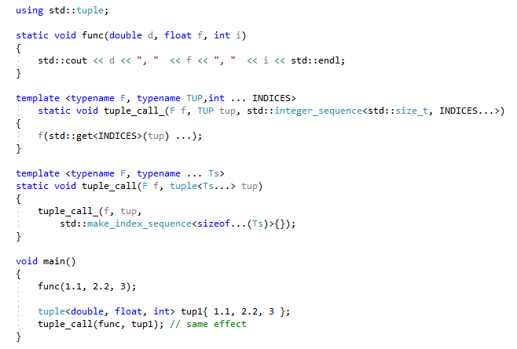
compile-time integer sequences
The class template std::integer_sequence represents a compile-time sequence of integers. There are
a few helpers built on top:
std::make_integer_sequence<T, N...> - creates a sequence of 0, ..., N - 1 with type T.
std::index_sequence_for<T...> - converts a template parameter pack into an integer sequence.

Slide 17
std::make_unique
std::make_unique is the recommended way to create instances of std::unique_ptrs due to the following
reasons:
Avoid having to use the new operator.
Prevents code repetition when specifying the underlying type the pointer shall hold.
Most importantly, it provides exception-safety. Suppose we were calling a function foo like so:
C++11 | C++14
struct Vec3 { int x, y, z; Vec3(int x, int y, int z) :x(x), y(y), z(z) { } }; std::unique_ptr<int> u1 (new int); std::unique_ptr<Vec3> u2 (new Vec3(1,2,3)); | struct Vec3 { int x, y, z; Vec3(int x, int y, int z) :x(x), y(y), z(z) { } }; std::unique_ptr<int> u1 = std::make_unique<int>(); std::unique_ptr<Vec3> u2 = std::make_unique<Vec3>(0, 1, 2);

Slide 18
Thank you

