Slide 1
Vsomeip
SOME/IP introduction
What & Why ?
Comparison
SOME/IP run over Ethernet
Ethernet automotive
Unicast
Mutilcast
Vsomeip (an implementation of the SOME/IP protocol)
SOME/IP Message Format
Service-Discovery
Request/Response/pub-sub
Vsomeip + CommonApi
RPC (Remote procedure call)
Demo & Debugging
Q&A
https://github.com/minhthedt/vsomeip-example
Presenter the.vu@lge.com, Ha Noi 2025-10-03
Notes:
Here's a comprehensive presentation structure for vsomeip:
vsomeip Presentation Outline
1. Introduction & Overview (5-7 slides)
What is vsomeip?
Open-source SOME/IP implementation
Developed by BMW Group
C++ library for automotive communication
SOME/IP Protocol Basics
Scalable service-Oriented MiddlewarE over IP
AUTOSAR standard
Service-oriented communication for automotive ECUs
2. Architecture & Components (8-10 slides)
vsomeip Stack Architecture
Application Layer
vsomeip Library
Network Layer (TCP/UDP)
Key Components:
Routing Manager
Service Discovery
Event/Notification System
Request/Response Pattern
Communication Patterns:
Client-Server
Publisher-Subscriber (Events)
Fire & Forget
3. Configuration Deep Dive (6-8 slides)
JSON Configuration Structure
Network Settings (unicast, multicast)
Service Definitions
Application Registration
Logging & Debugging Options
Service Discovery Settings
4. Service Discovery (4-5 slides)
What is Service Discovery?
Automatic vs Static Configuration
Multicast Announcements
Service Offers & Finds
When to Enable/Disable SD
5. Events & Notifications (5-6 slides)
Event-based Communication
Eventgroups & Subscriptions
Field vs Event Types
Reliable vs Unreliable Events
Multicast Event Distribution
6. Practical Examples (8-10 slides)
Hello World Service/Client
Configuration Examples
Code Snippets:
Service Implementation
Client Implementation
Event Handling
Common Patterns & Best Practices
7. Debugging & Troubleshooting (4-5 slides)
Logging Levels & Output
Network Analysis Tools
Common Issues:
Service Discovery Problems
Event Subscription Issues
Network Configuration
Wireshark Analysis
8. Advanced Topics (6-8 slides)
Security Considerations
Performance Optimization
Integration with Other AUTOSAR Components
Docker/Container Deployment
Testing Strategies
Production Deployment
9. Comparison & Alternatives (3-4 slides)
vsomeip vs Other SOME/IP Implementations
When to Use vsomeip
Integration with DDS, ROS, etc.
Pros & Cons
10. Demo & Q&A (5-10 slides)
Live Demo:
Service startup
Client connection
Event notifications
Configuration changes
Common Questions
Resources & Documentation
Practical Demo Ideas:
Basic Hello World: Show service/client communication
Event Notifications: Demonstrate publish/subscribe
Service Discovery: Enable/disable and show differences
Network Analysis: Use Wireshark to show SOME/IP packets
Configuration Impact: Change settings and show effects
Supporting Materials:
Code examples from your vsomeip-example project
Network packet captures
Configuration file templates
Troubleshooting checklists
Would you like me to elaborate on any specific section or help you create detailed content for particular slides?

Slide 2
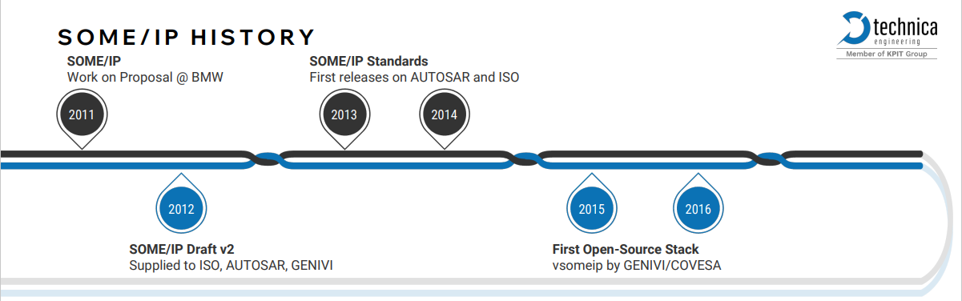
SOME/IP introduction : What ?
SOME/IP (Scalable service-Oriented Middleware over IP) is a middleware protocol designed for service-oriented communication over IP networks. (https://some-ip.com/ ). It was designed from beginning on to fit devices of different sizes and different operating systems perfectly. This includes small devices like cameras, AUTOSAR devices, and up to head units or telematics devices
SOME/IP remained as a proprietary protocol, originally developed and published by BMW Group for internal use and later shared publicly.
vsomeip is an open-source implementation of the SOME/IP protocol developed by Vector Informatik (https://github.com/COVESA/vsomeip )
Notes:
https://some-ip.com/papers/2024-AEC_Ampere_TechnicaEngineering_-_SOMEIP-next-10-years_final_v1.1a.pdf

Slide 3
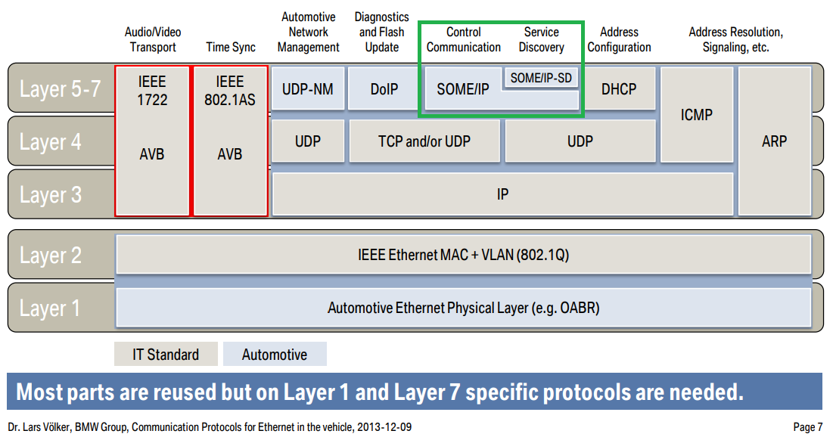
SOME/IP introduction : What ?
OSI Layer | SOME/IP Role
Layer 7 – Application | Defines the services, methods, and data structures used in communication (e.g., RPC calls, service interfaces).
Layer 6 – Presentation | Handles data encoding/decoding, serialization, and marshalling of complex data types (e.g., using CDR or custom formats).
Layer 5 – Session | Manages service discovery, session establishment, and lifecycle management of services (via SOME/IP-SD).
Notes:
https://www.iqpc.com/media/9048/29408.pdf

Slide 4
SOME/IP introduction : Why ?
ECU communication protocols in automotive
In modern automotive systems, the most commonly used CAN, LIN, Ethernet, why ?
real-time control, robust
Up to 1 Mbps
infotainment and multimedia
Up to 150 Mbps
high-bandwidth, scalable communication
in modern architectures
Up to 100 Mbps – 10Gbps
Engine Control Module (ECM)
Transmission Control Module (TCM)
Brake Control Module (ABS/ESC)
Airbag Control Unit
Body Control Module (BCM)
Steering Control Module …
Infotainment Head Unit
Audio Amplifier ECU
Rear Seat Entertainment ECU
Navigation ECU
Display Control ECU …
Diagnostic tool
ADAS ECU
Camera ECU
Radar/LiDAR ECU
Telematics ECU (OTA updates, cloud services) …
MOST
Ethernet
(BroadR-Reach)
TSN Ethernet
CAN
LIN
Flexray
Layer 1,2
SOME/IP run over Ethernet
1986
1990
2000
2010
2015
Window Lift ECU
Seat Adjustment ECU
Mirror Control ECU
Sunroof ECU …
Brake-by-Wire ECU
Steer-by-Wire ECU
Chassis Control ECU …
Autonomous driving domain controller
Sensor fusion ECU (LiDAR, radar, camera)
Brake-by-wire ECU …
low-speed, low-cost
Up to 20 Kbps
safety-critical and
time-deterministic
Up to 10 Mbps
Real-time, deterministic,
safety-critical, high-speed
SOME/IP was developed because of:
Ethernet Adoption in Automotive
Need for Service-Oriented Architecture (SOA)
Notes:
https://www.iqpc.com/media/9048/29408.pdf
list down basic ECU in automotive according protocol history: CAN, LIN, FlexRay, MOST, Enthernet, someip, TSN Ethernet
Pre-2010: Ethernet was used in diagnostics and testing tools, but not in production vehicles.
Traditional networks like CAN, LIN, and FlexRay dominated.
2011: Broadcom introduced BroadR-Reach, a 2-wire Ethernet standard tailored for automotive.

Slide 5
SOME/IP introduction : Why ?
Ethernet-Based Protocol Comparison
Protocol (layer 5~7) | Architecture | Real-Time Support | Service Discovery | Use Case
SOME/IP (a lightweight binary protocol over TCP/UDP) | Service-Oriented (SOA) RPC (Remote Procedure Call) | ⚠ Limited (via TSN) | ✅ SOME/IP-SD | ECU-to-ECU communication, AUTOSAR Adaptive, infotainment, ADAS
DDS (Data Distribution Service) | Publish-Subscribe | ✅ Strong (QoS) | ✅ Dynamic | ECU-to-ECU communication, Autonomous driving, robotics, safety-critical systems
gRPC (built on HTTP/2 + Protocol Buffers) | Service-Oriented (SOA RPC (Remote Procedure Call) | ⚠Limited | ❌ Manual or via registry | Vehicle to backend services, Cloud-native services, infotainment
MQTT (Message Queuing Telemetry Transport) | Publish-Subscribe | ❌ Weak | ❌ Broker-based | Vehicle-to-cloud telemetry, diagnostics
REST over HTTP | Request-Response | ❌ Not real-time | ❌ Manual | Vehicle to Web services, connected car platforms
Both gRPC and SOME/IP follow a Service-Oriented Architecture (SOA) model, but their design goals and environments
are quite different. gRPC is less performant and heavier for embedded ECUs, ideal for backend/cloud communication
DDS offers better real-time performance than SOME/IP, but SOME/IP is more lightweight and better suited for
AUTOSAR
Notes:
https://www.iqpc.com/media/9048/29408.pdf
list down basic ECU in automotive according protocol history: CAN, LIN, FlexRay, MOST, Enthernet, someip, TSN Ethernet
Pre-2010: Ethernet was used in diagnostics and testing tools, but not in production vehicles.
Traditional networks like CAN, LIN, and FlexRay dominated.
2011: Broadcom introduced BroadR-Reach, a 2-wire Ethernet standard tailored for automotive.

Slide 6
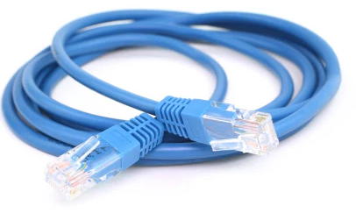
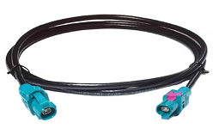
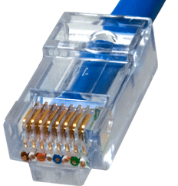
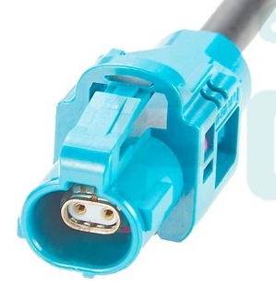
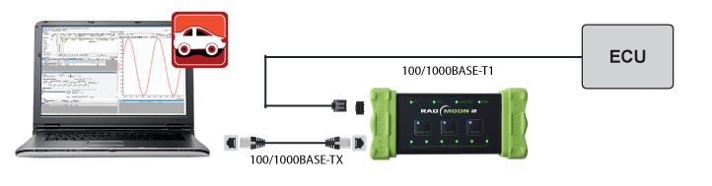
2. SOME/IP run over Ethernet
Automotive Ethernet (BroadR-Reach)
BroadR-Reach is a specialized Ethernet physical layer standard developed for automotive applications.
It was originally created by Broadcom
Feature | Traditional Ethernet | BroadR-Reach
Cable Type | Rj45(8 wires) | Single twisted pair (2 wires)
Cable Length | Up to 100 meters | Up to 15 meters (UTP), 40m (STP)
Duplex Mode | Full-duplex | Full-duplex
Weight & Cost | Heavier and more expensive | Lighter and cheaper
Convert Automotive Ethernet <-> Traditional Ethernet: Media Converter
Notes:
https://www.accuratetechnologies.com/blog/post/automotive-ethernet-vs.-regular-ethernet

Slide 7
2. SOME/IP run over Ethernet
Automotive Ethernet: Topology
Daisy chain topology (less common): is often used in cost-sensitive or space-constrained design.
Disadvantages : If one ECU or link fails → breaks the chain, harder fault isolation and timing control
ECU1
ECU2
ECU3
ECU4
Ethernet PHY
Ethernet PHY
Ethernet PHY
Ethernet PHY
Star topology (most common today): used in most current automotive Ethernet architectures
Advantages:
Simple management
Easier diagnostics (one link failure doesn’t affect others)
Supports mixed networks (Ethernet ↔ CAN, LIN, FlexRay via gateway)
Disadvantages:
Requires more cabling to the central switch
Slightly higher cost due to extra switch port count
Switch
ECU1
ECU2
ECU3
ECU4
Notes:
https://www.accuratetechnologies.com/blog/post/automotive-ethernet-vs.-regular-ethernet

Slide 8


2. SOME/IP run over Ethernet
Unicast (TCP/UDP)
192.168.1.3/24
Switch1
Send to 192.168.1.4
If PC1 wants to send the same data to PC2 and PC3,
it must send two separate packets:
PC1 → PC2 : Packet #1
PC1 → PC3 : Packet #2
PC 1
Send to 192.168.1.5
192.168.1.4/24
PC 2
➡️ This means:
2 copies of the same data are transmitted.
Bandwidth usage doubles for each additional receiver.
The sender’s CPU must process multiple send operations.
Switch2
192.168.1.5/24
PC 3
192.168.1.6/24
PC 4
Mutilcast is better for this case
Notes:
https://www.accuratetechnologies.com/blog/post/automotive-ethernet-vs.-regular-ethernet

Slide 9
2. SOME/IP run over Ethernet
Mutilcast (UDP only)
Switch 1 update multicast forwarding table
Switch1
Multicast Group | Forward to ports
224.224.224.245:30490 | Port_PC2, Port_trunk_to_Switch2
192.168.1.3/24
PC 1
192.168.1.4/24
IGMP join multicast
224.224.224.245:30490
IGMP Snooping
PC 2
Switch 2 update multicast forwarding table
Switch2
192.168.1.5/24
Multicast Group | Forward to ports
224.224.224.245:30490 | Port_PC3, Port_trunk_to_Switch1
IGMP Join multicast
224.224.224.245:30490
PC 3
192.168.1.6/24
PC 4
PC2 and PC3 join a multicast group (224.224.224.245:34090),
they will receive any data sent to that multicast IP address
— as long as the network infrastructure supports multicast forwarding.
Notes:
https://www.accuratetechnologies.com/blog/post/automotive-ethernet-vs.-regular-ethernet

Slide 10
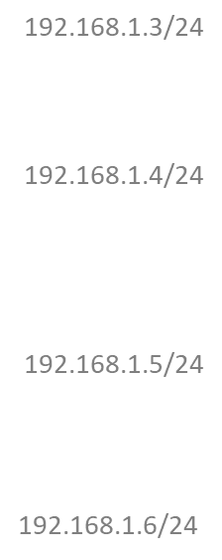

2. SOME/IP run over Ethernet
Mutilcast (UDP only)
Switch 1 update multicast forwarding table
Switch1
Multicast Group | Forward to ports
224.224.224.245:30490 | Port_PC2, Port_trunk_to_Switch2
Send to 224.224.224.245:30490
forward
forward
Switch2
Switch 2 update multicast forwarding table
forward
Multicast Group | Forward to ports
224.224.224.245:30490 | Port_PC3, Port_trunk_to_Switch1
When PC1 sends data to a multicast IP address (224.224.224.245:30490),
and PC2 and PC3 have joined that multicast group, they will receive the same data.
Notes:
https://www.accuratetechnologies.com/blog/post/automotive-ethernet-vs.-regular-ethernet

Slide 11
3. Vsomeip
Service-Oriented Architecture (SOA)
Abstraction: Service interfaces
Discoverability: Find services dynamically
…
ServiceA identifier {
service ID = 0x1234
instance ID = 0x5678
}
App ID = 0x1212
Device1(192.168.1.3/24)
vsomeip.json
Device2(192.168.1.4/24)
App1 impl
App2 impl
Ethernet
App3 impl
Service A
Service B
App4 impl
Service C
Client A
Client C
Client A
Vsomeip lib
Vsomeip lib
Vsomeip lib
Vsomeip lib
/tmp/vsomeip-1212
Local socket (UDS)
Local socket (UDS)
Mutilcast {
IP: 224.224.224.245
Port: 30490
}
Service-Discovery
(Offer/Find Service)
/tmp/vsomeip-0
RoutingManagerd impl
RoutingManagerd impl
request/response/
publish-subscribe
ServiceA endpoint{
TCP port= 30500
UDP port = 30501
}
Vsomeip lib
Vsomeip lib
ClientA don’t know Device2 (IP + TCP/UDP Port)
ClientA only know ServiceA identifier (service ID + instance ID).
Q: How client A can send data to Service A ?
The RoutingManagerd (Middleware daemon) is responsible for:
Routing service messages between applications on the same device.
Forwarding messages between devices over Ethernet.
Managing service discovery and subscription handling.
There is only one routingmanagerd per device/host.
vsomeip.json define multiple critical purposes in the vsomeip architecture (include ServiceA identifier, ServiceA endpoint)
Notes:
https://aws.amazon.com/what-is/service-oriented-architecture/
https://github.com/COVESA/vsomeip/tree/master/documentation
Local socket (UDS): https://github.com/COVESA/vsomeip/blob/master/documentation/vsomeipProtocol.md
Vsomeip.json: https://github.com/COVESA/vsomeip/blob/master/documentation/vsomeipConfiguration.md

Slide 12
3. Vsomeip
Vsomeip.json is the main configuration file used by the vsomeip runtime to define:
https://github.com/COVESA/vsomeip/blob/master/documentation/vsomeipConfiguration.md
1. Application Identity
Application name
Instance ID
Routing configuration (local or remote)
2. Service Definitions
Services offered (offer_service)
Services consumed (request_service)
Event groups and events
3. Transport Settings
TCP or UDP
Reliable vs unreliable communication
Port numbers and IP addresses
4. Service Discovery (SD)
Enable/disable SD
Repetition intervals for OfferService
TTL and re-subscription behavior
Multicast settings
5. Logging and Debugging
Log level
Console/file output
Tracing options
{
"unicast" : “192.168.1.4",
“logging” : {"level" : "debug", "console" : "true","dlt" : "false"}
"applications" :
[
{
"name" : "app3",
"id" : "0x1212"
}
],
"services" :
[
{
"service" : "0x1234", "instance" : "0x5678",
"reliable": "30500", "unreliable": "30501“,
"events" : [ { "event" : "0x8778", "is_reliable" : "false", ... }],
"eventgroups" :
[
{
"eventgroup" : "0x4465",
"multicast" : {"address" : "224.244.224.246", "port" : "30506" },
"events" : [ "0x8778" ],
"threshold" : "1"
}
]
}
],
"routing" : "routingmanagerd",
"service-discovery" :
{
"multicast" : "224.224.224.245",
"port" : "30490",
“ttl”: “3”
"cyclic_offer_delay" : "2000",
...
}
}
Notes:
https://github.com/COVESA/vsomeip/blob/master/documentation/vsomeipConfiguration.md

Slide 13
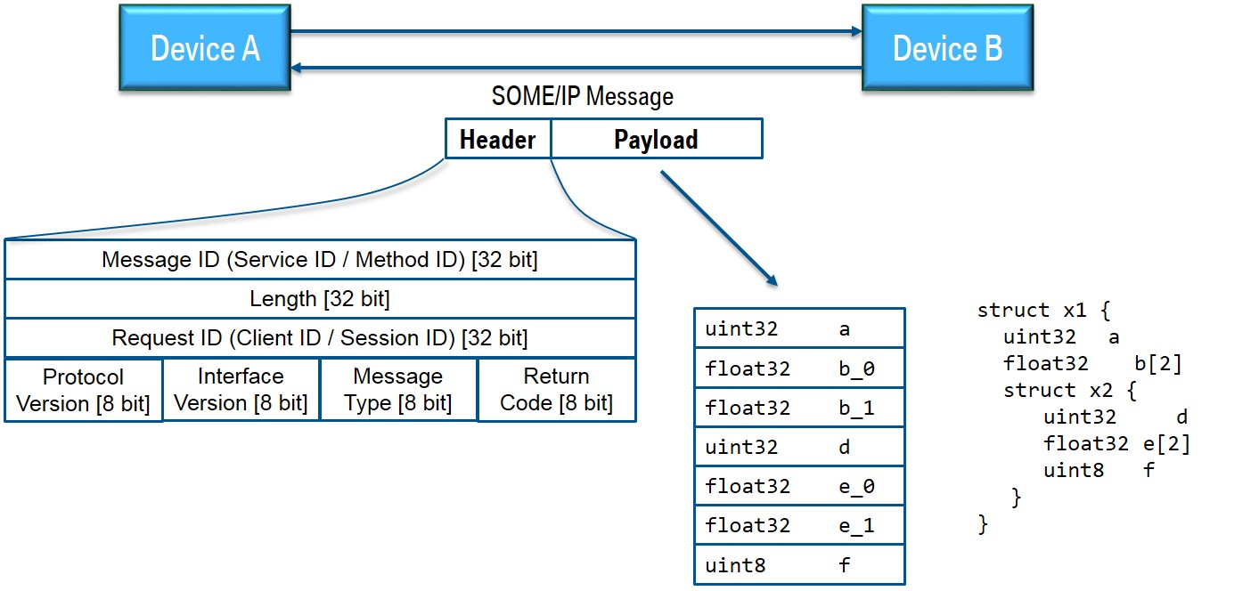
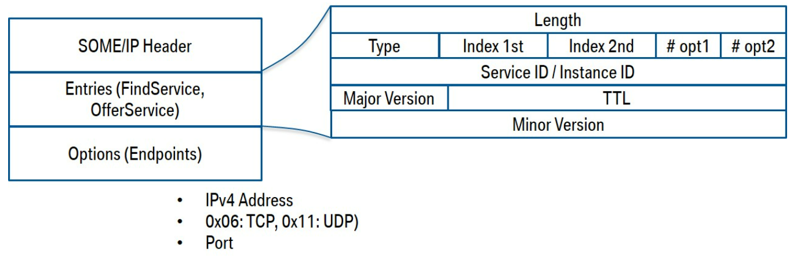
3. Vsomeip
SOME/IP Message Format
Header: includes information of who is requesting and which service is requested, and what is request
Payload: contains the serialized data.
SOME/IP Service-Discovery Message (Offer/ Find / Subscribe …)
Payload
Notes:
https://github.com/COVESA/vsomeip/wiki/vsomeip-in-10-minutes

Slide 14
3. Vsomeip
SOME/IP header
https://github.com/COVESA/vsomeip/wiki/vsomeip-in-10-minutes
Field | Description
Service ID | unique identifier for each service
Method ID | 0-32767 for methods, 32768-65535 for events
Length | length of payload in byte (covers also the next IDs, that means 8 additional bytes)
Client ID (App ID) | unique identifier for the calling client inside the ECU; has to be unique in the overall vehicle
Session ID | identifier for session handling; has to be incremented for each call
Protocol Version | 0x01
Interface Version | major version of the service interface
Message Type | REQUEST (0x00) / REQUEST_NO_RETURN (0x01) / NOTIFICATION (0x02) / RESPONSE (0x80)/ REQUEST_ACK (0x40) / NOTIFICATION_ACK (0x42 / ERROR (0x81) / RESPONSE_ACK (0xC0 / RESPONSE_ACK (0xC0) / ERROR_ACK (0xC1) / UNKNOWN (0xFF)
Return Code | E_OK (0x00) / E_NOT_OK (0x01) / E_WRONG_INTERFACE_VERSION (0x08) / E_MALFORMED_MESSAGE (0x09) E_WRONG_MESSAGE_TYPE (0x0A) / E_UNKNOWN_SERVICE (0x02) / E_UNKNOWN_METHOD (0x03) / E_UNKNOWN_METHOD (0x03) E_NOT_READY (0x04) / E_NOT_REACHABLE (0x05) / E_NOT_REACHABLE (0x05) / E_TIMEOUT (0x06) E_WRONG_PROTOCOL_VERSION (0x07) / E_UNKNOWN (0xFF)
Notes:
https://github.com/COVESA/vsomeip/wiki/vsomeip-in-10-minutes

Slide 15
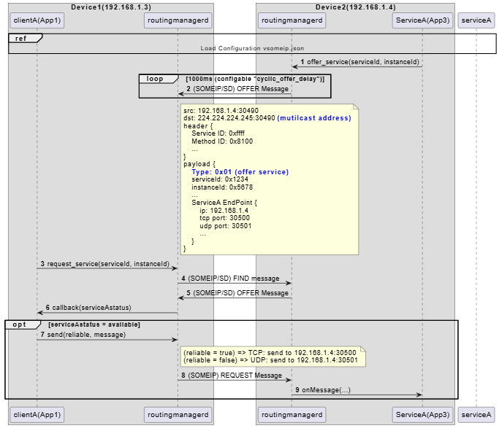
3. Vsomeip
Service-Discovery (Offer/Find Service)
src: 192.168.1.3:30490
dst: 224.224.224.245:30490 (mutilcast address)
header {
Service ID: 0xffff
Method ID: 0x8100
...
}
payload {
Type: 0x00 (find service)
serviceId: 0x1234
instanceId: 0x5678
...
}
Notes:
https://aws.amazon.com/what-is/service-oriented-architecture/
https://github.com/COVESA/vsomeip/tree/master/documentation

Slide 16
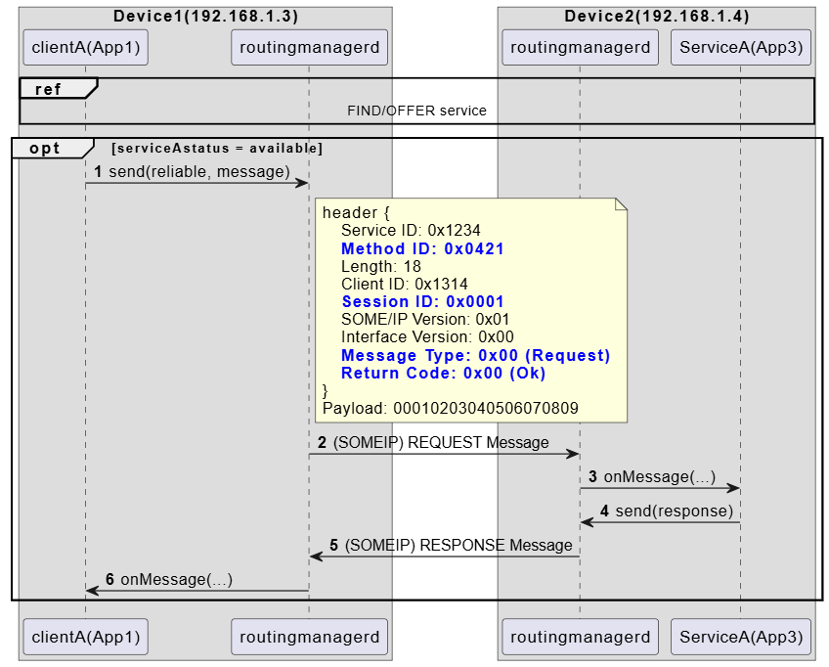
3. Vsomeip
Request/Response (unicast)
src: 192.168.1.4:30501
Dst: 192.168.1.3: xxxx
header {
Service ID: 0x1234
Method ID: 0x0421
Length: 18
Client ID: 0x1314
Session ID: 0x0001
SOME/IP Version: 0x01
Interface Version: 0x00
Message Type: 0x80 (Response)
Return Code: 0x00 (Ok)
}
Payload: 09080706050403020100
Notes:
https://aws.amazon.com/what-is/service-oriented-architecture/
https://github.com/COVESA/vsomeip/tree/master/documentation

Slide 17
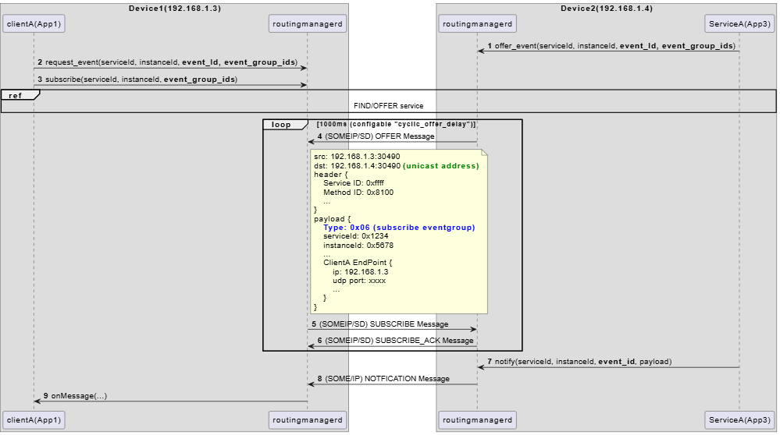
3. Vsomeip
Publish/Subscribe (mutilcast)
Why subscribe event_group_id instead of event_id ?
src: 192.168.1.3:30490
dst: 192.168.1.4:30490 (unitcast address)
header {
Service ID: 0xffff
Method ID: 0x8100
...
}
payload {
Type: 0x07 (subscribe eventgroup ack)
serviceId: 0x1234
instanceId: 0x5678
...
Endpoint {
ip: 224.224.224.246 (mutilcast)
udp port: 30506
}
}
src: 192.168.1.4:30501
dst: 224.224.224.246:30506 (mutilcast)
header {
Service ID: 0x1234
Method ID: 0x8778 (= event_id)
Length: 12
Client ID: 0x0000
Session ID: 0x0001
SOME/IP Version: 0x01
Interface Version: 0x00
Message Type: 0x02 (Notification)
Return Code: 0x00 (Ok)
}
Payload: 00010203
Notes:
https://aws.amazon.com/what-is/service-oriented-architecture/
https://github.com/COVESA/vsomeip/tree/master/documentation

Slide 18
4. Vsomeip + CommonApi
CommonAPI: A middleware abstraction layer that allows you to define services using Franca IDL
and generate client/server code automatically
RPC (Remote procedure call)
Get/Set/Notify/Field
APP implementation (proxy/stub)
CommonApi
(header files)
Core code generator
Franca IDL
*.fidl
CommonApi-core lib
Binding code generator
(SOME/IP or D-BUS)
CommonApi Binding (source files)
Franca Development
*.fdepl
CommonApi-someip lib
commonapi.ini
[default]
binding=someip
[logging]
console =true
file=./commonapi.log
dlt=true
level=verbose
Vsomeip lib
vsomeip.json
RoutingManagerd impl
Vsomeip lib
Notes:
https://aws.amazon.com/what-is/service-oriented-architecture/
https://github.com/COVESA/vsomeip/tree/master/documentation
Local socket (UDS): https://github.com/COVESA/vsomeip/blob/master/documentation/vsomeipProtocol.md
Vsomeip.json: https://github.com/COVESA/vsomeip/blob/master/documentation/vsomeipConfiguration.md

Slide 19
4. Vsomeip + CommonApi
RPC (Remote procedure call)
GET Method
Int32_t calculateSum(int32_t a, int32_t b);
ClientA
ServiceA
…
Int32_t a = 3;
Int32_t b = 4;
Int32_t sum = 0;
CommonAPI::CallInfo info(3000ms); //timeout default = 5s
myProxy->calculateSum(a, b, callStatus, sum , &info);
Printf(“sum = %d”, sum ); // sum = 7
// async call
myProxy->calculateSumAsync(a, b, callback, &info);
Payload: 0000000300000004
Payload: 00000007
Request(0x00) / response(0x80)
…
XXXStubImpl::calculateSum(
const std::shared_ptr<CommonAPI::ClientId> _client,
int32_t a, int32_t b, calculateSumReply_t _reply) {
int32_t sum = a + b;
_reply(sum );
}
Notes:
https://www.iqpc.com/media/9048/29408.pdf

Slide 20
4. Vsomeip + CommonApi
RPC (Remote procedure call)
SET Method
void setValue(int32_t x);
CommonApi-someip does not support fire&forget
Client send message with Type = 0x00(REQUEST)
instead of Type = 0x01(REQUEST_NO_RETURN)
ClientA
ServiceA
…
Int32_t x = 255;
myProxy->setValue( x, callStatus, &info);
Payload: 000000ff
…
XXXStubImpl::setValue(
const std::shared_ptr<CommonAPI::ClientId> _client,
int32_t x, setValueReply_t _reply) {
printf(“x = %d\n”, x);
_reply( ); // if comment this line => client get callstatus = REMOTE_ERROR
}
No payload
Request(0x00) / response(0x80)
Notes:
https://www.iqpc.com/media/9048/29408.pdf

Slide 21
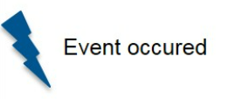
5. Vsomeip + CommonApi
RPC (Remote procedure call)
NOTIFY Method (pub-sub)
void onMyStatusChanged (int32_t myStatus);
ClientA
ServiceA
…
// subscribe
myProxy->getMyStatusEvent().subscribe(onMyStatusChanged);
Payload: 00000007
NOTIFY
…
Int myStatus = 7;
// notify
myService->fireMyStatusEvent(myStatus );
Notification (0x02)
Event – a Fire&Forget callback, that is sent out by the Server (e.g. cyclically or on change).
In SOME/IP, if Service Discovery (SD) is disabled, then notification (event communication) is not supported
in the dynamic subscription model.
Notes:
https://www.iqpc.com/media/9048/29408.pdf

Slide 22
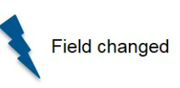
5. Vsomeip + CommonApi
RPC (Remote procedure call)
Field – represents a remote accessible property that
includes Getter/Setter and/or Notification.
Getter – Method to read field value.
Setter – Method to set field value.
Notification (sends out Events with new values on change of field value, notification is also sent immediately
when a client first registers for the attribute (initial value)).
StudentData getStudentData()
void setStudentData(StudentData v)
void onStudentDataChanged(StudentData v)
…
StudentData data;
//getter
myProxy->getStudentDataAttribute().getValue(callStatus, data, &info);
//setter
myProxy->getStudentDataAttribute().setValue(data, callStatus, data, &info);
//Subscribe
myProxy->getStudentDataAttribute().getChangedEvent().
subscribe(onStudentDataChanged)
ClientA
ServiceA
GET/SET
NOTIFY
…
StudentStruct data = xxx;
//notify
myService->setStudentDataAttribute(data);
Request(0x00) / response(0x80) / notification(0x02)
In SOME/IP, if Service Discovery (SD) is disabled, then notification (event communication) is not supported
in the dynamic subscription model.
Notes:
https://www.iqpc.com/media/9048/29408.pdf
// Difference between attribute and broadcast:
// - attribute: Represents a readable (and optionally writable) property of the interface. Clients can query its current value at any time.
// - broadcast: Represents an event notification. Clients register to receive notifications when the event occurs (e.g., state changes).
// For attribute:
// - Clients receive notification only if the attribute is defined as "observable" or "readonly observable".
// - Notification is sent when the attribute value changes.
// - Notification is also sent immediately when a client first registers for the attribute (initial value).
// - If the attribute is just "readonly" (not observable), clients must poll to get updates; no automatic notification.

Slide 23
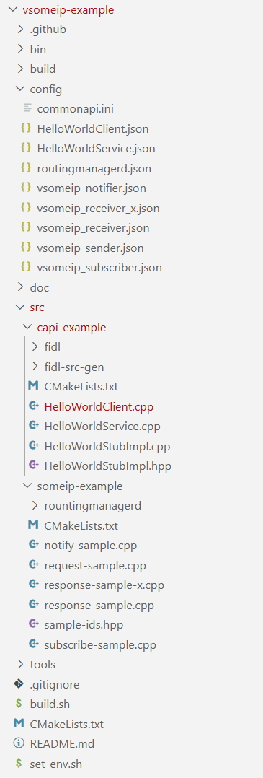
6. Demo
Download & Build example
Environment: Ubuntu 18.04 and higher
1) Download vsomeip-example
# Install essential tools
sudo apt update
sudo apt install -y openssh-server screen git
sudo apt install -y net-tools netcat socat tcpdump
# Clone example and install dependencies
git clone https://github.com/minhthedt/vsomeip-example.git
cd vsomeip-example
./set_env.sh
2) Build vsomeip-example
cd vsomeip-example
./build.sh
# Output: ./vsomeip-example/bin/...
Notes:
https://www.iqpc.com/media/9048/29408.pdf
// Difference between attribute and broadcast:
// - attribute: Represents a readable (and optionally writable) property of the interface. Clients can query its current value at any time.
// - broadcast: Represents an event notification. Clients register to receive notifications when the event occurs (e.g., state changes).
// For attribute:
// - Clients receive notification only if the attribute is defined as "observable" or "readonly observable".
// - Notification is sent when the attribute value changes.
// - Notification is also sent immediately when a client first registers for the attribute (initial value).
// - If the attribute is just "readonly" (not observable), clients must poll to get updates; no automatic notification.

Slide 24
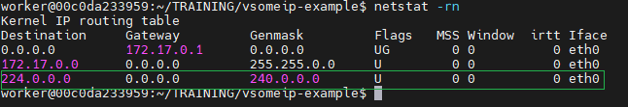
6. Demo
[Important] Make sure both PCs can send/receive multicast before testing.
# (Optional) Route all multicast traffic (224.0.0.0/4) via eth0
ifconfig
sudo ip route add 224.0.0.0/4 dev eth0
# or: sudo route add -net 224.0.0.0/4 dev eth0
# Show routing table
netstat -rn
# Sender
echo "Hello multicast" | socat - UDP4-DATAGRAM:239.0.0.1:12345
# Receiver
socat -v UDP4-RECVFROM:12345,ip-add-membership=239.0.0.1:0.0.0.0,fork -
Notes:
https://www.iqpc.com/media/9048/29408.pdf
// Difference between attribute and broadcast:
// - attribute: Represents a readable (and optionally writable) property of the interface. Clients can query its current value at any time.
// - broadcast: Represents an event notification. Clients register to receive notifications when the event occurs (e.g., state changes).
// For attribute:
// - Clients receive notification only if the attribute is defined as "observable" or "readonly observable".
// - Notification is sent when the attribute value changes.
// - Notification is also sent immediately when a client first registers for the attribute (initial value).
// - If the attribute is just "readonly" (not observable), clients must poll to get updates; no automatic notification.

Slide 25
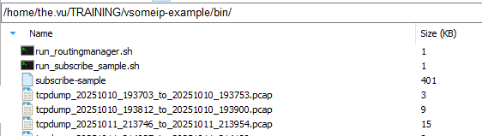
6. Demo
Run Tests
PC1 (172.17.0.6) | PC2(172.17.0.5)
Set correct IP addresses to ./vsomeip-example/config/HelloWorldClient.json | Set correct IP addresses to ./vsomeip-example/config/HelloWorldService.json
cd vsomeip-example sudo ./bin/run_HelloWorldClient.sh | cd vsomeip-example sudo ./bin/run_HelloWorldService.sh
Pcap log will be generated after press “ctrl + C” to terminate program.
Example log:
vsomeip-example/doc/FIND_OFFER.pcap
vsomeip-example/doc/REQUEST_RESPONSE.pcap
vsomeip-example/doc/ HelloWorldService.pcap
vsomeip-example/doc/ HelloWorldService_DLT_LOG.zip
Notes:
https://www.iqpc.com/media/9048/29408.pdf
// Difference between attribute and broadcast:
// - attribute: Represents a readable (and optionally writable) property of the interface. Clients can query its current value at any time.
// - broadcast: Represents an event notification. Clients register to receive notifications when the event occurs (e.g., state changes).
// For attribute:
// - Clients receive notification only if the attribute is defined as "observable" or "readonly observable".
// - Notification is sent when the attribute value changes.
// - Notification is also sent immediately when a client first registers for the attribute (initial value).
// - If the attribute is just "readonly" (not observable), clients must poll to get updates; no automatic notification.

Slide 26
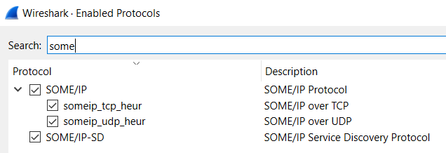
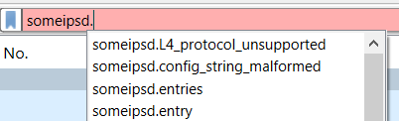
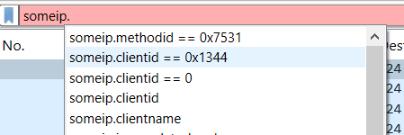
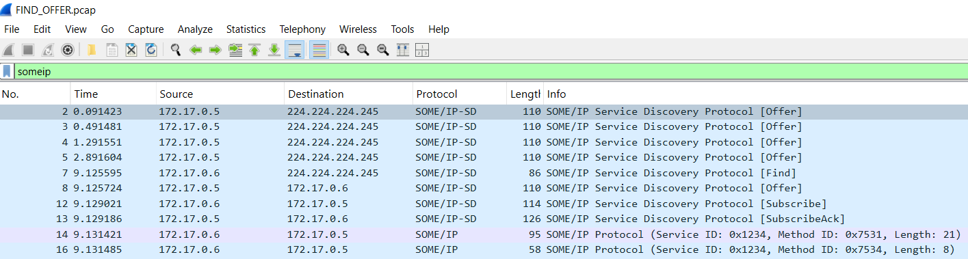
6. Demo
Analyze pcap log
Install writeshark (https://www.wireshark.org/download.html)
Open wireshark -> Analyze -> Enable protocols … -> tick box SOME/IP, SOME/IP-SD
filter
Notes:
https://www.iqpc.com/media/9048/29408.pdf
// Difference between attribute and broadcast:
// - attribute: Represents a readable (and optionally writable) property of the interface. Clients can query its current value at any time.
// - broadcast: Represents an event notification. Clients register to receive notifications when the event occurs (e.g., state changes).
// For attribute:
// - Clients receive notification only if the attribute is defined as "observable" or "readonly observable".
// - Notification is sent when the attribute value changes.
// - Notification is also sent immediately when a client first registers for the attribute (initial value).
// - If the attribute is just "readonly" (not observable), clients must poll to get updates; no automatic notification.

Slide 27
6. Demo
Analyze DLT log
ECU1 E01C TC 1631380 nw_trace ipc verbose 2 ac 11 00 05 77 33 02 01 56 78 12 34 75 32 00 00 00 10 13 13 00 02 01 00 00 00 00 00 00 03 00 00 00 04
ECU1 E01C TC 1631380 nw_trace ipc verbose 2 ac 11 00 05 77 33 02 00 56 78 12 34 75 32 00 00 00 0c 13 13 00 02 01 00 80 00 00 00 00 07
Byte(s) | Value | Meaning
ac 11 00 05 | 172.17.0.5 | IPv4 address (Docker container IP)
77 33 | 30515 | Ephemeral client port
02 | UDP | Protocol (0x02 = UDP)
01 | Sending | Direction (vsomeip is sending the message)
56 78 | 0x5678 | Instance ID (HelloWorld instance)
HelloWorldClient.json
"tracing" :
{
"enable" : "true"
},
Byte(s) | Value | Meaning
12 34 | 0x1234 | Service ID (HelloWorld service)
75 32 | 0x7532 | Method/Event ID
00 00 00 10 | 16 bytes | Length of header remainder + payload
13 13 | 0x1313 | Client ID
00 02 | 0x0002 | Session ID
01 | 1 | Protocol Version (SOME/IP v1.0)
00 | 0 | Interface Version
00 | REQUEST | Message Type (0x00 = REQUEST)
00 | E_OK | Return Code
00 00 00 00 00 00 03 00 00 00 04 | Payload | 11 bytes of data
tracing of the SOME/IP messages is enabled
-> log the internal messages that are sent over
the Unix Domain Sockets (UDS) to DLT
Notes:
https://www.iqpc.com/media/9048/29408.pdf
// Difference between attribute and broadcast:
// - attribute: Represents a readable (and optionally writable) property of the interface. Clients can query its current value at any time.
// - broadcast: Represents an event notification. Clients register to receive notifications when the event occurs (e.g., state changes).
// For attribute:
// - Clients receive notification only if the attribute is defined as "observable" or "readonly observable".
// - Notification is sent when the attribute value changes.
// - Notification is also sent immediately when a client first registers for the attribute (initial value).
// - If the attribute is just "readonly" (not observable), clients must poll to get updates; no automatic notification.

Slide 28
7. Q&A
Question | Answer
Why routingmanagerd need to send “OFFER” periodically ? "service-discovery" : { "ttl" : "3", ...} | Each OFFER includes a TTL(Time To Live) value. If clients don’t receive a new OFFER before TTL expires, they assume the service is unavailable. Periodic offers refresh the TTL, keeping the service marked as active.
Why routingmanagerd need to send “SUBSCRIBE” periodically ? | Each subscription has a Time-To-Live (TTL). If the server doesn’t receive a renewed subscription before TTL expires, it removes the client from the event group. Periodic SUBSCRIBE messages refresh the TTL, keeping the subscription alive.
If disable service-discovery, what happen ? | “notify event” is not supported Request/respon work normally if client know specific IP/port of service "services" : [ { "service" : "0x1234", "instance" : "0x5678", "unicast" : "172.17.0.5", "unreliable" : "30509",...}]
Can service notify events via both unicast/mutilcast ? | YES (demo in HelloWorldService.json)
How’s about SOME/IP security ? | https://github.com/COVESA/vsomeip/blob/master/documentation/vsomeipConfiguration.md#security
Notes:
https://www.iqpc.com/media/9048/29408.pdf
// Difference between attribute and broadcast:
// - attribute: Represents a readable (and optionally writable) property of the interface. Clients can query its current value at any time.
// - broadcast: Represents an event notification. Clients register to receive notifications when the event occurs (e.g., state changes).
// For attribute:
// - Clients receive notification only if the attribute is defined as "observable" or "readonly observable".
// - Notification is sent when the attribute value changes.
// - Notification is also sent immediately when a client first registers for the attribute (initial value).
// - If the attribute is just "readonly" (not observable), clients must poll to get updates; no automatic notification.

Slide 29
8. Reference
https://github.com/COVESA/vsomeip
https://github.com/COVESA/vsomeip/wiki/vsomeip-in-10-minutes#devices
https://github.com/COVESA/vsomeip/tree/master/documentation
https://github.com/COVESA/capicxx-someip-tools/wiki/CommonAPI-C---SomeIP-in-10-minutes
https://github.com/GENIVI/capicxx-core-tools/releases/download/3.1.12/CommonAPICppUserGuide.pdf
https://github.com/COVESA/capicxx-someip-tools/blob/master/org.genivi.commonapi.someip/src-gen/org/genivi/commonapi/someip/Deployment.java
Notes:
https://www.iqpc.com/media/9048/29408.pdf
// Difference between attribute and broadcast:
// - attribute: Represents a readable (and optionally writable) property of the interface. Clients can query its current value at any time.
// - broadcast: Represents an event notification. Clients register to receive notifications when the event occurs (e.g., state changes).
// For attribute:
// - Clients receive notification only if the attribute is defined as "observable" or "readonly observable".
// - Notification is sent when the attribute value changes.
// - Notification is also sent immediately when a client first registers for the attribute (initial value).
// - If the attribute is just "readonly" (not observable), clients must poll to get updates; no automatic notification.

