Slide 1
DRUPAL 7
DRUPAL 7
By Chien Pham
Date Created: May 7 2011

Slide 2
Drupal 7
Drupal concepts
Module Development
What is Drupal?.
Drupal’s architecture
Drupal's major subsystems
Basic structure of Module
Menu System
Block API
Form API
Theming Modules

Slide 3
Drupal 7
SUTRIX MEDIA
72/4 Truong Quoc Dung
District Phu Nhuan, Ho Chi Minh City, VN
+848 997 5901
inquiry@sutrixmedia.com

Slide 4
What is Drupal?
Content Management System (CMS)
Over 7000 free community-contributed addons, known as contrib modules
Extend Drupal's core capabilities

Slide 5
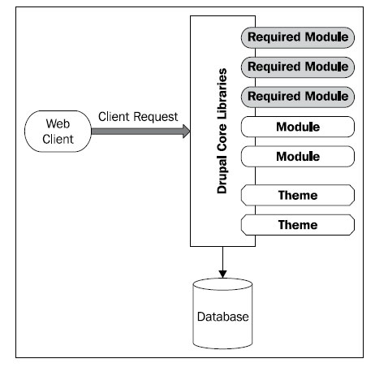
Drupal architecture
Ex: The request http://example.com/node/123
The browser contacts the web server at example.com and requests the resource at /node/123
PHP executes Drupal's index.php file, handing it the path /node/123
The Drupal core undergoes a bootstrap process, initializing resources, and then uses the menu system to find out how to handle /node/123
The node system responds to the request for /node/123 by loading the node (piece of content) with the ID 123.
The theme system takes the node information and applies formatting and style information to it, essentially transforming data into chunks of HTML with associated CSS
The Drupal core completes all processing and then returns the data to the client
The client web browser transforms the HTML and CSS into a visual presentation for the user, running any necessary JavaScript along the way
The user views the document

Slide 6
Drupal's major subsystems
Themes
  Multiple Template Engines available (Smarty, PHPTAL, LOLThem).
  Drupal uses PHP Template as the primary templating engine
  Total customization possible by using
    Css
    Writing custom template files
    Overriding template.php functions
    Writing a subtheme

Slide 7
Menus
Menus
  Menus are a collection of links (menu items) used to navigate a website.
  The Menu module provides an interface to control and customize the powerful menu system that comes with Drupal.
  Menus are primarily displayed as a hierarchical list of links
  provides APIs for generating, retrieving, and modifying elements that describe the site structure. It handles the system's navigational menus.
  Menus are hierarchical, that is, they have a tree-like structure.
  The menu system to structure our site into sections and subsections.

Slide 8
Taxonomy
Taxonomy
  a powerful core module, gives your sites use of the organizational keywords known in other systems as categories, tags, or metadata.
  terms are gathered within "vocabularies.“
  Drupal 7 is the ability to add taxonomy fields to vocabularies and terms.
  is the practice of classifying content.
  Kinds of Taxonomy
    There are several kinds of taxonomy.
    The simplest is a list of terms, and the most complex has multiple hierarchical relationships. Additionally, terms may be synonyms of or related to other terms. Let’s start with the simplest first.

Slide 9
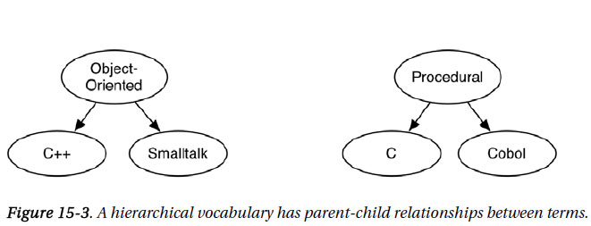
Taxonomy
  Flat
  Hierarchical
    let’s introduce the concept of hierarchy, where each term may have a relationship to another term.

Slide 10
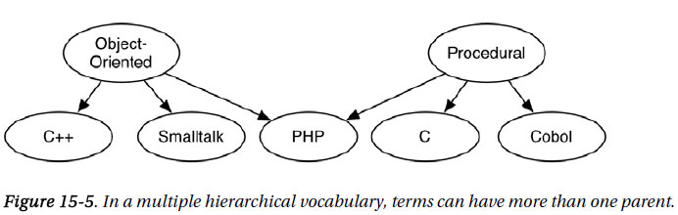
Taxonomy
  Multiple Hierarchical
    A vocabulary may have multiple hierarchies instead of a single hierarchy.
    This simply means that a term may have more than one parent.

Slide 11
Nodes
Nodes
    All content on a Drupal website is stored and treated as "nodes." A node is any posting, such as a page, poll, article, forum topic, or blog entry.
    Each item of content in your site is a node. A node has several default fields. A node can be one of a number of content types.
    You can create custom fields and define your own content types.
    In Drupal 7, much of the functionality of CCK has been integrated into Drupal core.
    There are many different kinds of nodes, or node types. Some common node types are “blog entry,” “poll,” and “forum.” Often the term content type is used as a synonym for node type.
    All nodes have the following attributes stored within the node and node_revisions database table:

Slide 12
Nodes
  nid: A unique ID for the node.
  vid: A unique revision ID for the node, needed because Drupal can store content revisions for each node. The vid is unique across all nodes and node revisions.
  type: Every node has a node type—for example, blog, story, article, image, and so on.
  language: The language for the node. Out of the box, this column is empty, indicating language-neutral nodes.
  title: A short 255-character string used as the node’s title, unless the node type declares that it does not have a title, indicated by a 0 in the has_title field of the node_type table.
  uid: The user ID of the author. By default, nodes have a single author.
  status:
    0: means unpublished.
    1: means the node is published
  created: A Unix timestamp of when the node was created.

Slide 13
Nodes
  changed: A Unix timestamp of when the node was last modified. If you’re using the node revisions system, the same value is used for the timestamp field in the node_revisions table.
  comment: An integer field describing the status of the node’s comments, with three possible values:
    0: Comments have been disabled for the current node. This is the default value for existing nodes when the comment module is disabled. In the user interface of the node editing form’s “Comment settings” section, this is referred to as Disabled.
    1: No more comments are allowed for the current node. In the user interface of the node editing form’s “Comment settings” section, this is referred to as “Read only.”
    2: Comments can be viewed, and users can create new comments. Controlling who can create comments and how comments appear visually is the responsibility of the comment module. In the user interface of the node editing form’s “Comment settings” section, this is referred to as Read/Write.

Slide 14
Nodes
  promote: An integer field to determine whether to show the node on the front page, with two values:
    1: Promoted to the front page. The node is promoted to the default front page of your site. The node will still appear at its normal page, for example, http://example.com/?q=node/3. It should be noted here that, because you can change which page is considered the front page of your site at Configuration -> Site information, “front page” can be a misnomer. It’s actually more accurate to say the http://example.com/?q=node page will contain all nodes whose promote field is 1. The URL http://example.com/?q=node is the front page by default.
    0: Node isn’t shown on http://example.com/?q=node.
  sticky: When Drupal displays a listing of nodes on a page, the default behavior is to list first those nodes marked as sticky, and then list the remaining unsticky nodes in the list by date created. In other words, sticky nodes stick to the top of node listings. A value of 1 means sticky, and a value of 0 means, well, unsticky. You can have multiple sticky nodes within the same list.
  tnid: When a node serves as the translated version of another node, the nid of the source node being translated is stored here. For example, if node 3 is in English and node 5 is the same content as node 3 but in Swedish, the tnid field of node 5 will be 3.
  translate: A value of 1 indicates that the translation needs to be updated; a value of 0 means translation is up to date.

Slide 15
Drupal's major subsystems
Forms API
  The Drupal Form API provides sophisticated form techniques and also allows for almost unlimited possibilities for custom theming, validation, and execution of forms
  Drupal's Form API is a powerful tool allowing developers to create forms and handle form submissions quickly and easily
  A robust programmatic tool for defining, displaying, validating, and submitting forms.
  Adds a layer of security.
  The Form API provides a secure framework for forms, protecting against many exploits, and the programmer has to do almost nothing to get this protection.

Slide 16
Blocks
Blocks
  Blocks are the boxes of content (such as "User Login" or "Who's online") that can be displayed in regions (such as footer or sidebar) on your page.
  Can be enabled or disabled in a specific location on site’s template.

Slide 17
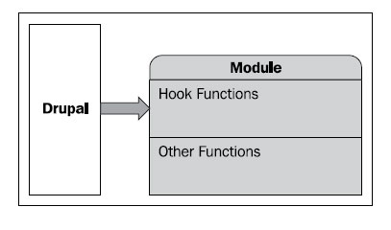
Drupal Hook
As internal Drupal events
called callbacks
tap into Drupal’s core functionality is through the implementation of hooks in modules
hook_user_login (Drupal core)
training.module (custom module)
  training_user_login

Slide 18
Drupal 7 Module Development
SUTRIX MEDIA
72/4 Truong Quoc Dung
District Phu Nhuan, Ho Chi Minh City, VN
+848 997 5901
inquiry@sutrixmedia.com

Slide 19
Code standards
Drupal’s coding conventions
  Line Indention and Whitespace
    Drupal code uses two spaces for indentation—not tabs.
    Lines should have no trailing whitespace at the end.
  Operators
    All binary operators, such as +, -, =, !=, ==, >, etc., should have a space before and after the operator.
    For example, an assignment should be formatted as c = a + b instead of c=a+b.
  Control Structures
    Control structures such as if, for, while, and switch should have one space between the control keyword and the opening parenthesis
if (condition1 || condition2) {
do something;
}
else {
just do this;
}
switch (condition) {
case 1:
action1;
break;
}
do {
actions;
} while ($condition);

Slide 20
Code standards
  Function Calls
    In function calls, there should be a single space surrounding the operator (=, <, >, etc.) and no spaces between the name of the function and the function’s opening parenthesis. There is also no space between a function’s opening parenthesis and its first parameter. Middle function parameters are separated with a comma and a space, and the last parameter has no space between it and the closing parenthesis.
  Function Declarations
    There should be no space between a function’s name and its opening parenthesis. When writing a function that uses default values for some of its parameters, list those parameters last.
Incorrect
$var=foo ($bar,$baz);
Correct
$var = foo($bar, $baz);

Slide 21
Code standards
Incorrect
function foo ($bar = 'baz', $qux){
$value = $qux + some_function($bar);
}
Correct
function foo($qux, $bar = 'baz') {
$value = $qux + some_function($bar);
return $value;
}
  Function Names
    Function names in Drupal are in lowercase and based on the name of the module or system they are part of. This convention avoids namespace collisions. Underscores are used to separate descriptive parts of the function name.
Incorrect
function some_text_munge() {
...
}
Correct
function mymodule_munge_some_text() {
...
}

Slide 22
Code standards
  PHP Code Tags
    Always use <?php ?> to delimit PHP code and not the shorthand <? ?>.
    The ?> is always omitted from the end of a code file; this includes modules and include files.
  Comments
    Drupal follows most of the Doxygen comment style guidelines. All documentation blocks must use the following syntax:
  /**
  * Documentation here.
  */
  Reference: http://drupal.org/coding-standards

Slide 23
Module Development
A Drupal site can have three kinds of modules
  Core modules that ship with Drupal and are approved by the core developers and the community.
  Contributed modules written by the Drupal community and shared under the same GNU Public License (GPL) as Drupal.
  Custom modules created by the developer of the website.
  Introduction to Drupal modules
    A Drupal module is a collection of files containing some functionality and is written in PHP.

Slide 24
Module Development
Info File
  Name (Required)
    The displayed name of your module. It should follow the Drupal capitalization standard: only the first letter of the first word is capitalized ("Example module", not "example module" or "Example Module").
  Description (Required)
    A short, preferably one line description that will tell the administrator what this module does on the module administration page. Overly long descriptions can make this page difficult to work with, so please try to be concise. This field is limited to 255 characters.
name = Training
description = Simple module for training.

Slide 25
Module Development
  core (Required)
    The version of Drupal that your module is for. For Drupal 7 this would be 7.x, etc. Note that modules cannot specify the minor version of a branch of Drupal. 6.x is correct; 6.2 is not.
  files[] (Optional)
    Drupal now supports a dynamic-loading code registry. To support it, all modules must now declare any code files containing class or interface declarations in the .info file, like so:
core = 7.x
files[] = training.module

Slide 26
Module Development
  dependencies (Optional) :
    There are a couple of extra options that may appear in the .info file, one of which are module dependencies. If a module requires another module to be enabled, list each module (filename) required in the following syntax:
  package (Optional) :
    If a module has a package string, on the admin/build/modules page it will be listed with other modules with the same category. If a package string is not assigned, it will simply be listed in the 'Other' category. Not assigning a package for your module is perfectly ok; in general packages are best used for modules that are distributed together or are meant to be used together. If in doubt, leave this field blank.
dependencies[] = taxonomy
dependencies[] = comment
package = Sutrix Media Development

Slide 27
Module Development
Creating .module files
  Name your module
    The first step in creating a module is to choose a "short name" for it. This short name will be used in all file and function names in your module, so it must start with a letter, and it must contain only lower-case letters and underscores.
    For this example, we'll choose “training" as the short name.
  Create a folder and a module file
    Given that our choice of short name is “training", start the module by creating a folder in your Drupal installation at the path:

Slide 28
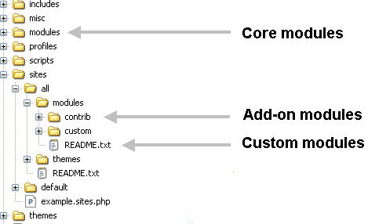
Module Development

Slide 29
Module Development
http://drupal.org/project/examples
<?php
// $Id$
/**
* @file
* A module exemplifying Drupal coding practices and APIs.
*
* This module provides a block that lists all of the
* installed modules. It illustrates coding standards,
* practices, and API use for Drupal 7.
*/
/**
* Implements hook_help().
*/
function newmodule_help($path, $arg) {
if ($path == 'admin/help#newmodule') {
return t('A demonstration module.');
}
}

Slide 30
The Drupal menu system
The Drupal menu system
  Responsible for the navigation site.
  mapping Drupal paths to the functions.
  controlling access to Drupal pages
Defining a page callback with hook_menu
/**
* Implement hook_menu().
*/
function user_warn_menu() {
  $items = array();
  $items['admin/config/people/user_warn'] = array(
    'title' => 'User Warn',
    'description' => 'Configuration for the User Warn module.',
    'page callback' => 'drupal_get_form',
    'page arguments' => array('user_warn_form'),
    'access arguments' => array('administer users'),
    'type' => MENU_NORMAL_ITEM,
  );
  return $items;
}

Slide 31
The Drupal menu system
title: A required field that represents the untranslated title of the menu item
Description: The untranslated description of the menu item
page callback: The function to call to display a web page when the user visits the path
page arguments: An array of arguments to pass to the page callback function; integer values pass the corresponding URL component.
access callback: A function returning a Boolean value that determines whether the user has access rights to this menu item; this defaults to user_access() unless a value is inherited from a parent menu item.
access arguments: An array of arguments to pass to the access callback function; integer values pass the corresponding URL component.
file: A file that will be included before the callbacks are accessed; this allows callback functions to be in separate files. The file should be relative to the implementing module’s directory, unless otherwise specified by the “file path” option.

Slide 32
The Drupal menu system
weight: An integer that determines the relative position of items in the menu; higherweighted items sink. Defaults to 0. When in doubt, leave this alone; the default alphabetical order is usually the best.
type: A bitmask of flags describing properties of the menu item; values to be used are:
  MENU_NORMAL_ITEM: Normal menu items show up in the menu tree and can be moved/hidden by the administrator.
  MENU_CALLBACK: Callbacks simply register a path so that the correct function is fired when the URL is accessed.
  MENU_SUGGESTED_ITEM: Modules may “suggest” menu items that the administrator may enable.
  MENU_LOCAL_TASK: Local tasks are rendered as tabs by default.
  MENU_DEFAULT_LOCAL_TASK: Every set of local tasks should provide one “default” task, which links to the same path as its parent when clicked.

Slide 33
The Drupal menu system
Using wildcards in menu paths
  Drupal often uses paths like user/4/track or node/15/edit, where part of the path is dynamic
  The % character is a wildcard character in Drupal menu items
    The Drupal paths menufun/hi, menufun/foo/bar,
    menufun/123, and menufun/file.html
    The wildcard menufun/% will match only a
    string with two parts.
function menufun_menu() {
  $items['menufun/%'] = array(
    'title' => 'Hi',
    'page callback' => 'menufun_hello',
    'page arguments' => array(1),
    'access callback' => TRUE,
  );
  return $items;
}

Slide 34
Block API
Create Drupal Blocks
  Using PHP code and Drupal API
  hook_block_info(): This is used to tell Drupal about the new block or blocks that we will declare
  hook_block_view(): This tells Drupal what to do when a block is requested for viewing
  Example :
/**
* Implements hook_block_info().
*/
function sm_hello_block_info() {
$blocks = array();
$blocks[sm_hello'] = array(
'info' => t(.'),
'cache' => DRUPAL_NO_CACHE,
);
return $blocks;
}

Slide 35
Block API
/**
* Implements hook_block_view().
*
* Prepares the contents of the block.
*/
function sm_hello_block_view($block_name = '') {
if ($block_name == 'sm_hello') {
$list = module_list();
$theme_args = array('items' => $list, 'type' => 'ol');
$content = theme('item_list', $theme_args);
$block = array(
'subject' => t('Enabled Modules'),
'content' => $content,
);
return $block;
}
}

Slide 36
Form API
/**
* Form builder; Create and display the User Warn configuration
* settings form.
*/
function user_warn_form($form, &$form_state) {
  // Text field for the e-mail subject.
  $form['user_warn_e-mail_subject'] = array(
    '#type' => 'textfield',
    '#title' => t('Warning e-mail subject'),
    '#description' => t('The subject of the e-mail which will be sent
    to users.'),
    '#size' => 40,
    '#maxlength' => 120,
    '#required' => TRUE,
  );
  // Submit button
  $form['submit'] = array(
    '#type' => 'submit',
    '#value' => t('Save settings'),
  );
  return $form;
}
Using drupal_get_form()
  returns a structured array that
  represents an HTML form
  gets rendered by Drupal and
  presented as an HTML form
Building a form callback
Function
Form API Quickstart guide:
  http://api.drupal.org/api/drupal/
  developer--topics--forms_api.html/7

Slide 37
Form API
Form submission process
  Drupal looks for two specifically named functions—a validate function and a submit function
  form ID and appending either _validate() or _submit()
  $form is the original Form API array for the submitted form.
  $form_state is an associative array containing information specific to this submission.
  $form_state['values']

Slide 38

Form API
/**
* Save configuration settings for User Warn module.
*/
function user_warn_form_submit($form, &$form_state) {
  variable_set('user_warn_e-mail_subject',
  $form_state['values']['user_warn_e-mail_subject']);
  variable_set('user_warn_e-mail_text',
  $form_state['values']['user_warn_e-mail_text']);
  variable_set('user_warn_bcc',
  $form_state['values']['user_warn_bcc']);
  drupal_set_message(t('The settings have been saved'));
}

Slide 39
Theming Module
hook_theme() overview : Register a module (or theme's) theme implementations.
hook_theme($existing, $type, $theme, $path)
Parameters
  $existing :An array of existing implementations that may be used for override purposes. This is primarily useful for themes that may wish to examine existing implementations to extract data (such as arguments) so that it may properly register its own, higher priority implementations.
  $type : What 'type' is being processed. This is primarily useful so that themes tell if they are the actual theme being called or a parent theme. May be one of:
    module: A module is being checked for theme implementations.
    base_theme_engine: A theme engine is being checked for a theme which is a parent of the actual theme being used.
    theme_engine: A theme engine is being checked for the actual theme being used.
    base_theme: A base theme is being checked for theme implementations.
    theme: The actual theme in use is being checked.
  $theme : The actual name of theme that is being being checked (mostly only useful for theme engine).
  $path : The directory path of the theme or module, so that it doesn't need to be looked up.
Return value
  A keyed array of theme hooks.

Slide 40
Theming Module
Work Flow to theming module :
  Registering a Theme : To register the module's default theme, we need to implement the theme registration hook (hook_theme()), following the naming convention _theme(), where is the name of the module:
  Creating a Theme Hook Function
/**
* Implementation of hook_theme().
*/
function newmodule_function_theme() {
return array(
'theme_function_name' => configuration_array(),
);
}
**
* Theme function for theming quotes.
* @param $text
* The quote content as a string.
* @param $origin
* The original source of the quote, as a string.
* @return
* An HTML themed string.
*/
function theme_ theme_function_name() {
return $output;
}

Slide 41
Theming Module
Overriding the Default Theme from a Theme :
  Overriding the Default Theme's CSS :
  drupal_add_css($path = NULL, $type = 'module', $media = 'all', $preprocess = TRUE)
  Parameters
    $path (optional) The path to the CSS file relative to the base_path(), e.g., /modules/devel/devel.css.
    $type (optional) The type of stylesheet that is being added. Types are: module or theme.
    $media (optional) The media type for the stylesheet, e.g., all, print, screen.
    $preprocess (optional) Should this CSS file be aggregated and compressed if this feature has been turned on under the performance section?
  Return value
    An array of CSS files.
  Include path
  drupal_get_path($type, $name)
  Parameters
    $type The type of the item (i.e. theme, theme_engine, module).
    $name The name of the item for which the path is requested.
  Return value
    The path to the requested item.

Slide 42
Theming Module
Example :
Overriding Layout with Templates
More info at Drupal API :
  http://api.drupal.org
function theme_newmodule_function ($param1, $param2) {
$module_path = drupal_get_path('module', 'philquotes');
$full_path = $module_path .'/philquotes.css';
drupal_add_css($full_path);
$output = '<div id=“newmodule-param1">'. t($param1)
.'</div><div id=“newmodule-param2">' . t($param2) . '</div>';
return $output;
}

Slide 43
QUESTIONS
QUESTIONS

