Slide 1

Cross-Battery State-of-Health Estimation
under Randomized Loading
Leakage-safe evaluation · uncertainty · EOL behavior · model interpretation
Thu Dang
Supervisor: Lê Võ Minh Thư
ADY201m · FPT University Ho Chi Minh City · 2026
GROUP 7

Slide 2
Outline
Three parts, one storyline: problem → evidence → reliable modeling.
PART 1
PART 2
PART 3
Understanding the Problem & Data
Research questions
Problem & gap
Data understanding
Six SQL tasks
Python Analysis & Visualization
Degradation trajectory
Cross-cell heterogeneity
Exposure-controlled evidence
Modeling, Reliability & Reflection
Five-model comparison
Uncertainty & EOL
XAI / ablation
Tool & reflection
Core question: Can SOH be estimated credibly for a completely unseen RW battery?

Slide 3
PART 1
Understanding the Problem & Data
Research Questions
Problem Statement
Data Understanding
SQL Queries

Slide 4
Research Questions
Three questions drive the analysis and the final presentation.
RQ1 · Degradation
RQ2 · Generalization
RQ3 · Reliability
How does cumulative usage relate to SOH?
Do recent 50-step load summaries add residual information after cumulative exposure is controlled?
Which regression family performs best on completely unseen battery cells under repeated cell-disjoint evaluation?
How reliable is the selected model near EOL?
Which inputs matter most, and what is the compute trade-off?
Presentation rule: answer RQ1 → RQ2 → RQ3 in the same order.

Slide 5
Problem Statement
The evaluation must match the real deployment question: unseen batteries.
UNSEEN CELL
WHOLE-CELL
MACRO-CELL MAE
Target deployment setting
Train / calibration / test split
Equal weight per held-out battery
Why row-wise splitting is risky
Project objective
Neighboring rows from the same cell share degradation history and often the same next-reference SOH. Mixing them across train and test can make transfer look easier than it is.
Estimate next-reference SOH, compare five models on unseen cells, then evaluate uncertainty, EOL behavior, model dependence, and computational cost.
Key design choice: separate complete battery cells before any final scoring.

Slide 6
Research Gap
The contribution is an integrated evaluation design—not a claim that prior methods are inferior.
Study
Unseen
Random
Unc.
EOL
XAI
Repeated
Cost
Bole et al.
–
✓
–
–
–
–
–
Richardson et al.
△
–
✓
–
–
–
–
Yang et al.
△
△
–
–
–
–
–
Chen et al.
✓
–
–
–
–
–
–
Ma et al.
✓
–
–
–
–
–
–
Mondal et al.
✓
–
–
–
–
△
–
Our work
✓
✓
✓
✓
✓
✓
✓
Gap addressed: randomized use + unseen-cell evaluation + uncertainty + EOL + interpretation + repeated splits + cost.

Slide 7
Data Understanding
From raw NASA RW records to the final supervised SOH modeling table.
28
1,117,894
947
548,010
cells · RW1–RW28
raw records
valid reference discharges
final rows with 50-step history
Target
Inputs
EOL & scope
Next valid reference capacity ÷ that cell’s initial valid reference capacity = SOH.
14 model inputs: instantaneous electrical / thermal features, cumulative Ah, 50-step summaries, and 2 temperature-missingness indicators.
EOL threshold: SOH ≤ 0.80.
Evidence comes from controlled NASA experiments; external operational validation is still needed.
50-step history = current operational step + previous 49 steps within the same cell.

Slide 8
Target Alignment & Data Quality
Most row reduction comes from honest temporal alignment—not aggressive cleaning.
1,117,894
554,522
549,382
548,010
14
→
→
→
→
Raw records
Operational C/D
Next-ref SOH
50-step history
Final inputs
Missing SOH
Invalid SOH
History ≠ 50
0
0
0
Negative duration
Negative Ah
Temp sentinels
0
0
13,239 missing
Leakage guard: predictors use current/past operational information; the future reference check is used only as the label.

Slide 9
EDA · What Matters Before Modeling
Strong degradation structure exists, but cross-cell heterogeneity changes how evaluation should be done.
−0.9961
2.93×
0.331–0.989
Median cell-wise Spearman · cumulative Ah vs SOH
Fastest vs slowest degradation-rate spread
SOH range after full history
Plateaus matter
Exposure dominates
Cells differ
Neighboring operational rows can share the same next-reference SOH → row-wise splits can leak highly related observations.
Cumulative Ah rises while SOH generally falls. It is the strongest degradation coordinate in the data.
A single pooled error can hide transfer difficulty. Primary scoring should balance held-out batteries.
EDA motivates the protocol: cell-disjoint splits + macro-cell metrics.

Slide 10
SQL Queries · Overview
Six distinct SQL tasks satisfy the 2-student × 3 requirement and support the research questions.
Q1 · SOH by cumulative-throughput bin
Q2 · Load severity by health state
GROUP BY · HAVING
CASE · aggregation
Q3 · Leakage-safe 50-step history
Q4 · Final feature-table checks
window functions
CASE · SUM
Q5 · Cross-cell degradation slope
Q6 · EOL prevalence across cells
CTE · REGR_SLOPE
CTE · conditional aggregation
Main deck shows the SQL idea + result; full query code stays in the notebook for Q&A.

Slide 11
SQL Q1 · SOH vs Cumulative Throughput
Use readable bins to summarize the degradation pattern; the bins are descriptive, not the training target.
SQL idea
0.979
0.813
FLOOR(cum_ah / 100) → Ah bin
GROUP BY cell, ah_bin
HAVING COUNT(*) ≥ 20
Output: 499 bins across 28 cells
RW1 mean SOH · 0–99 Ah
RW1 mean SOH · ~1,000 Ah
0.616
RW1 mean SOH · ~1,800 Ah
Q1 takeaway: SOH generally decreases as accumulated operational throughput increases.

Slide 12
SQL Q2 · Load Severity by Health State
Compare healthy, aged, and EOL rows descriptively—without causal interpretation.
SQL idea
CASE
healthy: SOH > 0.90
aged: 0.80 < SOH ≤ 0.90
EOL: SOH ≤ 0.80
Then aggregate count, current, temperature, duration, step Ah, and cumulative Ah.
State
Rows
|I|
Tmax
Cum. Ah
Healthy
119,080
2.477 A
37.51 °C
255 Ah
Aged
130,969
2.506 A
36.16 °C
762 Ah
EOL
299,333
2.411 A
30.78 °C
1,999 Ah
Interpretation: EOL rows occur much later in cumulative exposure; current/temperature differences remain descriptive only.

Slide 13
SQL Q3 · 50-Step History Features
The rolling window is cell-local and backward-looking, so it does not use future information.
Core window logic
548,010
28
AVG(ABS(i_mean)) OVER (
PARTITION BY cell
ORDER BY step
ROWS BETWEEN 49 PRECEDING
AND CURRENT ROW
)
Same pattern → t_max50, ah50, temp_valid_n50.
rows retained
cells kept intact
50 steps
current + previous 49
Why it is safe: every rolling statistic uses only current and preceding rows within the same cell.

Slide 14
SQL Q4 · Final Quality Check
Validate the exact feature table used by every downstream model.
Checks in one query
548,010
28
COUNT(*) · COUNT(DISTINCT cell)
Missing / invalid SOH
History length ≠ 50
Negative duration
Negative Ah
Temperature sentinels are intentionally kept missing and handled separately.
Rows
Cells
0
0
Missing SOH
Invalid SOH
0
0 / 0
Invalid history
Negative duration / Ah
Result: all structural / target checks pass before modeling.

Slide 15
SQL Q5 · Cross-Cell Degradation Slope
A per-cell regression slope quantifies how differently batteries age with cumulative Ah.
SQL idea
−0.03808
−0.02034
WITH per_cell AS (...)
100 × REGR_SLOPE(soh, cum_ah)
GROUP BY cell
Then summarize MIN / MEDIAN / MAX and fastest-to-slowest ratio.
Fastest decline / 100 Ah
Median decline / 100 Ah
−0.01299
2.93×
Slowest decline / 100 Ah
Fastest / slowest spread
Q5 takeaway: degradation pace differs materially across cells → pooled row-weighted error can be misleading.

Slide 16
SQL Q6 · EOL Prevalence Across Cells
Establish how much of the dataset reaches the operational retirement region before evaluating a model.
SQL idea
25 / 28
299,333
Per cell:
COUNT(*)
SUM(CASE WHEN SOH ≤ 0.80 THEN 1 ELSE 0 END)
Then aggregate cells reaching EOL, total EOL rows, and EOL row share.
cells reaching EOL
aligned EOL rows
54.49%
EOL row share
Why it matters: EOL is common, but not universal → report misses / false alarms in addition to global MAE.

Slide 17
RQ1 Evidence · Statistical Handoff
SQL establishes structure; Python adds rank-based and exposure-controlled evidence.
−0.9961
p < 0.001
−0.038…−0.013
Median Spearman · cumulative Ah vs SOH
One-sided cross-cell Wilcoxon
Cell-wise slope range / 100 Ah
Recent-load association shrinks after controlling cumulative Ah
RQ1 answer
Feature
Raw ρ
Partial ρ
Accumulated throughput dominates the monotonic degradation signal. Recent 50-step summaries retain only weak residual monotonic association after exposure is controlled.
Association ≠ causation.
ah50
+0.431
−0.066
i_ma50
+0.416
+0.122
t_max50
+0.159
+0.029

Slide 18
PART 2
Python Analysis & Visualization
Analysis Workflow
Degradation Trajectory
Cross-Cell Heterogeneity
Evidence-Based Insights

Slide 19
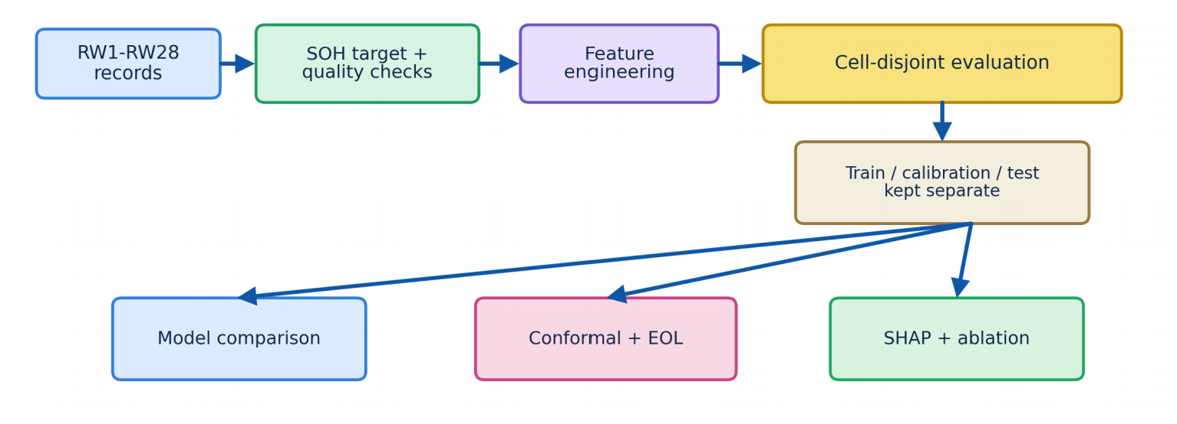
Analysis Workflow
A leakage-safe chain from target construction to accuracy, uncertainty, and interpretation.
Test evidence never feeds back into fitting: train / calibration / test cells remain separate.

Slide 20
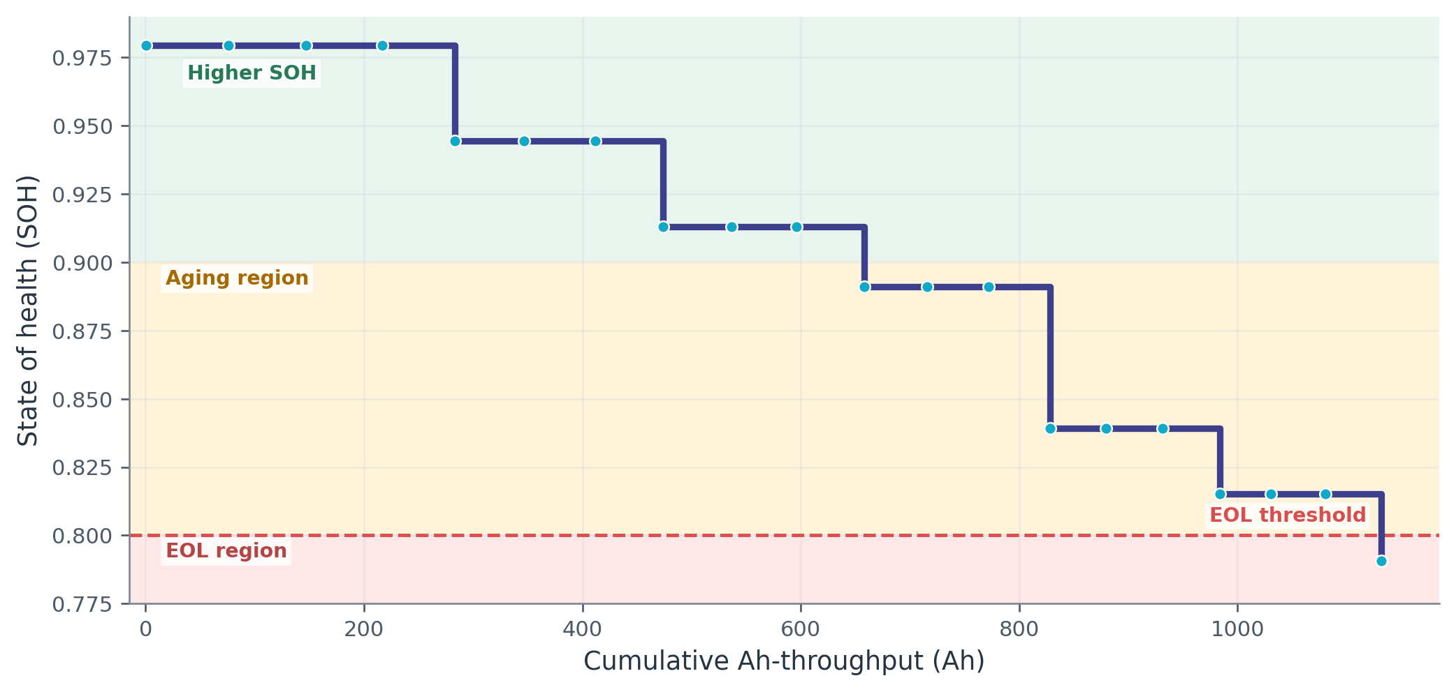
RW10 Degradation Trajectory
SOH changes at reference checks while cumulative operational exposure continues to increase.
Plateaus explain the leakage risk: neighboring rows can share the same future reference SOH.

Slide 21
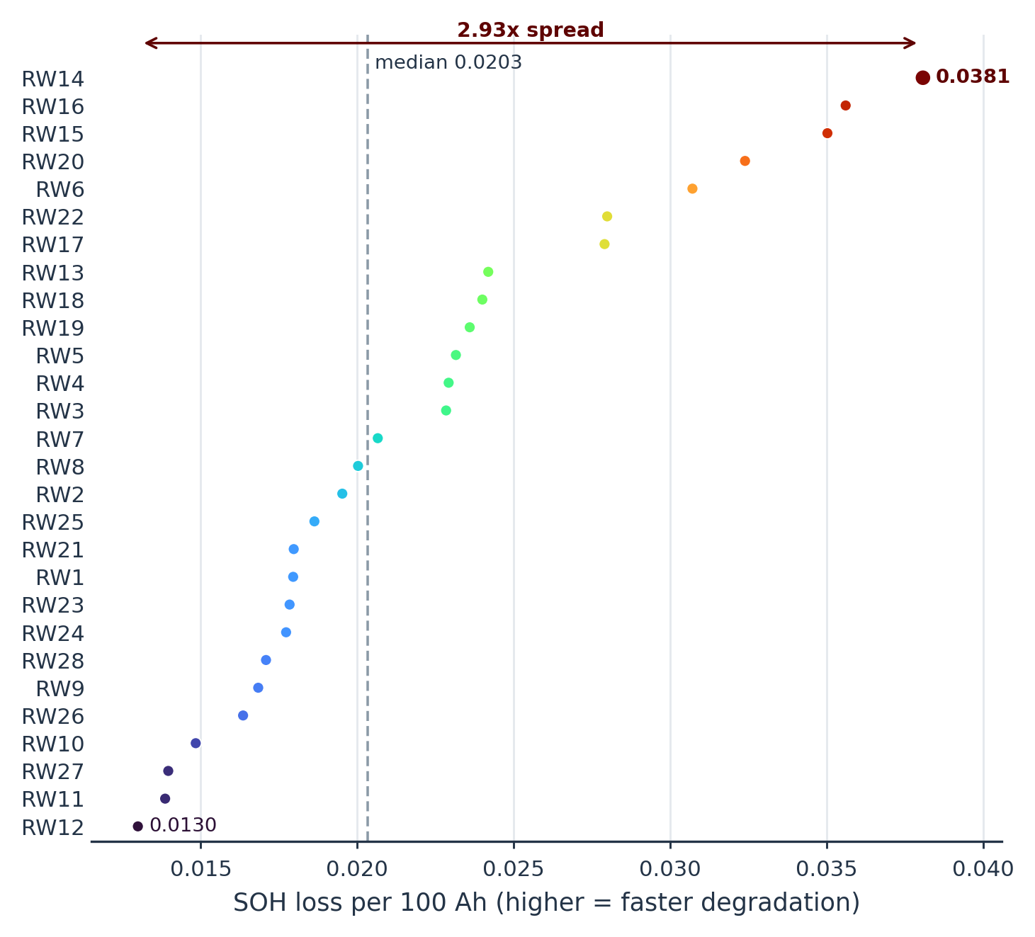
Cross-Cell Degradation Heterogeneity
The same overall trend hides markedly different degradation rates across the 28 cells.
Fastest loss
0.0381 SOH / 100 Ah
Median loss
0.0203 SOH / 100 Ah
Spread
2.93× fastest vs slowest
Implication: macro-cell scoring is safer than a row-weighted average when batteries contribute different row counts.

Slide 22
Raw vs Exposure-Controlled Load Associations
Recent-load correlations shrink sharply after controlling cumulative Ah.
Raw association
Partial after cum. Ah
raw +0.431
50-step Ah
partial -0.066
raw +0.416
50-step mean |I|
partial +0.122
raw +0.159
50-step max T
partial +0.029
-0.1
0.0
0.1
0.2
0.3
0.4
0.5
Interpretation: cumulative exposure explains most of the monotonic relationship; ablation later tests nonlinear predictive value.

Slide 23
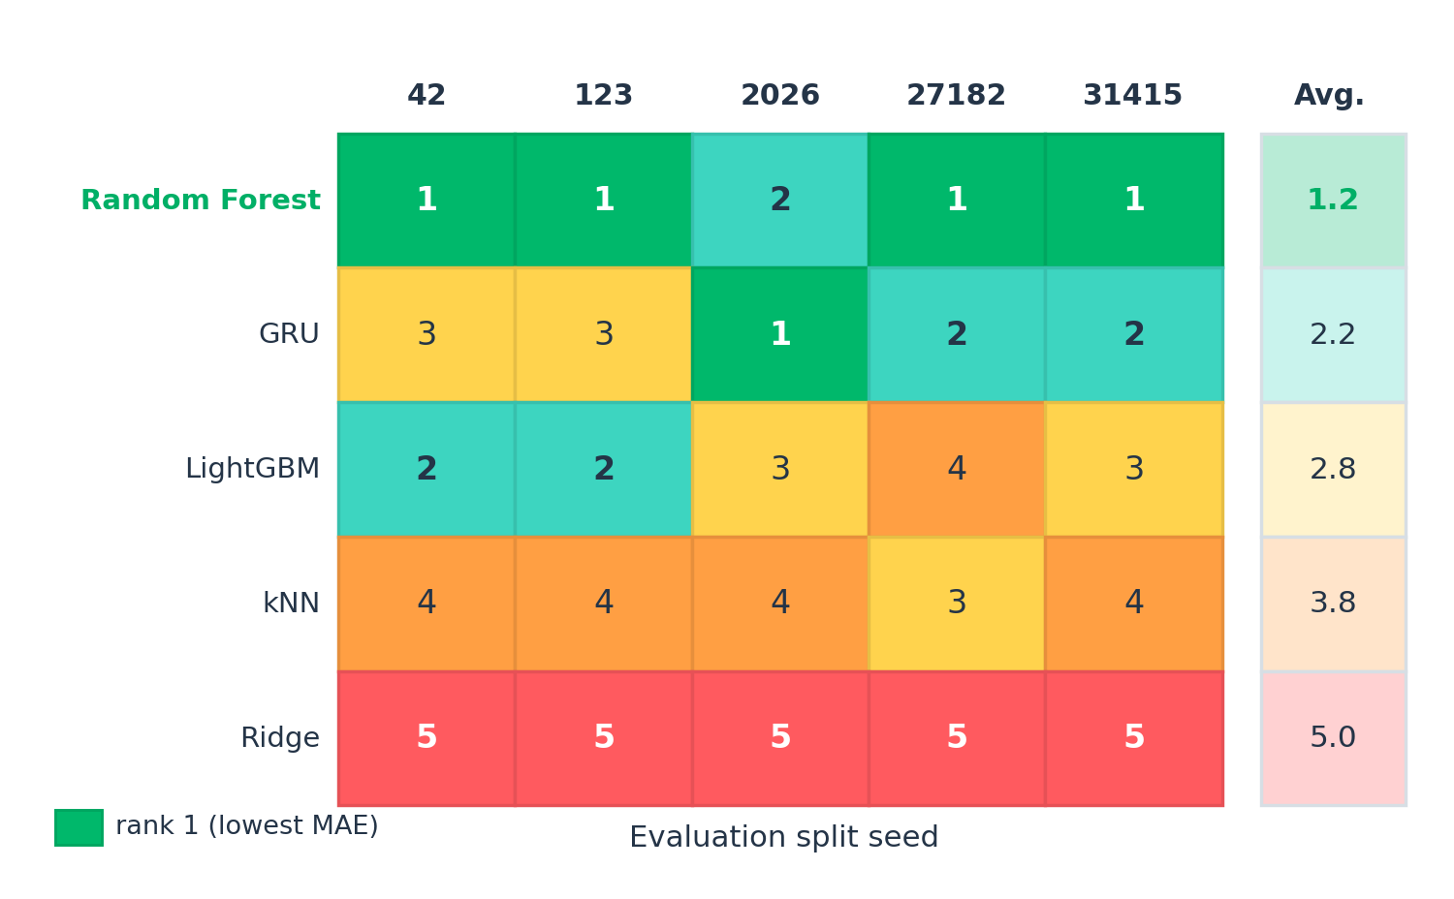
Model-Rank Stability Across Splits
Repeated complete-cell holdouts prevent one lucky partition from deciding the story.
Random Forest ranks #1 in 4/5 splits; GRU wins seed 2026 → directionally stable, not universally superior.

Slide 24
PART 3
Modeling, Reliability & Reflection
Models & Variables
Metrics
Reliability & XAI
Tool + AI Reflection

Slide 25
Models & Variables
Same feature set, same unseen-cell protocol, five reproducible evaluation partitions.
42
123
2026
27182
31415
Target & inputs
Candidate models
Split & metric
Target: continuous next-reference SOH
14 inputs: instantaneous electrical/thermal + cumulative Ah + 50-step summaries + 2 temperature-missingness indicators
Ridge
kNN
Random Forest
LightGBM
Compact GRU
Per seed: 18 train · 5 calibration · 5 test cells
Primary metric: macro-cell MAE
Hyperparameters frozen after seed-42 development
Every final score is computed on cells absent from both fitting and calibration.

Slide 26
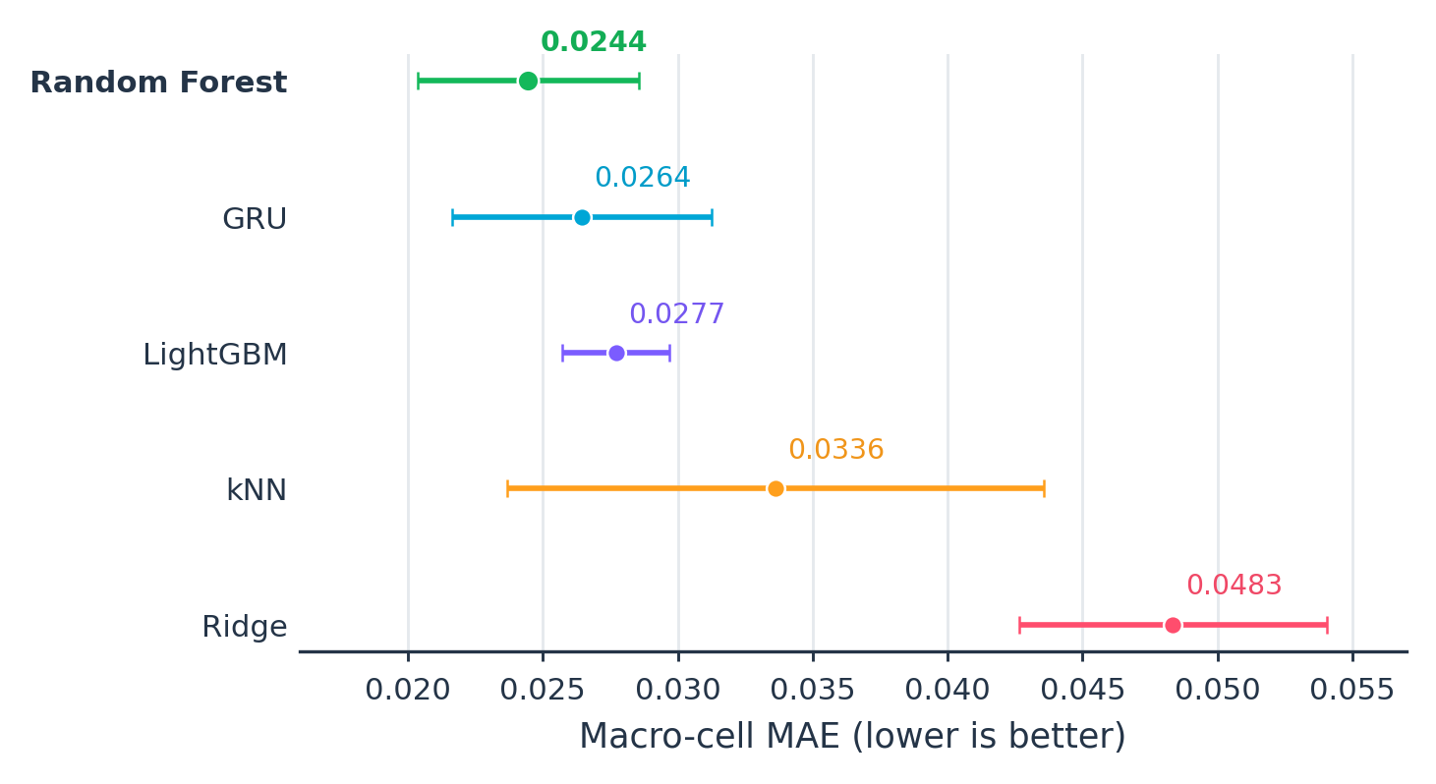
Five-Model Result
Mean performance across five cell-disjoint evaluation partitions.
0.02445
Random Forest mean macro-cell MAE
4 / 5
#1 ranked splits
~8.1%
lower mean MAE than GRU
RQ2 answer: Random Forest is the most defensible reference model, but its lead is modest—not universal dominance.

Slide 27
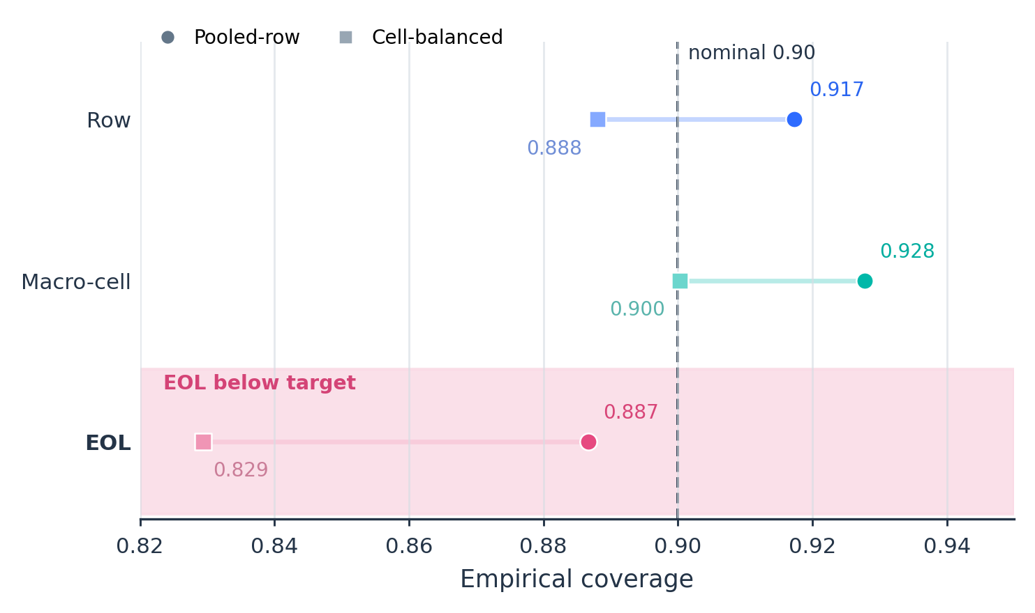
Reliability · Conformal Coverage & EOL
Global coverage is not enough when the retirement threshold matters.
92.78%
Macro-cell coverage
88.67%
EOL pooled-row coverage
20.94%
Missed-EOL rate
RQ3 reliability: credible in aggregate, but weaker near EOL.

Slide 28
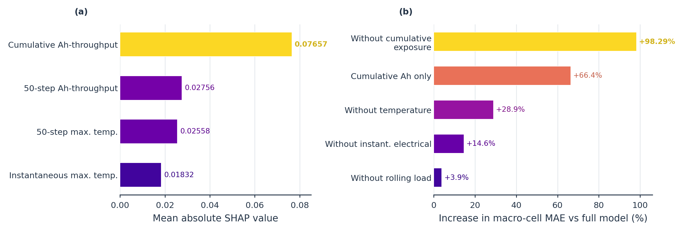
Interpretation · SHAP + Feature-Family Ablation
Two complementary views agree that cumulative exposure is the dominant predictive signal.
SHAP #1
Ablation
cum_ah · mean |SHAP| = 0.0766
Remove cumulative exposure → +98.29% macro-cell MAE

Slide 29
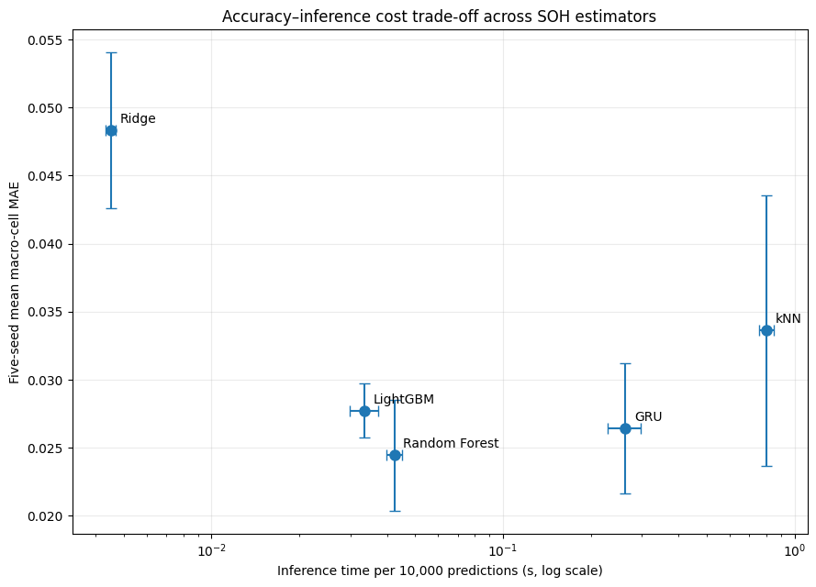
Analysis Tool & Efficiency Trade-off
The current deliverable is notebook-first; timing is hardware and protocol dependent.
Live demo
Notebook A → SQL Q3/Q4 + RQ1 evidence
Notebook B → split table + model result + conformal/EOL
Trade-off
Random Forest = accuracy-first
LightGBM = strong efficiency alternative
Important caveat
No standalone dashboard is included in the current package.
Use the notebooks and saved figures as the reproducible analysis tool during presentation.

Slide 30
AI Reflection · Human Delta & Hallucination Check
Focus on what humans verified and where verification changed the story.
AI Use
Human Delta
Hallucination Check
Use AI only as an assistant for tasks such as:
• SQL/window design explanation
• leakage-safe split checks
• conformal / SHAP explanations
Document only prompts your group actually used.
Manual checks already evidenced:
• RW10 rolling features checked against SQL
• train/calibration/test cells verified disjoint
• approximate TreeSHAP checked against exact behavior
Key corrections:
• proposal expected LightGBM → experiment selected RF
• SHAP / correlation ≠ causation
• global coverage does not hide weaker EOL behavior
Before submission: attach 1–2 real prompt examples and briefly state how each answer was verified.

Slide 31
Conclusion · Answers to the Research Questions
Three messages to leave with the audience.
RQ1 · Exposure dominates
RQ2 · RF leads
RQ3 · EOL is harder
Cumulative Ah is the strongest monotonic degradation signal.
Median ρ = −0.9961
Recent 50-step summaries have weak residual monotonic association after controlling cumulative Ah.
Random Forest is the most defensible reference model for unseen-cell transfer.
Macro-cell MAE = 0.02445 ± 0.00410
Average rank = 1.2
Wins 4/5 splits.
Aggregate uncertainty is reasonable, but threshold behavior remains weaker.
Coverage = 92.78% overall
Missed EOL = 20.94%
Remove cum. exposure → +98.29% MAE.
Practical message: credible cross-battery SOH needs whole-cell holdout + repeated splits + EOL / uncertainty diagnostics.

Slide 32
Q&A
Cross-Battery State-of-Health Estimation under Randomized Loading
Thank you

