Slide 1


HỌC VIỆN ĐÀO TẠO QUỐC TẾ ANi
ACADEMY OF NETWORK AND INNOVATIONS
PAST PERFECT
Ms. Linh Chi
TEACHER

Slide 2
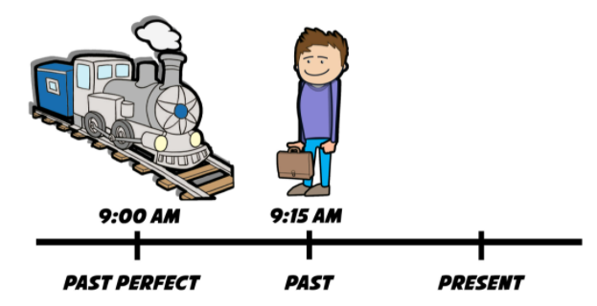
FORM
When he arrived to the train station, the train had left
S+had+pp

Slide 3
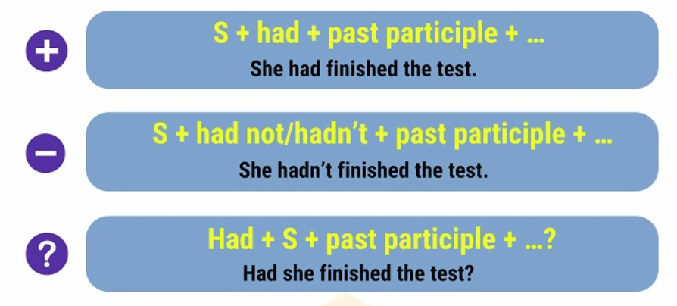
FORM

Slide 4
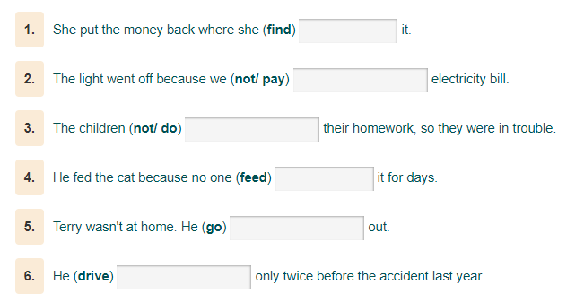

Slide 5
Usage 1
Diễn tả hành động xảy ra trước 1 hành động khác trong quá khứ
E.g. When I came home, they had already eaten the meal
By the time I returned home, he had already left
She had washed her hands before she cooked the dinner
He began to run after he had seen the cat
Signals:
- When, as soon as
- By/prior to the time, by the end of+time
- Before/ After
- already

Slide 6
Usage 2
Diễn tả hành động xảy ra trước 1 thời điểm xác định trong quá khứ
E.g. He had came back home before last night
She had done her homework before yesterday
Signals:
- Before + thời điểm trong qúa khứ

Slide 7
PRACTICE
They (come) ………… back home after they (finish) ………………… their work
She said that she (meet) ………………. Mr. Bean before
Before he (go) ………… to bed, he (read) ……………….. a novel
He told me he (not/wear) ………………… such kind of clothes before
When I came to the stadium, the match (start)……………….
Last night, Peter (go)………...........to the supermarket before he (go) …………. home
came
had finished
had met
went
had read
hadn’t worn
had started
had gone
went

Slide 8
BT DẠNG ĐỀ READING PLACEMENT TEST
Choose the correct answer:
1. Before hanging out with friends, Jim has done/had done/ did his homework.
2. Peter told me that he has already finished/ had already finished/ already finished reading ‘Harry Porter’.
3. Mary said she has never been/ had never been/ didn’t be to Paris before.
4. When we came to the movie theater, the film had started/ started/ has started.
5. As soon as Jane saw/ had seen/ has been seeing Jim, she stormed/ has stormed/ had stormed out of the room.

Slide 9

Thank you for your attention!
HỌC VIỆN ĐÀO TẠO QUỐC TẾ ANI
103D Trường Chinh, Thành Phố Huế
Http://www.ani.edu.vn
Support@ani.edu.vn
(84)0234.3627999

