Slide 1


HỌC VIỆN ĐÀO TẠO QUỐC TẾ ANi
ACADEMY OF NETWORK AND INNOVATIONS
PAST SIMPLE
Ms. Linh Chi
TEACHER

Slide 2
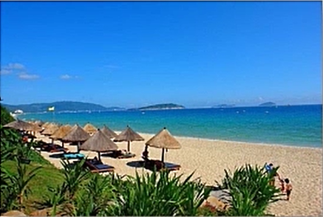
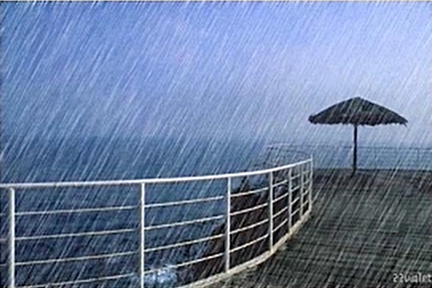


FORM: TO BE

Slide 3
I. FORM
1. To be
PRESENT SIMPLE | PAST SIMPLE
She is a student | She was a student
She is not a student | She was not a student
Is she a student? | Was she a student?
(+) S + was/were + O
( - ) S + was/were + not + O
( ? ) Was/ were + S + O ?
Am/is → was
Are → Were

Slide 4
PRACTICE
My computer …………… (be) broken yesterday
They …………… (not be) excited about the film last night
…………… (be) she tired of hearing her customer’s complaint yesterday?
They …………… (be) in London on their summer holiday last year
The girl …………… (be not) very happy last night because of having lost money
was
weren’t
Was
were
wasn’t

Slide 5
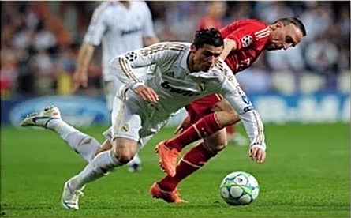
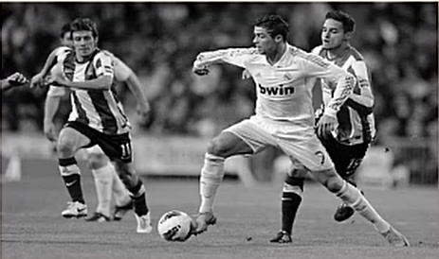


FORM: VERBS

Slide 6
I. FORM
2. Verb
PRESENT SIMPLE | PAST SIMPLE
He plays football | He played football
He doesn’t play football | He didn’t play football
Does he play football? | Did he play football?
(+) S + V2/ed + O
( - ) S + didn’t + V + O
( ? ) Did + S + V + O ?
Note: Đối với thì quá khứ chia với động từ thường không cần phụ thuộc vào số ít và số nhiều của S

Slide 7
PRACTICE
They …………… (watch) TV late at night yesterday
I …………… (go) to the fitness class last night
What …………… you …………… (do) two days ago?
We …………… (not see) …………… him at the cinema last night.
My father …………… (stop) smoking 2 years ago
watched
went
did
do
didn’t
see
stopped

Slide 8
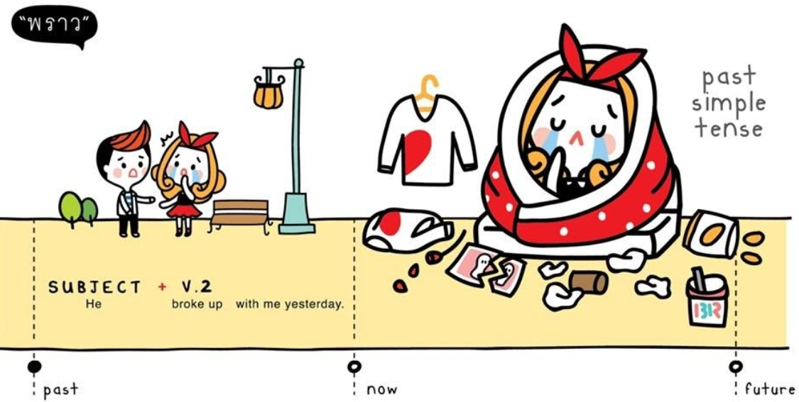
FORM

Slide 9
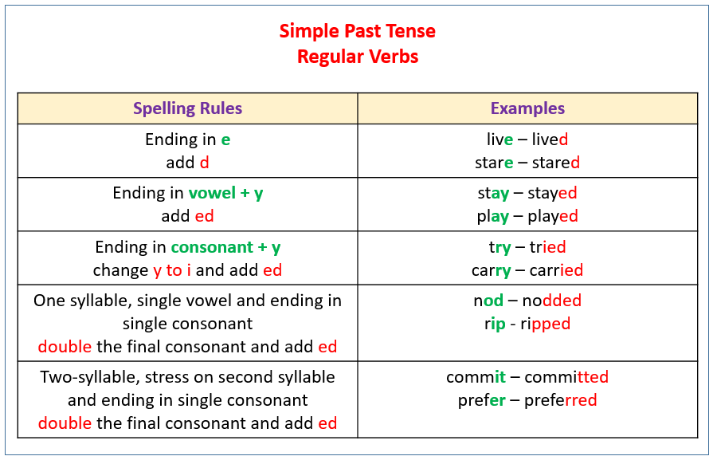
RULES

Slide 10
1. Regular verbs
Spelling rules |  | Example
1. V-e | Chỉ thêm d | Live → lived
2. V-y Trước y là nguyên âm: Trước y là phụ âm: | thêm ed như bình thường bỏ y thêm ied | Stay → stayed Study → studied
3. V có: 1 âm tiết 3 chữ cái cuối gồm 1 nguyên âm kẹp giữa 2 phụ âm (p-n-p) | gấp đôi phụ âm cuối rồi thêm ed | Stop → stopped
4. V có : 2 âm tiết nhấn âm 2 3 chữ cái cuối gồm 1 nguyên âm kẹp giữa 2 phụ âm (p-n-p) | gấp đôi phụ âm cuối rồi thêm ed | Refer → referred
II.RULES

Slide 11
2. Common irregular verbs
Base form | Simple Past
Be | Was/were
Do | Did
Have | Had
Make | Made
Take | Took
Go | Went
Get | Got
Think | Thought
Buy | Bought
Base form | Simple Past
come | Came
Become | Became
Begin | Began
Run | ran
Ring | Rang
Drink | Drank
Say | Said
Pay | Paid
See | saw
RULES

Slide 12
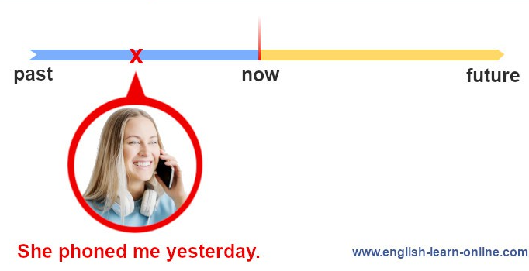
Usage 1
Diễn tả hành động đã xảy ra và kết thúc trong quá khứ
Signals:
- Yesterday
- Last + time
- Time + ago
- in/on/at + time in the past
- When + mệnh đề (thời điểm trong quá khứ)
E.g. I went to bed at 10 last night
I traveled to Paris 2 years ago
She bought a car in 1998

Slide 13
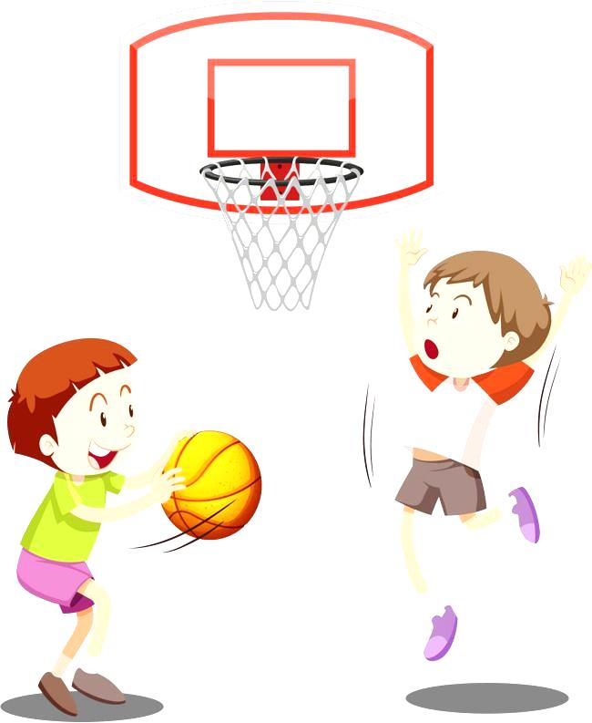
Usage 2
E.g. I always played basketball when I was a child.
He often played the guitar when he was 18.
Diễn tả 1 thói quen trong quá khứ và đã chấm dứt ở hiện tại
Signals:
- Adverbs of frequency
+ When

Slide 14
Usage 3
Diễn tả 1 chuỗi các hành động xảy ra liên tiếp trong quá khứ
E.g. I went out, walked to the park, and watched the sky silently.
He arrived from the airport at 11:00, looked for someone to ask the way, and called a taxi.
Signals:

Slide 15
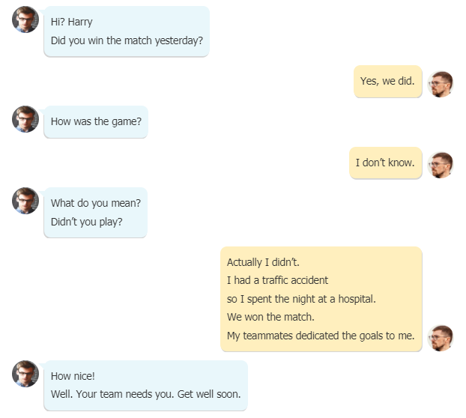
A dialogue about simple past tense

Slide 16
PRACTICE
I …………. (listen) to the new pop album yesterday. It’s great.
She …………. (like) the film but she didn’t like the music.
There …………. (be) a problem with the plug.
I …………. (be) happy to see her with a smile in her face.
Her parents …………. (travel) by train from Istanbul to Moscow.
I …………. (phone) you four times last night but you were out.
There …………. (be) many workers waiting outside.
We …………. (walk) along the beach yesterday. It was lovely.
I …………. (have) a problem. So I asked to my mother about it.
Last week I …………. (be) in Paris. I stayed in a hotel.

Slide 17

Thank you for your attention!
HỌC VIỆN ĐÀO TẠO QUỐC TẾ ANI
103D Trường Chinh, Thành Phố Huế
Http://www.ani.edu.vn
Support@ani.edu.vn
(84)0234.3627999

