Slide 1


HỌC VIỆN ĐÀO TẠO QUỐC TẾ ANi
ACADEMY OF NETWORK AND INNOVATIONS
PRESENT SIMPLE
Ms. Linh Chi
TEACHER

Slide 2
CONTENT
FORM (TO BE & VERB)
USAGE
SIGNAL
PRACTICE

Slide 3
FORM: TO BE
I ………... a student.
The teacher ………... tall and thin.
Her parents ………... good cooks.
My computer………... expensive.
Comic books ………... interesting.
am
is
Affirmative:
are
is
are
S+am/is/are+O

Slide 4
FORM: TO BE
I ………... a student.
The teacher ………... tall and thin.
Her parents ………... good cooks.
My computer………... expensive.
Comic books ………... interesting.
am not
isn’t
Negative:
aren‘t
isn‘t
aren‘t
S+am/is/are+not+O

Slide 5
FORM: TO BE
………... you a student?
………... the teacher tall and thin?
………... her parents good cooks?
………... your computer expensive?
………... comic books interesting?
Are
Is
Interrogative:
Are
Is
Are
Am/is/are+S+O?

Slide 6
I. FORM
1. To be
Example | Form
She is a student | (+) S + am/is/are + O
She is not a student | ( - ) S + am/is/are + not + O
Is she a student? | ( ? ) Am/is/are + S + O ?
Notes:
I → am
He/she/it, S số ít → is
We, you, they → are

Slide 7
PRACTICE
Phong and Bao _________ students.
_________ your father a doctor?
Those _______ my cats.
Ecotourism ______ very popular in Vietnam.
Everyone ________ beautiful in their own way.
are
Is
are
is
is

Slide 8
FORM: VERBS
We often _________ (get) up at 5 every morning.
Ben _______ (live) in a big city.
The children ______ (go) to school every weekdays.
Tracy and her mom _______ (watch) TV together every night.
Tourism _____ (have) a large number of negative effects on the environment.
get
lives
go
watch
has
S+V(s/es)+O

Slide 9
FORM: VERBS
He don’t stay/ doesn’t stay at school.
They don’t wash/ doesn’t wash the family car.
Adam don’t do/ doesn’t do his homework.
I don’t go/ doesn’t go to bed at 9.30 p.m.
Nam don’t close/ doesn’t close his notes.
Our hamster don’t eat/ doesn’t eat leaves.
They don’t chat/ doesn’t chat with your friends.
He don’t use/ doesn’t use a paper at the office.
Son don’t skate/ doesn’t skate in the garden.
The girl don’t throw/ doesn’t throw rocks.
S+do/does+not+V+O

Slide 10
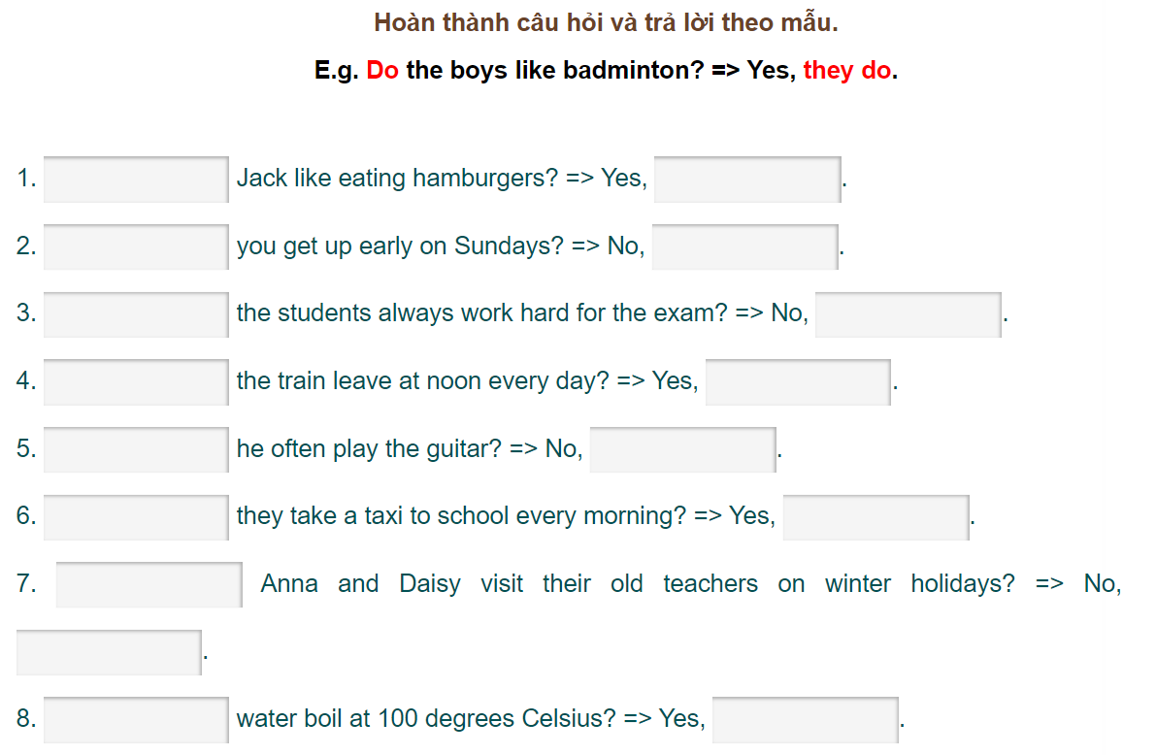
FORM: VERBS
Do/does+S+V+O?

Slide 11
I. FORM
2. Verb
Example | Form
I go to school | (+) S + V(s/es) + O
I don’t go to school | ( - ) S + don’t/doesn’t + V + O
Do you go to school? | ( ? ) Do/does + S + V + O ?
Notes:
S số ít → Vs/es → does
S số nhiều → V → do

Slide 12
II. RULES
QUY TẮC THÊM S/ES
RULES | EXAMPLES | BUT
1. Đa số động từ đều thêm s | Likes, circles, starts
2. Động từ có đuôi s,ss,x,sh,ch,z + es | Guesses, fixes, washes, watches, buzzes
3. Động từ có đuôi o + es | Do/does, go/goes
4. Động từ có đuôi y → ies | Study → studies | Play → plays
5. Động từ bất quy tắc | Have → has

Slide 13
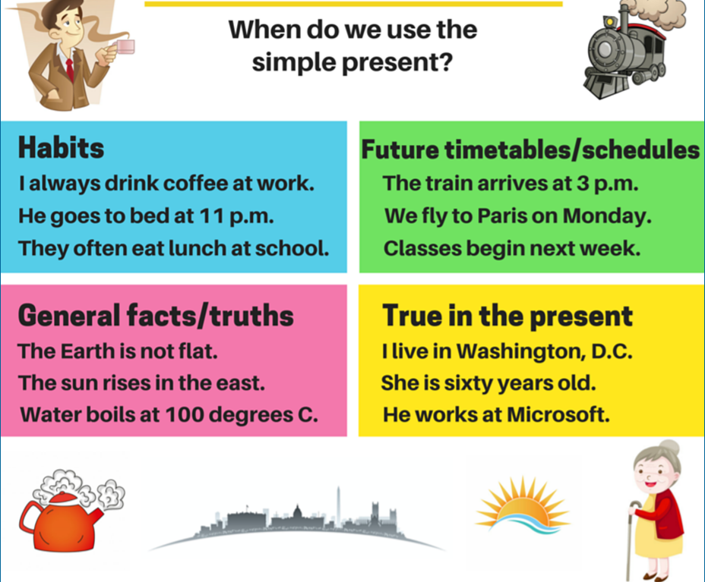
USAGE

Slide 14
SIGNALS
Always (luôn luôn) , usually (thường xuyên), often = frequently= generally = regularly (thường xuyên) , sometimes (thỉnh thoảng), seldom = rarely = hardly (hiếm khi) , never (không bao giờ)
Every+time
Day/week/month/year
Once/ twice/ three times….. a day/ week/ month/ year……. (một lần / hai lần/ ba lần……..một ngày/ tuần/ tháng/ năm)

Slide 15

Thank you for your attention!
HỌC VIỆN ĐÀO TẠO QUỐC TẾ ANI
103D Trường Chinh, Thành Phố Huế
Http://www.ani.edu.vn
Support@ani.edu.vn
(84)0234.3627999

