Slide 1


New York City
Motor Collision EDA
DSCI 261
Student: Võ Hoàng Minh Triết
Tutor: Nguyễn Hoàng Sỹ
HCMC, August 2026

Slide 2
Contents
What is this all about?
Data cleaning process
Data visualization
Model training
Recommendations and policy insights

Slide 3
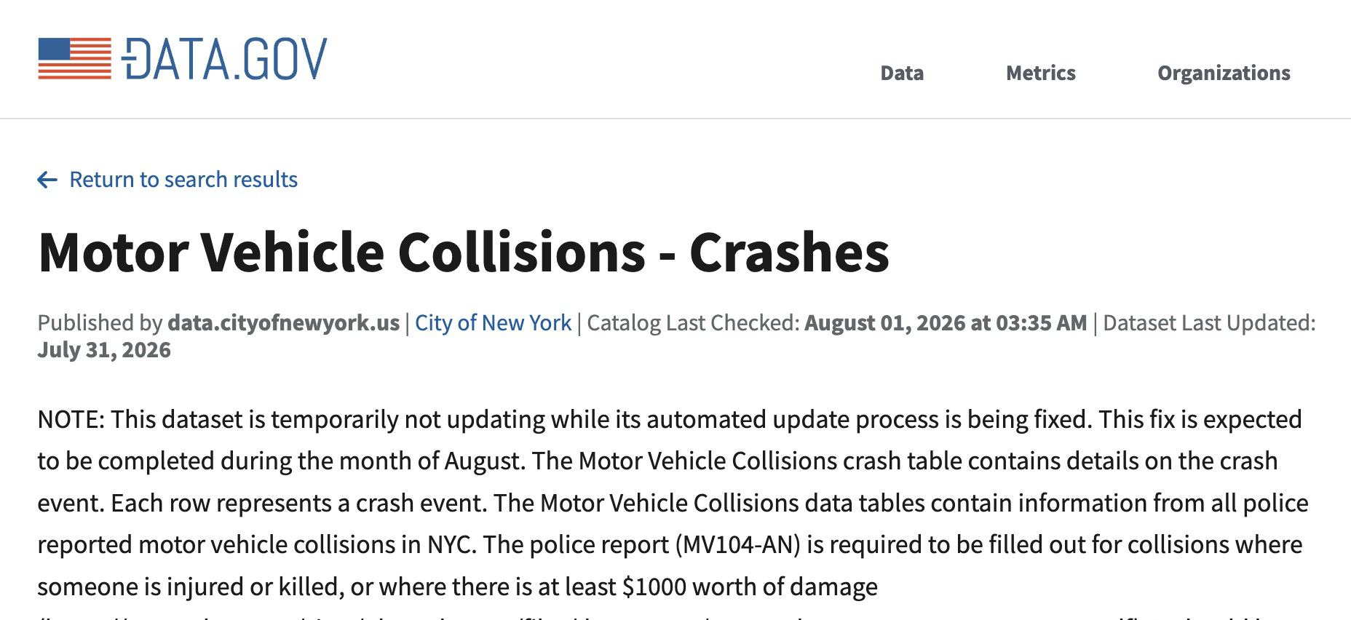
What is this all about?
Pretty self-explanatory, the data is about NYC Motor Collisions (motor vehicle crashes) from 2012 to 2026
Data source can be found here:
https://catalog.data.gov/dataset/motor-vehicle-collisions-crashes?from_hint=eyJzb3J0IjoicG9wdWxhcml0eSJ9

Slide 4
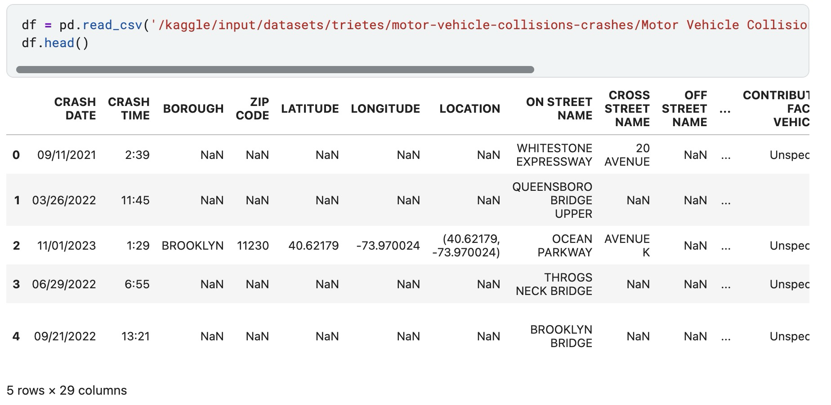
Data cleaning process
It’s one hell of a mess!

Slide 5
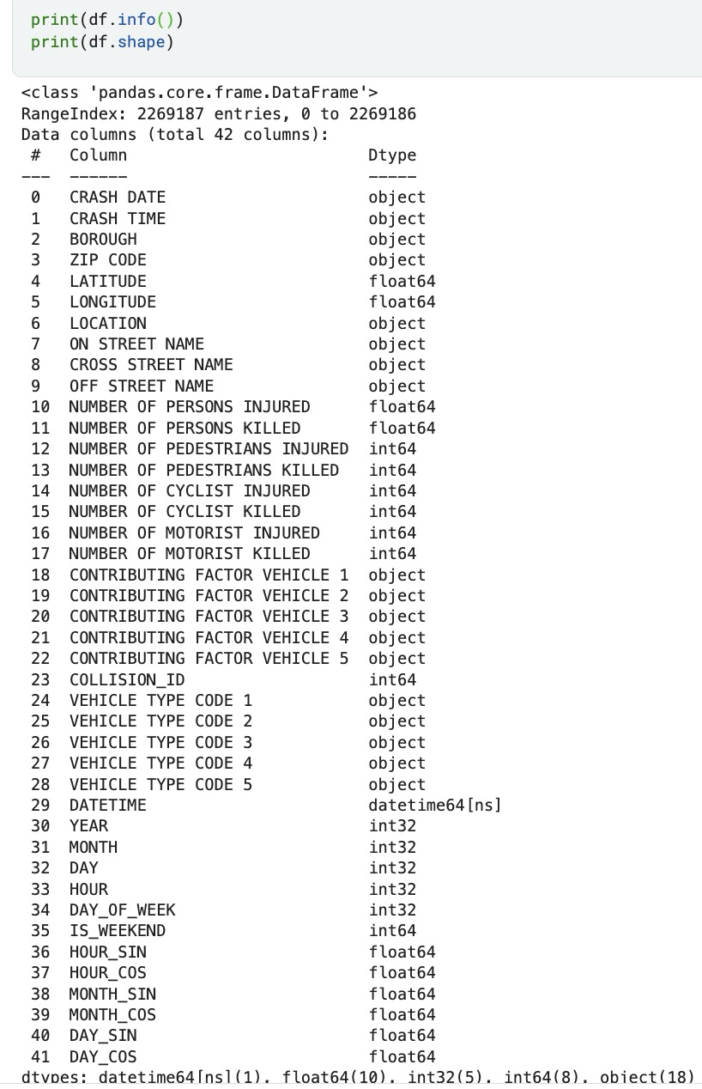
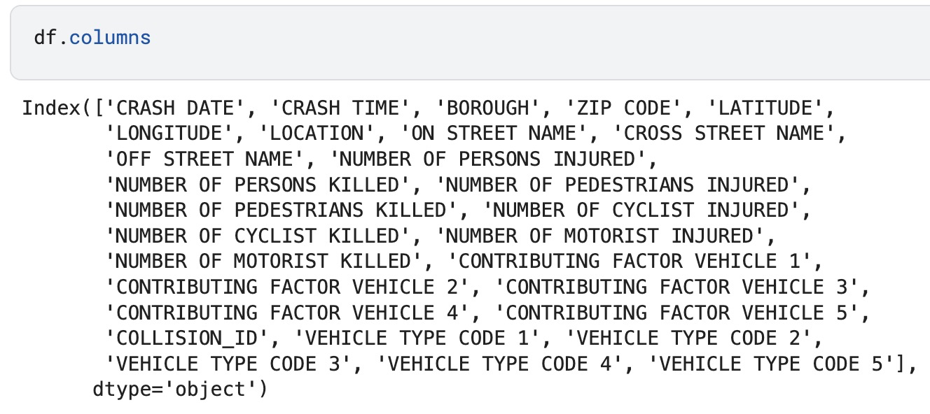
Data cleaning process
Let’s be systematic in our approach. We begin by examining the overall data structure.

Slide 6
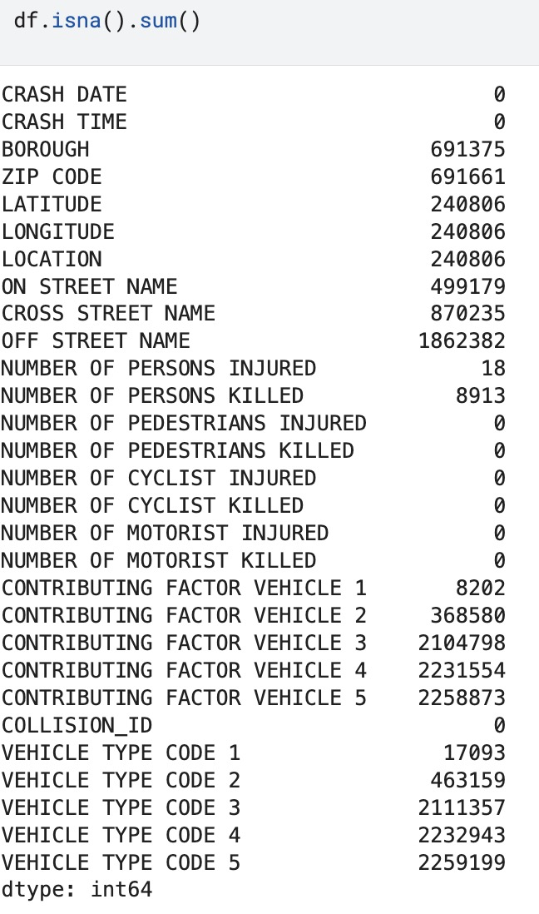
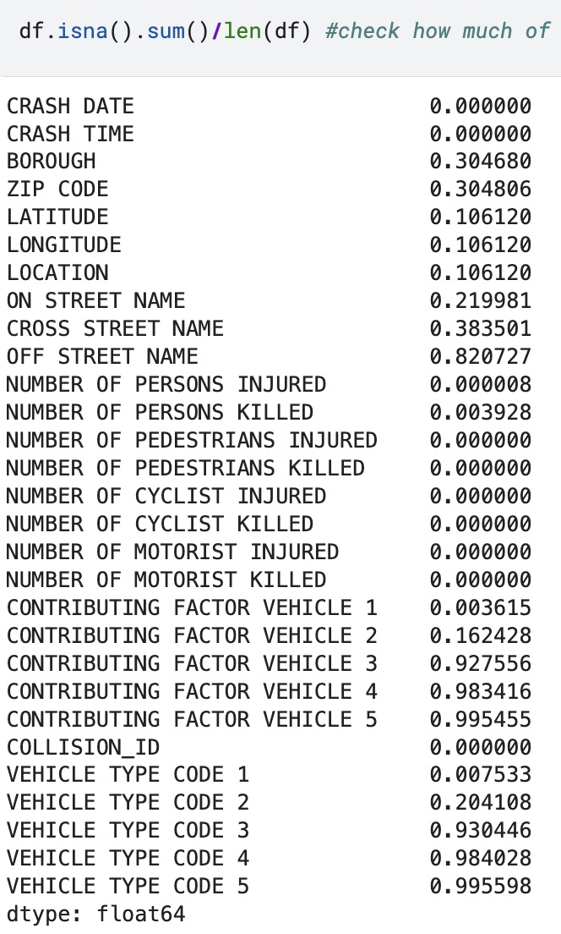
Data cleaning process
Let’s be systematic in our approach. We begin by examining the overall data structure.

Slide 7
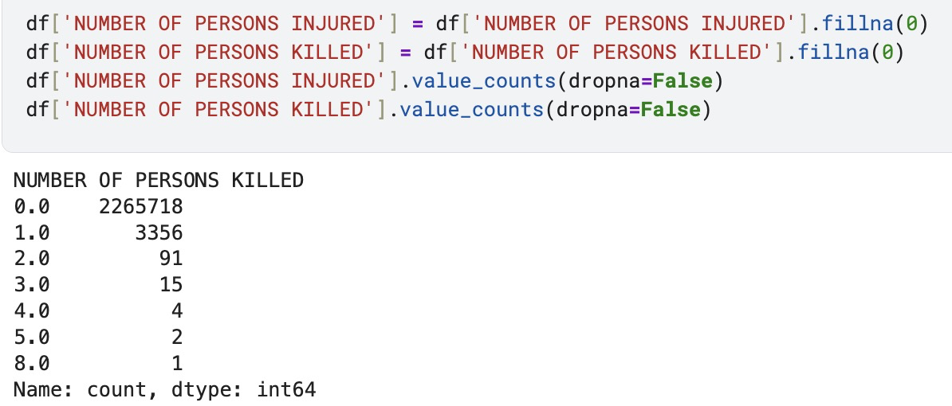
Data cleaning process
As there is only 18 records with missing injuries and 0.3% records with missing casualties, we assume that those who are in charge of recording probably forgot to add such attributes in the database, and if there actually are casualties/injuries, he/she would not have forgotten, hence the decision to fill 0 into said missing values.

Slide 8
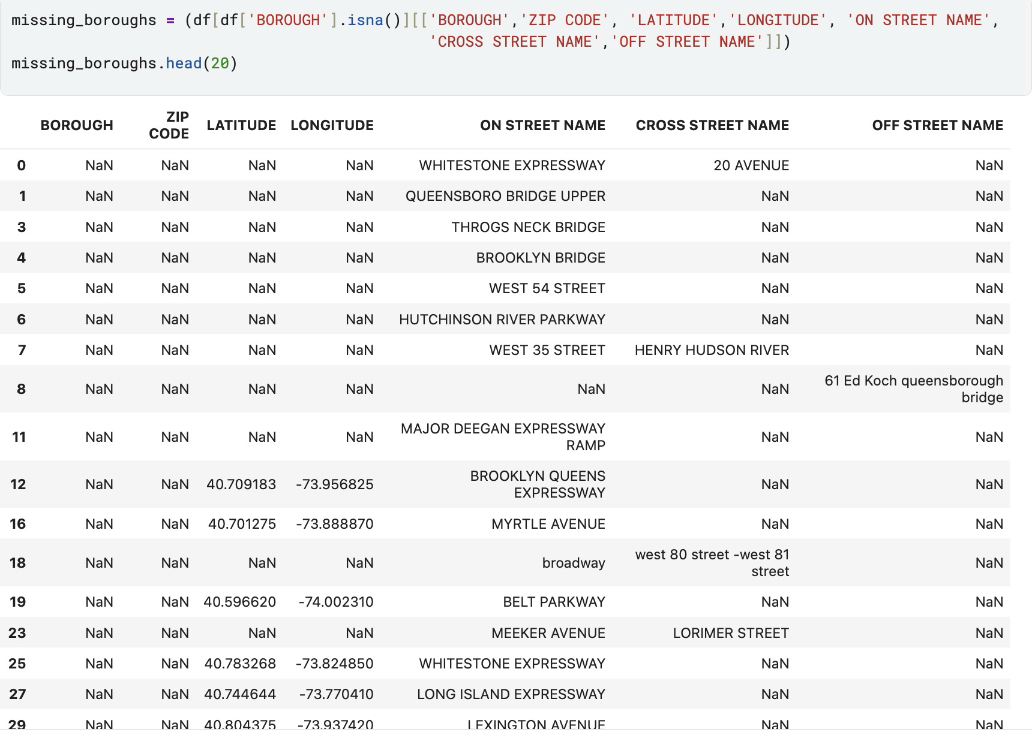
Data cleaning process
There are missing boroughs with totally valid locations. Why is that?

Slide 9
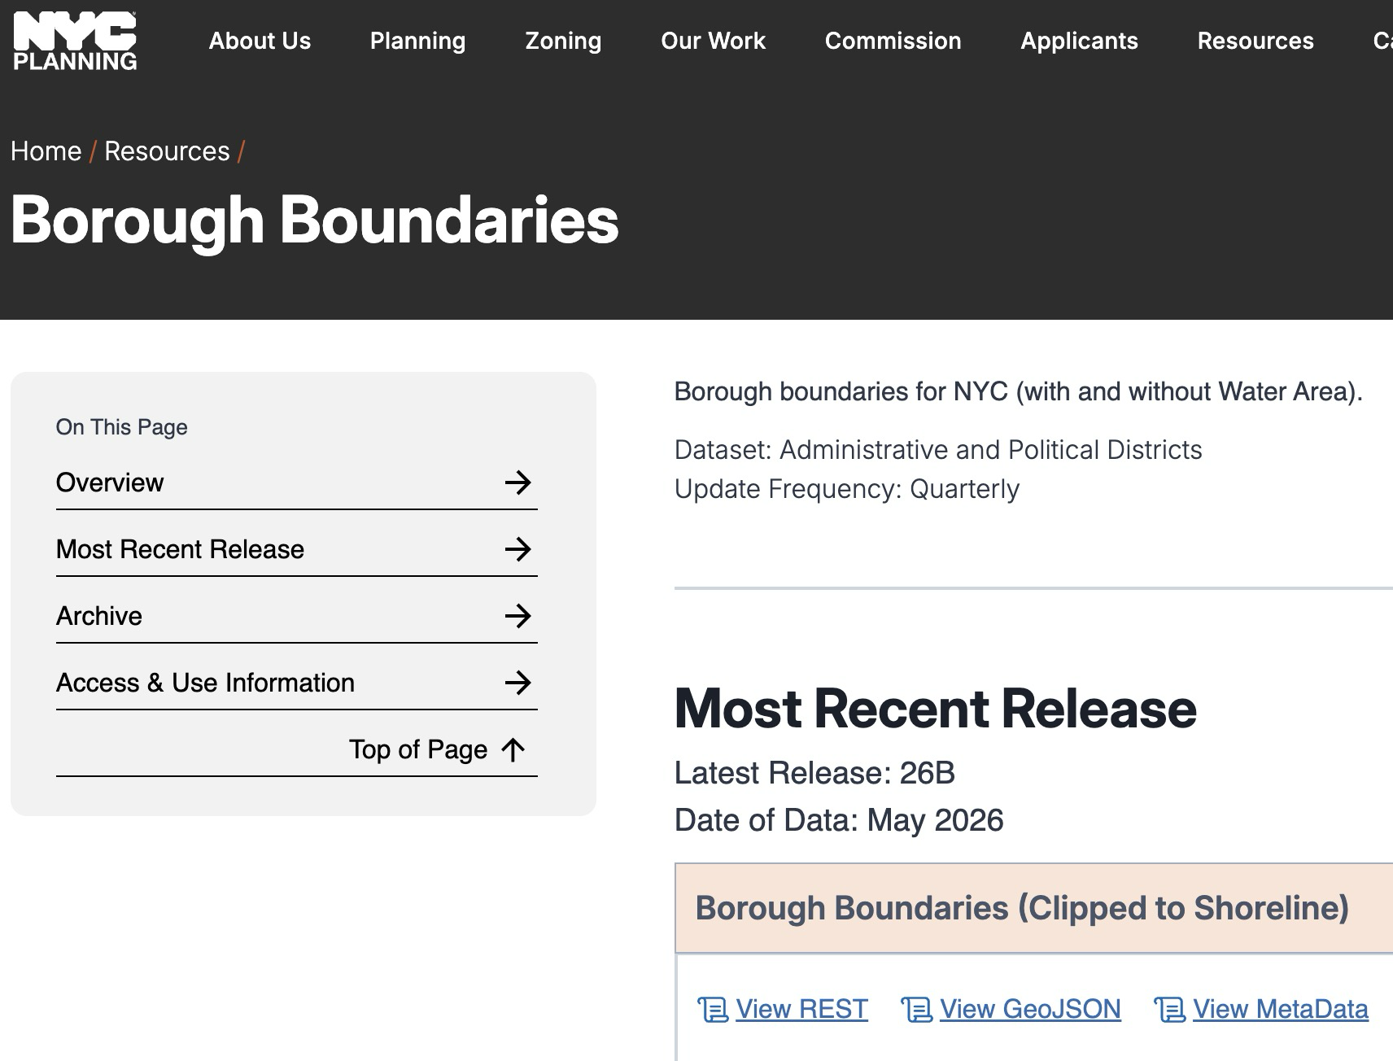
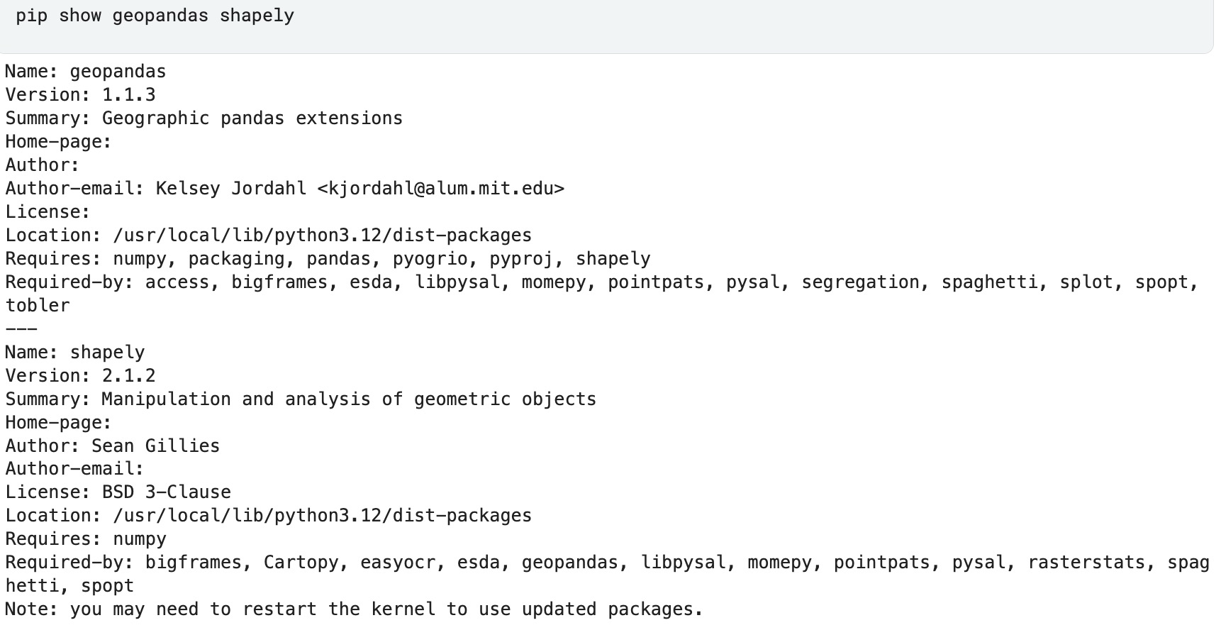
Data cleaning process
In order to fill in some missing boroughs, we need the help of some powerful tools, as well as NYC public data

Slide 10
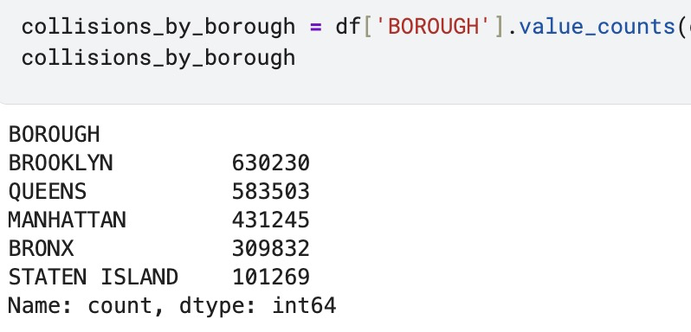
Data cleaning process
The result is around 2/3 of all borough NaN values are filled, allowing further analysis

Slide 11
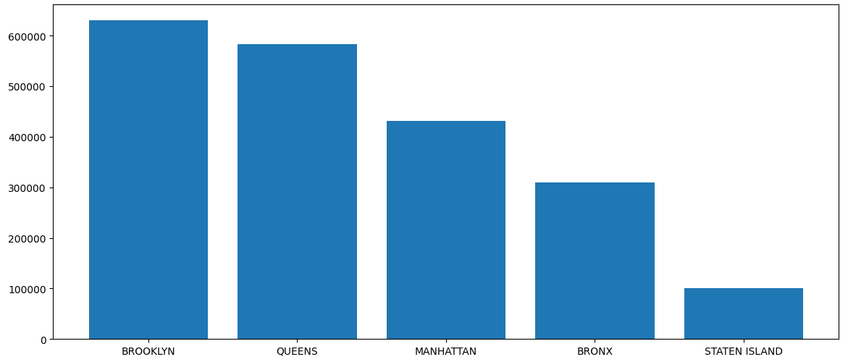
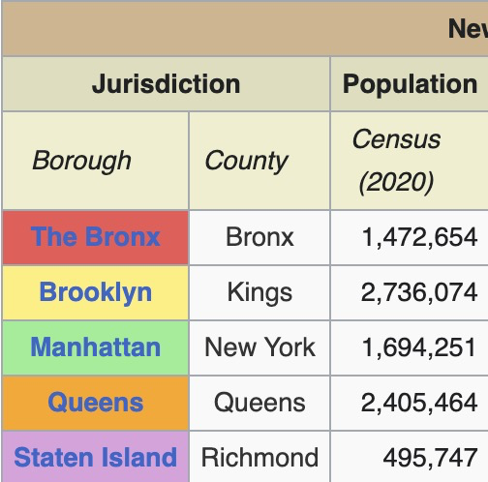
Data visualization
Plotting the previous table, it is obvious that population has strong correlation to the number of collisions in the city

Slide 12

Data visualization
We define Severe rate by:
$$\frac{\sum{number of persons injured + \sum{number of persons killed}}}{\sum{number of accidents }}$$

Slide 13
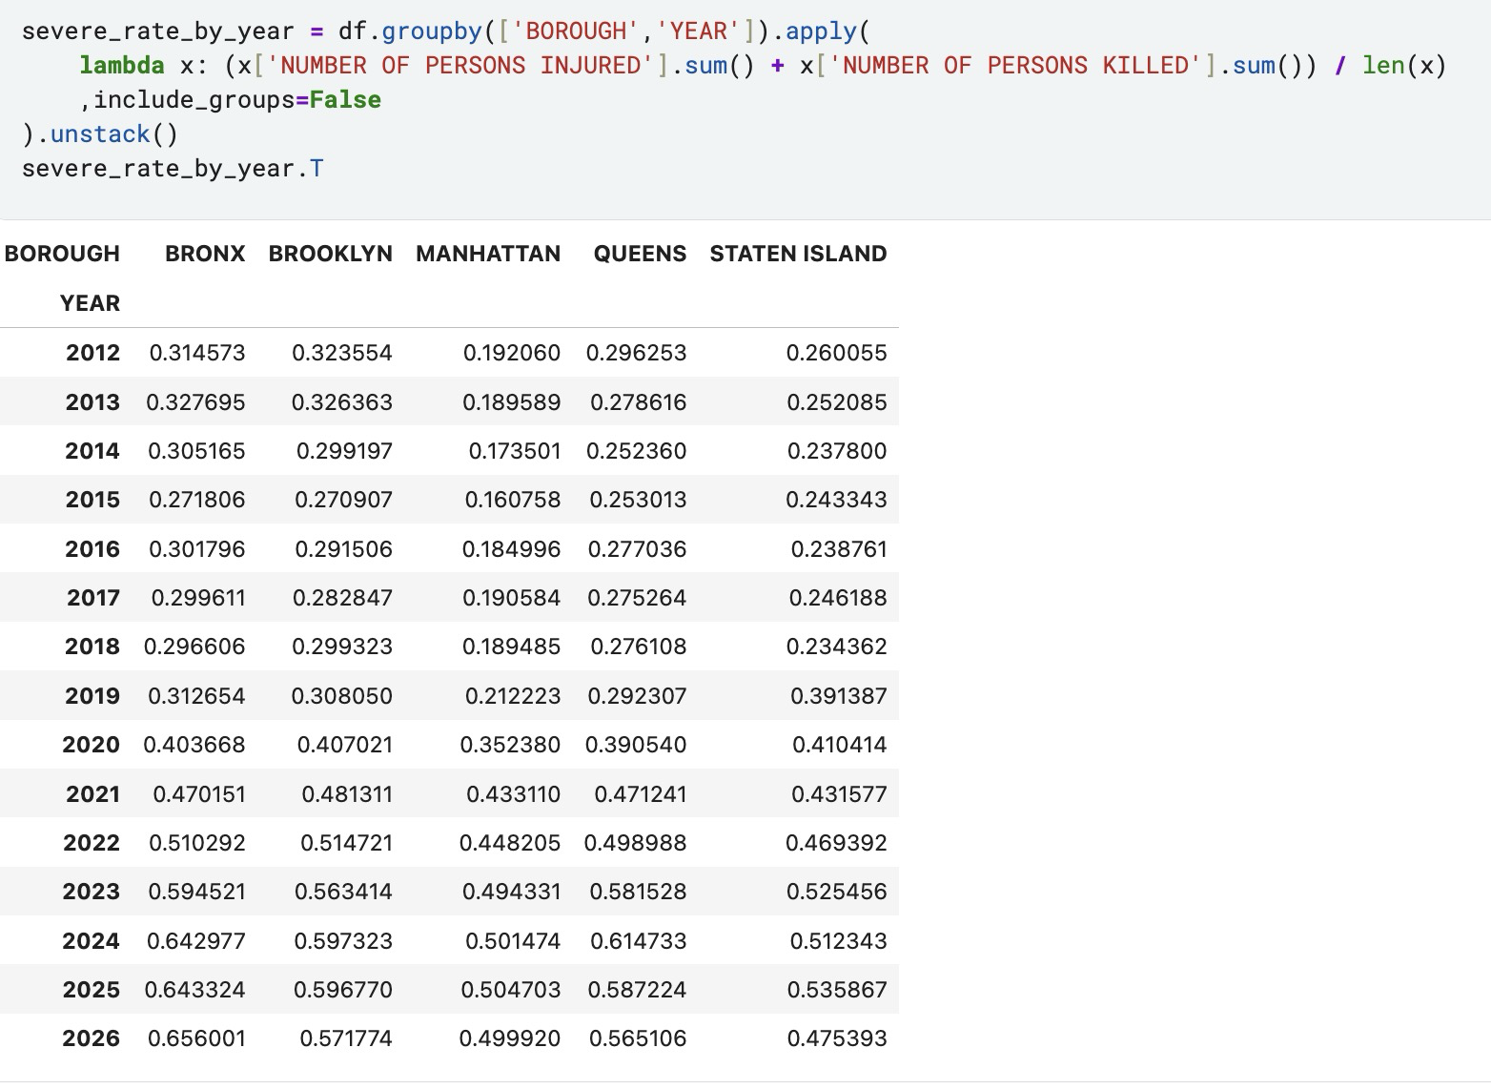
Data visualization
From the aforementioned severe rate, we got the following table:

Slide 14
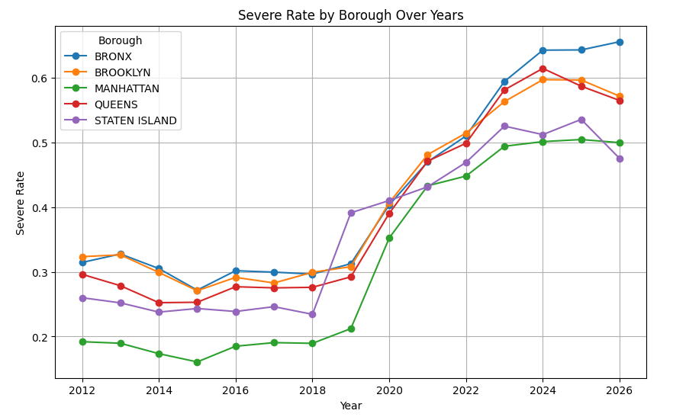
Data visualization
Surprisingly, Bronx has higher severity rate despite having less collisions than Brooklyn. Does this have anything to do with the average speed?

Slide 15
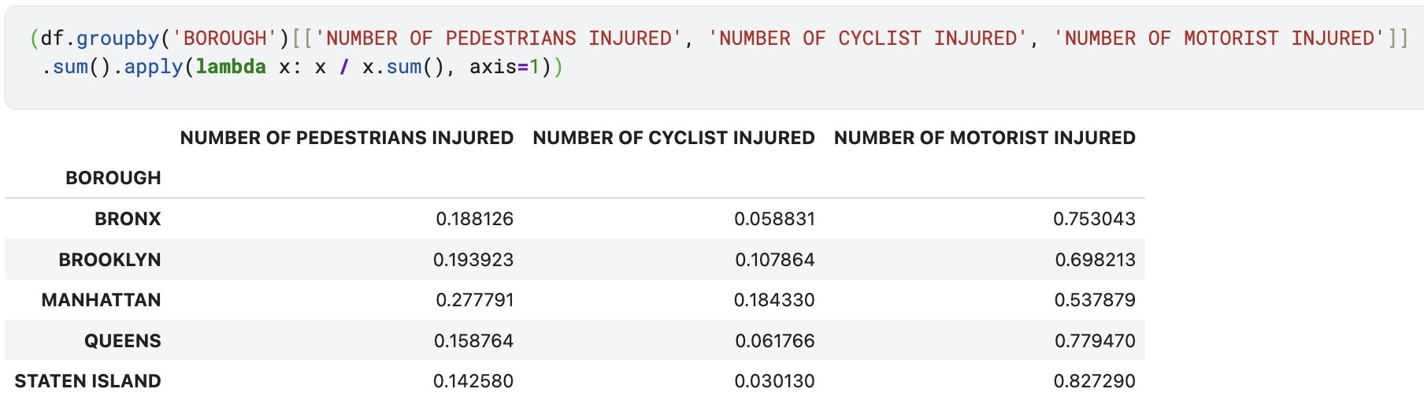
Data visualization
We calculate percentage of injuries/casualties by boroughs as followed.
The statistics makes sense since Manhattan is predominantly public transportation while Staten Island, Bronx, and Queens are more car-centric

Slide 16
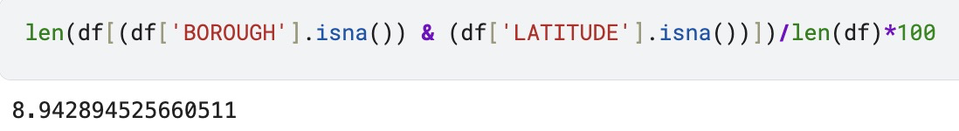
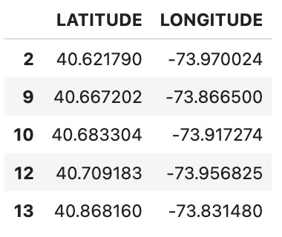
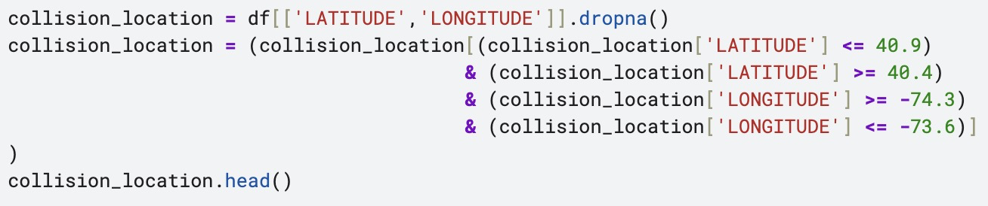
Data visualization
Since there is around 9% of rows that have missing coordination, and even more with invalid coordination, we temporarily remove them for plotting purposes (we can’t plot a missing value, and we sure as hell don’t want to plot a value that is 3000km away from the city)

Slide 17
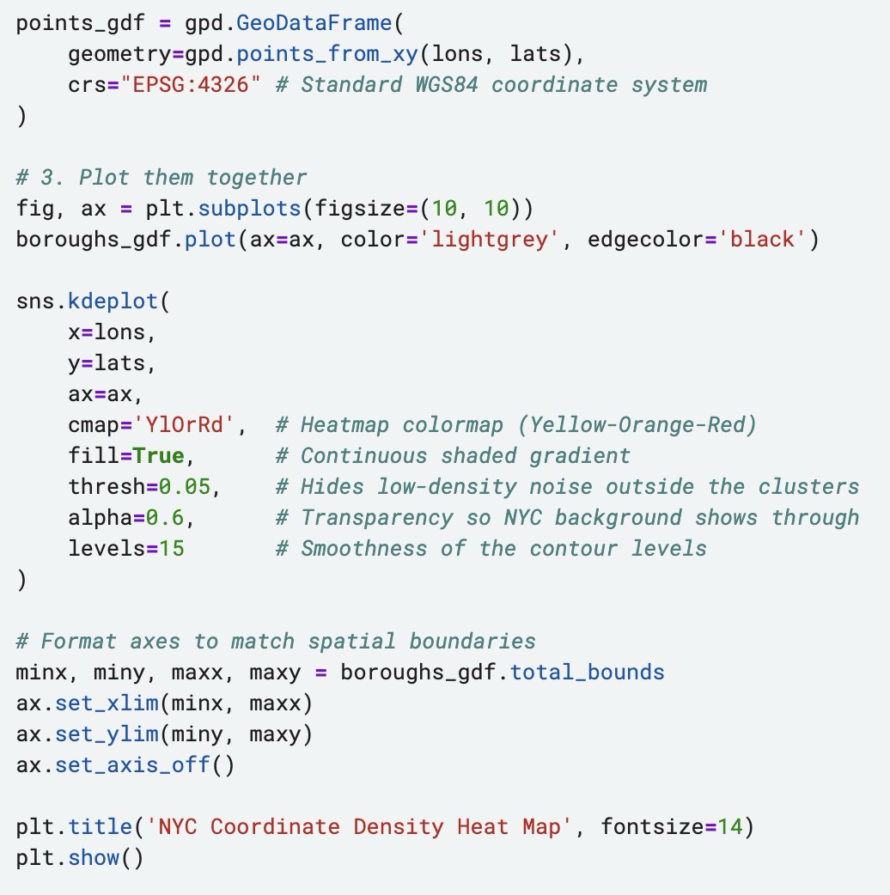
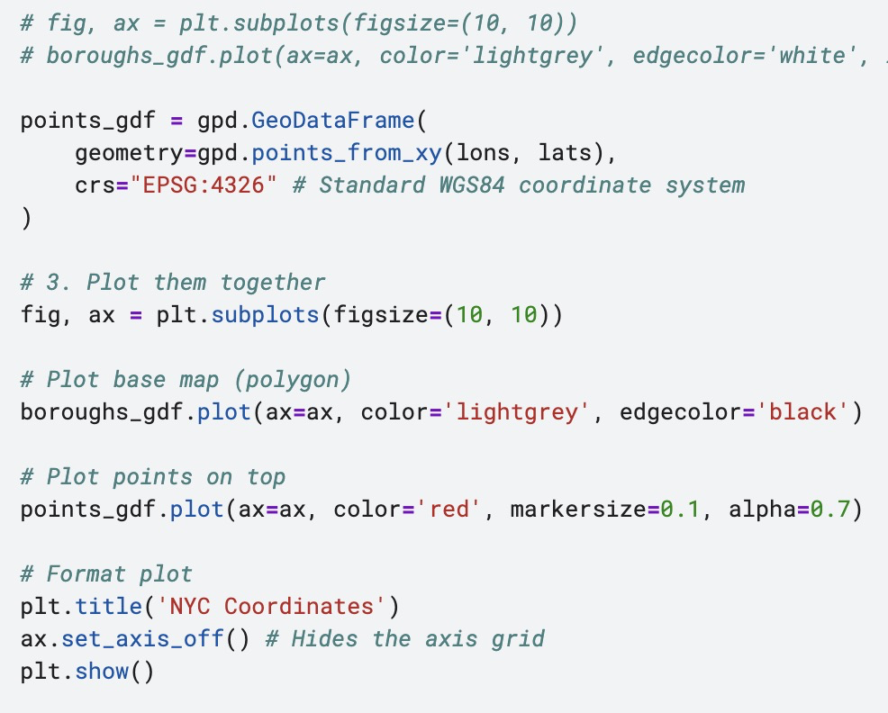
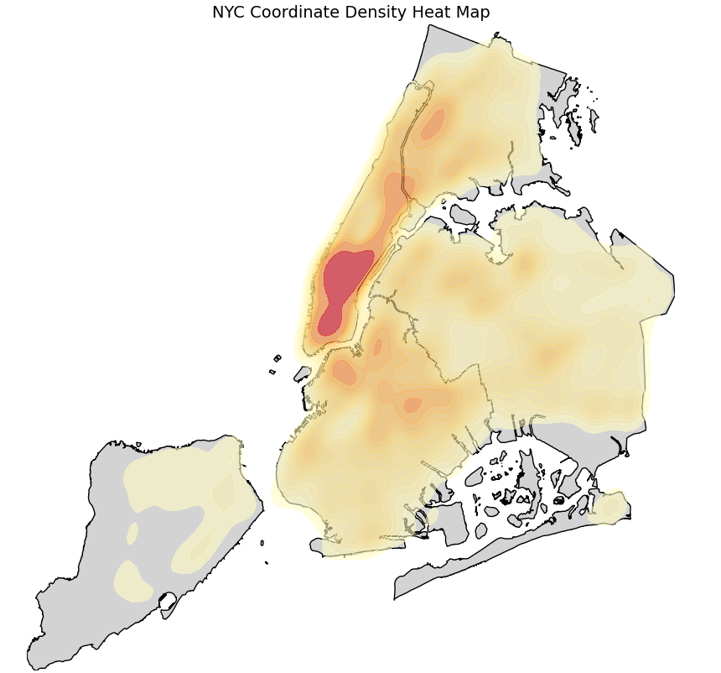
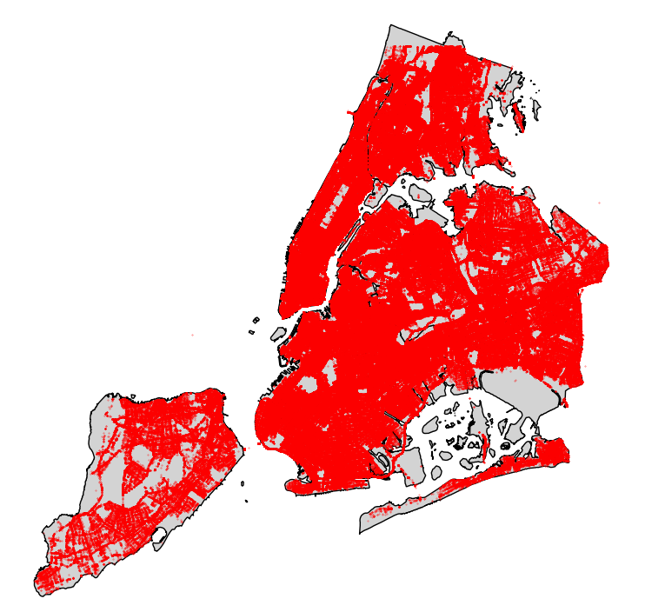
Data visualization

Slide 18
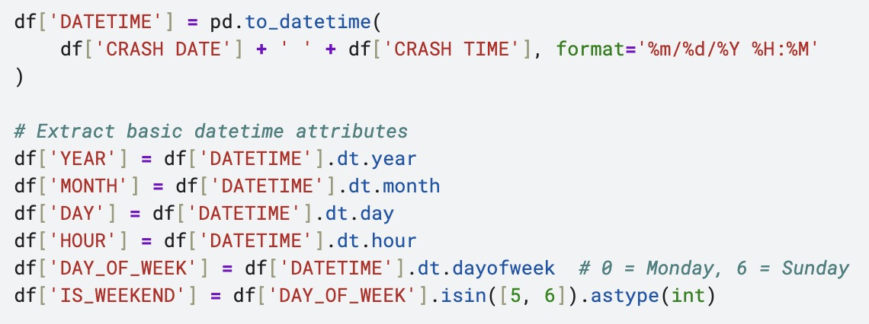
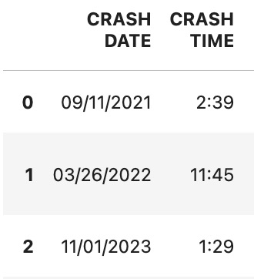
Data visualization
It’s high time we performed feature engineering, or else ‘CRASH DATE’ and ‘CRASH TIME’ is going to be a waste

Slide 19
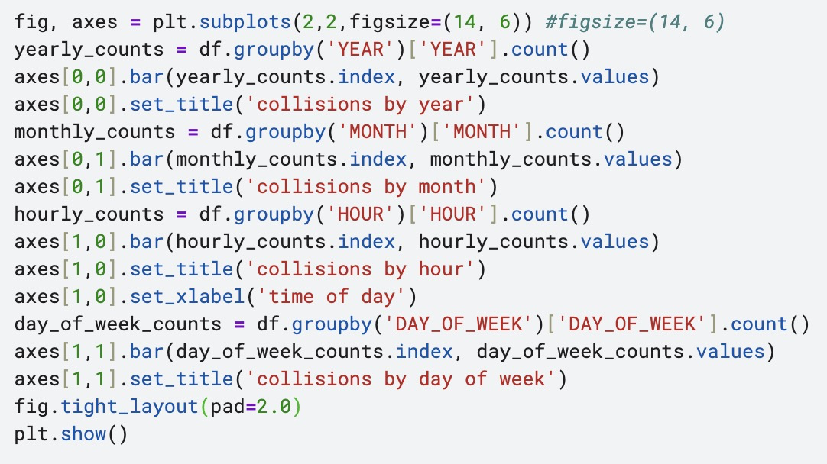
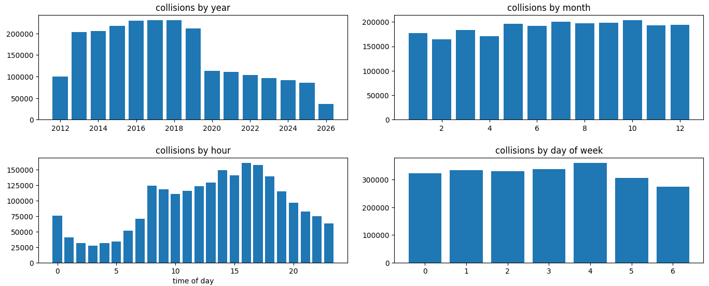
Data visualization
With fresh and ready chronological attributes, it is easier than ever to do even more plotting. Can you notice a pattern?

Slide 20
Model training
Now let's build for ourselves a useful prediction model. Assuming a location/date/time is known, what are the chances of that particular crash has high severity? (let's define severity as number of injured/death as of moment)

Slide 21
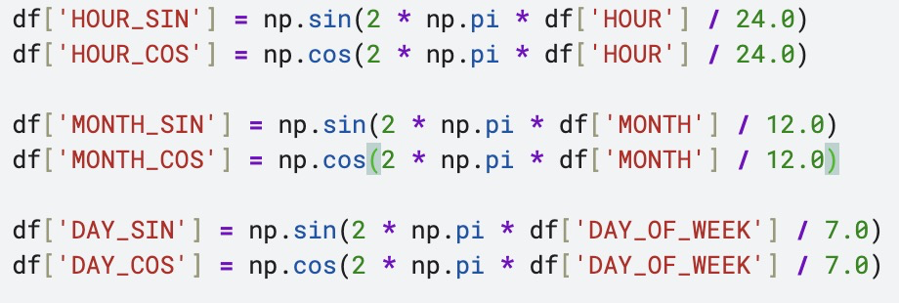
Model training
Transform cyclic time features (Hour, Month, Day of Week) into 2D coordinates on a clock face using sine and cosine transformations.

Slide 22
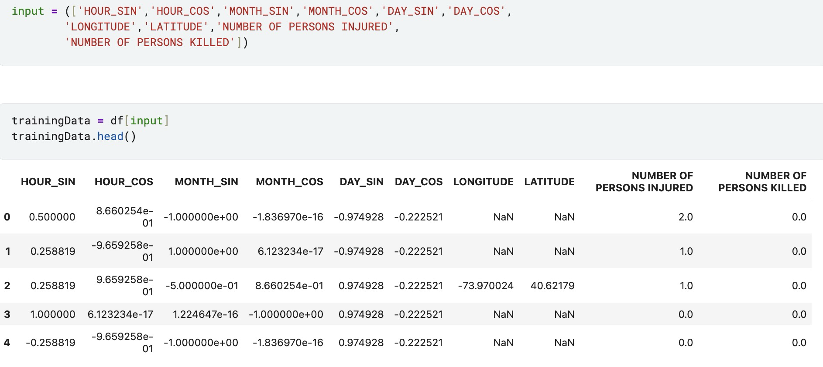
Model training
Next we select only attributes that we require for the prediction

Slide 23
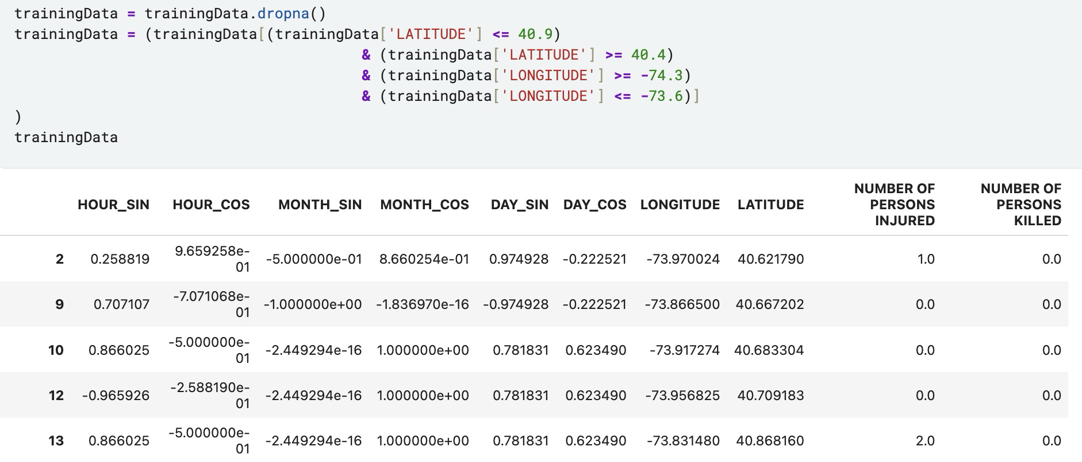
Model training
Clear NaN and invalid coordination records

Slide 24
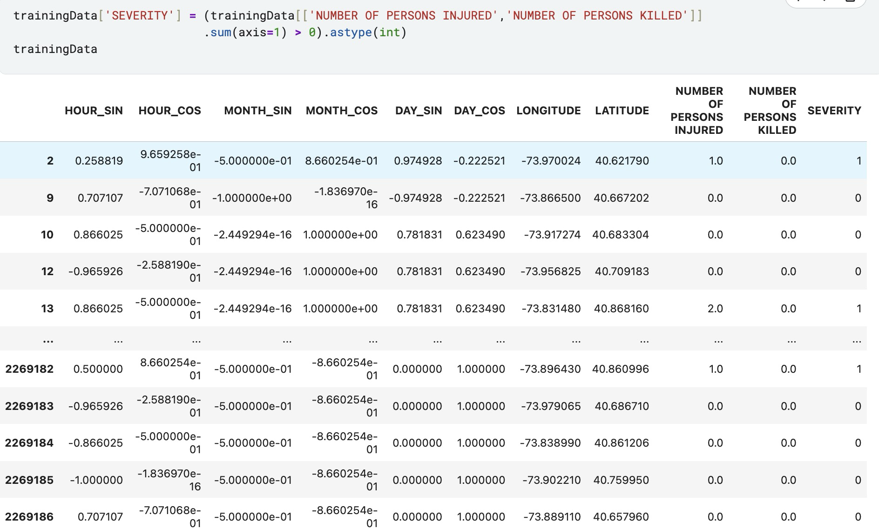
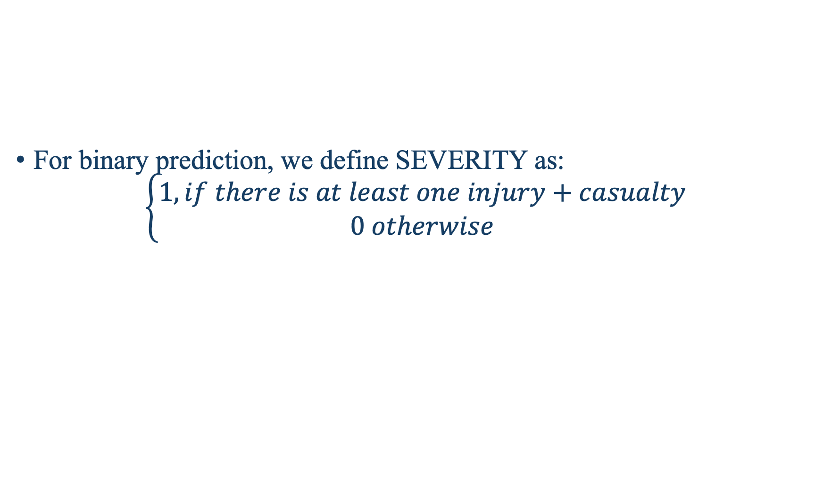
Model training
For binary prediction, we define SEVERITY as:
$$\left\{\begin{aligned}1, if there is at least one injury+casualty \\ 0 otherwise\end{aligned}\right.$$

Slide 25
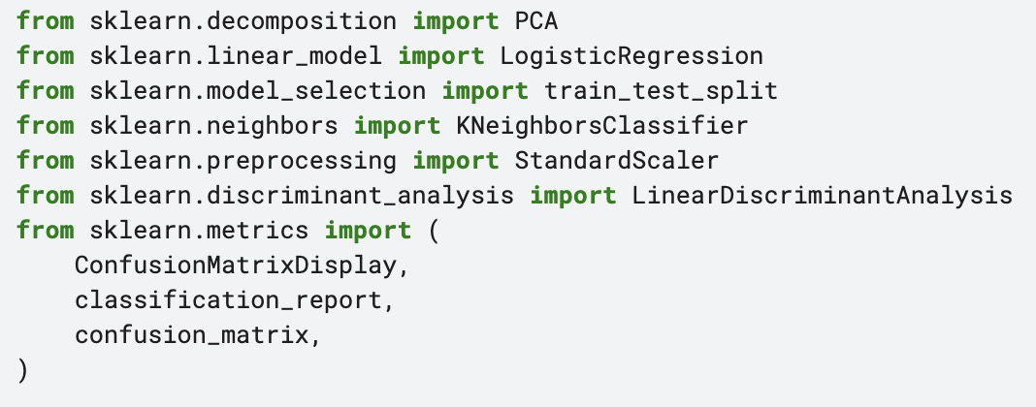
Model training
The model part is rather straightforward using powerful Python library: Scikit-learn. We will apply K-nearest neighbors and Logistic Regression for demonstrative purpose

Slide 26
Model training
The model part is rather straightforward using powerful Python library: Scikit-learn. We will apply K-nearest neighbors and Logistic Regression for demonstrative purpose

Slide 27
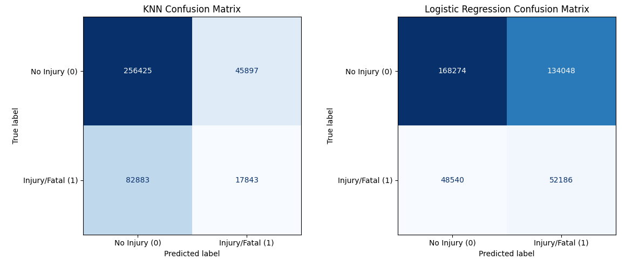
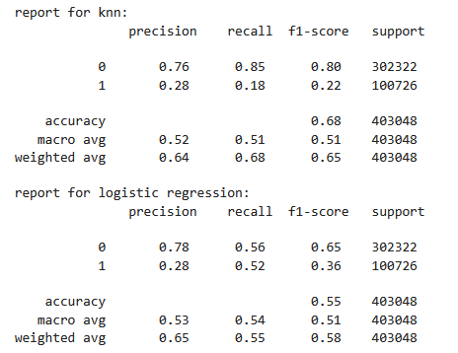
Model training
Turns out both models are equally bad (one with horrendous positive F1-score and one with slightly less horrendous F1-score but worse negative F1-score), but i guess that's it for demonstration process.

Slide 28
Recommendations and policy insights
Borough-specific traffic safety interventions based on victim profile distribution.
Data collection improvements for spatial recording and street-level metadata.

Slide 29
The End~!
Q&A

