Slide 1
Optimistic JPA & Spring Retry

Slide 2
Isolation level and Read phenomena
Isolation is one of the ACID Properties in DBMS.
Isolation determines how data integrity is visible to other transactions. It’s based on the Isolation Level.
Isolation level | Dirty reads | Non-repeatable | Phantoms | Serializabe Anomaly
Read Uncommitted | may occur | may occur | may occur | may occur
Read Committed | don’t occur | may occur | may occur | may occur
Repeatable Read | don’t occur | don’t occur | don’t occur | may occur
Serializable | don’t occur | don’t occur | don’t occur | don’t occur
Concurrency
Consistency
Notes:
ACID: atomicity, consistency, isolation, and durability
DBMS: Database Management Systems

Slide 3
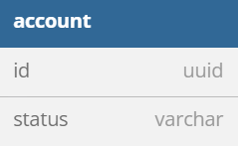
Demo Scenario
ACTIVE
IN_PROGRESS
INACTIVE
id | status
48e5b762-5861-11ed-9b6a-0242ac120002 | ACTIVE
Notes:
Query data table to check

Slide 4
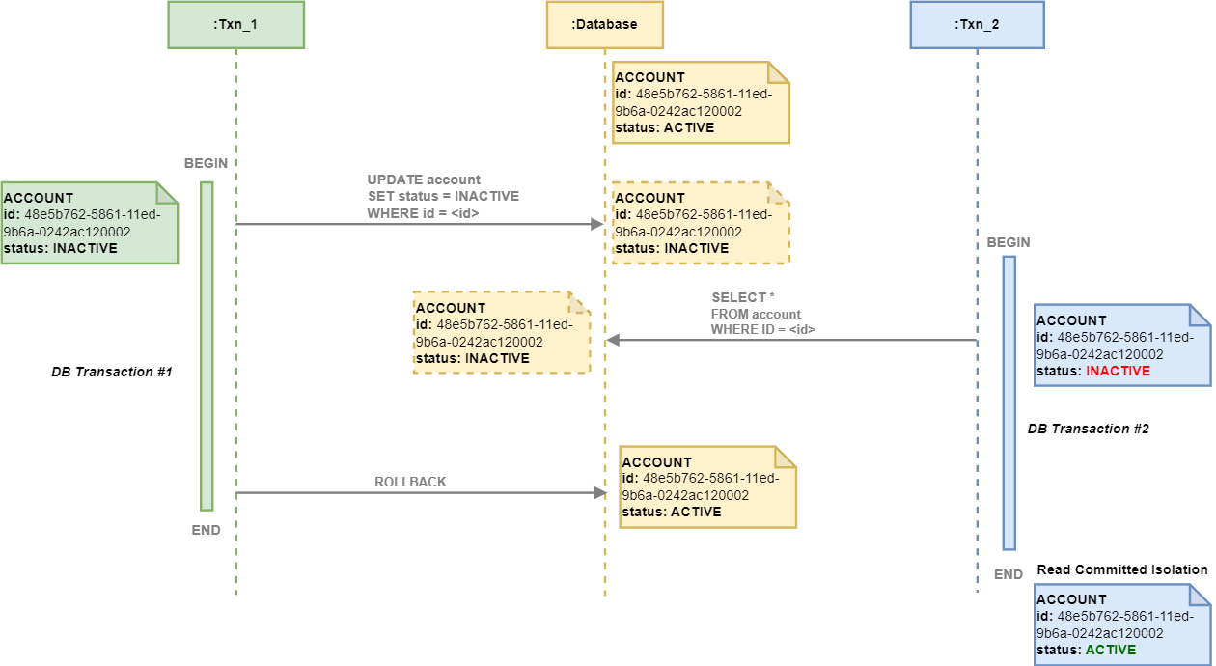
Drity Read
Notes:
Demo this case

Slide 5
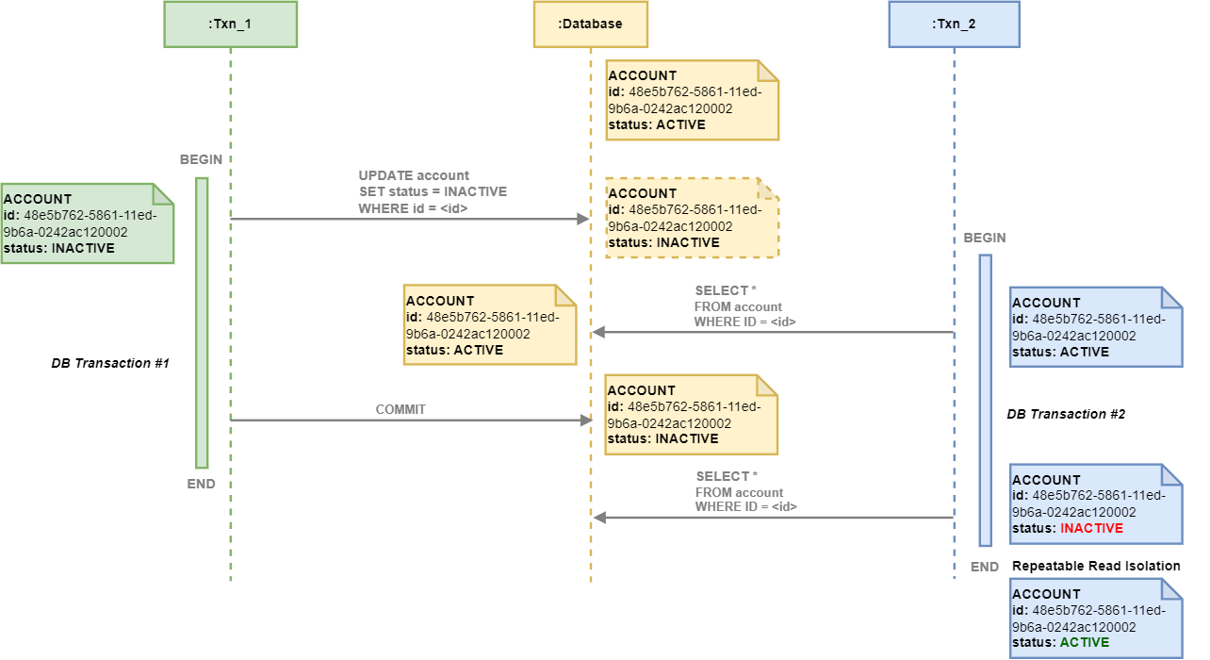
Non-repeatable
Notes:
Demo this case

Slide 6
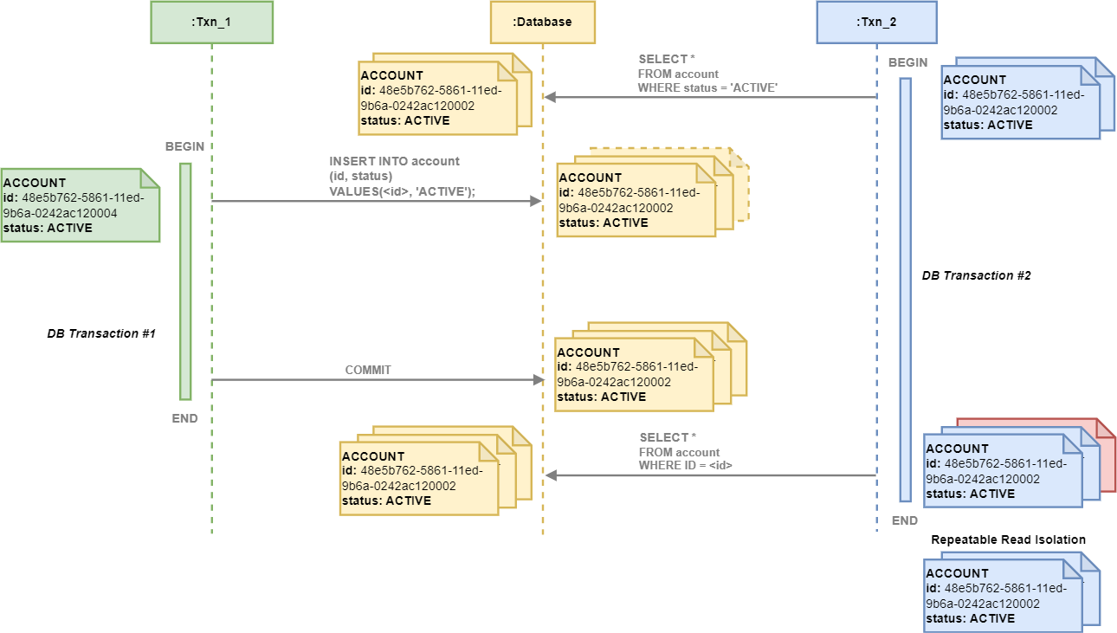
Phantom Read
Notes:
Demo this case
Phantom Reads : This phenomenon occurs when subsequent reads within the same transaction return new rows (ones that the transaction did not read before). This happens when another transaction inserted the new data in between the reads done by the affected transaction.

Slide 7
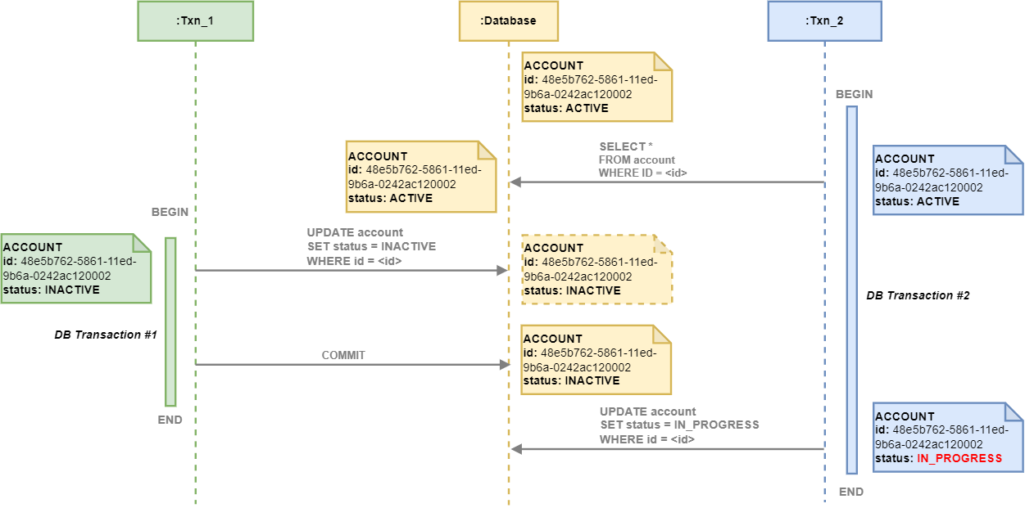
Seriablizable Anomaly
Notes:
Demo this case

Slide 8
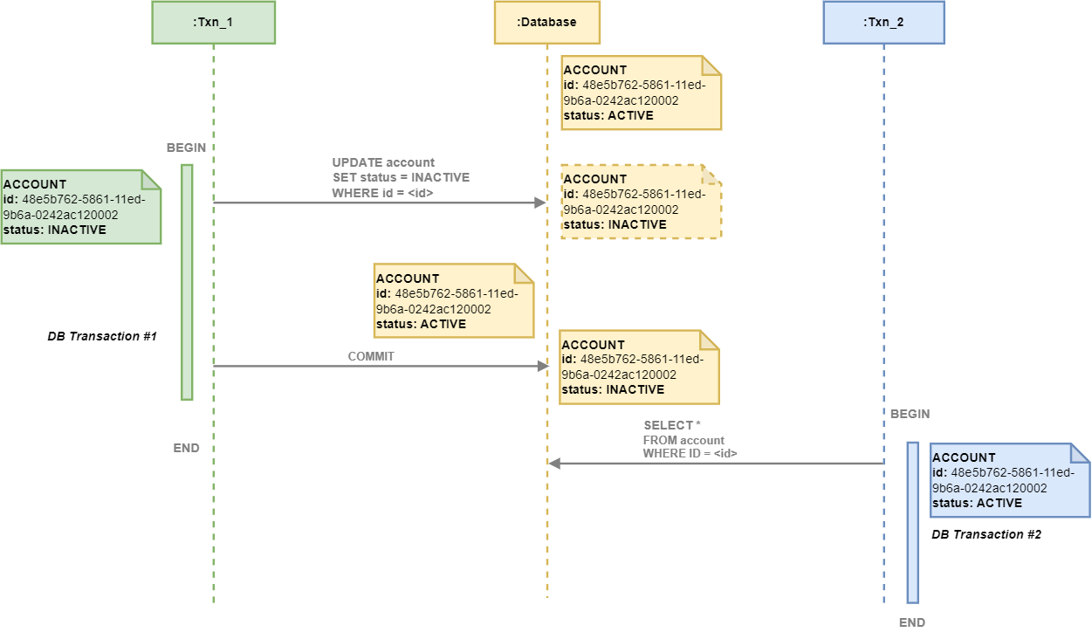
Seriablizable Anomaly (continued)
Notes:
Demo this case

Slide 9
Isolation in Cockroach Database
CockroachDB executes all transactions at the strongest transaction isolation level: SERIALIZABLE.
All other transaction isolation levels are automatically upgraded to SERIALIZABLE.
CockroachDB’s default isolation level is called Serializable Snapshot.

Slide 10
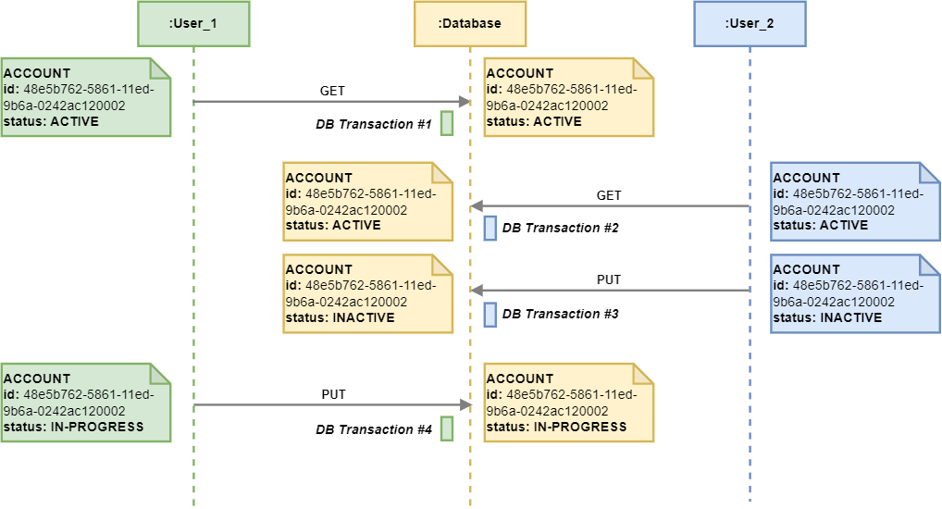
Seriablizable Anomaly in the Web Application
Notes:
Can we use the transactional isolation to resolve this probleam?

Slide 11
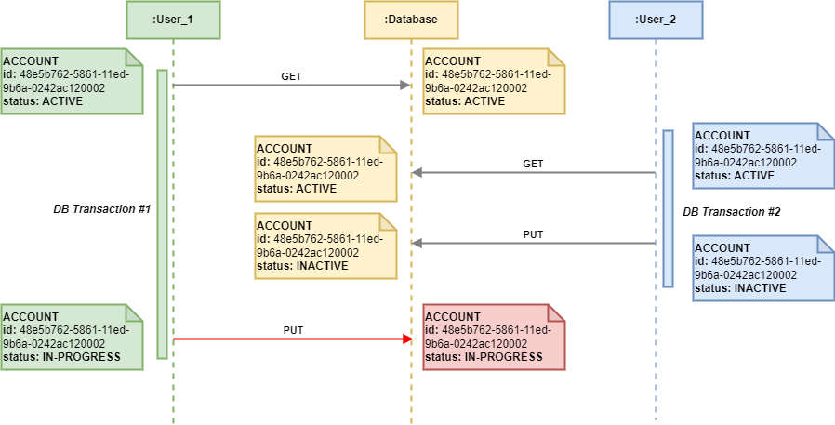
Seriablizable Anomaly in the Web Application (continued)

Slide 12
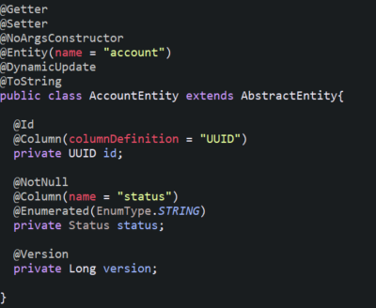
Optimistic Lock mechanism
Optimistic locking, also known as Optimistic concurrency control (OCC) is a concurrency control method applied to transactional systems.
Before committing, each transaction verifies that no other transaction has modified the data it has read. If the check reveals conflicting modifications, the committing transaction rolls back and can be restarted.
In JPA:
In order to use optimistic locking, we need to have an entity including a property with @Version annotation.
If the value has changed in the meantime, an OptimisticLockException is thrown. Otherwise, the transaction commits the update and increments a value version property.

Slide 13
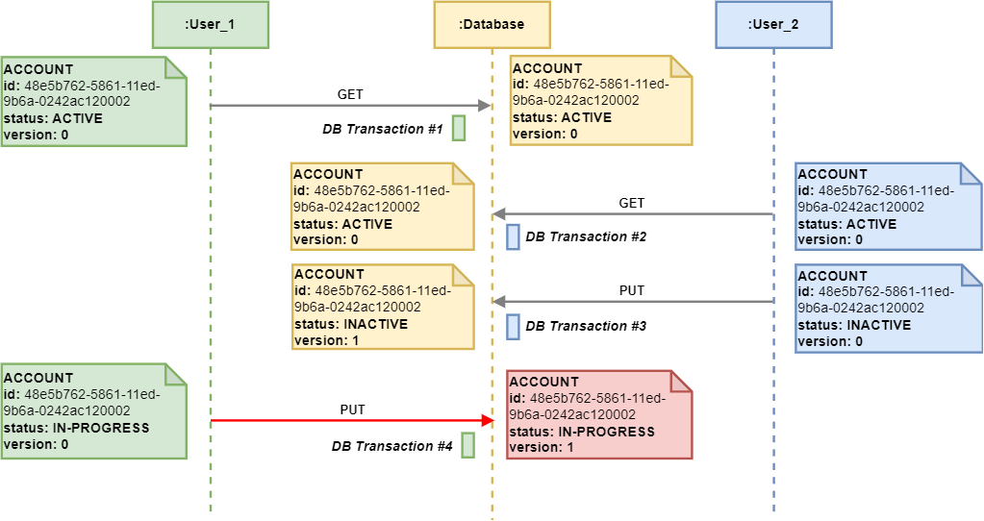
Optimistic Lock mechanism

Slide 14
Transaction Isolation vs Optismic lock (application layer)
Transaction Isolation
Isolated transaction only covers concurrent transaction scenarios.
Optismic lock (application layer)
Optimistic Locking in the application layer only covers non-concurrent transaction scenarios.

Slide 15
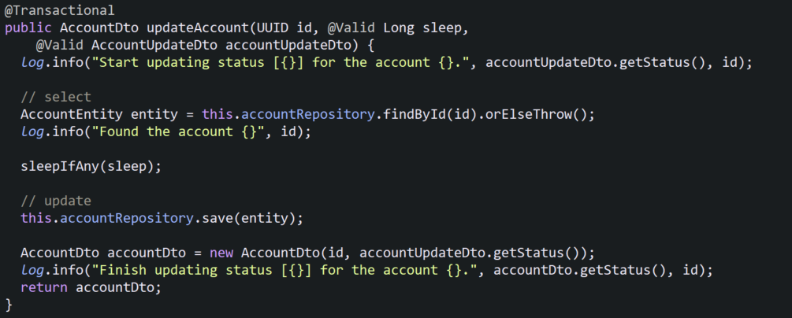
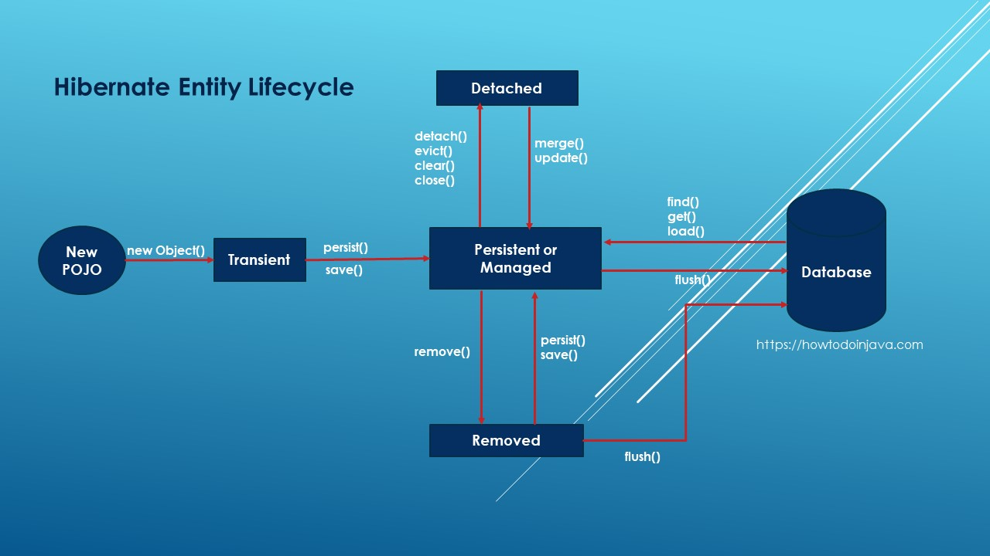
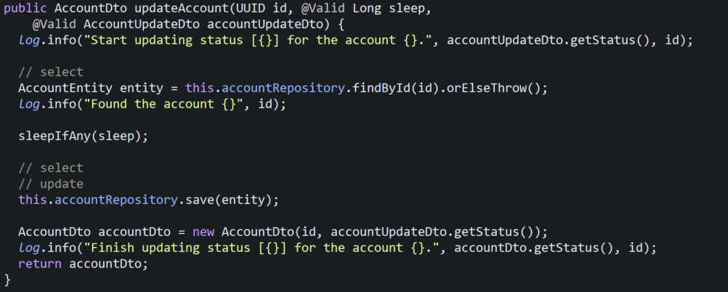
How does @Transactional acctually work?
@Transactional
SELECT statement - save
Account entity (Managed)
UPDATE statement - save
scenario 1
SELECT statement - findById
Account entity (Managed -> Detached)
SELECT statement - save
Account entity (Managed)
UPDATE statement - save
scenario 2
Notes:
demo this case
reset data

Slide 16
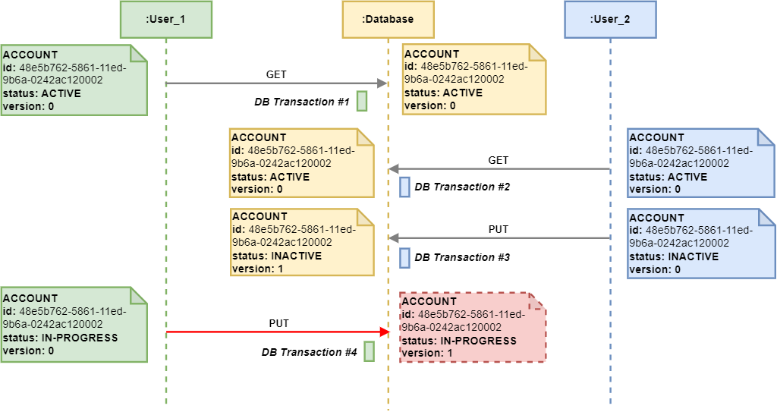
Optimistic Lock and Spring Data JPA
Notes:
Demo this case
Reset data

Slide 17
Optimistic Lock and Spring Data JPA (continued)
@Transactional
SELECT statement (version 0)
SELECT statement (version 0)
UPDATE statement (version 1)
UPDATE statement (version 0)
=> SQLException
scenario 1
SELECT statement (version 0)
SELECT statement (version 0)
SELECT statement (version 0)
UPDATE statement (version 1)
SELECT statement (version 1)
=> OptimisticLockException
scenario 2
Notes:
Demo this case
Reset data

Slide 18
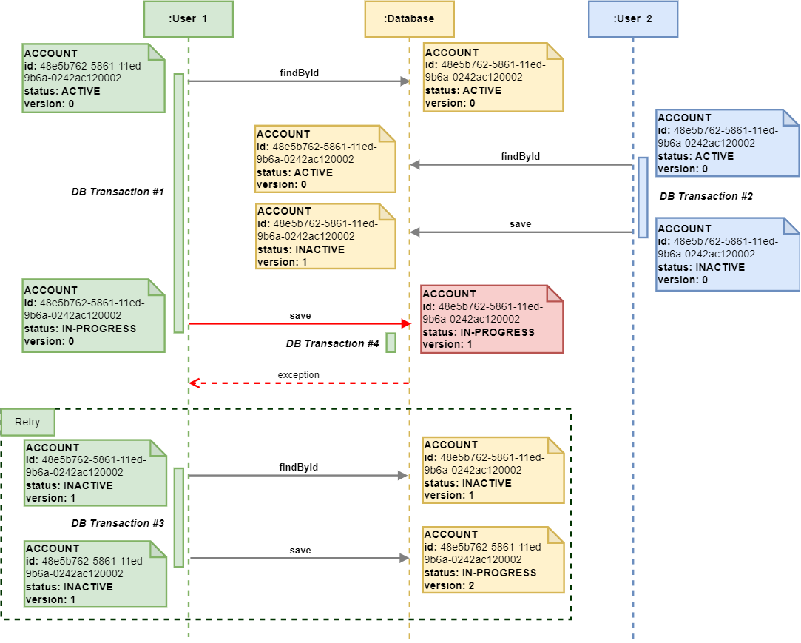

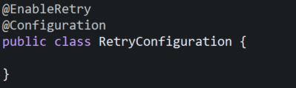
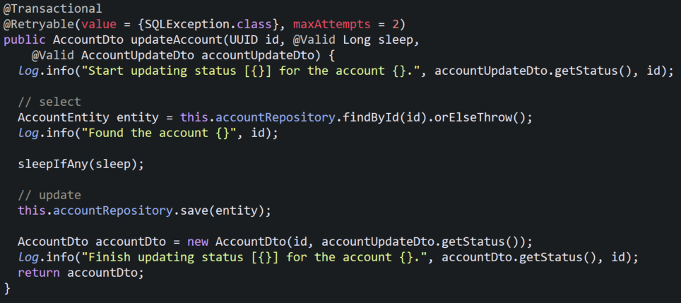
Optimistic Lock and Spring Retry
Retryable Configuration:
maxAttempts (default = 3) - including the first failure
Backoff:
delay (default = 1000 ms)
Notes:
Demo this case
Reset data

Slide 19

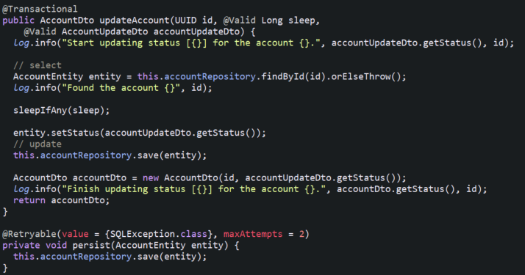
Spring Retry (Advance)
Backoff:
Backoff:
delay (default = 1000 ms) = 30000
multiplier = 2
maxDelay = 90000
1.Delay = 30000
2.Delay = 30000* 2 = 60000
3.Delay = 60000* 2 = 120000 with Max Delay of 90000
Recover:
Note:
@Retryable is powered by Aspect-Oriented Programming. Therefore, processing occurs when a bean is called from another bean.

Slide 20
Q&A

