Slide 1
Resilience

Slide 2
Resiliences
Application resilience is the ability of an application to react to problems in one of its components and still provide the best possible service.
There are the five resiliency patterns:
Timeout
Retry
Circuit breakers
Rate limiter
Bulkhead

Slide 3

Timeout
An HttpClient typically configures two main types of timeouts:
Connection Timed Out:
The connection timeout is the timeout in making the initial connection; i.e. completing the TCP connection handshake.
establish a connection
connection established
Read Timed Out:
The read timeout the time waiting for data – after establishing the connection.
establish a connection
connection established
request
response

Slide 4
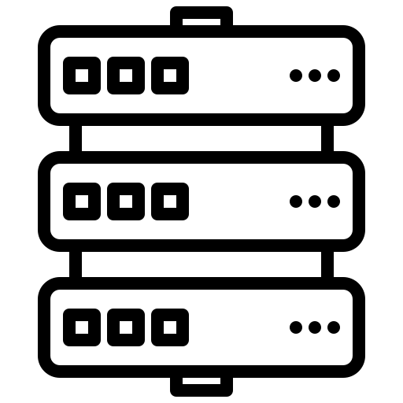
Retry
Retry provides an ability to automatically re-invoke a failed operation.
200 OK
Retry 1
408 Error
Retry 2
408 Error
Retry 3
200 OK

Slide 5
Circuit breakers
Circuit breakers protect downstream services by restricting or completely blocking the way requests go into downstream services.
Failed fast
Closed: The circuit breaker remains in the closed state and all calls to that microservice or system happen normally.
Closed
Error limit reached
Open
Open: The circuit breaker returns an error for calls without executing the function.
Wait time due
Request failed
Half Open: After the number of failures is reached, the circuit breaker switches to a open state. After awaiting time the circuit breaker switches to a half-open state. If a call fails in this state, it goes to the open state, otherwise it back to the closed state.
Request succeeded
Half Open

Slide 6

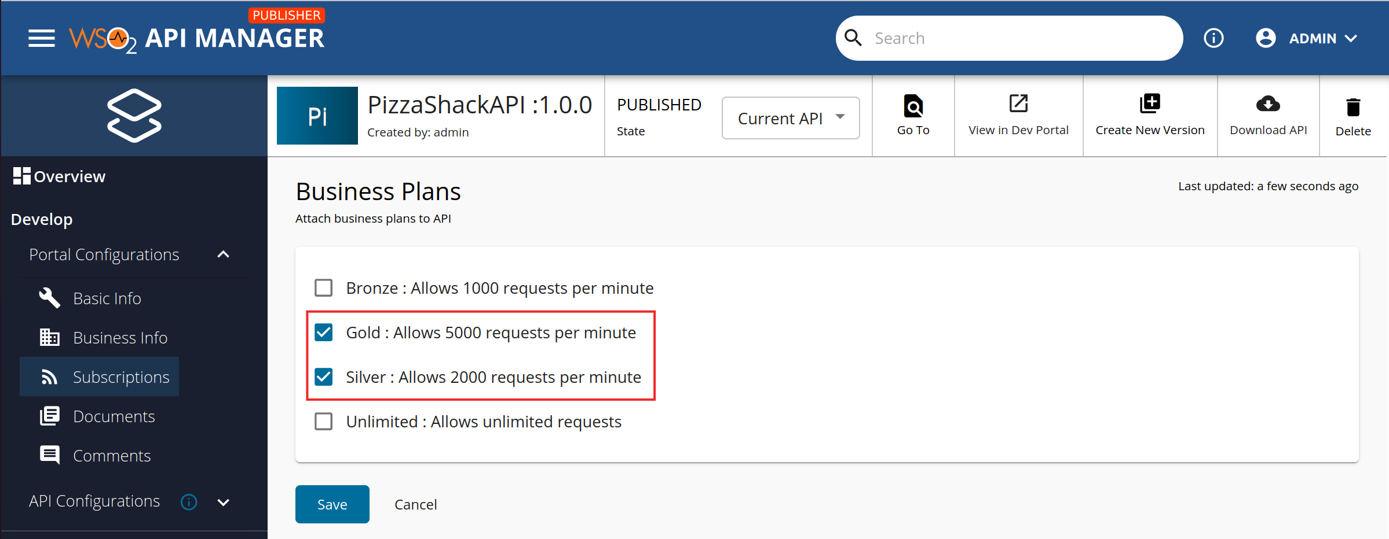
Rate limiter
The rate limiter limits the rate of requests to a resource.
429 Too Many Requests
Request
Client
Endpoint

Slide 7
Bulkhead
To minimize the impact, it is always a good practice to have a dedicated pool for each individual service.
Application
Application
Connection pool for A & B
Connection pool A
Connection pool B
Endpoint A
Endpoint B
Endpoint A
Endpoint B

Slide 8
Resilience for Subscription Application when calling 3rd party
External Service
(Server)
Subscription Application (Client)
HutTokenService
Request
Retry
ProductService
Timeout
AddressService
Response

Slide 9
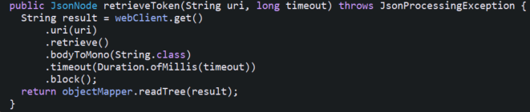
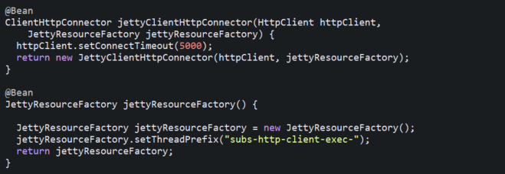
Timeout - Spring WebClient
WebClient - timeout:
JettyHttpClient - connectTimeout:

Slide 10
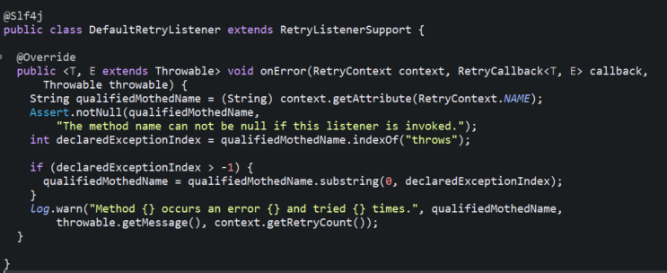
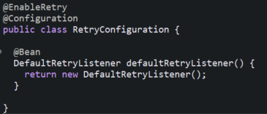
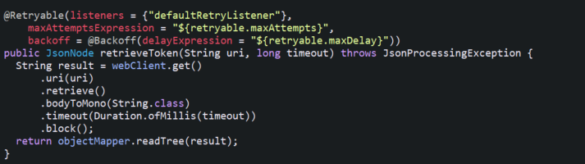
Retry - Spring Retry

Slide 11
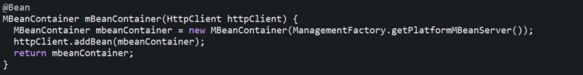


JMX & Jolokia Support
Expose JMX:
Setup Jolokia:

