Slide 1
Review of spatial proteomics
Minh Tran
21/9/20

Slide 2
General view
There are strategies to study the proteome and the molecular mechanism that it mediates:
Proteins are isolated and analyzed with respect of the structure using biochemical-based and biophysical-based methods.
Both approaches are able to perform in large-scale and quantify accurately. However, they are both unable to provide spatial and single-cell resolution.
Mass-spectrometry-based (MS) methods has transformed the way to and introduced new features to study proteomics⁽¹⁾.
Recent substantial advances in combination of high-throughput microscopy, quantitative mass spectrometry and interactomics mapping enable proteome-wide investigations of spatial cellular⁽¹⁾.
Notes:
Ref:
(1) Mass-spectrometric exploration of proteome structure and function
(2) Spatial proteomics: a powerful discovery tool for cell biology

Slide 3
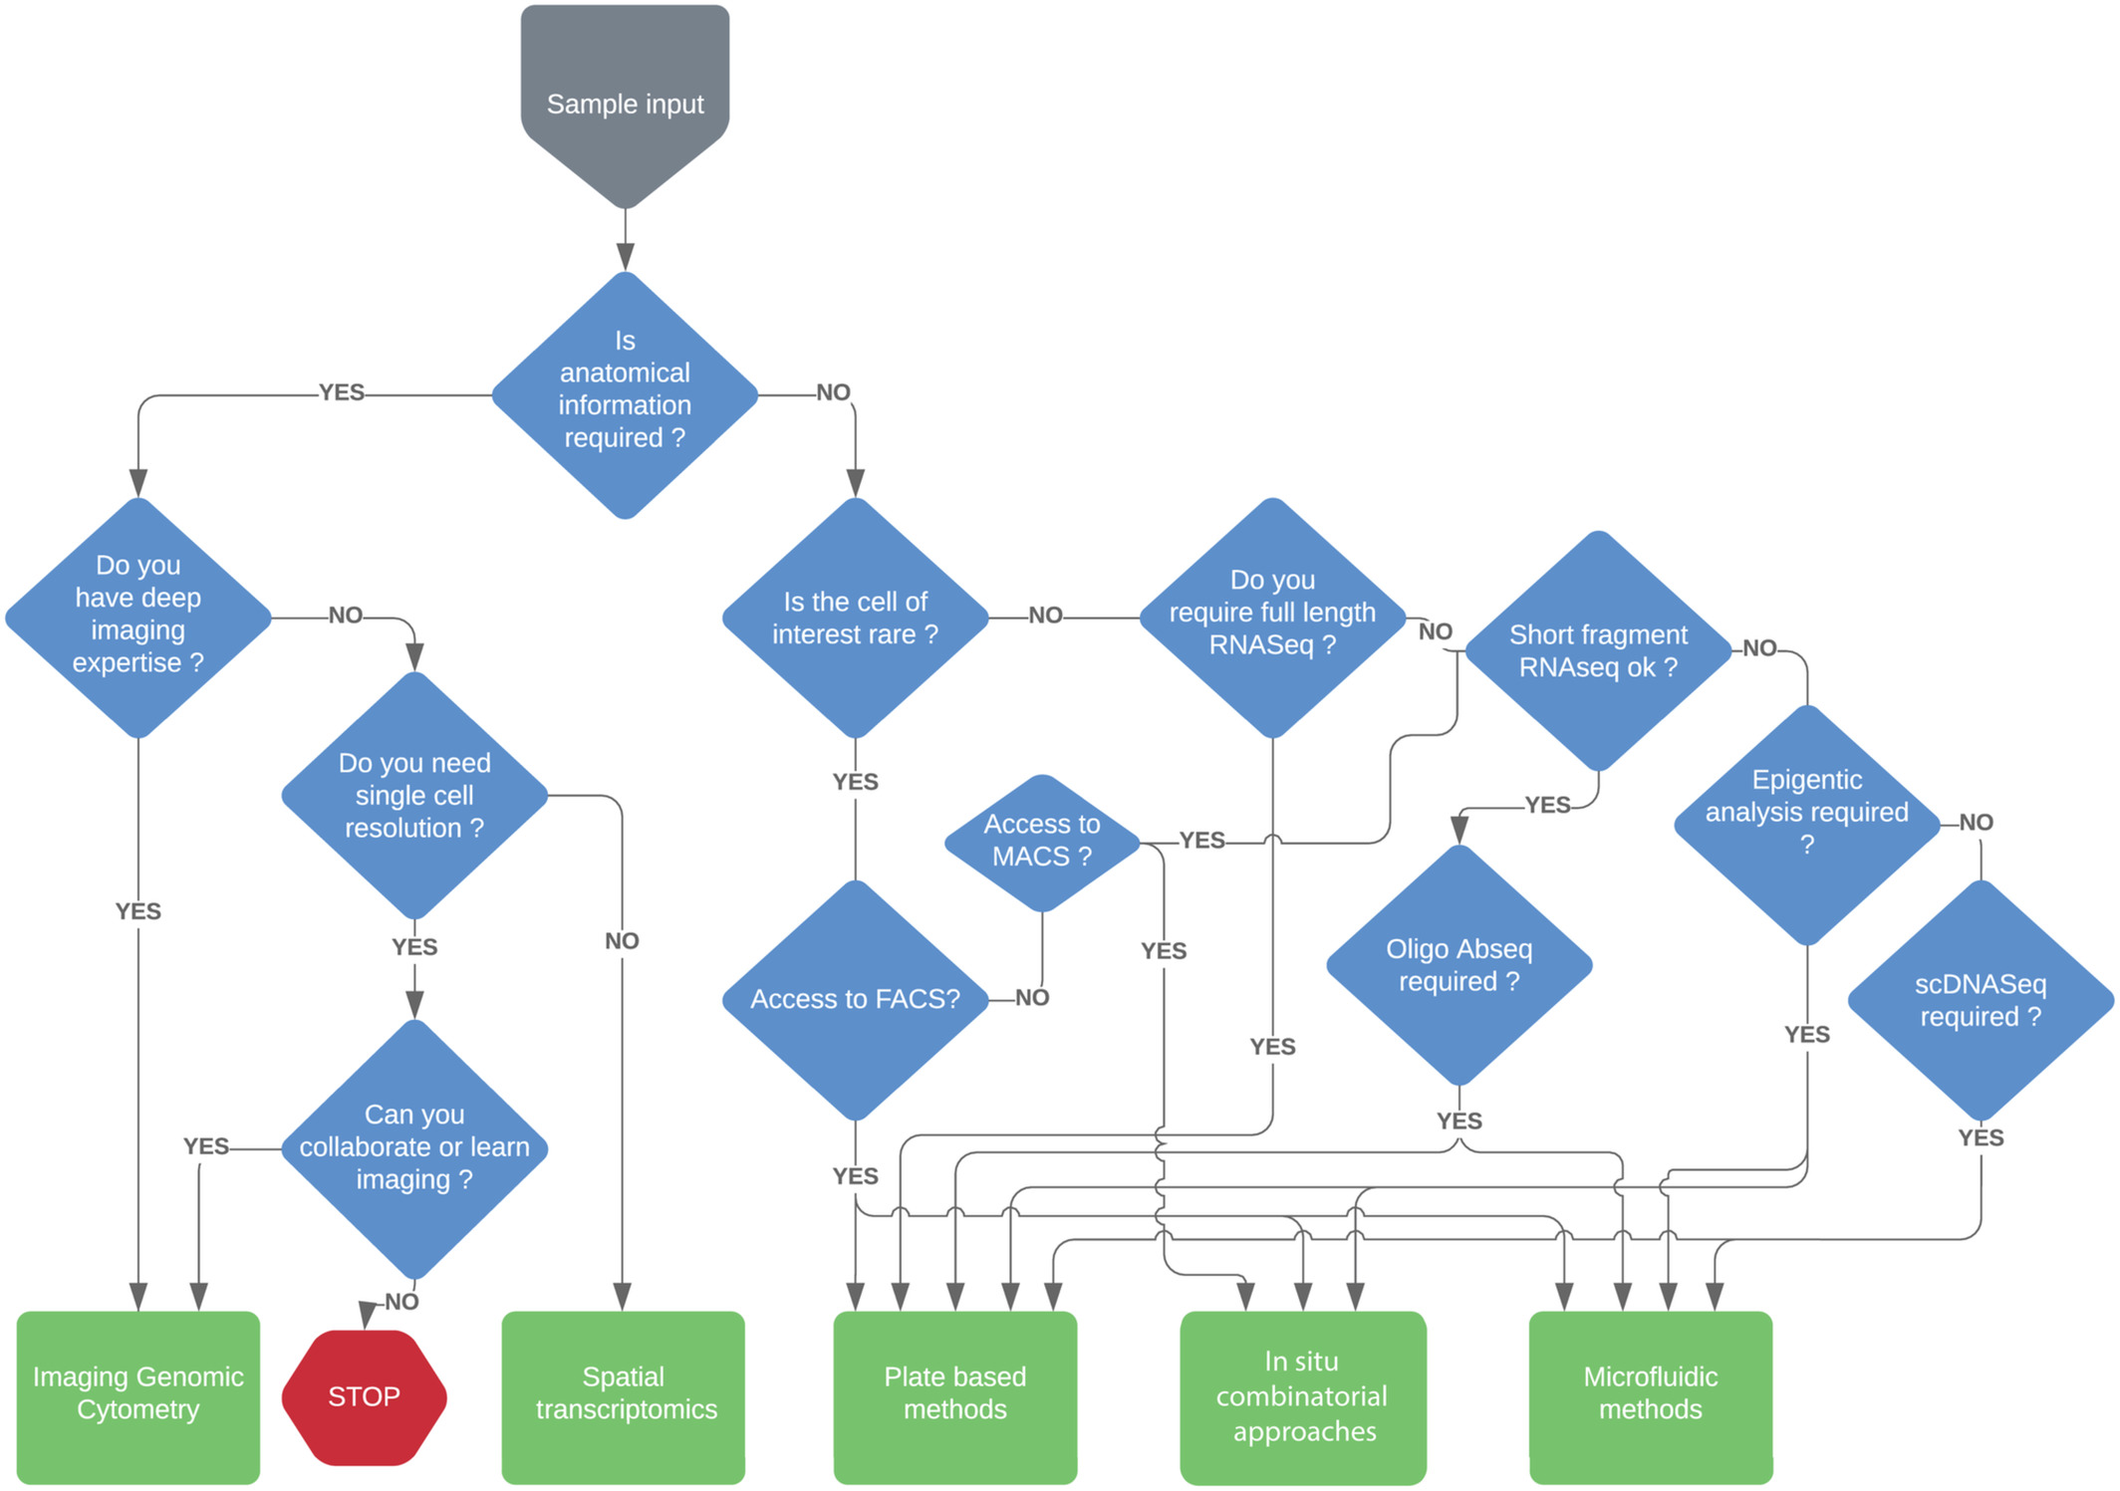
When/what spatial proteomic information can contribute to the biological question?
Spatial proteomics is the set of methods that use imaging technology for the visualization of proteins in their native cellular environment without the need for physical separation of cells or organelles before proteomic analysis.
Notes:
Image from: Genomic Cytometry and New Modalities for Deep Single-Cell Interrogation

Slide 4
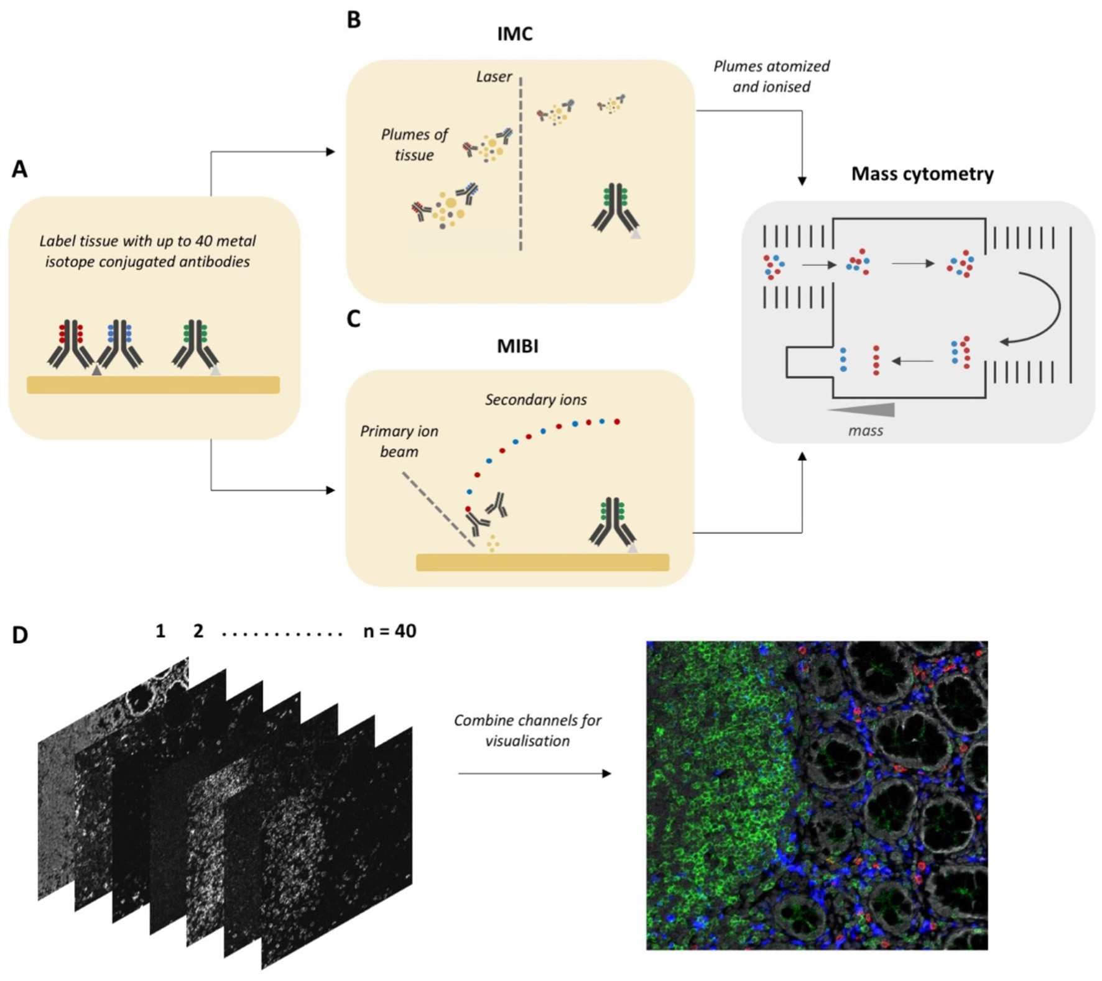
Current development of spatial proteomic
There are currently two popular approaches for spatial proteomic: Imaging Mass Cytometry (IMC), and Multiplexed Ion Beam Imaging (MIBI).
Both approaches use metal-isotope-tagged antibodies with up to 40 different types of antibodies can be used to labelled the proteins.
In IMC, the tissue is ablated, plumes of tissue are aerosolized and ionized and then fed into mass spectrometer (B process).
In MIBI, an oxygen-based primary ion beam rasterizes over the tissue and the releases the metal isotypes from the antibodies (C process).
The metal ions are also fed into the mass spectrometer to estimate isotope abundance and mapped back to the original coordinates.

Slide 5
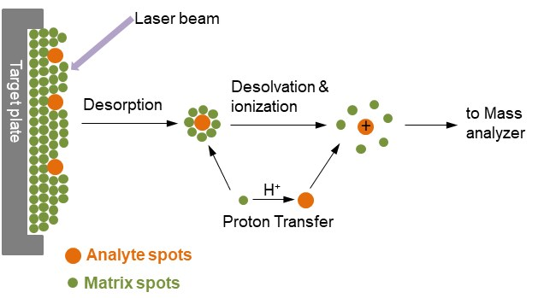
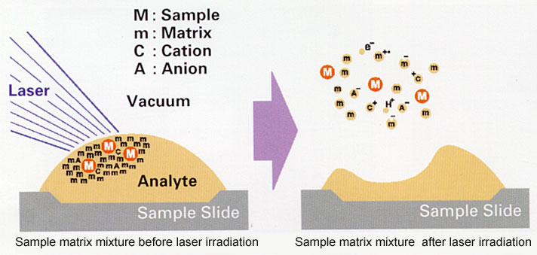
Current development of spatial proteomic
Another worth noting method is Matrix Assisted Laser Desorption/Ionization (MALDI)
In MALDI, a laser and mass spectrometer are used to ablate and ionize molecules on the surface of a sample and the mass spectrum of each pixel on the section is collected
However, MALDI-MSI has several limitations compared to IMC and MIBI, such as lower resolution, lower sensitivity.
Notes:
Picture from: https://www.creative-proteomics.com/technology/maldi-tof-mass-spectrometry.htm#:~:text=Mass%20spectrometry%20is%20an%20analytical,%2Dflight%20(TOF)%20analyzer.

Slide 6
Other spatial protemic profiling.
CODEX, for CO-Detection by indEXing) extends deep phenotyping capabilities of flow and mass cytometry to most standard three-color fluorescence microscope platforms for imaging of solid tissues ⁽¹⁾.
GeoMx DSP (nanostring):
MACSima: the instrument that is capable of detecting hundred of protein stimultaneously using flourescence microscopy
Notes:
Focuse more on nanostring and imc and biological question it solve.

