Slide 1



Terraform
Minh Kun - DaTeam

Slide 2
What is Ansible?
Open source by Red Hat Software
Configuration management
What is Ansible for?
Software provisioning
Application deployment
Configuration management.
The prominent advantage of Ansible is evident in the reduction of complexity and speeding up DevOps initiatives.

Slide 3
What is Terraform?
Open source created by HashiCorp
Orchestration
What is Terraform for?
Creating, managing, and improving infrastructure

Slide 4

Terraform vs Ansible
Orchestration or Configuration Management?

Slide 5

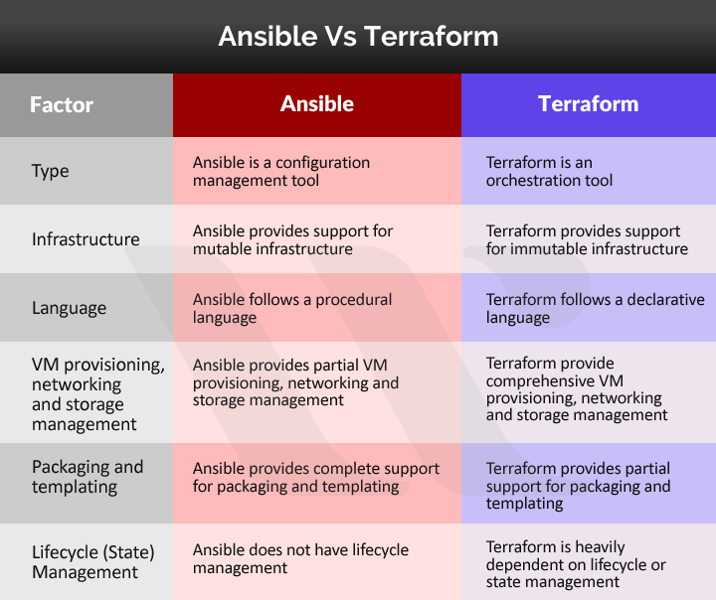


Slide 6
Why Terraform?

Slide 7
Why Terraform?
Zidan?
Sandy?

Slide 8
Why Terraform?
Zidan?
Sandy?
Anton?

Slide 9
Why Terraform?
Zidan?
Sandy?
Anton?
Henrich

Slide 10
Example: orchestra of musicians.
Assume that Terraform and Ansible these tools are a part of an orchestra of musicians.
Terraform serves as the manager or the conductor of the orchestra. The conductor is responsible for ensuring that the right number of instruments are in place.
In addition, the conductor also ensures that all the instruments are playing correctly. If any instrument malfunctions, then the conductor can remove the instrument and replace it with a well-functioning instrument
So, we can note that orchestration tools like Terraform focus highly on the final objectives. Therefore, Terraform always emphasizes on maintaining a particular state of the environment.

Slide 11
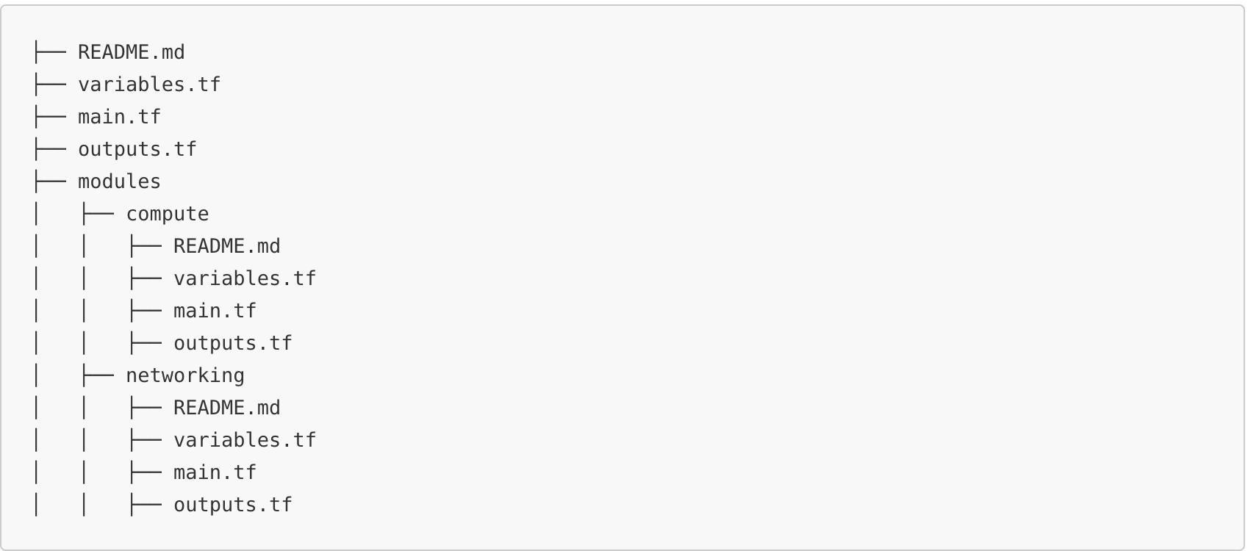
Terraform folder structure

Slide 12
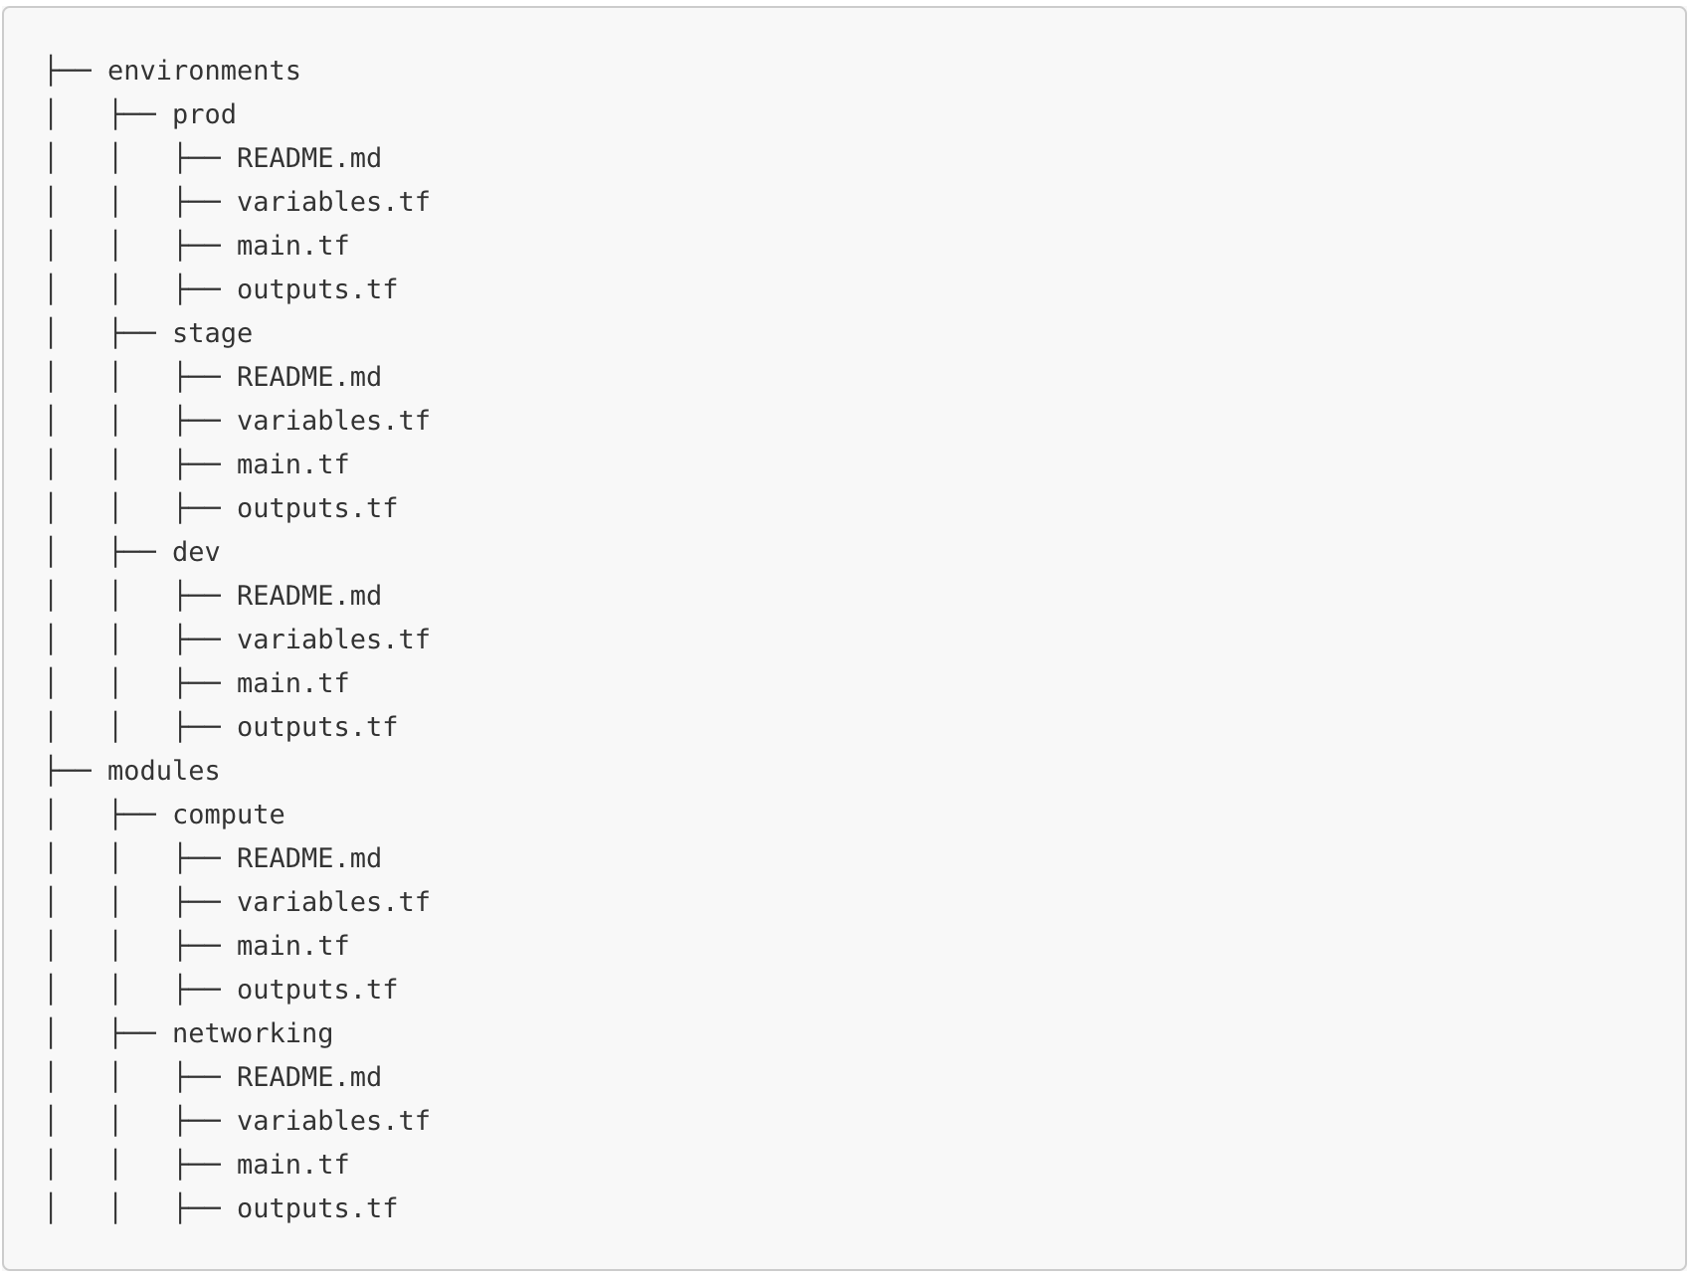

Slide 13
Q&A?
https://www.terraform.io/docs/

