Slide 1

PwC Digital Intelligence Task 2 Responsible AI
CREATED BY: Minh Tran
Date: 07/06/2021

Slide 2
Introduction
This analysis uses a banking dataset and creates a classification algorithm to predict future potential clients who are more likely to subscribe to their term deposits. The goal of the algorithm is to assist management on deliver better business decisions.

Slide 3
Dataset
Content: Banking information
Number of instances: 41,118
Number of attributes: 20
Labels: “yes” or “no”

Slide 4
Dataset
Attributes for prediction:
age
job
marital
education
default
housing
loan
contact
month
day_of_week
duration
campaign
pdays
previous
poutcome
emp.var.rate
cons.price.idx
cons.conf.idx
euribor3m
nr.employed

Slide 5
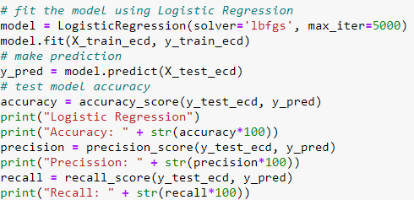
Classification Algorithms
Logistic Regression
Accuracy: 89.31
Precision: 67.95
Recall: 21.35

Slide 6
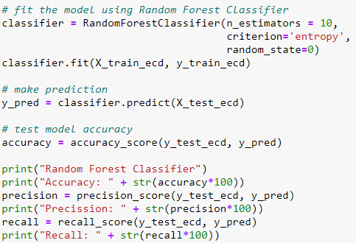
Classification Algorithms
Random Forest
Accuracy: 89.29
Precision: 62.09
Recall: 28.70

Slide 7
Classification Algorithms
While making predictions using all of the features, between Logistic Regression and Random Forest, they have close accuracy but the latter has a better recall, so I will choose Random Forest as the main classifier.

Slide 8
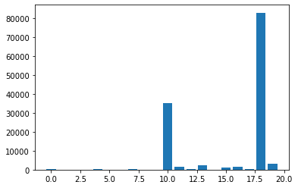
Feature selection
Using Chi-Squared test to perform feature selection.
Attributes that have highest Chi-Squared score contribute to the model the most.
Top 5 features:
euribor3m
duration
nr.employed
previous
campaign

Slide 9
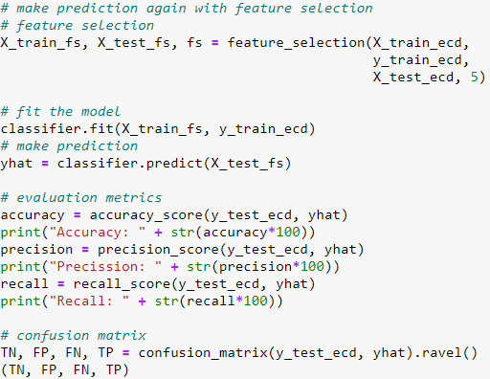
Feature selection
Random Forest after feature selection using Chi-Squared
Accuracy: 87.86
Precision: 49.40
Recall: 28.80
 | Positive | Negative
True | 286 | 6952
False | 293 | 707

Slide 10
Observation
While choosing the top 5 features based on the Chi-Squared score, the model performance reduces slightly. So besides the top contributed features, the other features still indeed contribute to the model, just less than the top 5.
The model accuracy is considerably high, because the model would predict correctly the clients who WON'T subscribe.

Slide 11
Observation
While choosing the top 5 features based on the In this case, recall might be more important evaluation metric to find the most clients who are likely to subscribe.
By using feature selection, the model accuracy has reduced however, the model recall has increased slightly due to less noise.

Slide 12
Conclusion
The management can use this classification model to predict the next future clients who are not likely to subscribe to the term deposits to save resources and find other clients.
Due to short time, this analysis has not covered data-wrangling in-depth, such as data audit, impute missing (unknown value), and outlier detection.

Slide 13
Appendix
More details on dataset and analysis development can be find here: https://github.com/minhtran384/data-science/tree/master/PwC

