Slide 1

OSGi for the earthlings:
meet eclipse libra
Naci Dai (@nacidai)

Slide 2

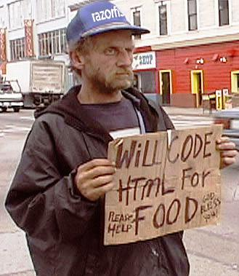
OSGi?
Human nature?
Pointed
Ears
Rounded
Ears
OSGi
Fully supported by
USS Enterprise
Eclipse PDE / WTP
http://xeobits.com/internet/humor-internet/2-cents-for-programmers-funny-one/

Slide 3
Five Levels of OSGi (Alex Blewit)
Denial
Anger
Bargaining
Depression
Acceptance
Can’t possibly work
OSGi is written by IBM?
I don’t use Eclipse
OSGi is too complex
ClassNotFoundException? It is there
These classes are the same but aren’t?
javax.swing is not there
hibernate is not working?
Cannot see my class
why this uses constraint fails
Can’t we start the services in order
Works on Equinox but not Felix
Let there be a Stack Overflow answer for
NoClassDefFoundError ...
• resolution:=optional, please just start
How do I load a JDBC driver?
How can I map JNDI references to data sources?
My custom Log4J logger does not work?
Write a Manifest manually?
Is there a bundle for Apache Beanutils
Bundle Enlightenment
Declarative services
Remote Services
Dynamically update code on servers
Tweets about OSGi

Slide 4
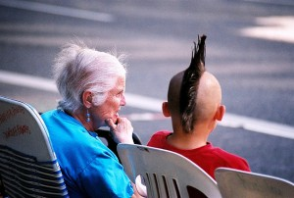
JavaEE: If the shoe does not fit
Tightly coupled
hardwired
Not Dynamic
Restarts with every deploy
Isolation
No sharing
Common libraries etc.
Version conflicts
Hierarchical class-loading
xflickrx, Flickr Creative Commons

Slide 5
OSGi The New Java Enterprise The fictional version
OSGi
Goodies
Modules
Services
Dynamic
Java EE
Goodies
Web
JPA
OSGi Enterprise
Subsystems, WABs, JPA, Blueprint, Naming, …
Transactions
JNDI
+
=

Slide 6
OSGi Enterprise Applications
OSGi programming model
Proven, standards-based
Dynamic
Modular
Manageable
Ubiquitous
Evolvable
Enterprise Infrastructure
Persistence, Transactions, Distributed, Management, Naming, …
A whole new generation of Enterprise Applications

Slide 7
Enterprise OSGi
Hello Client App
Hello Server App
Subsystems
& Services
(.ssa archives)
bundle
dynamic
subsystems
Target
Frameworks
Gemini
Eclipse Equinox
Apache Felix

Slide 8
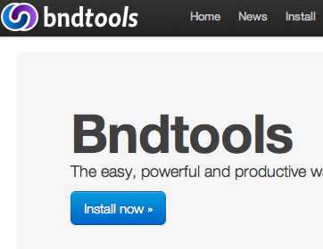
OSGi Tools
Too many/Not enough tools
Different Philosophies
OSGi Transparent
Generate Manifests
OSGi Frameworks are tricky
Launching
Installing
Etc.
Development Tools
Eclipse Libra
Eclipse PDE
Eclipse WTP
Eclipse Virgo Tools
BndTools
IBM Rational Development Tools for OSGi Applications
Silent, still alive???
Builds
Maven Tycho
PDE Builds

Slide 9


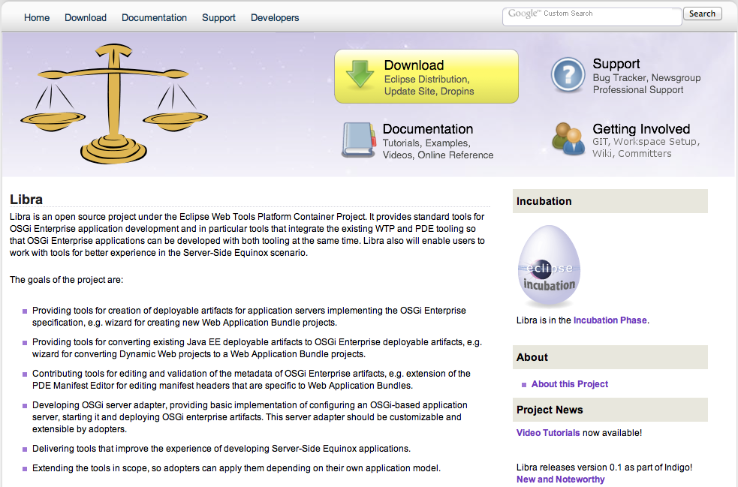



Meet Eclipse Libra
Tools for OSGi Enterprise Development
WTP
PDE
Tools

Slide 10
Libra Tools Scope
Frameworks
Standards & Technologies
Virgo
Aries
Blueprint
EclipseLink
OSGi
JPA
Jetty
OBR
Subsystems
IN
JavaEE
Gemini
Felix
Web
Equinox
Tomcat
Declarative Services
WebSphere(Liberty)
PARs
EABs
OUT
uJOnAS
WebLogic

Slide 11
What is in the Juno Release
OSGi Bundle Facet
WAR Products
OSGi Framework Adapters
Adapted from WTP servers
Launch configurations
Support for Apache Felix, Eclipse Equinox and Knopflerfish
Gemini / Apache Aries
Virgo tools not yet ported!
Manifest Editor / OBR / Adapter / Blueprint Editor
Framework Editor
Refactoring from Virgo Tools
Server Console
Bundle Overview
Dependency Graphs
PROVISIONAL
Bundle Projects
Manifest Editor

Slide 12
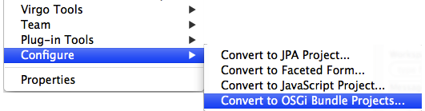
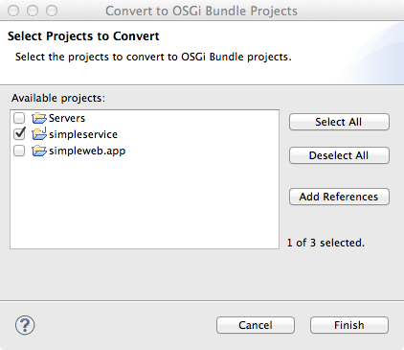
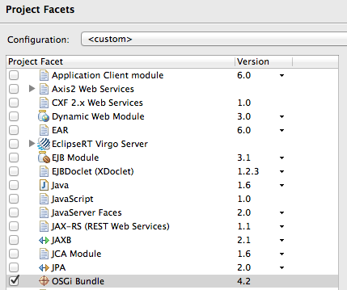
Bundle Projects
OSGi Bundle Facet
PDE / WTP project types
Versioned
Tools can add more behavior

Slide 13
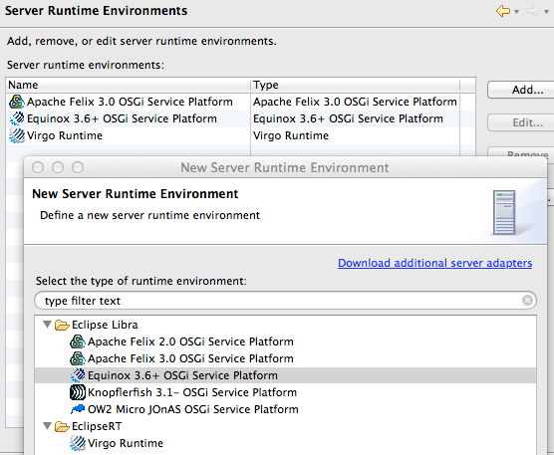
Framework Adapters
Vanilla OSGi Frameworks
Eclipse Equinox, Apache Felix, Knopflerfish
Eclipse RT (with above)
Gemini
Virgo
EclipseLink
Jetty
…
Apache Aries (with above)

Slide 14
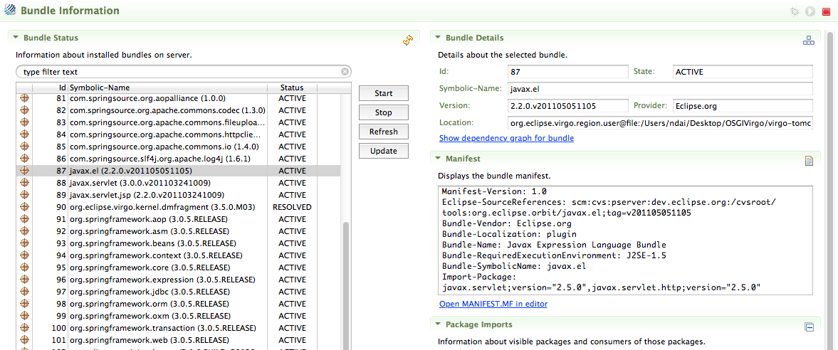
BundleOverview
Part of framework Editor
List and control all bundles

Slide 15
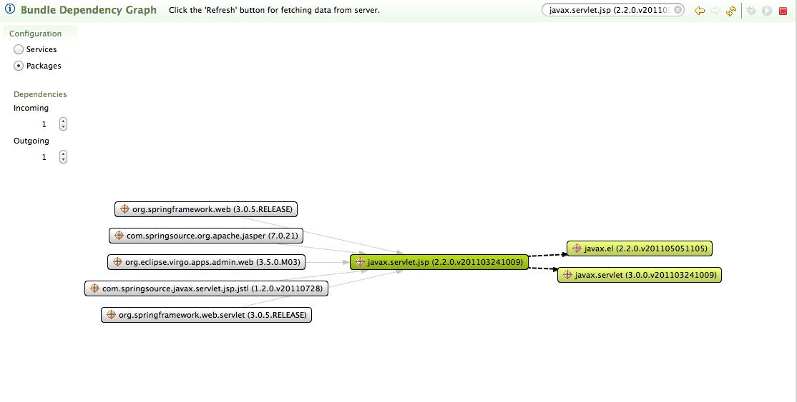
Bundle Dependency View
Graphical representation of bundle dependencies
Drill-downs

Slide 16
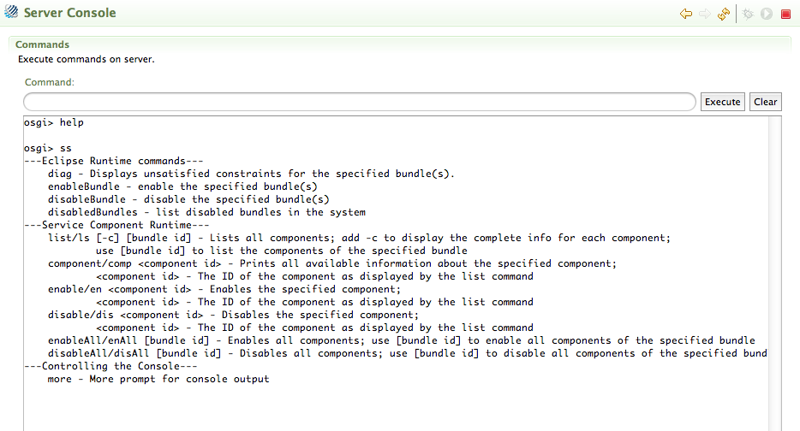
Server Console
Similar to console shells

Slide 17
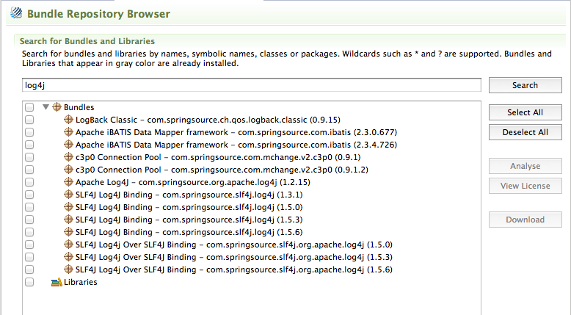
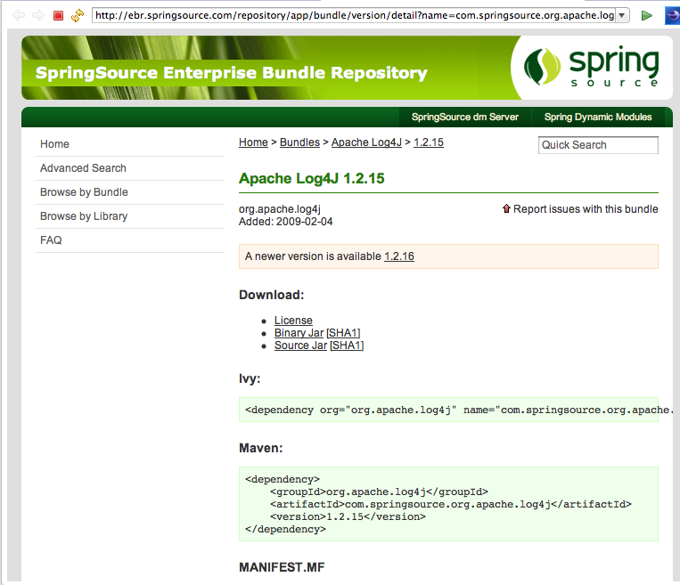
Bundle Repository Browser
(Virgo) Resolves bundles from OBRs
Spring Enterprise Bundle Repository

Slide 18
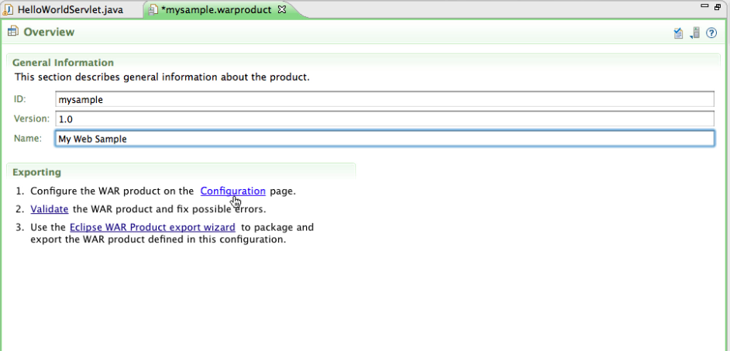
War Products
Equinox running in a JavaEE server in bridged mode
Add your plugins to a Product Definition that exports a WAR file
Includes all necessary plugins and deployment files (web.xml)

Slide 19
demo(s)
You can watch the Video tutorials online...
http://www.eclipse.org/libra/documentation/video/
Launchers and Declerative Services
Gemini Web
Http Service and WAR Products

Slide 20
Resources
http://eclipse.org/libra
Contact
Twitter: @nacidai
Email: naci@eteration.com

