Slide 1


COVID 19 PANDEMIC
DATA, ANALYSIS & VISUALIZATION
3TN TEAM
Trinh Xuan Nam
Le Nguyen Thien Thanh
Le Phuoc Tri
Tran Minh Tri

Slide 2


Data Sources
DataWorld
https://data.world/angie-scetta/covid-data-20210301/workspace/file?filename=covid_data.csv
Our World in Data
- https://github.com/owid/covid-19-data/tree/master/public/data/

Slide 3

COVID-19 PANDEMIC
First identified in later December, 2019

Slide 4

COVID-19 PANDEMIC
First case: Wuhan, Hubei, China

Slide 5
03/2021
173 Countries
113,863,086 Cases
2,532,633 Death

Slide 6
Exploratory Data Analysis on Covid-19 Cases and Deaths
01
02
03
Europe
North America
Asia
04
05
South America
Africa
33.883.270 Cases
811.247 Deaths
32.924.592 Cases
749.089 Deaths
25.090.189 Cases
399.483 Deaths
06
Oceania
18.026.103 Cases
467.842 Deaths
3906140 Cases
104021 Deaths
32792 Cases
951 Deaths

Slide 7
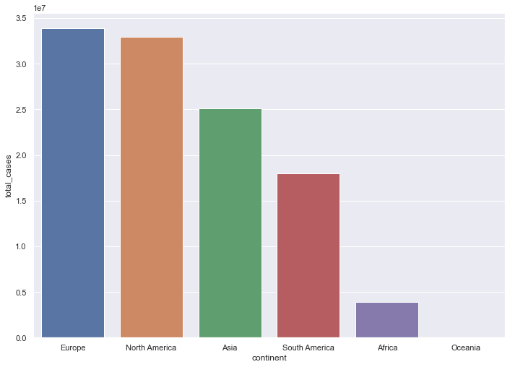
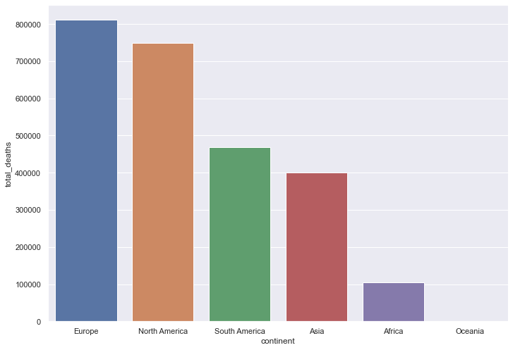
Phân tích số ca nhiễm và tử vong
Number of cases in Continents
Number of deaths in Continents

Slide 8
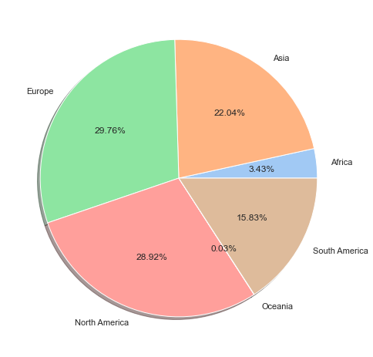
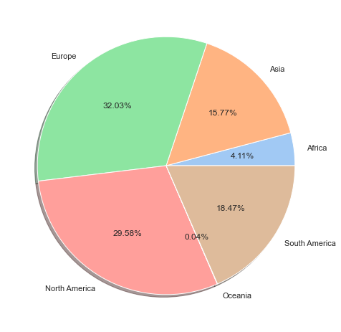
Phân tích số ca nhiễm và tử vong
Percentage of cases in Continents
Percentage of death in Continents

Slide 9
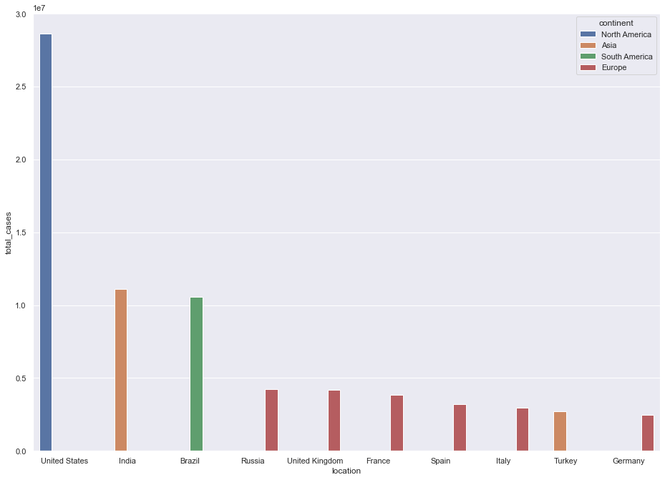
TOP 10
Countries have the highest number of cases

Slide 10
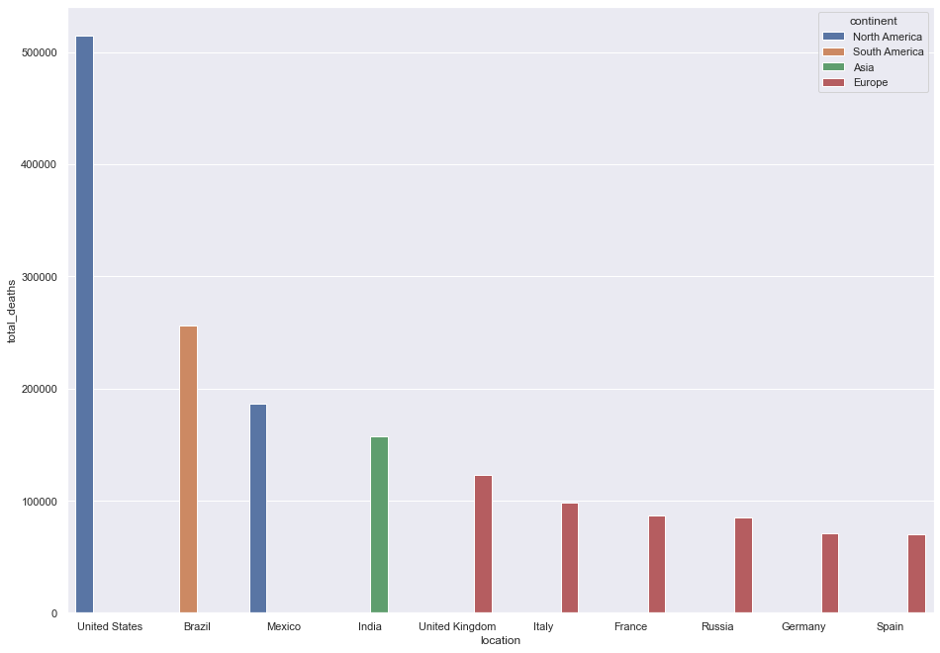
TOP 10
Countries have the highest number of deaths

Slide 11
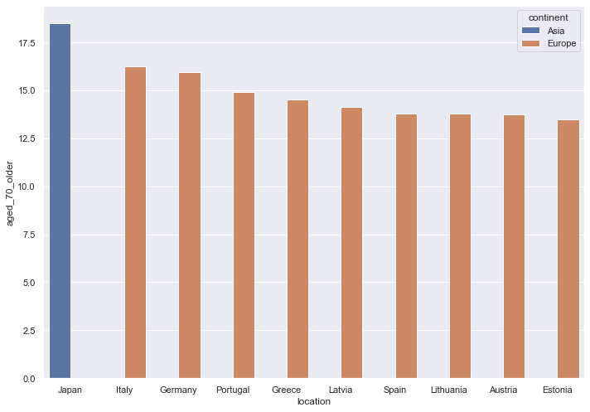
TOP 10
Countries have the highest 70 and above people

Slide 12
Linear Regeression Model
Running a Linear Regression Model bases on three variable: population, number of cases and number of elder to predict the number of deaths

Slide 13
