Slide 1
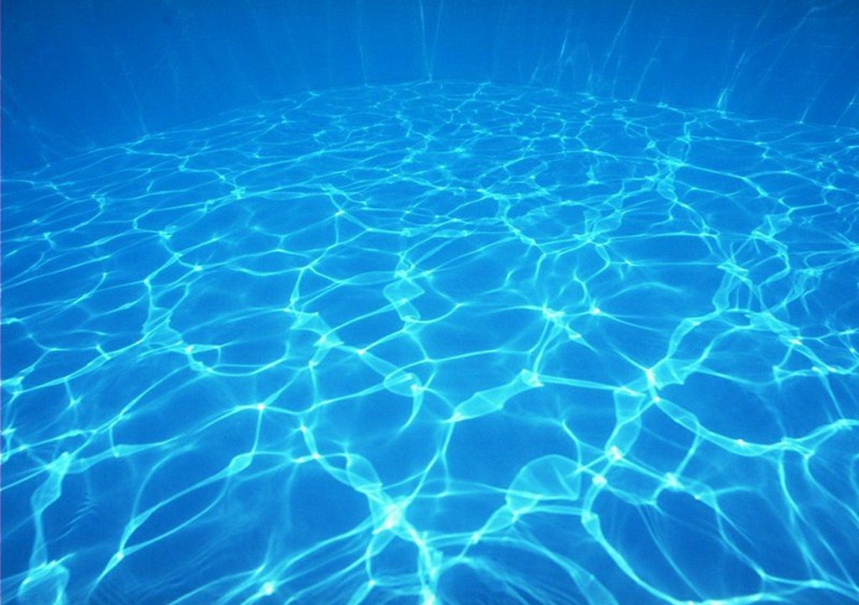
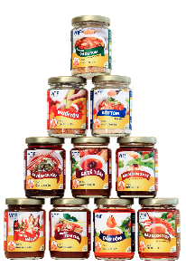
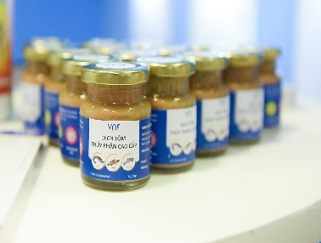
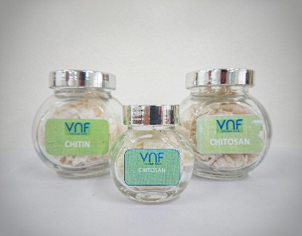
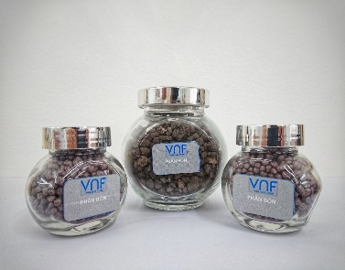







VNF: $28.5B Aquaculture Mineral Market Opportunity
REP. OFFICE: 2A Phan Ke Binh, Tan Dinh Ward, Ho Chi Minh City, Viet Nam
FACTORY 1: Hoa Trung Industrial Zone, Hoa Trung Hamlet, Luong The Tran Commune, Ca Mau Province, Viet Nam
FACTORY 2: Song Hau Industrial Park, Chau Thanh Commune, Can Tho City, Viet Nam
PHONE: (+84) 28 3911 2183
WEBSITE: www.vnfoods.vn
Confidential

Slide 2
AGENDA
1
Nano-minerals: $28.5B future p. 3
6
Highest-risk: bioefficacy failure p. 8
2
Shrimp-feed: $6.4B by 2035 p. 4
7
Three horizons for commercialisation p. 9
3
Nano-Se vs. ZnO outperforms p. 5
8
Build nano-minerals: $28.6M NPV p. 10
4
Organic chelates: cost vs. excretion p. 6
9
Three pillars for shrimp-feed p. 11
5
Lab to pond: 3-year roadmap p. 7
10
Chelates vs. nano-minerals: trade-offs p. 12

Slide 3
Nano-minerals là tương lai $28,5 tỷ USD, nhưng rủi ro tiềm ẩn có thể làm chậm tiến trình.
Tiềm năng tăng trưởng 1,5-3 lần
Chi phí đầu tư sản xuất 2-3 lần cao hơn
Rủi ro quy định chưa được giải quyết
• Dự báo thị trường nano-minerals tăng 1,5-3 lần trong 5 năm tới.
• Công nghệ nano-bioefficacy đang thu hút đầu tư từ các tập đoàn dược phẩm.
• Cơ hội hợp tác giữa nano và công nghệ chelate đang mở rộng.
• Nano-minerals có thể thay thế các sản phẩm hóa học truyền thống.
• Công nghệ nano đòi hỏi đầu tư cơ sở hạ tầng mới (CapEx) cao gấp 2-3 lần.
• Nano-minerals yêu cầu quy trình sản xuất phức tạp và kiểm soát chặt chẽ.
• Chi phí nghiên cứu và phát triển (R&D) cho nano-minerals cao hơn so với các sản phẩm truyền thống.
• Công nghệ nano đòi hỏi hợp tác giữa các chuyên gia đa ngành.
• Quy định về an toàn và môi trường cho nano-minerals chưa thống nhất.
• Nano-minerals có thể bị hạn chế xuất khẩu do quy định nghiêm ngặt.
• Rủ ro pháp lý từ các vụ kiện liên quan đến an toàn nano-technology.
• Cần hợp tác quốc tế để xây dựng tiêu chuẩn nano-minerals.

Slide 4
Shrimp-feed segment will be $6.4B by 2035
REVENUE
$4.3-4.6B
2024-25 forecast
Shrimp-feed segment growth
4.2-4.9% CAGR expected
REVENUE
$6.4B
2035 projection
Beachhead growth trend
Focus on trace minerals
MARKET SHARE
25%
Target capture
Shrimp-feed focus area
VNF market projections 2026
Nguồn: Source: VNF market projections 2026
Focus shrimp-feed trace minerals to capture 25% of the market.

Slide 5
Nano-Se vs. ZnO outperforms conventional minerals
Nano-Se
1.5x growth
Nano-ZnO
30% gain
ZnSO4
baseline
Post-challenge mortality data
Nguồn: Source: VNF lab trials 2026
Nano-formulations deliver 1.5-3x growth but require stabilisation.

Slide 6
Organic chelates cost 1.5-2.5x but have lower excretion
ORGANIC CHELATES
40% lower excretion
$2.8M risk budget
1.5-2.5x cost vs inorganic salts
Immediate cash flow solution
INORGANIC SALTS
Cheaper
Higher excretion
Lower upfront cost
Long-term excretion risk
Nguồn: Source: VNF performance benchmarks 2026
Use organic chelates for immediate cash flow while developing nano-formulations.

Slide 7
From lab to pond: 3-year nano-mineral roadmap
2026 year
+1 year
+2 year
2028 year
Lab trials
Pilot plants
Commercial
Deployment
Nguồn: Source: VNF strategic brief 2026
Validate stabilisation protocols before commercial-scale deployment.

Slide 8
Nano-bioefficacy failure is the highest-risk scenario
Low
Medium
Zero IP
Likelihood
High
Regulatory
Nano-bioefficacy
Nguồn: Source: VNF risk assessment 2026
Low
Medium
High
Allocate $2.8M for regulatory affairs to mitigate risks.
Impact

Slide 9
Three horizons for nano-mineral commercialisation
Q1'26
Q2'26
Q3'26
Q4'26
Regulatory & IP
File patents
Patent filed
Validation
Stabilisation
Validated
Contracts
Anchor deals
Signed
Nguồn: Source: VNF strategic brief 2026
Pre-invest in regulatory and IP to avoid derailment.

Slide 10
Build nano-minerals with partner overlay for $28.6M NPV
BUILD (HIGH RISK, HIGH REWARD)
Build nano-minerals
CHALLENGE (LOW RISK, HIGH REWARD)
REWARD ↑
Partner overlay
PARTNER (MODERATE RISK, MODERATE REWARD)
NICHE (LOW RISK, LOW REWARD)
Nguồn: Source: VNF financial model 2026
Partner overlay reduces risk while maintaining pricing power.
RISK →

Slide 11
Three pillars to unlock the $41.9M shrimp-feed opportunity
1
2
3
Shrimp-feed segment
$6.4B market size
High demand for trace minerals
Nano-minerals
1.5-3x growth potential
Innovative technology
Regulatory compliance
EFSA opinions 2027-28
Critical for market access
Focus on shrimp-feed trace minerals to capture 25% of the market

Slide 12
Organic chelates vs. nano-minerals: trade-offs
Strengths
Organic chelates: lower excretion
Organic chelates: cheaper
Weaknesses
Nano-minerals: stabilisation challenges
Opportunities
Nano-minerals: higher growth
Threats
Organic chelates: limited growth potential
Nguồn: Source: VNF performance benchmarks 2026
Organic chelates are safer but nano-minerals offer higher growth.

Slide 13
Nano-mineral stabilisation is the critical capability gap
Stabilisation
Hiện tại (current)
Mục tiêu (target)
Develop commercial stabilisation protocol before scaling
Regulatory
Scale-up
Nguồn: Source: VNF strategic brief 2026
Develop a commercial stabilisation protocol before scaling.

Slide 14
Key stakeholders in the aquaculture mineral market
INFLUENCE
Competitors
IMPACT
Feed mills
Regulators
VNF
FDA
311 patent filings
Nguồn: Source: VNF strategic brief 2026
MONITOR
ENGAGE
Collaborate with feed mills and regulators to accelerate adoption.

Slide 15
KPIs to track nano-mineral commercialisation progress
Stabilisation success ▲
75%
90%
Regulatory approvals ▲
50%
80%
Feed-mill adoption ▲
30%
60%
Nguồn: Source: VNF strategic brief 2026
Monitor stabilisation success, regulatory approvals, and feed-mill adoption.

Slide 16
Data sources and methodology caveats
DATA SOURCES
VNF strategic brief 2026
METHODOLOGY
Market projections (2025-2034)
Lab trials (2026)
Risk assessments (2026)
KEY ASSUMPTIONS
Nano-bioefficacy uncertainty
Nguồn: Source: VNF strategic brief 2026
Acknowledge data limitations to manage expectations.

Slide 17
AGENDA
1
Executive summary p. 1
2
Market analysis p. 2
3
Technology assessment p. 3
4
Regulatory risks p. 4
5
Strategic recommendations p. 5

Slide 18
Nano-minerals are the next frontier in aquaculture nutrition
“
Nano-enabled minerals are the next frontier in aquaculture nutrition.
— VNF CEO, VNF strategic brief 2026
Nguồn: Source: VNF strategic brief 2026
Invest in nano-minerals to lead the $28.5B market.

Slide 19
Multi-criteria scoring for nano-mineral candidates
CRITERIA
NANO-SE
NANO-ZNO
INORGANIC SALTS
Growth
●
●
◑
Stabilisation
◑
●
◑
Nguồn: Source: VNF strategic brief 2026
Prioritise candidates with high growth and low stabilisation risks.

