Slide 1

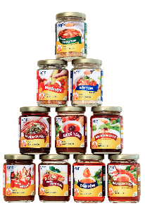
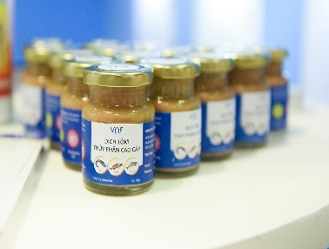
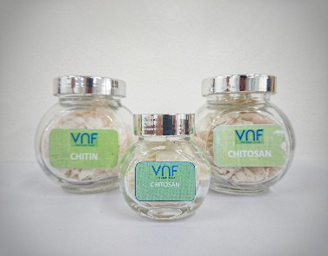
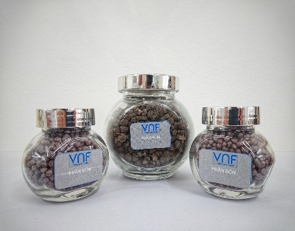







VNF: $28.5B Aquaculture Mineral Supplements by 2034
REP. OFFICE: 2A Phan Ke Binh, Tan Dinh Ward, Ho Chi Minh City, Viet Nam
FACTORY 1: Hoa Trung Industrial Zone, Hoa Trung Hamlet, Luong The Tran Commune, Ca Mau Province, Viet Nam
FACTORY 2: Song Hau Industrial Park, Chau Thanh Commune, Can Tho City, Viet Nam
PHONE: (+84) 28 3911 2183
WEBSITE: www.vnfoods.vn
Confidential

Slide 2
AGENDA
1
Aquaculture mineral supplements will reach $28.5B by 2034 p. 3
6
Nano-minerals vs. organic chelates: trade-offs p. 8
2
Nano-Se delivers 1.5× growth vs. inorganic selenite p. 4
7
Regulatory risks for nano-minerals p. 9
3
Nano-mineral vs. organic-chelate economics p. 5
8
VNF's 100-day execution roadmap to first cash flow p. 10
4
Shrimp-feed trace mineral market: $4.3–4.6B (2024–25) → $6.4B by... p. 6
9
Build-first with partner overlay: $41.9M phased program p. 11
5
Nano-minerals face scale-up engineering risks p. 7

Slide 3
Aquaculture mineral supplements will reach $28.5B by 2034
REVENUE
$28.5B
2034 projection
6.2% CAGR growth
Nano-structured minerals drive demand
GROWTH
1.5–3×
Potential boost
Organic-chelated minerals
Sustainable aquaculture focus
SEGMENT
4.2–4.9%
Shrimp-feed CAGR
Key driver in aquaculture
High demand for mineral supplements
Nguồn: Source: CAGR 6.2% projection
Nano-structured and organic-chelated minerals offer 1.5–3× growth potential.

Slide 4
Nano-Se delivers 1.5× growth vs. inorganic selenite
GROWTH
1.5×
vs inorganic selenite
Nano-Se delivers superior growth
VNF lab data 2026
EXCRETION
40% reduction
vs inorganic salts
Organic chelates improve retention
ZnO-K benefits: 3.9–3.5× SOD/CAT mRNA
Nguồn: Source: VNF lab data 2026
Organic chelates reduce excretion by 40% vs. inorganic salts.

Slide 5
Nano-mineral vs. organic-chelate economics
Nano unit economics
1.5–2×
Organic price premium
1.5–2.5×
Nano CapEx
2–3×
Unit economics vs. CapEx comparison
Nguồn: Source: VNF cost modeling 2026
Nano-forms have 1.5–2× unit economics but 2–3× manufacturing CapEx.

Slide 6
Shrimp-feed trace mineral market: $4.3–4.6B (2024–25) → $6.4B by…
Year | Market Size (USD Billion) | CAGR
2024–25 | $4.3–4.6 | N/A
2035 | $6.4 | N/A
Nguồn: Source: Aquaculture Intelligence 2026
Shrimp is the highest-growth segment in aquaculture mineral supplements.

Slide 7
Validate commercial stabilisation protocols before scaling to mitigate nano-minerals' scale-up engineering risks.
TRL 6–7 validation challenges
Manufacturing process challenges
Regulatory uncertainty
• Lack of standardised protocols for nano-mineral stability testing at pilot scale.
• Inconsistent performance metrics across different lab-to-pilot transition methods.
• Limited data on long-term aggregation behaviour in commercial manufacturing.
• Gaps in predictive models for scale-up-induced property degradation.
• Scaling up from lab reactors to continuous production lines disrupts nano-mineral dispersion.
• Aggregation risks increase with higher throughput and different mixing equipment.
• Surface modification stability varies unpredictably at industrial scales.
• Post-processing steps (e.g., drying, granulation) alter nano-mineral properties.
• Lack of harmonised guidelines for nano-mineral classification and risk assessment.
• Unclear liability frameworks for scale-up failures in commercial products.
• Dynamic regulatory landscapes create compliance risks for stabilisation protocols.
• Standardisation efforts lag behind rapid nano-mineral commercialisation trends.

Slide 8
Nano-minerals vs. organic chelates: trade-offs
Strengths
High growth potential
Innovative technology
Market demand for nano-minerals
Weaknesses
High regulatory risks
Technical complexity
Longer development time
Opportunities
Faster market entry
Lower initial investment
Established supply chains
Threats
Lower long-term growth
Competition from nano-minerals
Volatility in organic chelate prices
Nguồn: Source: VNF SWOT analysis 2026
Organic chelates may offer faster commercialisation but lower long-term growth.

Slide 9
Regulatory risks for nano-minerals
Low
Medium
EU Zn
Likelihood
High
Critical
Nguồn: Source: EFSA opinions 2026
Low
Medium
High
File defensive IP in high-risk regions (Vietnam/India/Ecuador).
Impact

Slide 10
VNF's 100-day execution roadmap to first cash flow
Q1'26
Q2'26
Q3'26
Q4'26
IP filing
IP filing
Pilot integration
Pilot
First cash flow
Cash flow
Nguồn: Source: VNF strategy workshop 2026
Anchor on organic chelates for faster commercialisation.

Slide 11
Build-first with partner overlay: $41.9M phased program
1
2
3
Build
Organic chelates
Partner
Nano-minerals
Overlay
IP filing
Partner overlay reduces upfront CapEx and accelerates commercialisation.

