Slide 1

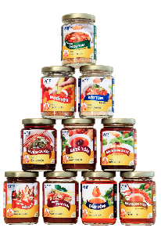
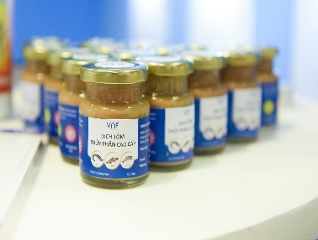
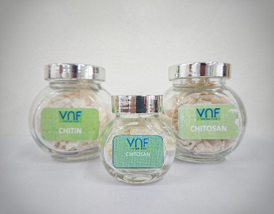
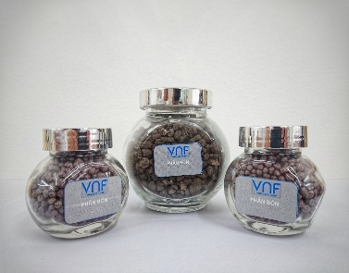







[Slide Title]
REP. OFFICE: 2A Phan Ke Binh, Tan Dinh Ward, Ho Chi Minh City, Viet Nam
FACTORY 1: Hoa Trung Industrial Zone, Hoa Trung Hamlet, Luong The Tran Commune, Ca Mau Province, Viet Nam
FACTORY 2: Song Hau Industrial Park, Chau Thanh Commune, Can Tho City, Viet Nam
PHONE: (+84) 28 3911 2183
WEBSITE: www.vnfoods.vn
Confidential

