Slide 1
job portal website

Slide 2
Introduction
HELLO!
Our group has 4 members:
Nguyen Quoc Anh - 1852238
Trinh Minh Trung - 1852825
Nguyen Minh Anh - 1852008
Phan The Minh - 1852580

Slide 3
Content
Overview of Job Portal Website
Requirement analysis
Use-case diagram.
Database design.
Technology.
Demonstration.
References.

Slide 4
1.
OVErview of
Job Portal

Slide 5
WHAT IS Job PoRTAL WEB?
It provides an easy and convenient search application for the job seekers to find their desired jobs and for the recruiters to find the right candidate.
Notes:
Hence, a job portal is simply a site where employer post vacancies and candidates upload their resume to get an applicable job for their career.

Slide 6
2.
ReQuirement ANAlysis

Slide 7
FUNCTIONAL REQUIREMENT
Admin
Guests(Unregistered)
Job Seekers
Employer
Notes:
Admin
Manage job seeker and employer profile
Manage payments of both employer and job seeker
Add new services, related to employer and job seeker
Send message to employer and job seeker for subscription
Provide rules and authentication to users
Job Seekers
Upload a CV
Search for job position(S)
Employers
Post jobs with detailed job description.
View CVs.
Search for candidates and contact.
Guests (unregistered Job Seekers | unregistered Employer)
Register
Login

Slide 8
NON-FUNCTIONAL REQUIREMENT
User interface
Performance
Reliability
Security
Notes:
User interface: The web site is designed for user friendly environment and ease of use.
Performance: 24 X 7 availability.
Reliability: maintaining integrity with error messages, controlling access of the users.
Security: several form validations and password encryptions.

Slide 9
3.
Use case Diagram

Slide 10
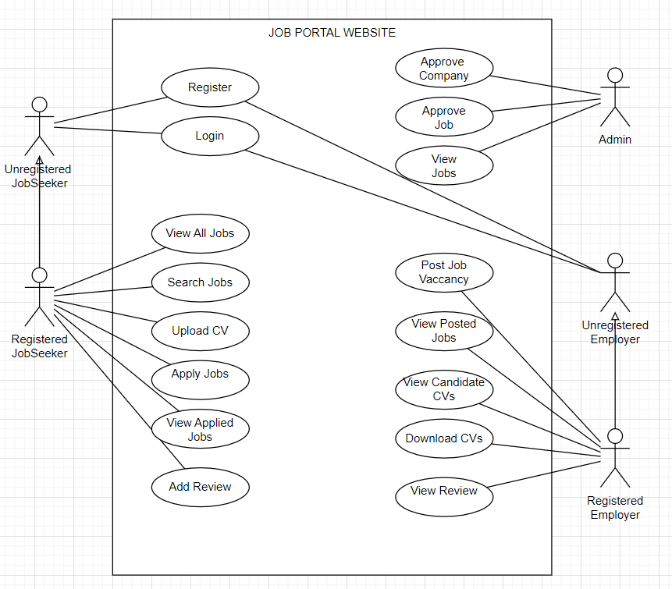
Use-case diagram
Notes:
https://core.ac.uk/download/pdf/77979433.pdf
https://core.ac.uk/download/132492064.pdf

Slide 11
4.
Database DeSIGN

Slide 12
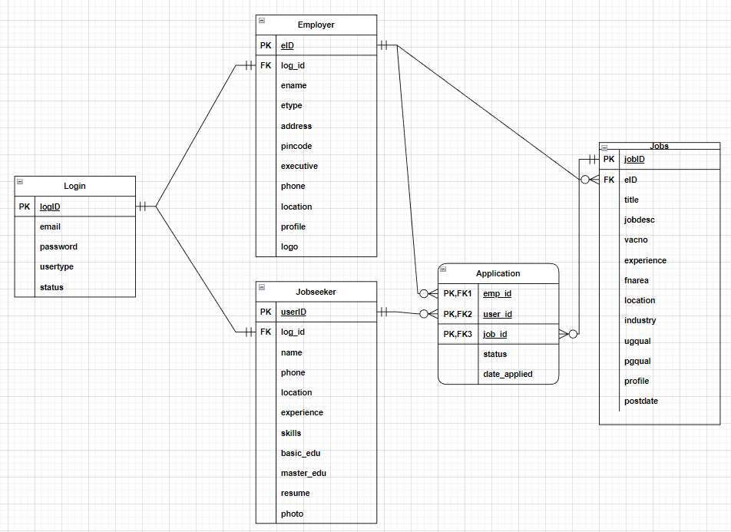
Database DEsign

Slide 13
5.
Technology

Slide 14
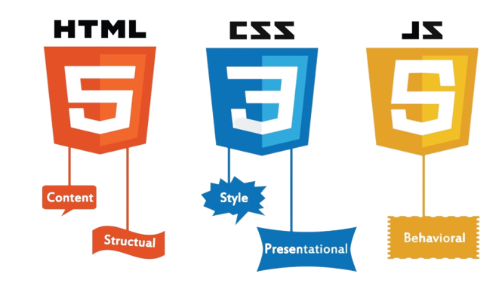

Front-End Technology
Notes:
Why HTML,CSS,JS?
HTML, CSS and JAVASCRIPT are three basics which are essential to make a website. They are at the core of any website.
Why Bootstrap?
Free front-end framework
Easily create responsive designs (look good on all devices small to large)
Compatible with all modern browsers (Chrome, Firefox, Edge, Safari, and Opera)
https://tuhoclaptrinh.edu.vn/html-css-javascript-la-gi-806.html (image source)

Slide 15

back-end technology
Why PHP & MySQL?
It provides an interactive, user-friendly website and also facilitates visitors to openly interact while producing a genuinely dynamic and flexible content.
Notes:
PHP is a server scripting language, and a powerful tool for making dynamic and interactive Web pages.
MySQL is an open source Relational Database Management System in which all the data are stored in the form of tables.

Slide 16
6.
Demonstration

Slide 17
7.
References

Slide 18
references
https://core.ac.uk/download/pdf/77979433.pdf
https://core.ac.uk/download/132492064.pdf
https://www.studocu.com/vn/document/fpt-university/web-based-java-applications/job-portal-system-cvfvfvbgbb/11469336

Slide 19
Thank you!

