Slide 1
Introduction: General Purpose GPU 101
Minh-Tue Vo
(mvo @ Tool and Frameworks)
More reasons to buy your dream gaming laptop/desktop this Christmas*

Slide 2
Before that
Sign up for ESPP!
Dev VPN: get Junos Pulse to replace Network Connect
Faster, better than Network Connect.
https://confluence.inside-box.net/display/BOX/Junos+Pulse+VPN+Instructions

Slide 3

Wow! Look at that graphics!

Slide 4
Once upon a time…
S. A. Shalom, M. Dash, and M. Tue, “Efficient K-Means Clustering Using Accelerated Graphics Processors”. pp. 166-175, 2008.
S. A. A. Shalom, M. Dash, and M. Tue, “Graphics hardware based efficient and scalable fuzzy c-means clustering,” AusDM, ser. CRPIT, JF Roddick, J. Li, P. Christen, and PJ Kennedy, Eds, vol. 87, pp. 179-186, 2008.

Slide 5
A brief history of GPGPU
Very fast at certain floating point calculations.
By the early 2000s vendors were starting to support programmable features such as lighting, shading calculations, texture mapping.
By the mid 2000s some were “hacking” OpenGL and other programming tools to do numeric computations on GPU devices.
In effect, one had to map a mathematical computation onto a graphics computation, do the graphics, and extract the result from the graphics memory.

Slide 6
A brief history of GPGPU
During the late 2000 NVIDIA introduced proprietary CUDA (“Compute Unified Device Architecture”) as a general purpose tool to make GPUs available for numerical computation.
The OpenCL standard was introduced by a consortium of vendors.
In 2012 Intel released its Phi accelerator, similar to GPU hardware but without the graphics heritage.

Slide 7
Three main reasons for ML@GPGPU
Excellent performance per cost (huge demand!)
Native support for Linear Algebra functions.
Excellent integration with standard programming languages (C++, Python, Java*).

Slide 8
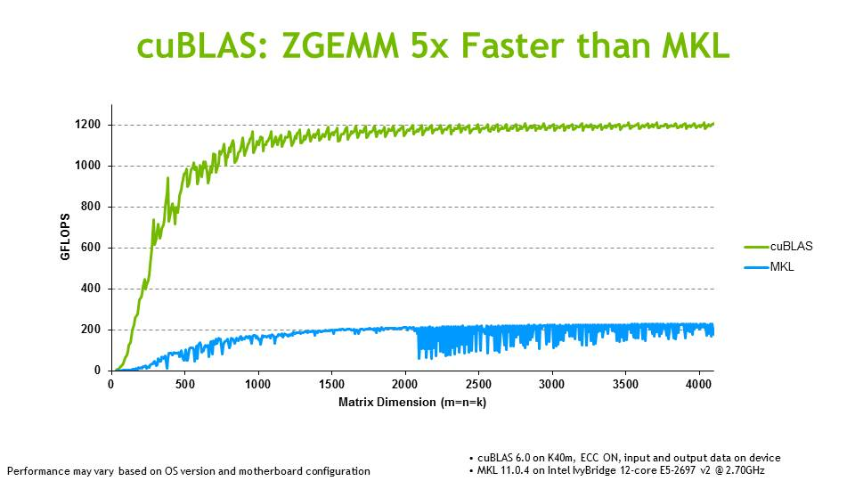
GPU Matrix Multiplication is fast !

Slide 9
Samples
push-relabel maximum flow algorithm
fast sort algorithms of large lists
two-dimensional fast wavelet transform
molecular dynamics simulations

Slide 10
NVIDIA’s CUDA is easy*
Native support in C++.
PyCUDA
Java
Matlab
Mathematica
…
*only works with NVIDIA’s GPUs

Slide 11
cuBLAS
CUDA Basic Linear Algebra Subroutines (cuBLAS)
Deliver 6x to 17x faster performance than the latest MKL BLAS*.
CUDA 6.0: multi-GPU support in cuBLAS-XT.

Slide 12
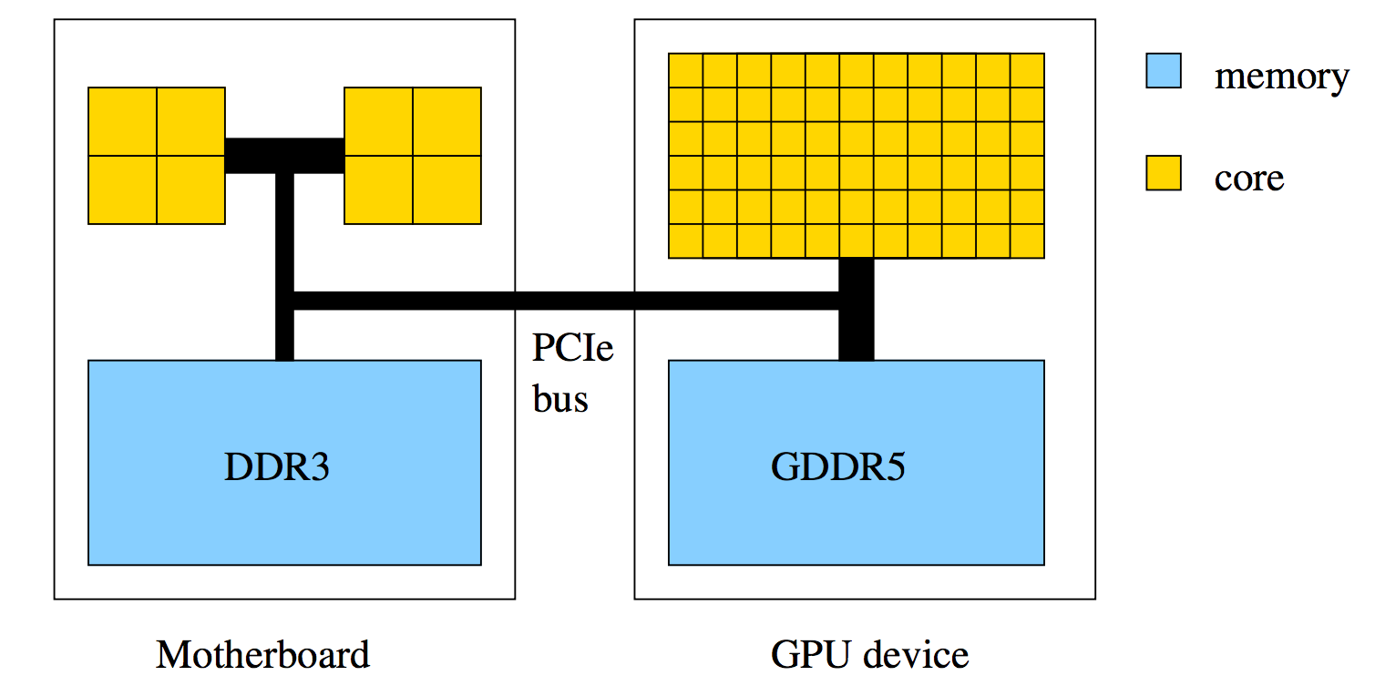
Hardware Overview

Slide 13
What does GPU have?
192 cores and 64K registers
64KB of shared memory / L1 cache (user configurable)
8KB of cache for constants
64KB of texture cache for read-only arrays
up to 2K threads per Stream Processor

Slide 14
Stream processor (SMX): Single Instruction, Multiple Thread
All cores execute the same instructions (kernel) simultaneously, but with different data.
Minimum of 32 threads (a warp) all doing same thing at the same time.
No “context switching;” each thread has its own registers (limits the number of active threads).
Each thread in a warp executes exactly the same instruction, or waits while others in the warp execute instructions note - want to avoid branches within a warp as the branches are executed sequentially

Slide 15
So what’s stream processor good for?
Task parallel
Independent processes with little communication
Data parallel
Lots of data on which the same computation is being executed
No dependencies between data elements in each step in the computation

Slide 16

What does a program look like?
1) Host (CPU) and device (GPU) are initialized when program starts.
2) Separate memory for data is allocated on host and on device.
3) Host data is initialized.
4) Data copied from host to device.
5) Host launches multiple instances of execution “kernel” on device.
6) Data copied from device to host.
7) Repeat steps 4 – 6.
8) Host deallocates memory on device and host and terminates.
Slow ☹
Fast! ☺
Slow ☹

Slide 17
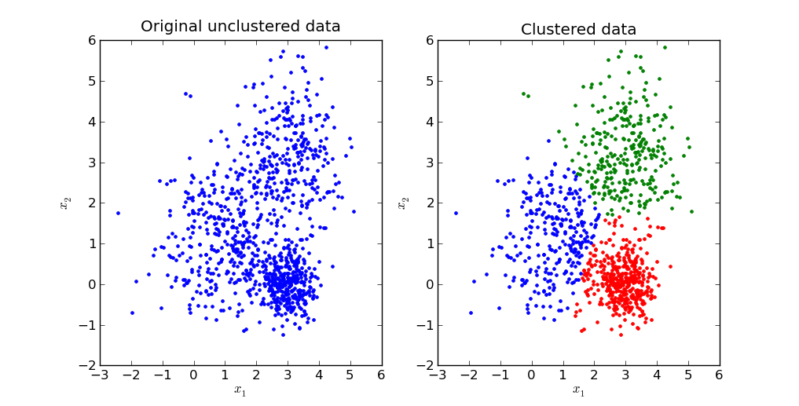
Example: Clustering

Slide 18
Example: K-means algorithm
N data points, m clusters, N >>> m
Output: m cluster centers (centroids)

Slide 19
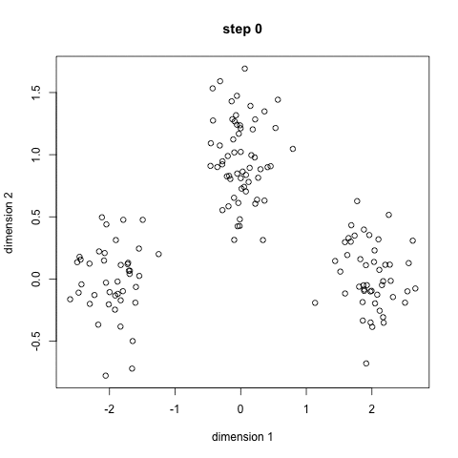

Slide 20
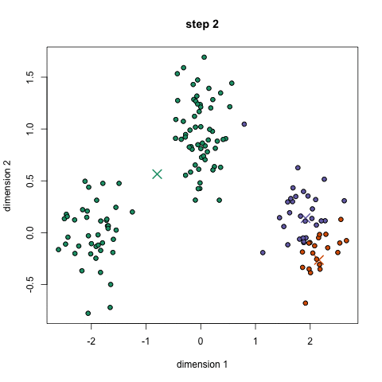

Slide 21
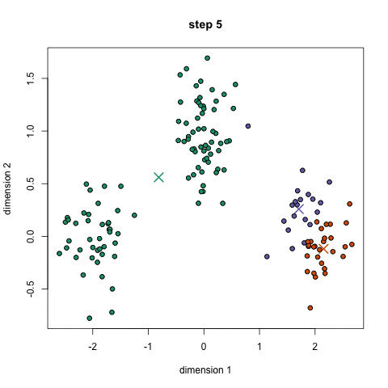

Slide 22
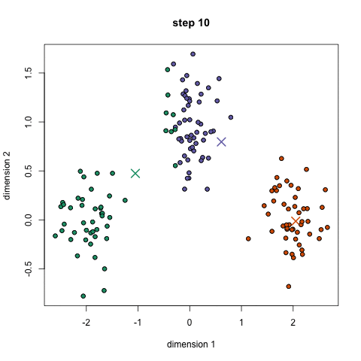

Slide 23
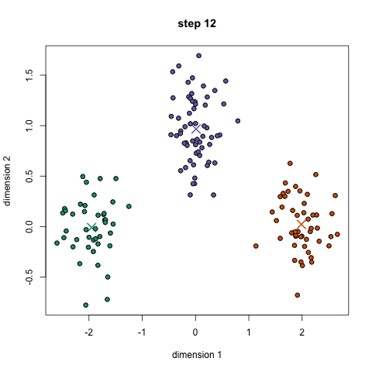

Slide 24
Example: K-means algorithm
N data points, m clusters, N >>> m
Randomly assign m cluster centers (centroids).
For each data point:
Compute the distance to every centroid.
Find the centroid with minimum distance.
For each centroid:
Compute the sum of all cluster members.
Average to compute the new centroid.
Check for convergence.

Slide 25
K-means on GPU
Host:
Randomize cluster centers (centroids).
Transfer data points from host (CPU) to device (GPU) (exp, read only).
Transfer cluster centers from host to device (exp, read only).
Device: For each data point:
Compute the distance to every centroid (cheap)
Find the closest centroid (cheap).
Host:
Transfer data from device to host (exp).
Remap data, transfer from host to device (exp)
Device: for each centroid:
Compute the sum of all cluster members (cheap).
Average to compute the new centroid (cheap).
Host:
Transfer data from device to host (exp)
Check for convergence.

Slide 26
Summary
Good: Awesome computation.
Bad: Terrible data bandwidth.
Careful data transfer
Careful data memory usages (shared, read-only, …)
Further optimization: GPU architecture (thread granularity, benchmarking transferring rate, …)

Slide 27
Getting started (Mac OS X)
http://docs.nvidia.com/cuda/cuda-getting-started-guide-for-mac-os-x
a CUDA-capable GPU
Mac OS X 10.8 or later
the gcc or Clang compiler and toolchain installed using Xcode
the NVIDIA CUDA Toolkit (available from the CUDA Download page)

Slide 28
ML @ GPGPU
http://www.nvidia.com/object/machine-learning.html
http://gpgpu.org/

Slide 29
Until next time
Coding tutorial with CUDA in Python/C++
Benchmarking: comparing apples & oranges
Papers!

Slide 30
Reference
Presentation adapted from:
http://www.math-cs.gordon.edu/courses/cps343/presentations/Intro_to_GPGPU.pdf
www.gpgpu.org

