Slide 1
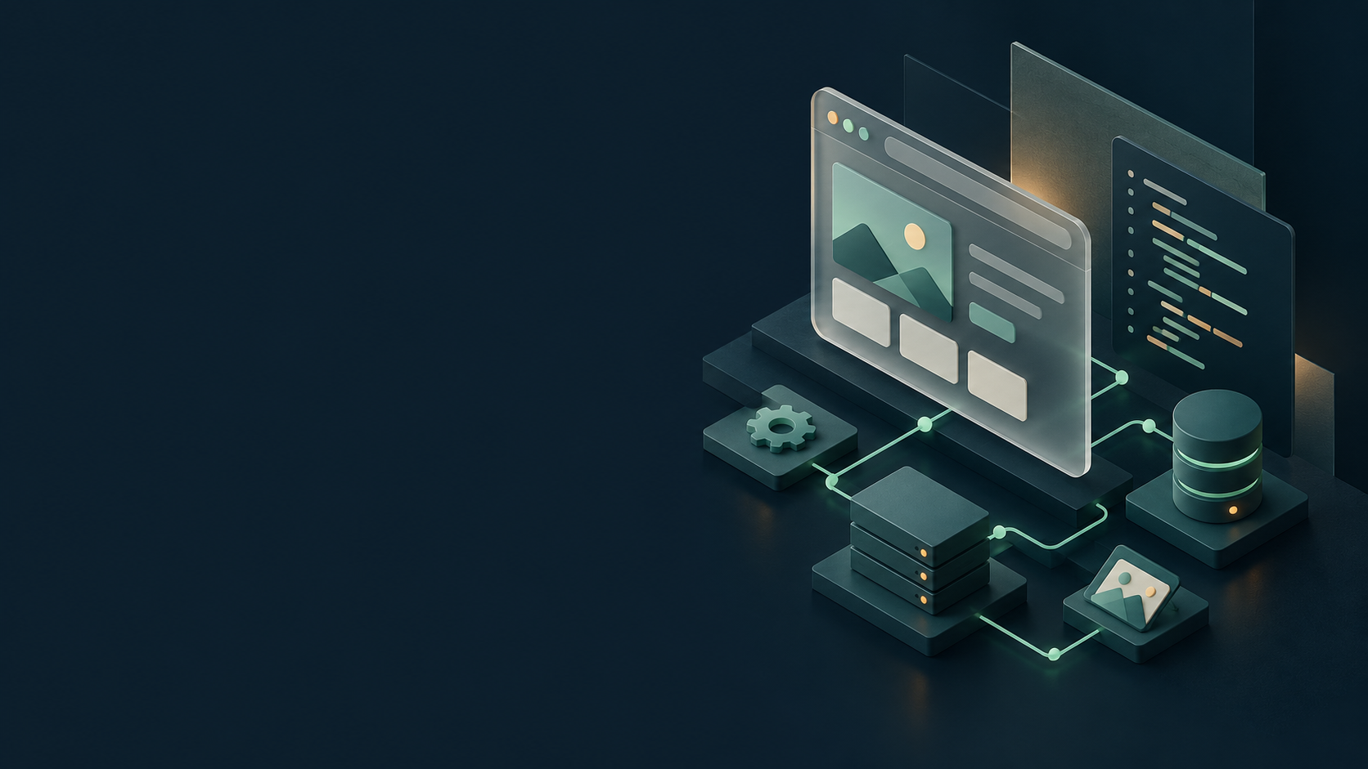
DJANGO / WEB DEVELOPMENT
Building Websites
with Django
Project files, data, templates and forms
Object-oriented programming / English edition
Python 3.12 Django 5.2
Notes:
Sources: https://docs.djangoproject.com/en/5.2/intro/tutorial01/
Scope: generated project and app files, plus common added files. This material does not enumerate the internal source files in site-packages/django.
Concept illustration generated with image_gen.

Slide 2
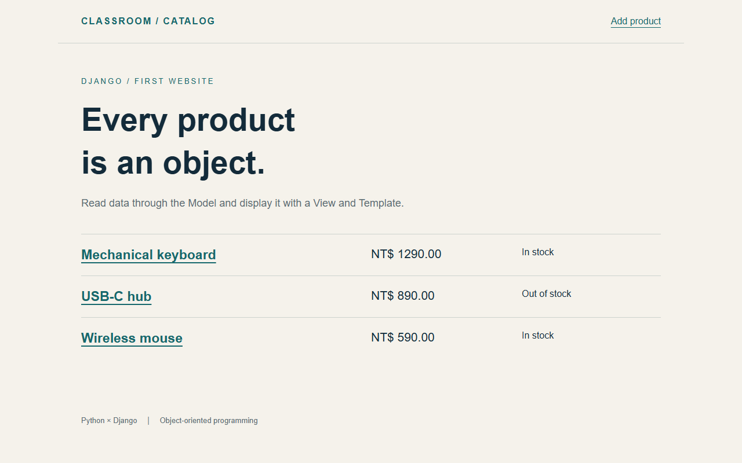
Our product catalog website
One working project connects all the files
Browse products
A list with prices and availability
View details
Retrieve one product by its ID
Add products
Validate a form and save the data
Complete example: Django_Website_Starter_EN.zip
02
Notes:
Sources: Runnable catalog project included with this course.
Scope: generated project and app files, plus common added files. This material does not enumerate the internal source files in site-packages/django.
Screenshot of the running localized Django sample.

Slide 3
How a website works
The browser and server have different roles
Browser
Sends HTTP requests and displays HTML with CSS and JavaScript.
Django
Runs Python on the server to handle URLs, data and responses.
Database
Stores products so the data survives a program restart.
URL
A route such as /products/ determines which view handles a request.
The browser receives a response. Server-side Python runs on the server.
03
Notes:
Sources: https://docs.djangoproject.com/en/5.2/intro/tutorial01/
Scope: generated project and app files, plus common added files. This material does not enumerate the internal source files in site-packages/django.

Slide 4
Model, View and Template
MVT separates the responsibilities of a website
Role | Location in this example | Responsibility
Model | catalog/models.py | Data fields and object behavior
View | catalog/views.py | Handle requests and build responses
Template | catalog/templates/catalog/ | Insert data into HTML
URLconf | config/urls.py, catalog/urls.py | Map URLs to views
A Django view handles the request. A template mainly defines the page structure.
04
Notes:
Sources: https://docs.djangoproject.com/en/5.2/intro/tutorial03/
Scope: generated project and app files, plus common added files. This material does not enumerate the internal source files in site-packages/django.

Slide 5
Tools and versions
This material uses Python 3.12 and Django 5.2
Python
The runtime for the website. Check it with python --version.
Virtual environment
Separate packages for each project prevent dependency conflicts.
Editor and terminal
Edit code in VS Code and run commands in PowerShell.
Browser
Open http://127.0.0.1:8000/ to check the website.
Commands mainly use Windows PowerShell.
05
Notes:
Sources: https://docs.djangoproject.com/en/5.2/intro/tutorial01/
Scope: generated project and app files, plus common added files. This material does not enumerate the internal source files in site-packages/django.

Slide 6
Workspace and virtual environment
PowerShell: choose a location for your project
mkdir django_shop
Runtime check
cd django_shop
python --version
The last line should show
the Python executable
inside .venv.
python -m venv .venv
.\.venv\Scripts\Activate.ps1
python -c "import sys; print(sys.executable)"
Without activation
You can invoke
.\.venv\Scripts\python.exe
directly for later commands.
macOS / Linux: python3 -m venv .venv, then source .venv/bin/activate.
06
Notes:
Sources: https://docs.python.org/3/library/venv.html
Scope: generated project and app files, plus common added files. This material does not enumerate the internal source files in site-packages/django.

Slide 7
Django installation and dependencies
Run subsequent commands in the active virtual environment
python -m pip install "Django>=5.2,<5.3"
Version range
python -m django --version
Use the 5.2 series while
allowing newer patch
releases.
# Contents of requirements.txt
Django>=5.2,<5.3
# Install dependencies for an existing project
requirements.txt
python -m pip install -r requirements.txt
Create this file yourself
to record dependencies.
Django does not create it.
Package details: python -m pip show Django.
07
Notes:
Sources: https://docs.djangoproject.com/en/5.2/intro/install/
Scope: generated project and app files, plus common added files. This material does not enumerate the internal source files in site-packages/django.

Slide 8
Creating a Django project
Run the command inside django_shop
python -m django startproject config .
The final dot
django_shop/
The trailing . uses the
current directory and avoids
an extra outer folder.
manage.py
config/
__init__.py
settings.py
Two names
urls.py
asgi.py
django_shop is the folder.
config is the settings package.
You can choose both names.
wsgi.py
This tree shows startproject output. It omits the existing .venv and requirements.txt.
08
Notes:
Sources: https://docs.djangoproject.com/en/5.2/intro/tutorial01/
Scope: generated project and app files, plus common added files. This material does not enumerate the internal source files in site-packages/django.

Slide 9
Project and app
Separate website configuration from business features
Item | Project: config | App: catalog
Scope | Configuration for the whole site | A group of related features
Contents | Settings, root URLs, server entry points | Models, views, forms, templates
Command | startproject | startapp
Relationship | Combines multiple apps | Reusable across projects
This example creates one project and adds a catalog app.
09
Notes:
Sources: https://docs.djangoproject.com/en/5.2/intro/tutorial01/
Scope: generated project and app files, plus common added files. This material does not enumerate the internal source files in site-packages/django.

Slide 10
manage.py: management commands
Keep this entry point in the project directory
python manage.py check
Purpose
python manage.py runserver
python manage.py startapp catalog
Loads config.settings and
passes commands to Django.
Usually needs no changes.
python manage.py makemigrations
python manage.py migrate
python manage.py createsuperuser
python manage.py shell
Working directory
python manage.py test
Run commands in the folder
containing manage.py, or
provide its full path.
Business logic normally belongs in the app.
10
Notes:
Sources: https://docs.djangoproject.com/en/5.2/ref/django-admin/
Scope: generated project and app files, plus common added files. This material does not enumerate the internal source files in site-packages/django.

Slide 11
__init__.py: Python packages
This file appears in config, catalog and migrations
config/__init__.py
Makes config a regular Python package, allowing imports such as config.settings.
catalog/__init__.py
Marks the app as a Python package. It is usually empty.
migrations/__init__.py
Marks the migration package. Keep it with the migration files.
Compared with __init__
__init__.py is a filename. A class uses __init__() to initialize an instance.
Empty files can serve a structural purpose. They do not need extra code.
11
Notes:
Sources: https://docs.python.org/3/tutorial/modules.html#packages
Scope: generated project and app files, plus common added files. This material does not enumerate the internal source files in site-packages/django.

Slide 12
settings.py: core configuration
Each setting controls a different part of the site
Setting | Purpose | This example
BASE_DIR | Build paths within the project | Project directory
INSTALLED_APPS | Enable apps and built-in features | Add CatalogConfig
ROOT_URLCONF | Select the root URL configuration | config.urls
DATABASES | Configure database connections | SQLite / db.sqlite3
TEMPLATES | Template engine and discovery | APP_DIRS=True
Settings are Python values. Strings, lists and dictionaries use their own syntax.
12
Notes:
Sources: https://docs.djangoproject.com/en/5.2/ref/settings/
Scope: generated project and app files, plus common added files. This material does not enumerate the internal source files in site-packages/django.

Slide 13
settings.py: other defaults
The generated settings also have specific roles
Setting | Purpose
MIDDLEWARE | Request and response processing, including sessions and authentication
AUTH_PASSWORD_VALIDATORS | Password rules for account creation and related workflows
LANGUAGE_CODE / TIME_ZONE | Interface language and default time zone
USE_I18N / USE_TZ | Translation support and time-zone-aware date/time handling
STATIC_URL / DEFAULT_AUTO_FIELD | Static URL prefix and the default automatic primary key type
This version uses en and Asia/Taipei, with the default middleware and password validators.
13
Notes:
Sources: https://docs.djangoproject.com/en/5.2/ref/settings/
Scope: generated project and app files, plus common added files. This material does not enumerate the internal source files in site-packages/django.

Slide 14
Development settings and entry points
Settings control the site environment
DEBUG
True helps local debugging. Turn it off in production.
ALLOWED_HOSTS
Accepted hostnames, such as localhost and 127.0.0.1, without port numbers.
SECRET_KEY
Supports signing. The demo value is local-only. Protect production keys separately.
WSGI_APPLICATION
Usually config.wsgi.application, for loading the WSGI application.
Keep production secret keys and passwords out of public repositories.
14
Notes:
Sources: https://docs.djangoproject.com/en/5.2/howto/deployment/checklist/
Scope: generated project and app files, plus common added files. This material does not enumerate the internal source files in site-packages/django.

Slide 15
wsgi.py and asgi.py
startproject generates both server entry points
File | Purpose | For beginners
config/wsgi.py | Creates the application that a WSGI server loads | Usually unchanged
config/asgi.py | Creates the application that an ASGI server loads | Usually unchanged
Both files | Load settings and expose an application object | Separate from URL routing
ASGI supports async interfaces. Real-time features still need suitable application and server setup.
15
Notes:
Sources: https://docs.djangoproject.com/en/5.2/howto/deployment/wsgi/
https://docs.djangoproject.com/en/5.2/howto/deployment/asgi/
Scope: generated project and app files, plus common added files. This material does not enumerate the internal source files in site-packages/django.

Slide 16
The first server run
At this point, config/urls.py still has its generated contents
python manage.py migrate
migrate
python manage.py runserver
Creates database tables for
built-in apps such as auth
and sessions.
# Open in the browser
http://127.0.0.1:8000/
# Stop the server: press Ctrl+C in the terminal
runserver
Starts the local development
server. Keep the terminal
running. Not for production.
The default URL setup shows the welcome page. Later we will use /products/.
16
Notes:
Sources: https://docs.djangoproject.com/en/5.2/intro/tutorial01/
Scope: generated project and app files, plus common added files. This material does not enumerate the internal source files in site-packages/django.

Slide 17
Creating the catalog app
Run this in the directory containing manage.py
python manage.py startapp catalog
Generated structure
catalog/
Django creates the files.
You then add the
application behavior.
__init__.py
admin.py
apps.py
migrations/
Add these yourself
__init__.py
models.py
urls.py, forms.py,
templates/ and static/
are not generated.
tests.py
views.py
catalog names the product feature, rather than the whole website.
17
Notes:
Sources: https://docs.djangoproject.com/en/5.2/intro/tutorial01/
Scope: generated project and app files, plus common added files. This material does not enumerate the internal source files in site-packages/django.

Slide 18
apps.py: app configuration
catalog/apps.py and config/settings.py
# catalog/apps.py
AppConfig
from django.apps import AppConfig
name is the Python path.
default_auto_field selects
the automatic primary key.
class CatalogConfig(AppConfig):
default_auto_field = "django.db.models.BigAutoField"
name = "catalog"
App registration
# config/settings.py: add to existing INSTALLED_APPS
"catalog.apps.CatalogConfig",
Add the configuration class
to the existing list. Keep
admin, auth and staticfiles.
Creating an app directory alone does not enable it in Django.
18
Notes:
Sources: https://docs.djangoproject.com/en/5.2/ref/applications/
Scope: generated project and app files, plus common added files. This material does not enumerate the internal source files in site-packages/django.

Slide 19
views.py: the first response
A minimal hello view
from django.http import HttpResponse
Input
def hello(request):
request contains the HTTP
method, URL information
and submitted data.
return HttpResponse("Hello, Django!")
Output
The view returns HttpResponse.
This example returns text
without a database or template.
A URL route must connect the browser to the view.
19
Notes:
Sources: https://docs.djangoproject.com/en/5.2/topics/http/views/
Scope: generated project and app files, plus common added files. This material does not enumerate the internal source files in site-packages/django.

Slide 20
catalog/urls.py: app routes
Create this file yourself
from django.urls import path
Path and function
from . import views
hello/ maps to views.hello.
Pass the function itself,
without calling views.hello().
app_name = "catalog"
urlpatterns = [
path("hello/", views.hello, name="hello"),
]
Route names
name supports URL reversing.
app_name keeps names from
different apps separate.
These are paths within the app. The project determines their URL prefix.
20
Notes:
Sources: https://docs.djangoproject.com/en/5.2/topics/http/urls/
Scope: generated project and app files, plus common added files. This material does not enumerate the internal source files in site-packages/django.

Slide 21
config/urls.py: root routes
Delegate /products/ to the catalog app
from django.contrib import admin
include()
from django.urls import include, path
After matching products/,
the app URLconf handles
the remaining path.
urlpatterns = [
path("products/", include("catalog.urls")),
path("admin/", admin.site.urls),
]
First working URL
/products/hello/ calls
hello(request) and displays
Hello, Django!
No route handles / yet. A 404 at the root does not mean the server has failed.
21
Notes:
Sources: https://docs.djangoproject.com/en/5.2/topics/http/urls/
Scope: generated project and app files, plus common added files. This material does not enumerate the internal source files in site-packages/django.

Slide 22
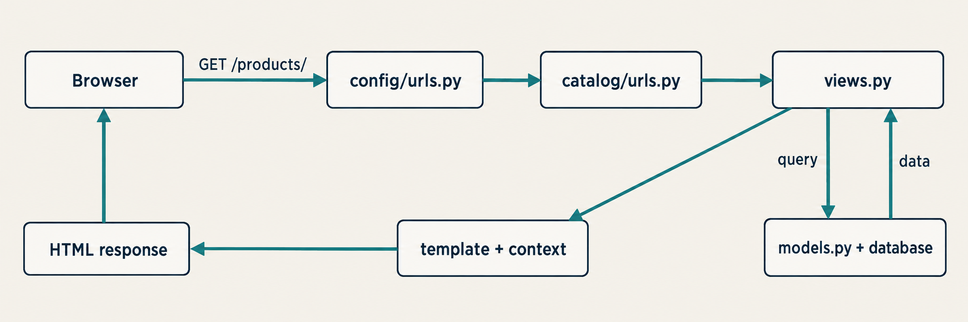
The journey of a web request
How the completed product list uses the project files
This simplified diagram omits middleware and server entry points. The view combines model data and a template.
22
Notes:
Sources: https://docs.djangoproject.com/en/5.2/intro/tutorial03/
Scope: generated project and app files, plus common added files. This material does not enumerate the internal source files in site-packages/django.
Concept illustration generated with image_gen.

Slide 23
models.py: product data
Fields in the Product class
from decimal import Decimal
Fields
from django.core.validators import MinValueValidator
from django.db import models
name is text, price is decimal,
and stock is nonnegative.
Django also adds an id.
class Product(models.Model):
name = models.CharField(max_length=80)
price = models.DecimalField(
Class and table
max_digits=8, decimal_places=2,
validators=[MinValueValidator(Decimal("0"))],
Product defines the structure.
Each instance is one product.
Migrations create the table.
)
stock = models.PositiveIntegerField(default=0)
Validators run during model or form validation, not immediately when you assign a field.
23
Notes:
Sources: https://docs.djangoproject.com/en/5.2/ref/models/fields/
Scope: generated project and app files, plus common added files. This material does not enumerate the internal source files in site-packages/django.

Slide 24
Object behavior in a model
Add these methods inside Product
@property
in_stock
def in_stock(self):
return self.stock > 0
Computes availability without
an extra database field.
Templates use product.in_stock.
def __str__(self):
return self.name
__str__()
Defines a readable text form.
The admin and shell can show
the product name.
This property only has a getter. You cannot assign in_stock directly.
24
Notes:
Sources: https://docs.djangoproject.com/en/5.2/ref/models/instances/
Scope: generated project and app files, plus common added files. This material does not enumerate the internal source files in site-packages/django.

Slide 25
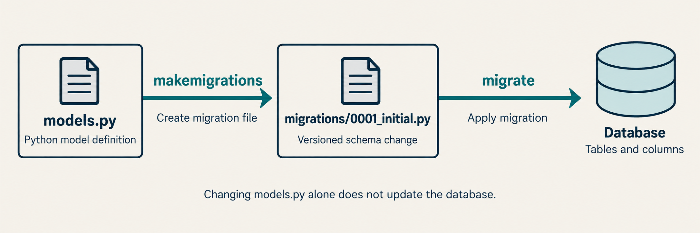
Migrations and database tables
Model definitions, change files and stored data have distinct roles
After changing models.py, generate a migration and then apply it to the database.
25
Notes:
Sources: https://docs.djangoproject.com/en/5.2/topics/migrations/
Scope: generated project and app files, plus common added files. This material does not enumerate the internal source files in site-packages/django.
Concept illustration generated with image_gen.

Slide 26
Creating the product table
Versioned Python files appear in migrations/
python manage.py makemigrations catalog
makemigrations
python manage.py migrate
python manage.py showmigrations catalog
Compares model definitions
with migration state and
generates a change file.
catalog/migrations/
__init__.py
0001_initial.py
migrate
Applies migrations in
dependency order. [X] in
showmigrations means applied.
Structural model changes need migrations. Ordinary product data updates do not.
26
Notes:
Sources: https://docs.djangoproject.com/en/5.2/topics/migrations/
Scope: generated project and app files, plus common added files. This material does not enumerate the internal source files in site-packages/django.

Slide 27
Migration files and db.sqlite3
Store code history separately from runtime data
Location / content | Purpose | Handling
migrations/__init__.py | Python package marker | Keep in version control
0001_initial.py | Initial table creation instructions | Review and commit
dependencies / operations | Migration dependencies and changes | Usually Django-generated
db.sqlite3 | SQLite data and migration records | Exclude from Git in this demo
Do not routinely delete migrations or the database to fix errors. Assess existing data first.
27
Notes:
Sources: https://docs.djangoproject.com/en/5.2/topics/migrations/
Scope: generated project and app files, plus common added files. This material does not enumerate the internal source files in site-packages/django.

Slide 28
Creating and querying data with the ORM
Run python manage.py shell, then enter Python code
from decimal import Decimal
ORM
from catalog.models import Product
Use Python models and query
methods. Django translates
queries for the database.
p = Product(name="Keyboard",
price=Decimal("1290.00"), stock=8)
p.full_clean()
p.save()
Validation and saving
Product.objects.all()
This example calls full_clean().
save() does not automatically
run full model validation.
Product.objects.filter(stock__gt=0)
Product.objects.get(pk=p.pk)
pk is the generic primary-key name. Product uses id by default.
28
Notes:
Sources: https://docs.djangoproject.com/en/5.2/topics/db/queries/
https://docs.djangoproject.com/en/5.2/ref/models/instances/
Scope: generated project and app files, plus common added files. This material does not enumerate the internal source files in site-packages/django.

Slide 29
admin.py: model registration
catalog/admin.py
from django.contrib import admin
Registration
from .models import Product
Makes Product available
in the built-in Django
admin site.
@admin.register(Product)
class ProductAdmin(admin.ModelAdmin):
list_display = ("name", "price", "stock")
search_fields = ("name",)
Display options
list_display selects columns.
search_fields enables search
for the specified fields.
admin.py configures the admin. Public product pages still use your views and templates.
29
Notes:
Sources: https://docs.djangoproject.com/en/5.2/ref/contrib/admin/
Scope: generated project and app files, plus common added files. This material does not enumerate the internal source files in site-packages/django.

Slide 30
Administrator account and login
Run these in a terminal, outside manage.py shell
python manage.py createsuperuser
Account creation
python manage.py runserver
Enter a username, email
and password as prompted.
Password characters stay hidden.
# Open in the browser
http://127.0.0.1:8000/admin/
Managing products
After creating the tables and
registering the model, log in
to add or edit products.
Each user creates a local account. The example includes no shared login or password.
30
Notes:
Sources: https://docs.djangoproject.com/en/5.2/ref/contrib/admin/
Scope: generated project and app files, plus common added files. This material does not enumerate the internal source files in site-packages/django.

Slide 31
The product list view
Add product_list to catalog/views.py
from django.shortcuts import render
Data query
from .models import Product
The QuerySet describes a query
sorted by product name and
provides data to the template.
def product_list(request):
products = Product.objects.order_by("name")
return render(
request,
render()
"catalog/product_list.html",
{"products": products},
Takes a template and context,
renders HTML and returns
an HttpResponse.
)
Next, add the template and map the empty app path to this view.
31
Notes:
Sources: https://docs.djangoproject.com/en/5.2/intro/tutorial03/
Scope: generated project and app files, plus common added files. This material does not enumerate the internal source files in site-packages/django.

Slide 32
The template directory
Create templates/ and its files yourself
catalog/
Inner catalog folder
templates/
catalog/
Provides a template namespace
so apps can use matching
HTML filenames safely.
base.html
product_list.html
product_detail.html
product_form.html
Template discovery
# Existing TEMPLATES setting in config/settings.py
With the app installed and
APP_DIRS=True, Django searches
the app templates/ directory.
"APP_DIRS": True
render() uses catalog/product_list.html rather than a full filesystem path.
32
Notes:
Sources: https://docs.djangoproject.com/en/5.2/topics/templates/
Scope: generated project and app files, plus common added files. This material does not enumerate the internal source files in site-packages/django.

Slide 33
base.html: the shared page structure
Excerpt from catalog/templates/catalog/base.html
{% load static %}
Template inheritance
<!doctype html>
<html lang="en">
Share the head and navigation.
Each page fills the
appropriate block.
<head>
<meta charset="utf-8">
<title>{% block title %}Product catalog{% endblock %}</title>
<link rel="stylesheet"
The static tag
href="{% static 'catalog/site.css' %}">
</head>
Builds a static file URL using
settings such as STATIC_URL.
It does not inline the CSS.
<body>
{% block content %}{% endblock %}
</body>
</html>
The complete example also puts the viewport, navigation and footer in base.html.
33
Notes:
Sources: https://docs.djangoproject.com/en/5.2/ref/templates/language/
https://docs.djangoproject.com/en/5.2/howto/static-files/
Scope: generated project and app files, plus common added files. This material does not enumerate the internal source files in site-packages/django.

Slide 34
product_list.html: loops and values
Core content of catalog/templates/catalog/product_list.html
{% extends "catalog/base.html" %}
Two syntaxes
{% block content %}
<h1>Product catalog</h1>
{{ ... }} displays a value.
{% ... %} runs template tags
such as for, if and block.
<ul>
{% for product in products %}
<li>{{ product.name }} / {{ product.price }}
{% if product.in_stock %}In stock{% endif %}
Data source
</li>
{% empty %}
products comes from the
context dictionary in the view.
The variable names must match.
<li>No products yet</li>
{% endfor %}
</ul>
{% endblock %}
Templates do not run arbitrary Python. Keep default HTML autoescaping enabled.
34
Notes:
Sources: https://docs.djangoproject.com/en/5.2/ref/templates/language/
Scope: generated project and app files, plus common added files. This material does not enumerate the internal source files in site-packages/django.

Slide 35
static/ and site.css: page styling
Create catalog/static/catalog/site.css
/* catalog/static/catalog/site.css */
Namespace
body {
color: #132b3a;
The inner catalog directory
prevents CSS filename
collisions between apps.
background: #f5f2eb;
font-family: "Arial", sans-serif;
}
During development
With staticfiles enabled and
DEBUG=True, runserver serves
static files. Production needs
separate setup.
Keep STATIC_URL = "static/" in settings.py. Put the CSS above only in site.css.
35
Notes:
Sources: https://docs.djangoproject.com/en/5.2/howto/static-files/
Scope: generated project and app files, plus common added files. This material does not enumerate the internal source files in site-packages/django.

Slide 36
The complete catalog/urls.py
Routes for the list, details and creation form
from django.urls import path
Path parameters
from . import views
<int:pk> converts the segment
to an integer and passes
it to the view as pk.
app_name = "catalog"
urlpatterns = [
path("hello/", views.hello, name="hello"),
path("", views.product_list, name="product_list"),
Build order
path("new/", views.product_create,
name="product_create"),
Define views before adding
routes that reference them.
The complete ZIP has them all.
path("<int:pk>/", views.product_detail,
name="product_detail"),
]
List: /products/ Create: /products/new/ Detail: /products/1/
36
Notes:
Sources: https://docs.djangoproject.com/en/5.2/topics/http/urls/
Scope: generated project and app files, plus common added files. This material does not enumerate the internal source files in site-packages/django.

Slide 37
Product details and missing records
Add product_detail to catalog/views.py
from django.shortcuts import get_object_or_404
One product
def product_detail(request, pk):
Returns the matching product
or produces a 404 response
when no record exists.
product = get_object_or_404(Product, pk=pk)
return render(request,
"catalog/product_detail.html",
{"product": product})
Template links
# Core content of product_detail.html
Use a route name and pk
to build the detail URL
instead of hard-coding it.
<h1>{{ product.name }}</h1>
<p>Price：{{ product.price }}</p>
<p>Stock：{{ product.stock }}</p>
Template link: {% url 'catalog:product_detail' product.pk %}
37
Notes:
Sources: https://docs.djangoproject.com/en/5.2/topics/http/shortcuts/
Scope: generated project and app files, plus common added files. This material does not enumerate the internal source files in site-packages/django.

Slide 38
forms.py: input and validation
Create catalog/forms.py yourself
from django import forms
ModelForm
from .models import Product
Builds fields from the model,
converts input strings and
performs related validation.
class ProductForm(forms.ModelForm):
class Meta:
model = Product
fields = ["name", "price", "stock"]
Explicit fields
labels = {
"name": "Product name",
fields lists the inputs that
users may submit and avoids
exposing unintended data.
"price": "Price",
"stock": "Stock",
}
A form object defines fields and validation. A template renders the HTML.
38
Notes:
Sources: https://docs.djangoproject.com/en/5.2/topics/forms/modelforms/
Scope: generated project and app files, plus common added files. This material does not enumerate the internal source files in site-packages/django.

Slide 39
The product creation view
catalog/views.py: handling GET and POST
@require_http_methods(["GET", "POST"])
GET
def product_create(request):
if request.method == "POST":
Creates an empty form
and displays the input page.
form = ProductForm(request.POST)
if form.is_valid():
form.save()
return redirect("catalog:product_list")
POST
else:
form = ProductForm()
Validates input. Success saves
and redirects to the list.
Invalid input shows errors.
return render(request,
"catalog/product_form.html",
{"form": form})
Imports: ProductForm, render, redirect and require_http_methods. See the complete source.
39
Notes:
Sources: https://docs.djangoproject.com/en/5.2/topics/forms/modelforms/
Scope: generated project and app files, plus common added files. This material does not enumerate the internal source files in site-packages/django.

Slide 40
product_form.html: submitting data
catalog/templates/catalog/product_form.html
{% extends "catalog/base.html" %}
CSRF token
{% block content %}
<h1>Add product</h1>
Works with CSRF middleware
to protect POST forms. Do not
remove it to bypass errors.
<form method="post">
{% csrf_token %}
{{ form.as_p }}
<button type="submit">Save product</button>
form.as_p
</form>
{% endblock %}
Renders fields, labels and
errors, so users can see
validation results.
The local example allows product creation. Public sites also need authentication and permissions.
40
Notes:
Sources: https://docs.djangoproject.com/en/5.2/ref/csrf/
https://docs.djangoproject.com/en/5.2/topics/forms/modelforms/
Scope: generated project and app files, plus common added files. This material does not enumerate the internal source files in site-packages/django.

Slide 41
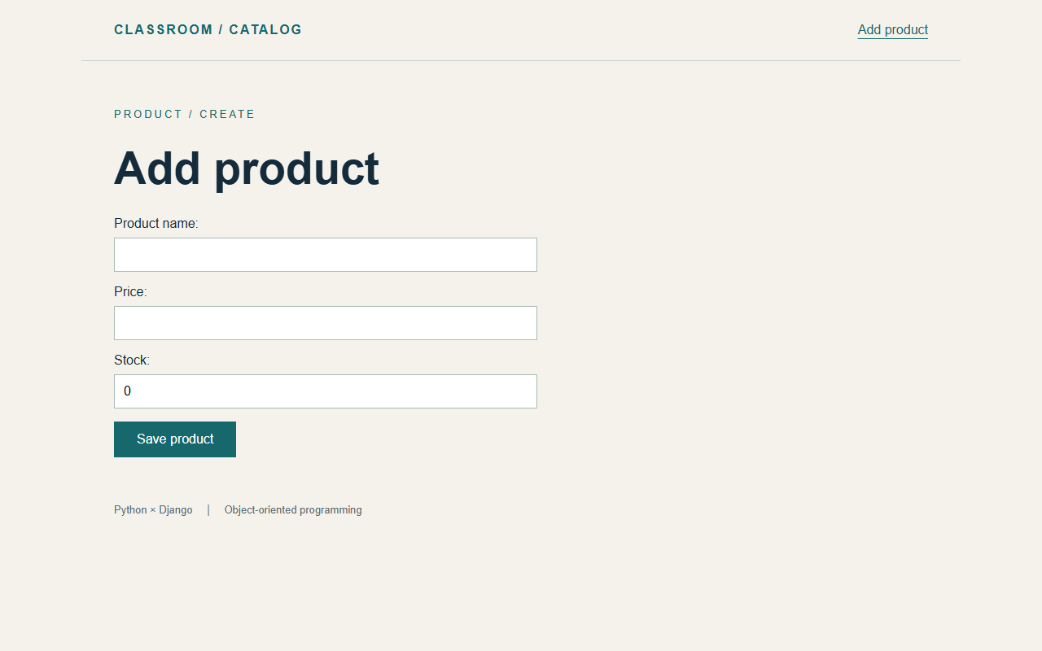
The completed product form
One form connects the model, view and template
Display
product_form.html renders the form
Validation
ProductForm checks the input
Success
save() stores it, then redirects
Try a negative price locally. Check the error message and confirm that no product was saved.
41
Notes:
Sources: Runnable catalog project included with this course.
Scope: generated project and app files, plus common added files. This material does not enumerate the internal source files in site-packages/django.
Screenshot of the running localized Django sample.

Slide 42
tests.py: repeatable website checks
Excerpt from catalog/tests.py, using an isolated test database
from django.test import TestCase
Test client
from django.urls import reverse
from .models import Product
Calls routes and checks
responses without starting
runserver.
class CatalogTests(TestCase):
def test_list(self):
Product.objects.create(
Running tests
name="Keyboard", price="1290", stock=8)
response = self.client.get(
Use the command below.
Django normally removes the
test database when finished.
reverse("catalog:product_list"))
self.assertEqual(response.status_code, 200)
self.assertContains(response, "Keyboard")
Run: python manage.py test catalog. More tests cover forms, 404s, redirects and CSRF.
42
Notes:
Sources: https://docs.djangoproject.com/en/5.2/topics/testing/overview/
Scope: generated project and app files, plus common added files. This material does not enumerate the internal source files in site-packages/django.

Slide 43
MIDDLEWARE: shared request processing
The list lives in config/settings.py
SessionMiddleware
Provides session access for state that persists across requests.
Authentication
AuthenticationMiddleware adds the current user to request and depends on sessions.
CsrfViewMiddleware
Checks CSRF where required, together with the template token.
Other defaults
Security, Common, Message and XFrameOptions each serve their own role.
Requests follow list order and responses return in reverse. Middleware may return a response early.
43
Notes:
Sources: https://docs.djangoproject.com/en/5.2/topics/http/middleware/
Scope: generated project and app files, plus common added files. This material does not enumerate the internal source files in site-packages/django.

Slide 44
File index: project
startproject generates these files
File | Purpose | When to edit
manage.py | Run management commands | Usually unchanged
config/__init__.py | Python package marker | Usually empty
config/settings.py | Apps, database and environment | App or environment setup
config/urls.py | Root URL configuration | Connect apps or entry routes
config/wsgi.py, asgi.py | Server application entry points | Special deployment needs
Having both entry-point files does not require running both types of server.
44
Notes:
Sources: https://docs.djangoproject.com/en/5.2/intro/tutorial01/
Scope: generated project and app files, plus common added files. This material does not enumerate the internal source files in site-packages/django.

Slide 45
File index: generated app files
startapp catalog generates this structure
File | Purpose
catalog/__init__.py, apps.py | Package marker and AppConfig
catalog/models.py | Data models and object behavior
catalog/views.py | Handle requests and produce responses
catalog/admin.py, tests.py | Admin registration and automated tests
catalog/migrations/__init__.py | Migration package. makemigrations creates version files.
Keep responsibilities separate instead of putting all behavior in views.py.
45
Notes:
Sources: https://docs.djangoproject.com/en/5.2/intro/tutorial01/
Scope: generated project and app files, plus common added files. This material does not enumerate the internal source files in site-packages/django.

Slide 46
File index: added files
Conventional paths help Django and developers locate content
Location | Purpose | Origin
catalog/urls.py | App URL patterns | Added manually
catalog/forms.py | Forms and input validation | Added manually
templates/catalog/*.html | Base, list, detail and form templates | Added manually
static/catalog/site.css | Styles. This directory can also hold JS and images. | Added manually
migrations/0001_initial.py | Model change history | makemigrations
In this example, templates/ and static/ both live inside the catalog app.
46
Notes:
Sources: https://docs.djangoproject.com/en/5.2/intro/tutorial01/
Scope: generated project and app files, plus common added files. This material does not enumerate the internal source files in site-packages/django.

Slide 47
Environment and version control files
These support development and runtime data
File / directory | Purpose | Version control
requirements.txt, README.md | Dependencies and run instructions | Usually commit
.gitignore | Patterns for Git to ignore | Usually commit
.venv/, __pycache__/ | Isolated packages and bytecode cache | Do not commit
db.sqlite3, media/ | Local database and user uploads | Follow data policy
.env (optional) | Environment values. Django does not load it automatically. | Exclude real secrets
This example has no uploads or .env dependency. media and static serve different purposes.
47
Notes:
Sources: https://docs.python.org/3/library/venv.html
https://docs.djangoproject.com/en/5.2/howto/static-files/
Scope: generated project and app files, plus common added files. This material does not enumerate the internal source files in site-packages/django.

Slide 48
Using the complete example
Extract the ZIP and enter django_shop, which contains manage.py
Dependencies
Create and activate .venv, then run python -m pip install -r requirements.txt.
Database
Run python manage.py migrate. The ZIP includes 0001_initial.py.
Products
Add products in the admin or submit the form at /products/new/.
Run and check
Run the server and open /products/. Run test catalog for automated tests.
The ZIP already contains the project. Do not run startproject or startapp again.
48
Notes:
Sources: Runnable catalog project included with this course.
Scope: generated project and app files, plus common added files. This material does not enumerate the internal source files in site-packages/django.

Slide 49
Common errors and where to look
Use the error message to identify the relevant file
Symptom | First checks
No module named django | Virtual environment, Python path and installed packages
404 / NoReverseMatch | Root and app URLs, name, app_name and parameters
TemplateDoesNotExist | Template paths, INSTALLED_APPS and APP_DIRS
no such table | Migration files and whether migrate has run
Missing CSS / CSRF 403 | Static path and tag / CSRF token and middleware
Keep the complete error message. Find the cause before changing files or disabling protections.
49
Notes:
Sources: https://docs.djangoproject.com/en/5.2/topics/http/urls/
https://docs.djangoproject.com/en/5.2/howto/static-files/
Scope: generated project and app files, plus common added files. This material does not enumerate the internal source files in site-packages/django.

Slide 50
Local development and production
Production requires additional configuration
Server entry point
Use a suitable WSGI or ASGI server to load the application.
Environment
Turn off DEBUG and configure allowed hosts, secrets and database connections.
Static files
Configure STATIC_ROOT, run collectstatic and serve files through an appropriate service.
Data and access
Plan HTTPS, user permissions, backups and storage for uploaded files.
runserver is for development. Deployment configuration depends on the hosting platform.
50
Notes:
Sources: https://docs.djangoproject.com/en/5.2/howto/deployment/checklist/
Scope: generated project and app files, plus common added files. This material does not enumerate the internal source files in site-packages/django.

Slide 51
Command reference
Run these in the directory containing manage.py
Command | Purpose
python manage.py runserver | Start the development server
python manage.py makemigrations catalog | Record model structure changes
python manage.py migrate | Apply migrations to the database
python manage.py createsuperuser | Create an administrator account
python manage.py check | Run basic system checks
python manage.py test catalog | Run the catalog tests
Each row is one complete command. Use the active virtual environment.
51
Notes:
Sources: https://docs.djangoproject.com/en/5.2/ref/django-admin/
Scope: generated project and app files, plus common added files. This material does not enumerate the internal source files in site-packages/django.

Slide 52
Website features and their files
Knowing each responsibility helps you find the right edit
New URL
Edit the app urls.py and connect it in config/urls.py if needed.
New data field
Edit models.py, then create and apply a migration.
Pages and input
Adjust templates, static files or forms.py. Let the view coordinate them.
Behavior checks
Add repeatable checks in tests.py and run the tests.
Build on these responsibilities as you explore Django and object-oriented design.
52
Notes:
Sources: https://docs.djangoproject.com/en/5.2/intro/tutorial01/
Scope: generated project and app files, plus common added files. This material does not enumerate the internal source files in site-packages/django.

Slide 53
References and versions
Official Django 5.2 documentation and the runnable project
Getting started
docs.djangoproject.com/en/5.2/intro/
URLs, models, templates and forms
docs.djangoproject.com/en/5.2/topics/
Settings, apps and admin
docs.djangoproject.com/en/5.2/ref/
Testing and deployment
docs.djangoproject.com/en/5.2/howto/
Slide notes link to sources. The example was verified with Python 3.12 and Django 5.2.18.
53
Notes:
Sources: https://docs.djangoproject.com/en/5.2/intro/tutorial01/
https://docs.djangoproject.com/en/5.2/intro/tutorial02/
https://docs.djangoproject.com/en/5.2/intro/tutorial03/
https://docs.djangoproject.com/en/5.2/topics/forms/modelforms/
https://docs.djangoproject.com/en/5.2/ref/settings/
https://docs.djangoproject.com/en/5.2/ref/applications/
https://docs.djangoproject.com/en/5.2/topics/http/urls/
https://docs.djangoproject.com/en/5.2/topics/migrations/
https://docs.djangoproject.com/en/5.2/ref/contrib/admin/
https://docs.djangoproject.com/en/5.2/ref/templates/language/
https://docs.djangoproject.com/en/5.2/howto/static-files/
https://docs.djangoproject.com/en/5.2/topics/testing/overview/
https://docs.djangoproject.com/en/5.2/howto/deployment/checklist/
Scope: generated project and app files, plus common added files. This material does not enumerate the internal source files in site-packages/django.

