Slide 1
PYTHON OOP / CARD MATCHING
Card matching & object state
Card · Board · Game
Each card is an object.
Step through state changes and references.
https://minhuangyuntech.github.io/oo2026/en/memory/play/
01
Notes:
References
https://minhuangyuntech.github.io/oo2026/en/memory/play/

Slide 2
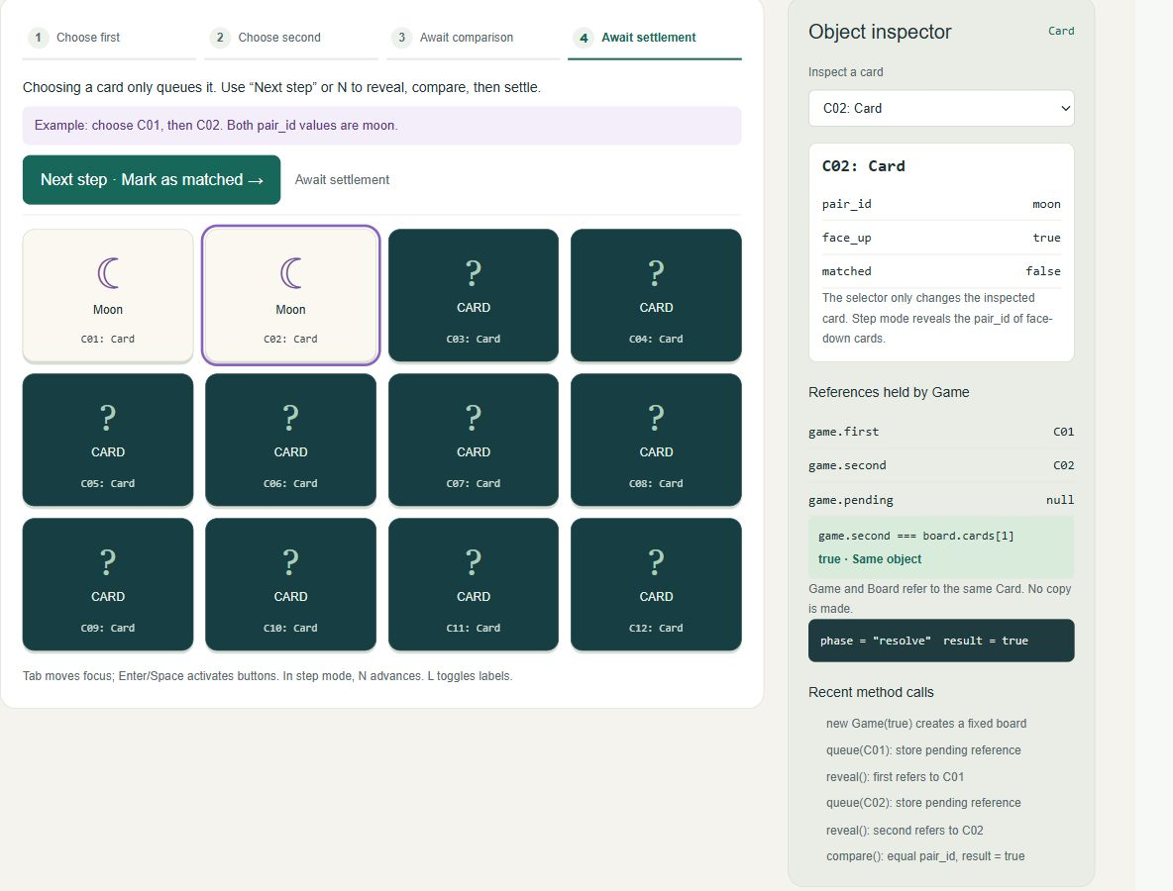
Browser game & object labels
12 cards, 6 pairs. Play directly in your browser.
Normal play: choose two cards, then confirm the turn.
Step mode: queue, reveal, compare, and settle.
Play in your browser
https://minhuangyuntech.github.io/oo2026/en/memory/play/
02
Notes:
References
https://minhuangyuntech.github.io/oo2026/en/memory/play/

Slide 3
Play & inspection controls
Use a mouse, touch, or keyboard
Control | Result
Normal play | Choose two cards; confirm the turn
Step mode / N | Reveal, compare, and settle separately
L / Object labels | Toggle labels such as C01: Card
Object inspector | Inspect a card without revealing it
Fixed examples | Create a new game in step mode
New game / shuffle | Create new objects and a shuffled board
Switching languages preserves the board and progress. Reloading starts a new game.
03
Notes:
References
https://minhuangyuntech.github.io/oo2026/en/memory/play/

Slide 4
Three class responsibilities
Keep data and behavior in the responsible object
Class | Data | Responsibility
Card | name, pair_id, face_up, matched | Reveal, hide, mark matched
Board | cards | Create and find 12 cards
Game | first, second, pending, phase | Coordinate selection and turns
The view reads model state. Buttons call model methods.
04
Notes:
References
https://minhuangyuntech.github.io/oo2026/en/memory/play/
https://docs.python.org/3.12/tutorial/classes.html

Slide 5
UML class diagram
Name, attributes, methods. Arrows show navigable associations.
Game
Board
Card
board: Board
first: Card [0..1]
second: Card [0..1]
pending: Card [0..1]
phase, turns, matches
board
cards: list[Card]
complete: bool
cards
name, pair_id
face_up, matched
1
12
queue(name)
step(), compare(), settle()
get(name)
reveal()
hide(), mark_matched()
first / second / pending : Card [0..1]
One Game has one Board. The Board holds 12 Cards.
first, second, and pending each refer to zero or one Card.
05
Notes:
References
https://minhuangyuntech.github.io/oo2026/en/memory/play/

Slide 6
Equal pictures, distinct objects
Fixed board: C01 and C02 both have pair_id = moon
game : Game
C01 is C02 → False
C01 : Card
first → C01
second → C02
pair_id = "moon"
face_up = True
board : Board
C02 : Card
cards[0] → C01
cards[1] → C02
pair_id = "moon"
face_up = True
C01 and C02 are separate instances with independent face_up values.
Game.first and Board.cards[0] can refer to the same card.
06
Notes:
References
https://minhuangyuntech.github.io/oo2026/en/memory/play/
https://docs.python.org/3.12/reference/expressions.html#is-not

Slide 7
Three Card states
Two Boolean attributes describe the visible state
Visible state | face_up | matched
Face down | False | False
Revealed, not yet matched | True | False
Matched, stays face up | True | True
A matched card stays face up. hide() leaves it unchanged.
07
Notes:
References
https://minhuangyuntech.github.io/oo2026/en/memory/play/

Slide 8
Card: data and reveal behavior
model.py · Card
class Card:
def __init__(self, name, pair_id):
self.name = name
self.pair_id = pair_id
self.face_up = False
self.matched = False
def reveal(self):
if self.face_up or self.matched:
return False
self.face_up = True
return True
reveal() rejects cards that are already face up or matched.
Attributes are writable here. The game uses methods to maintain its rules.
model.py
08
Notes:
References
https://minhuangyuntech.github.io/oo2026/en/memory/play/
https://docs.python.org/3.12/tutorial/classes.html

Slide 9
Board: create and keep cards
model.py · Board.__init__
def __init__(self, sample=False):
pairs = SAMPLE.copy()
if not sample:
shuffle(pairs)
self.cards = [Card(f'C{i+1:02}', pair)
for i, pair in enumerate(pairs)]
Each Card(...) call creates a new instance.
sample=True keeps the fixed order. Normal games shuffle.
model.py
09
Notes:
References
https://minhuangyuntech.github.io/oo2026/en/memory/play/
https://docs.python.org/3.12/tutorial/classes.html

Slide 10
Selection: a pending reference
model.py · Game.queue
def queue(self, name):
if self.phase not in ('first', 'second') or self.pending:
return False
card = self.board.get(name)
if card is None or card.face_up or card.matched:
return False
self.pending = card
return True
Queuing does not change face_up. The next step reveals it.
A revealed card cannot also be selected as the second card.
model.py
10
Notes:
References
https://minhuangyuntech.github.io/oo2026/en/memory/play/

Slide 11
One step: reveal the queued card
Reveal branch of Game.step(); other branches call compare() and settle()
def step(self):
if self.pending and self.phase in ('first', 'second'):
card = self.pending
self.pending = None
card.reveal()
if self.phase == 'first':
self.first = card
self.phase = 'second'
else:
self.second = card
self.phase = 'compare'
return True
first and second hold references to existing Cards.
Each step() completes only one stage.
model.py
11
Notes:
References
https://minhuangyuntech.github.io/oo2026/en/memory/play/

Slide 12
Comparison: check pair_id
model.py · Game.compare
def compare(self):
if self.phase != 'compare' or not (self.first and self.second):
return
self.result = self.first.pair_id == self.second.pair_id
self.turns += 1
self.phase = 'resolve'
Compare picture values and count one comparison.
matched is still False until the settlement step.
model.py
12
Notes:
References
https://minhuangyuntech.github.io/oo2026/en/memory/play/

Slide 13
Settlement: keep or hide
model.py · Game.settle
def settle(self):
if self.phase != 'resolve' or not (self.first and self.second):
return
if self.result:
self.first.mark_matched()
self.second.mark_matched()
self.matches += 1
else:
self.first.hide()
self.second.hide()
self.first = self.second = None
self.result = None
self.phase = 'won' if self.board.complete else 'first'
Equal pictures are marked matched; different ones are hidden.
Temporary references are cleared. Board still holds the cards.
model.py
13
Notes:
References
https://minhuangyuntech.github.io/oo2026/en/memory/play/

Slide 14
Match example: C01 and C02
Load the Match example, select cards, and use N
Action | phase | Observation
Choose C01, press N | second | first → C01; face_up = True
Choose C02, press N | compare | second → C02; both face up
N: compare | resolve | result = True; turns = 1
N: settle | first | matched = True; matches = 1
Selecting a card only queues it. Each N advances one stage.
14
Notes:
References
https://minhuangyuntech.github.io/oo2026/en/memory/play/

Slide 15
Mismatch example: C03 and C04
Load the Mismatch example: leaf versus sun
Action | phase | Observation
C03, N; then C04, N | compare | leaf and sun are face up
N: compare | resolve | result = False; turns = 1
N: settle | first | Both face_up = False
Inspect Board.cards | first | Same objects; matches = 0
Hiding changes the existing Cards. It does not create replacements.
15
Notes:
References
https://minhuangyuntech.github.io/oo2026/en/memory/play/

Slide 16
References, reset & identity
Python is tests object identity
game = Game(sample=True)
game.play('C01')
card = game.first
print(card is game.board.cards[0]) # True
new_game = Game(sample=True)
print(card is new_game.board.cards[0]) # False
print(card.face_up) # True
A new game creates a new Board and new Cards.
The variable card can still refer to an object from the old game.
model.py
16
Notes:
References
https://minhuangyuntech.github.io/oo2026/en/memory/play/
https://docs.python.org/3.12/reference/expressions.html#is-not

Slide 17
Run the Python example
Python 3.12+, with no additional packages
python main.py --lang en --sample
python -m unittest discover -s tests -v
Open a terminal in the extracted memory_oop folder.
Commands: pick C01, step, inspect C01, confirm, sample, quit.
Terminal / PowerShell
17
Notes:
References
https://minhuangyuntech.github.io/oo2026/en/memory/play/

Slide 18
Exercises & references
Check rules through observable state
01
Call hide() after matching. The card should stay face up.
02
Keep a card reference, start a new game, and compare identities.
03
Compare languages: === checks object identity in the web version; Python uses is.
Python · Classes https://docs.python.org/3.12/tutorial/classes.html
Python · Identity https://docs.python.org/3.12/reference/expressions.html#is-not
18
Notes:
References
https://minhuangyuntech.github.io/oo2026/en/memory/play/

