Slide 1
PYTHON OOP / PYGAME
Objects in a shooting game
Pygame · Classes, references & interactions
One game. Three languages. Five core classes.
Start with the screen; see how objects cooperate.
01

Slide 2
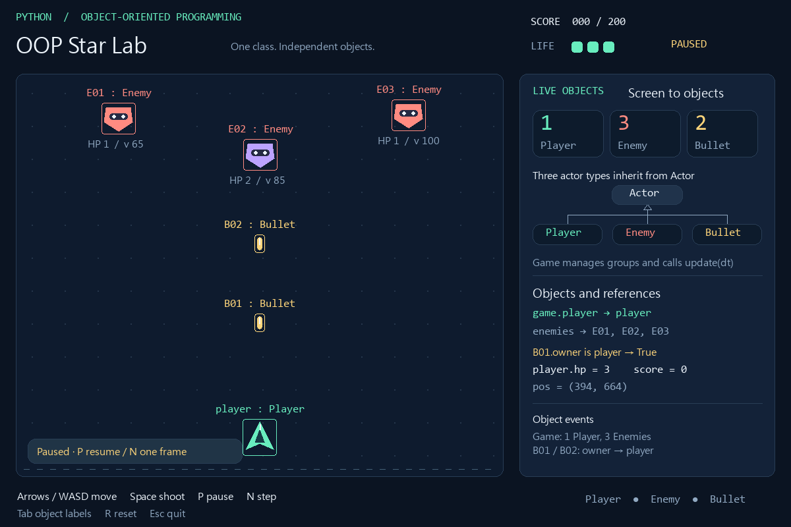
Every on-screen actor is an object
Observe labels, state, and references in the inspector
The green Player is you; red and purple Enemies are separate instances.
Each yellow Bullet holds an owner reference; the panel counts live objects.
02

Slide 3
Install and run: Windows
Extract the ZIP; open PowerShell in the project folder
py -3.12 -m venv .venv
.\.venv\Scripts\python.exe -m pip install -r requirements.txt
.\.venv\Scripts\python.exe main.py --lang en
Use Python 3.12; requirements.txt pins pygame==2.6.1.
Call the environment's Python directly; activation is unnecessary.
PowerShell
03

Slide 4
Install and run: macOS / Linux
Open a terminal in the project; use a graphical desktop
python3 -m venv .venv
.venv/bin/python -m pip install -r requirements.txt
.venv/bin/python main.py --lang en
--lang accepts zh, en, or ja; game rules stay the same.
If CJK text is missing, install a system Noto Sans CJK font.
Terminal
04

Slide 5
Play one round; observe the objects
+10 per defeated enemy; win at 200; start with 3 HP
Key | Action
Enter | Start
Arrows / WASD | Move
Space | Shoot
P / N | Pause / advance one paused frame
Tab / R / Esc | Labels / reset to ready / quit
Contact or a missed enemy triggers damage; invulnerability prevents repeated HP loss.
05

Slide 6
Five classes, five responsibilities
Actors handle themselves; Game coordinates interactions
Class | State | Responsibility
Actor | pos, velocity, image, rect | Shared position and visual data
Player | hp, cooldown, invulnerable | Direction, shooting, damage
Enemy | hp, max_hp | Descent, hits, defeat
Bullet | owner, damage | Travel and off-screen removal
Game | score, state, groups | Spawning, collisions, game loop
06

Slide 7
One class can create many objects
A class defines shared rules; instances keep separate state
e1 = Enemy("E01", (180, 180), hp=1)
e2 = Enemy("E02", (395, 235), hp=2)
print(e1 is e2) # False
print(isinstance(e2, Enemy)) # True
e1.take_hit(1)
print(e1.hp, e2.hp) # 0 2
e1 and e2 are both Enemies, but have different identities and HP.
e1.take_hit(1) does not reduce e2.hp.
actors.py · Enemy
07

Slide 8
Read three UML notations
Class diagrams show structure; object diagrams show instances at a moment
01
Class box: name at the top, attributes in the middle, methods below.
02
A hollow triangle points to the superclass; an open arrow shows a navigable association.
03
1 means one; 0..* means zero or more. Underline name : Class for an instance.
08
Notes:
References
https://www.pygame.org/docs/ref/sprite.html
https://www.pygame.org/docs/ref/time.html
https://docs.python.org/3.12/reference/datamodel.html
https://www.omg.org/spec/UML/2.5.1

Slide 9
Class diagram: three kinds of Actor
Share movement, then add specialized behavior
pygame.sprite.Sprite
Actor
name, pos, velocity, image, rect
update(dt)
Player
Enemy
Bullet
hp, cooldown, invulnerable
hp, max_hp
owner, damage
shoot(name), take_damage()
set_direction(x, y), update(dt)
take_hit(damage)
update(dt)
Hollow triangles point to superclasses. Some drawing details are omitted.
09
Notes:
References
https://www.pygame.org/docs/ref/sprite.html
https://www.pygame.org/docs/ref/time.html
https://docs.python.org/3.12/reference/datamodel.html
https://www.omg.org/spec/UML/2.5.1

Slide 10
Relationships: manage, reference, create
Bullet.owner is a reference; Game manages actors through groups
player
Player
owner
Bullet
1
hp, cooldown
1
0..*
owner, damage
1
shoot(name)
update(dt)
Game
player, score, state
all_sprites
enemies, bullets
Group
Actor
groups
members
1
3
Sprite references
0..*
0..*
pos, velocity
update(dt)
add(), update(), draw()
update(dt)
groups = all_sprites, enemies, bullets
Each Bullet references one Player; many Bullets can reference that same Player.
Group membership is not exclusive ownership, so no composition diamond is used.
10
Notes:
References
https://www.pygame.org/docs/ref/sprite.html
https://www.pygame.org/docs/ref/time.html
https://docs.python.org/3.12/reference/datamodel.html
https://www.omg.org/spec/UML/2.5.1

Slide 11
Object diagram: one player, two references
Paused snapshot: 1 Player, 3 Enemies, 2 Bullets
B01 : Bullet
E01 : Enemy
damage = 1
owner → player
hp = 1
velocity.y = 65
owner
player : Player
hp = 3
pos = (394, 664)
E02 : Enemy
hp = 2
velocity.y = 85
B02 : Bullet
owner
damage = 1
owner → player
E03 : Enemy
hp = 1
velocity.y = 100
B01.owner is B02.owner → True
B01.owner and B02.owner refer to the same player; no player is copied.
Each enemy still has its own HP, position, and velocity.
11
Notes:
References
https://www.pygame.org/docs/ref/sprite.html
https://www.pygame.org/docs/ref/time.html
https://docs.python.org/3.12/reference/datamodel.html
https://www.omg.org/spec/UML/2.5.1

Slide 12
Groups organize; they do not copy
One Enemy can belong to two groups at once
e = Enemy("E01", (180, 180))
all_sprites = pygame.sprite.Group(e)
enemies = pygame.sprite.Group(e)
print(all_sprites.sprites()[0] is e) # True
print(enemies.sprites()[0] is e) # True
all_sprites updates and draws; enemies narrows collision checks.
Changing e.hp is visible through either reference to that same object.
game.py · spawn_enemy()
12
Notes:
References
https://www.pygame.org/docs/ref/sprite.html
https://www.pygame.org/docs/ref/time.html
https://docs.python.org/3.12/reference/datamodel.html
https://www.omg.org/spec/UML/2.5.1

Slide 13
Actor: keep shared data together
image holds appearance; rect holds placement and collision bounds
class Actor(pygame.sprite.Sprite):
def __init__(self, name, position, size):
super().__init__()
self.name = name
self.image = pygame.Surface(size, pygame.SRCALPHA)
self.pos = pygame.Vector2(position)
self.rect = self.image.get_rect(center=position)
self.velocity = pygame.Vector2()
super().__init__() initializes Sprite's group machinery.
pos keeps floating-point coordinates; rect uses integer pixels.
actors.py · Actor.__init__()
13

Slide 14
Movement = velocity × elapsed time
dt is in seconds; velocity is in pixels per second
def update(self, dt):
self.pos += self.velocity * dt
self.rect.center = (round(self.pos.x), round(self.pos.y))
At 80 pixels per second, 0.5 seconds produces 40 pixels of movement.
Update pos, then sync rect, so fractional movement is retained.
actors.py · Actor.update()
14

Slide 15
Player: turn input into direction
Game reads keys; Player sets its own velocity
def set_direction(self, x, y):
direction = pygame.Vector2(x, y)
if direction.length_squared() > 1:
direction = direction.normalize()
self.velocity = direction * PLAYER_SPEED
(1, 0) moves right; (0, -1) moves up; (0, 0) stops.
normalize() keeps diagonal and straight movement at the same speed.
actors.py · Player.set_direction()
15

Slide 16
Player.shoot(): decide whether to fire
One method encapsulates the rule and state change
def shoot(self, name):
if self.cooldown > 0 or self.hp == 0:
return None
self.cooldown = SHOT_INTERVAL
return Bullet(name, self)
Return None while cooling down or when HP is zero.
On success, create a new Bullet; self is the player firing it.
actors.py · Player.shoot()
16

Slide 17
Bullet: remember who fired it
owner stores a reference; negative y velocity moves upward
def __init__(self, name, owner):
position = (owner.rect.centerx, owner.rect.top - 9)
super().__init__(name, position, (8, 20))
self.owner = owner
self.damage = 1
self.velocity.y = -BULLET_SPEED
owner is a Player object, not a string or a copy.
Drawing details are omitted here; damage is 1.
actors.py · Bullet.__init__() · excerpt
17

Slide 18
Game: add the new bullet to the scene
Constructing an object and adding it to a group are separate steps
bullet = self.player.shoot(f"B{self.next_bullet:02}")
if bullet is not None:
self.next_bullet += 1
self.bullets.add(bullet)
self.all_sprites.add(bullet)
Player creates the Bullet; Game chooses its group memberships.
bullets enables collision checks; all_sprites enables updates and drawing.
game.py · Game.try_shoot() · excerpt
18

Slide 19
Polymorphism: one call, different behavior
game.all_sprites.update(dt)
01
Player.update: move, clamp to the field, update cooldown and invulnerability.
02
Enemy inherits Actor.update and moves downward using its own velocity.
03
Bullet.update: move, then kill() when it leaves the top edge.
19
Notes:
References
https://www.pygame.org/docs/ref/sprite.html
https://www.pygame.org/docs/ref/time.html
https://docs.python.org/3.12/reference/datamodel.html
https://www.omg.org/spec/UML/2.5.1

Slide 20
Enemy: manage its own damage state
Game asks whether it was defeated; Enemy manages its HP
def take_hit(self, damage):
self.hp = max(0, self.hp - damage)
if self.hp == 0:
self.kill()
return True
return False
max(0, ...) prevents HP from becoming negative.
True reports defeat; Game then awards the points.
actors.py · Enemy.take_hit()
20

Slide 21
Collision: one bullet, one hit
Use rect overlap; this example does not use pixel masks
for bullet in self.bullets.sprites():
hits = pygame.sprite.spritecollide(
bullet, self.enemies, False)
if hits:
enemy = hits[0]
destroyed = enemy.take_hit(bullet.damage)
bullet.kill()
if destroyed:
self.score += 10
hits[0] selects one enemy, so one bullet does not hit every overlapping enemy.
Apply damage, remove the bullet, then add 10 only on defeat.
game.py · Game.resolve_collisions() · excerpt
21

Slide 22
Damage: Player keeps its state valid
Lose 1 HP per accepted hit, then gain 0.8 seconds of invulnerability
def take_damage(self):
if self.invulnerable > 0 or self.hp == 0:
return False
self.hp -= 1
self.invulnerable = 0.8
return True
Reject damage during invulnerability or when HP is already zero.
Game calls take_damage() instead of changing player.hp directly.
actors.py · Player.take_damage()
22

Slide 23
kill(): leave the scene, still an object
Group membership and Python object lifetime are different
b = game.player.shoot("B99")
if b is not None:
game.bullets.add(b)
game.all_sprites.add(b)
b.kill()
print(b.alive()) # False
print(b.owner is game.player) # True
kill() removes every Group membership; b still holds a reference.
alive() checks group membership, not HP.
interactive example · fresh Game
23
Notes:
References
https://www.pygame.org/docs/ref/sprite.html
https://www.pygame.org/docs/ref/time.html
https://docs.python.org/3.12/reference/datamodel.html
https://www.omg.org/spec/UML/2.5.1

Slide 24
The loop: input, update, draw
Order inside run(); key-reading details are omitted
dt = min(self.clock.tick(FPS) / 1000, 1 / 30)
self.handle_events(pygame.event.get())
# direction and shooting come from keyboard input
self.tick(dt, direction, shooting)
view.draw(self)
pygame.display.flip()
tick() updates only while playing; view.draw() also renders paused and end states.
Clock returns milliseconds; divide by 1000 for seconds. This game caps dt at 1/30.
game.py · Game.run() · excerpt
24
Notes:
References
https://www.pygame.org/docs/ref/sprite.html
https://www.pygame.org/docs/ref/time.html
https://docs.python.org/3.12/reference/datamodel.html
https://www.omg.org/spec/UML/2.5.1

Slide 25
State: paused really means paused
ready → playing ⇄ paused; playing → won / lost
score ≥ 200
won
Enter
ready
playing
P
P
hp = 0
lost
paused
R: any state → ready
N calls update(1 / FPS) only while paused: one frame, without automatic firing.
R resets to ready; Enter starts again. Zero HP takes priority over reaching 200 points.
25

Slide 26
Reset: create a new round of objects
reset() rebuilds the player and groups, then resets score and state
if hasattr(self, "all_sprites"):
for actor in self.all_sprites.sprites():
actor.kill()
self.player = Player((PLAY_AREA.centerx, PLAY_AREA.bottom - 60))
self.all_sprites = pygame.sprite.Group(self.player)
self.enemies = pygame.sprite.Group()
self.bullets = pygame.sprite.Group()
self.score = 0
self.state = "ready"
Old objects leave their groups; other references can still keep them accessible.
The game then spawns three initial enemies; the new player is a new object.
game.py · Game.reset() · excerpt after first initialization
26

Slide 27
Find the file that owns the change
Five core classes; display and language use separate functions
File | Contents
actors.py | Actor, Player, Enemy, Bullet
game.py | Game: events, spawning, collision, state
view.py / i18n.py | Display and UI text; no game rules
settings.py / main.py | Parameters / command-line entry point
tests/test_game.py | Behavior, collisions, state, rendering
27

Slide 28
Test how the objects cooperate
Check observable outcomes, not just the code's appearance
# Windows PowerShell
.\.venv\Scripts\python.exe -m unittest discover -s tests -v
# macOS / Linux
.venv/bin/python -m unittest discover -s tests -v
Check identity, cooldown, single hits, invulnerability, and stopped end states.
Tests use SDL's dummy driver, so they do not need a game window.
project folder
28

Slide 29
Small exercises: change the responsible class
Describe completion through observable, testable behavior
01
Give an Enemy 3 HP: three hits to defeat it, with one 10-point award.
02
Set Bullet.damage to 2: defeat a 2-HP enemy with one shot.
03
Shorten SHOT_INTERVAL: verify no new Bullet is created during cooldown.
29

Slide 30
Five classes explain one system
Keep state in objects; let methods coordinate behavior
Inheritance shares behavior; associations hold references; polymorphism unifies calls.
The course website includes the complete example, three decks, and searchable chapters.
Pygame · Sprite / Group
https://www.pygame.org/docs/ref/sprite.html
Pygame · Clock
https://www.pygame.org/docs/ref/time.html
Python 3.12 · Data model
https://docs.python.org/3.12/reference/datamodel.html
OMG · UML 2.5.1
https://www.omg.org/spec/UML/2.5.1
Course · Pygame
https://minhuangyuntech.github.io/oo2026/en/pygame/
30
Notes:
References
https://www.pygame.org/docs/ref/sprite.html
https://www.pygame.org/docs/ref/time.html
https://docs.python.org/3.12/reference/datamodel.html
https://www.omg.org/spec/UML/2.5.1

