Slide 1

WEEK 01
Object-Oriented
Programming
Theory and Practice
Week 1 Course Overview 90 minutes
National Yunlin University of Science and Technology
Department of Electronic Engineering
Academic Year 115, Semester 1 Min-Huang Ho
01
Notes:
Source: https://webapp.yuntech.edu.tw/WebNewCAS/Course/Plan/Query.aspx?&115&1&1478
Name spelling: https://uel.yuntech.edu.tw/en/faculty_1.html

Slide 2
Which programming problems have you faced?
Hard to understand
A month later, you forget your own reasoning.
Hard to change
Adding one feature causes other features to break.
Hard to move
The program stops working on another computer.
Hard to integrate
Everyone finishes their part, but the interfaces do not match.
02

Slide 3
Your programming experience
Build on your C experience and identify the skills you want to strengthen.
What have you built?
What have you used?
What would you improve?
C or Python
Class exercises, projects
or your own small tools
Functions and data structures
Git, testing
or web frameworks
Reading code
Debugging and revising
or working with others
03

Slide 4
Course learning goals
Understand object-oriented thinking
and design software systems
that can evolve.
Practice object modeling, design principles, testing and refactoring in Python.
Complete an individual project that you can run, explain and reproduce.
04
Notes:
Source: https://minhuangyuntech.github.io/oo2026/

Slide 5
Final project: an individual OOP system
Choose a real problem
Define the users, scenarios and scope.
Build a testable system with clear class responsibilities
and meaningful object collaboration.
MiniClaw, a personal AI assistant, is a suggested integration project.
You may choose another topic that demonstrates OOP design.
05
Notes:
Source: https://minhuangyuntech.github.io/oo2026/#project
Source: https://github.com/openclaw/openclaw

Slide 6
MiniClaw: an optional integration project
Inspired by OpenClaw, keep the scope small and complete the core features.
Core scope for this example
Optional extensions
Web chat and conversation history
A real model and a test double
Tools that work with data
Input validation and error handling
Scheduled reminders
Sensor integration
External chat platforms
Streaming responses
Set a step limit for tool calls and choose features that fit your project.
06
Notes:
Source: https://minhuangyuntech.github.io/oo2026/#project
Source: https://github.com/openclaw/openclaw

Slide 7
18 weeks, three stages of learning
Stage | Learning focus | Outcome
Weeks 1–5 | Python, classes, encapsulation and the object memory model | Develop object-oriented thinking
Weeks 6–11 | UML, inheritance, polymorphism and advanced type mechanisms | Organize replaceable components
Weeks 12–18 | Analysis, design, SOLID, patterns, testing and supplementary integration | Complete an individual system project
07
Notes:
Source: https://minhuangyuntech.github.io/oo2026/#roadmap

Slide 8
Theory and practice this semester
Object models and core concepts
Analysis and design practices
Classes, encapsulation and object lifecycles
Relationships, inheritance and polymorphism
Abstract interfaces and UML class diagrams
Data classes, generics and Protocol
OOA/OOD, SOLID and design patterns
Testing, refactoring and system integration
Use Python for implementation and build on C to understand objects and responsibilities.
08
Notes:
Source: https://minhuangyuntech.github.io/oo2026/#weeks

Slide 9
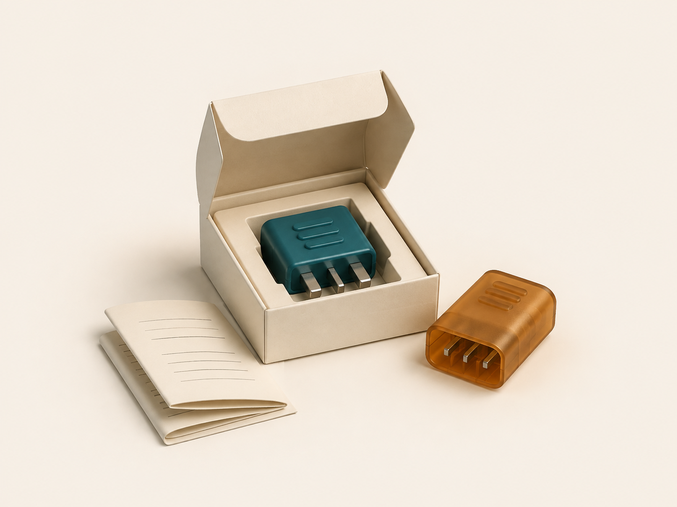
Extension: a reusable Python module
Turn one clear function
into a standalone module
that fits your project.
A clear public API and usage example
An installable package as a next step
TestPyPI and PyPI publishing practice
09
Notes:
Source: https://packaging.python.org/en/latest/tutorials/packaging-projects/

Slide 10
Three programming paradigms
Procedural
Use functions to process data and a control flow to connect operations.
Object-oriented
Combine state and behavior in objects. Organize the system
around responsibilities and collaboration.
Functional
Favor pure functions and immutable data to reduce
hidden state and side effects.
Choose the approach that fits the problem. A system can combine paradigms.
10
Notes:
Source: https://minhuangyuntech.github.io/oo2026/week/1/

Slide 11
One problem: withdrawing from an account
Aspect | Procedural | Object-oriented
Where data lives | An account dictionary or struct | Attributes of an Account object
How to withdraw | withdraw(account, 250) | account.withdraw(250)
Who checks rules | The function validates the amount and balance | The method maintains object invariants
Maintenance focus | Coordination of control flow and data | Object responsibilities and the public interface
11
Notes:
Source: https://minhuangyuntech.github.io/oo2026/week/1/

Slide 12
Final project deliverables
Requirements and code
Clear usage scenarios, functional scope and runnable source code.
Design documentation
UML that matches the code, plus one SOLID principle
or design pattern and the problem it solves.
Tests and reflection
Test cases, results, remaining risks and your personal reflection.
Setup and deployment
README, version history, and a URL or complete startup instructions.
12
Notes:
Source: https://minhuangyuntech.github.io/oo2026/week/18/

Slide 13
The individual project workflow
01
Define the problem
Identify users, scenarios and verifiable requirements.
02
Model objects and APIs
Explain responsibilities, UML and interaction flows.
03
Build and test
Test normal, boundary and failure cases, then refactor.
04
Review, present and deliver
Week 17: design review.
Week 18: complete the required deliverables.
13
Notes:
Source: https://minhuangyuntech.github.io/oo2026/week/12/
Source: https://minhuangyuntech.github.io/oo2026/week/17/
Source: https://minhuangyuntech.github.io/oo2026/week/18/

Slide 14
Reproducibility is part of acceptance
Start in a clean environment using the README
Complete the main use cases
Run the tests and check the results
14
Notes:
Source: https://minhuangyuntech.github.io/oo2026/week/17/

Slide 15

Integration example: Django and MiniClaw
LLM
Django web app
Assistant core
Python package
Database
Accept input,
display results
Coordinate the model
and tools
Run specific
operations
Store data and logs
15
Notes:
Source: https://minhuangyuntech.github.io/oo2026/week/15/
Source: https://docs.djangoproject.com/en/6.0/

Slide 16
Web and AI: supplementary integration
Week 15: web and databases. Week 16: LLM integration and Linux deployment.
Platforms and external services
The core you design
Django web app and database
Cloud APIs or Ollama models
Linux environment and deployment
Object responsibilities and domain rules
Replaceable providers and services
Tests that run independently
Choose integrations to suit your topic. The core logic should work independently first.
16
Notes:
Source: https://minhuangyuntech.github.io/oo2026/week/15/
Source: https://minhuangyuntech.github.io/oo2026/week/16/

Slide 17
Development tools at a glance
Task | Tools | Purpose
Coding and debugging | Python, editor and debugger | Inspect code and object state
Analysis and design | UML and CRC cards | Express responsibilities, relationships and interactions
Versioning and quality | Git, testing and type-checking tools | Track changes and verify behavior
Delivery and integration | Python packages, web apps and model services | Reproduce results and connect external capabilities
17
Notes:
Source: https://minhuangyuntech.github.io/oo2026/#weeks

Slide 18

Your project idea
What problem would you solve
with object-oriented design?
Start with a specific problem
in your studies, lab work
or daily life.
18

Slide 19
A requirement worth implementing
User
Who will use it? What problem do they face?
Request
How would the user ask for it?
Data
What information must it read or change?
Failure scenarios
What could prevent the task from succeeding?
19

Slide 20
Course assessment
30%
30%
40%
Attendance and
ongoing coursework
Midterm exam
Final project
Written midterm in Week 9.
Assignments and detailed grading criteria will follow.
20
Notes:
Source: https://webapp.yuntech.edu.tw/WebNewCAS/Course/Plan/Query.aspx?&115&1&1478

Slide 21
Guidelines for AI assistance
AI can help with
Your responsibilities
Understanding concepts and code
Debugging and comparing approaches
Suggesting test scenarios
Explain how the code works
Verify results and limitations
Make the required changes
21

Slide 22
Course materials and contact
Course materials
https://minhuangyuntech.github.io/oo2026
Course platform
https://eclass.yuntech.edu.tw
Min-Huang Ho minhuang@yuntech.edu.tw
Office hours: Wednesday 10:00–12:00, by appointment
22
Notes:
Source: https://webapp.yuntech.edu.tw/WebNewCAS/Course/Plan/Query.aspx?&115&1&1478
Name spelling: https://uel.yuntech.edu.tw/en/faculty_1.html

Slide 23
Week 2: Python fundamentals review
Data and control flow
Data types, operators, conditions and loops.
Functions and
parameters
Functions, scope, parameter passing and return values.
Containers and data
list, tuple, dict, set and comprehensions.
Moving from C
to Python
Compare syntax and execution models. Rewrite a small program
with functions and containers.
23
Notes:
Source: https://minhuangyuntech.github.io/oo2026/week/2/

