Slide 1
PYTHON OOP / Week 8
Polymorphism, abstraction
and interfaces
Shared interfaces and replaceable objects in the shooter
Enemy · update(dt) · ABC · Protocol · Motion
01
Notes:
References
https://minhuangyuntech.github.io/oo2026/materials/week-8-examples.zip

Slide 2
This week’s topics
Different objects can respond to the same call
01
Trace update(dt) to understand polymorphism and dynamic dispatch.
02
Compare duck typing, ABCs, and Protocols.
03
Add enemy behavior and replace movement through composition.
02
Notes:
References
https://minhuangyuntech.github.io/oo2026/materials/week-8-examples.zip

Slide 3
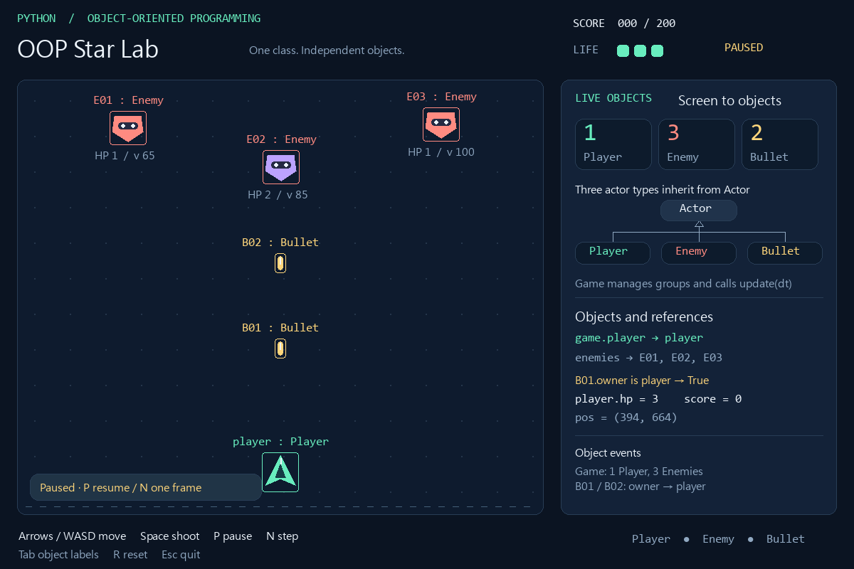
Objects in the original shooter
Game manages Player, Enemy, and Bullet
Each actor holds its own position, velocity, and state.
Game updates the group. Actors handle their own behavior.
03
Notes:
References
https://minhuangyuntech.github.io/oo2026/materials/pygame-oop-shooter.zip
https://www.pygame.org/docs/ref/sprite.html#pygame.sprite.Group.update

Slide 4
Existing classes and update behavior
Enemy inherits Actor.update() unchanged
Class | Update behavior
Actor | Move by velocity and synchronize rect
Player | Shared motion, bounds, and cooldown
Enemy | Use Actor movement
Bullet | Shared motion, then remove offscreen bullets
Inherited methods also participate in polymorphism. Not every subclass needs an override.
04
Notes:
References
https://minhuangyuntech.github.io/oo2026/materials/pygame-oop-shooter.zip

Slide 5
One call updates the group
Game.update() in the original game.py
self.all_sprites.update(dt)
# Conceptual equivalent:
for actor in self.all_sprites:
actor.update(dt)
Group.update(dt) forwards the same dt to each Sprite’s update.
The group does not collect update return values.
game.py / Game.update
05
Notes:
References
https://minhuangyuntech.github.io/oo2026/materials/pygame-oop-shooter.zip
https://www.pygame.org/docs/ref/sprite.html#pygame.sprite.Group.update

Slide 6
Dynamic dispatch paths
Method lookup follows the object’s actual class
Actual object | Method found | Further call
player: Player | Player.update | super().update(dt)
E01: Enemy | Actor.update | Move directly
B01: Bullet | Bullet.update | super().update(dt)
The loop name stays actor while the referenced object changes.
06
Notes:
References
https://minhuangyuntech.github.io/oo2026/materials/pygame-oop-shooter.zip
https://docs.python.org/3.12/tutorial/classes.html#inheritance

Slide 7
Shared movement and dt
dt is in seconds. Velocity is in pixels per second.
def update(self, dt):
self.pos += self.velocity * dt
self.rect.center = (round(self.pos.x), round(self.pos.y))
At velocity −620 and dt=0.5, bullet y decreases by 310 pixels.
pos retains fractions. rect uses integers for drawing and collision.
actors.py / Actor.update
07
Notes:
References
https://minhuangyuntech.github.io/oo2026/materials/pygame-oop-shooter.zip

Slide 8
Overriding and super()
Bullet adds its rule after shared movement
def update(self, dt):
super().update(dt)
if self.rect.bottom < PLAY_AREA.top:
self.kill()
In this inheritance chain, super().update(dt) calls Actor.update.
When the bullet leaves the top edge, kill() removes it from all groups.
actors.py / Bullet.update
08
Notes:
References
https://minhuangyuntech.github.io/oo2026/materials/pygame-oop-shooter.zip
https://docs.python.org/3.12/tutorial/classes.html#inheritance

Slide 9
An enemy that weaves sideways
WeavingEnemy is a Week 8 extension
class WeavingEnemy(Enemy):
def __init__(self, name, position, speed=80, hp=1):
super().__init__(name, position, speed, hp)
self.elapsed = 0.0
def update(self, dt):
self.elapsed += dt
self.velocity.x = 100 * cos(3 * self.elapsed)
super().update(dt)
elapsed accumulates seconds. cos() varies horizontal velocity.
HP, damage handling, and group operations remain inherited.
extension.py / WeavingEnemy
09
Notes:
References
https://minhuangyuntech.github.io/oo2026/materials/week-8-examples.zip

Slide 10
The new enemy joins the same group
Choose the class at creation. Keep the shared update call.
from actors import Enemy
from extension import WeavingEnemy
a = Enemy("E01", (180, 180))
b = WeavingEnemy("E02", (395, 235))
group = pygame.sprite.Group(a, b)
group.update(1 / 60)
Both the original Enemy and the new enemy accept update(dt).
The complete spawn logic is in demo_game.py.
demo_game.py / Week8Game.spawn_enemy (concept)
10
Notes:
References
https://minhuangyuntech.github.io/oo2026/materials/week-8-examples.zip
https://www.pygame.org/docs/ref/sprite.html#pygame.sprite.Group.update

Slide 11
Duck typing with Spark
An object can participate when it supports the required operation
class Spark:
def __init__(self) -> None:
self.ttl = 1.0
def update(self, dt: float) -> None:
self.ttl = max(0.0, self.ttl - dt)
Spark stores a remaining lifetime, ttl. It does not inherit from Enemy.
Spark fits an ordinary update list. Pygame groups still need Sprite support.
contracts.py / Spark
11
Notes:
References
https://minhuangyuntech.github.io/oo2026/materials/week-8-examples.zip
https://docs.python.org/3.12/library/typing.html#typing.Protocol
https://www.pygame.org/docs/ref/sprite.html#pygame.sprite.Group.update

Slide 12
Calls need compatible methods
Both the method name and its parameters affect the call
class BadClock:
def update(self):
pass
bad = BadClock()
bad.update(0.5) # TypeError
A missing update method raises AttributeError.
An update method without a dt parameter also fails this call.
contracts.py / BadClock
12
Notes:
References
https://minhuangyuntech.github.io/oo2026/materials/week-8-examples.zip
https://docs.python.org/3.12/tutorial/classes.html#inheritance

Slide 13
The update contract
A shared interface includes behavior and units
Item | Contract in this example
Input | dt: float
Units | Elapsed seconds, dt ≥ 0
Side effects | Update own state and synchronize rect when needed
Return | None
Abstraction exposes required operations while keeping implementation details inside objects.
13
Notes:
References
https://minhuangyuntech.github.io/oo2026/materials/week-8-examples.zip

Slide 14
Abstract base classes
Abstract methods declare operations subclasses must complete
from abc import ABC, abstractmethod
class UpdateableABC(ABC):
@abstractmethod
def update(self, dt: float) -> None:
pass
This is a separate simplified model. The original Actor remains concrete.
ABC and abstractmethod come from the abc module.
contracts.py / UpdateableABC
14
Notes:
References
https://minhuangyuntech.github.io/oo2026/materials/week-8-examples.zip
https://docs.python.org/3.12/library/abc.html

Slide 15
Unimplemented abstract methods
Python blocks instantiation while abstract methods remain
class Incomplete(UpdateableABC):
pass
Incomplete() # TypeError
# Still abstract:
UpdateableABC() # TypeError
pass alone creates no abstract contract. ABC and the decorator do.
ABCs do not fully validate override signatures or behavior.
contracts.py / abstract-class example
15
Notes:
References
https://docs.python.org/3.12/library/abc.html

Slide 16
A concrete implementation
FallingTarget implements update(dt)
class FallingTarget(UpdateableABC):
def __init__(self) -> None:
self.y = 0.0
def update(self, dt: float) -> None:
self.y += 80.0 * dt
After creation, update(0.5) changes y from 0.0 to 40.0.
An abstract class can also provide shared implementations and regular methods.
contracts.py / FallingTarget
16
Notes:
References
https://minhuangyuntech.github.io/oo2026/materials/week-8-examples.zip
https://docs.python.org/3.12/library/abc.html

Slide 17
Protocol describes required capabilities
Compatibility follows structure without explicit inheritance
from typing import Protocol
from collections.abc import Iterable
class Updatable(Protocol):
def update(self, dt: float) -> None: ...
def tick_all(items: Iterable[Updatable], dt: float) -> None:
for item in items:
item.update(dt)
tick_all only needs each item to accept update(dt).
Iterable accepts sources such as lists and tuples.
contracts.py / Updatable, tick_all
17
Notes:
References
https://minhuangyuntech.github.io/oo2026/materials/week-8-examples.zip
https://docs.python.org/3.12/library/typing.html#typing.Protocol

Slide 18
Different classes share one update function
FallingTarget and Spark both satisfy Updatable
from contracts import FallingTarget, Spark, tick_all
target = FallingTarget()
spark = Spark()
tick_all([target, spark], 0.5)
print(target.y, spark.ttl)
# 40.0 0.5
Spark does not need to declare class Spark(Updatable).
The same dt produces different state changes in different objects.
contracts.py / executable example
18
Notes:
References
https://minhuangyuntech.github.io/oo2026/materials/week-8-examples.zip
https://docs.python.org/3.12/library/typing.html#typing.Protocol

Slide 19
Static checking finds incompatible methods
typing_error.py intentionally contains a type error
from contracts import BadClock, Updatable
bad: Updatable = BadClock()
# mypy: incompatible types in assignment
mypy expects update(self, dt: float), but BadClock has no dt.
Type hints support checking. Python does not run mypy automatically.
typing_error.py
19
Notes:
References
https://minhuangyuntech.github.io/oo2026/materials/week-8-examples.zip
https://docs.python.org/3.12/library/typing.html#typing.Protocol
https://mypy.readthedocs.io/en/stable/protocols.html

Slide 20
Limits of runtime_checkable
Runtime checks look for members, not complete signatures
from typing import Protocol, runtime_checkable
from contracts import BadClock
@runtime_checkable
class CanUpdate(Protocol):
def update(self, dt: float) -> None: ...
print(isinstance(BadClock(), CanUpdate))
# True
isinstance returning True does not guarantee update(0.5) succeeds.
An ordinary Protocol needs this decorator for this isinstance check.
contracts.py / CanUpdate
20
Notes:
References
https://minhuangyuntech.github.io/oo2026/materials/week-8-examples.zip
https://docs.python.org/3.12/library/typing.html#typing.Protocol

Slide 21
Three ways to express an interface
Choose the contract and checking approach you need
Approach | Compatibility | Main check
Duck typing | Required operation works | At the call
ABC | Inheritance and implementations | At instantiation
Protocol | Method and attribute structure | Primarily static checking
All three support polymorphism. ABCs and Protocols can coexist in one project.
21
Notes:
References
https://docs.python.org/3.12/library/abc.html
https://docs.python.org/3.12/library/typing.html#typing.Protocol
https://mypy.readthedocs.io/en/stable/protocols.html

Slide 22
Type compatibility and correct behavior
Interfaces describe calls. Tests check state changes.
01
Every update(dt) uses seconds. One class must not silently use milliseconds.
02
An override still accepts existing calls without extra required arguments.
03
Tests also check position, HP, and rect consistency.
22
Notes:
References
https://minhuangyuntech.github.io/oo2026/materials/week-8-examples.zip
https://docs.python.org/3.12/tutorial/classes.html#inheritance
https://docs.python.org/3.12/library/typing.html#typing.Protocol

Slide 23
Separate movement through composition
Enemy holds a Motion object to calculate velocity
from typing import Protocol
class Motion(Protocol):
def velocity(self, dt: float) -> tuple[float, float]: ...
Motion describes velocity(dt), returning (vx, vy).
The returned values are velocities, not yet multiplied by dt.
motion.py / Motion
23
Notes:
References
https://minhuangyuntech.github.io/oo2026/materials/week-8-examples.zip

Slide 24
Straight and weaving strategies
The same velocity(dt) interface produces different velocities
from math import cos
class Straight:
def velocity(self, dt: float) -> tuple[float, float]:
return (0.0, 80.0)
class Weave:
def __init__(self) -> None:
self.elapsed = 0.0
def velocity(self, dt: float) -> tuple[float, float]:
self.elapsed += dt
return (100.0 * cos(3.0 * self.elapsed), 80.0)
Straight needs no timer. Weave keeps its own elapsed time.
Create a separate Weave for each enemy to avoid sharing mutable time state.
motion.py / Straight, Weave
24
Notes:
References
https://minhuangyuntech.github.io/oo2026/materials/week-8-examples.zip

Slide 25
StrategyEnemy delegates velocity
Inherit Enemy behavior while holding a movement strategy
class StrategyEnemy(Enemy):
def __init__(self, name, position, motion: Motion):
super().__init__(name, position)
self.motion = motion
def update(self, dt):
vx, vy = self.motion.velocity(dt)
self.velocity.update(vx, vy)
super().update(dt)
Get velocity first. Actor.update then multiplies it by dt.
This is object composition by reference. A field alone does not prove UML composite ownership.
extension.py / StrategyEnemy
25
Notes:
References
https://minhuangyuntech.github.io/oo2026/materials/week-8-examples.zip

Slide 26
Keep the enemy and replace its strategy
Change the motion reference without rebuilding Enemy
from extension import StrategyEnemy
from motion import Straight, Weave
enemy = StrategyEnemy("E03", (620, 175), Weave())
original = enemy
enemy.motion = Straight()
print(enemy is original) # True
Enemy identity, position, and HP remain. The next update uses the new strategy.
Press C in the Week 8 game to switch StrategyEnemy between straight and weaving motion.
extension.py + motion.py
26
Notes:
References
https://minhuangyuntech.github.io/oo2026/materials/week-8-examples.zip

Slide 27
Choosing inheritance or composition
Decide from identity and how behavior changes
Situation | Choice | Example
A kind of Enemy sharing damage rules | Inheritance | WeavingEnemy(Enemy)
One enemy switches movement behavior | Composition | enemy.motion = Straight()
Unrelated objects can update | Protocol | tick_all([target, spark], dt)
StrategyEnemy uses both inheritance and composition. They can complement each other.
27
Notes:
References
https://minhuangyuntech.github.io/oo2026/materials/week-8-examples.zip

Slide 28
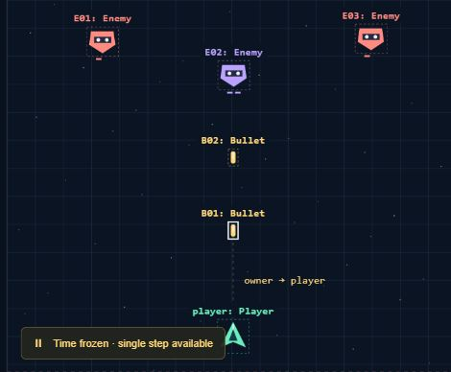
Pause and inspect the browser game
The browser keeps the original game. New strategies are in the Week 8 download.
Load the observation example, select B01, then press N for one frame.
B01.y changes from about 490.0 to 479.7. Its owner stays the same Player.
Open the original browser game ↗
28
Notes:
References
https://minhuangyuntech.github.io/oo2026/materials/pygame-oop-shooter.zip
https://minhuangyuntech.github.io/oo2026/pygame/play/

Slide 29
Run the Week 8 examples
Run inside week8_examples after extracting the ZIP
python -m pip install -r requirements.txt
python contracts.py
python demo_game.py --lang en
python -m mypy --strict contracts.py motion.py
python -m mypy --strict typing_error.py
python -m unittest discover -s tests -v
Download Week 8 examples ↗
Python 3.12+. Original controls remain. C switches strategy, P pauses, N steps.
Use en or ja for English or Japanese. typing_error.py should report a type error.
week8_examples/
29
Notes:
References
https://minhuangyuntech.github.io/oo2026/materials/week-8-examples.zip

Slide 30
Exercise: a motion-freeze strategy
Add Freeze so an existing enemy stays in place
01
Implement velocity(dt) and return zero horizontal and vertical velocity.
02
Assign Freeze() to enemy.motion, then call update(0.5).
03
Check that position is unchanged while identity and HP remain.
30
Notes:
References
https://minhuangyuntech.github.io/oo2026/materials/week-8-examples.zip

Slide 31
Exercise solution and state checks
Replace the behavior object and reuse the update flow
class Freeze:
def velocity(self, dt: float) -> tuple[float, float]:
return (0.0, 0.0)
enemy.motion = Freeze()
before = tuple(enemy.pos)
original = enemy
enemy.update(0.5)
assert tuple(enemy.pos) == before
assert enemy is original
Freeze satisfies Motion structurally without explicit inheritance.
The complete tests also check HP, rect, and group membership.
motion.py / Freeze; tests/test_week8.py
31
Notes:
References
https://minhuangyuntech.github.io/oo2026/materials/week-8-examples.zip

Slide 32
Key ideas and references
Shared interfaces let objects cooperate and be replaced
01
Polymorphism selects behavior by object. Inheritance and duck typing both support it.
02
ABCs require implementations. Protocols describe structural compatibility.
03
Composition enables replaceable behavior. Tests check the contract behind the interface.
Python abstract classes ↗
Python Protocol ↗
32
Notes:
References
https://docs.python.org/3.12/library/abc.html
https://docs.python.org/3.12/library/typing.html#typing.Protocol
https://docs.python.org/3.12/tutorial/classes.html#inheritance
https://www.pygame.org/docs/ref/sprite.html#pygame.sprite.Group.update
https://mypy.readthedocs.io/en/stable/protocols.html

