Slide 1
Results Summary 2
May 19

Slide 2
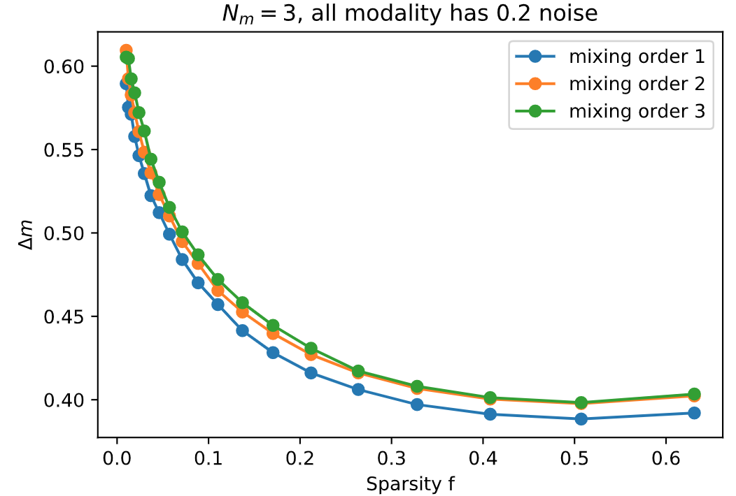
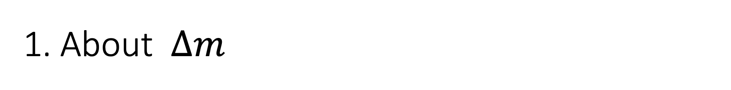
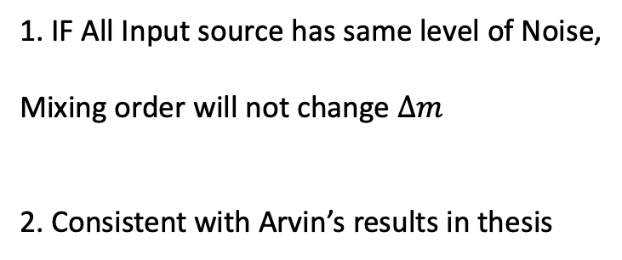
1. About $∆m$
Add Same Noise to all modalities
1. IF All Input source has same level of Noise,
Mixing order will not change $∆m$
2. Consistent with Arvin’s results in thesis
3. Because All neurons are homogeneous,
Babaldi’s equation could apply here.

Slide 3
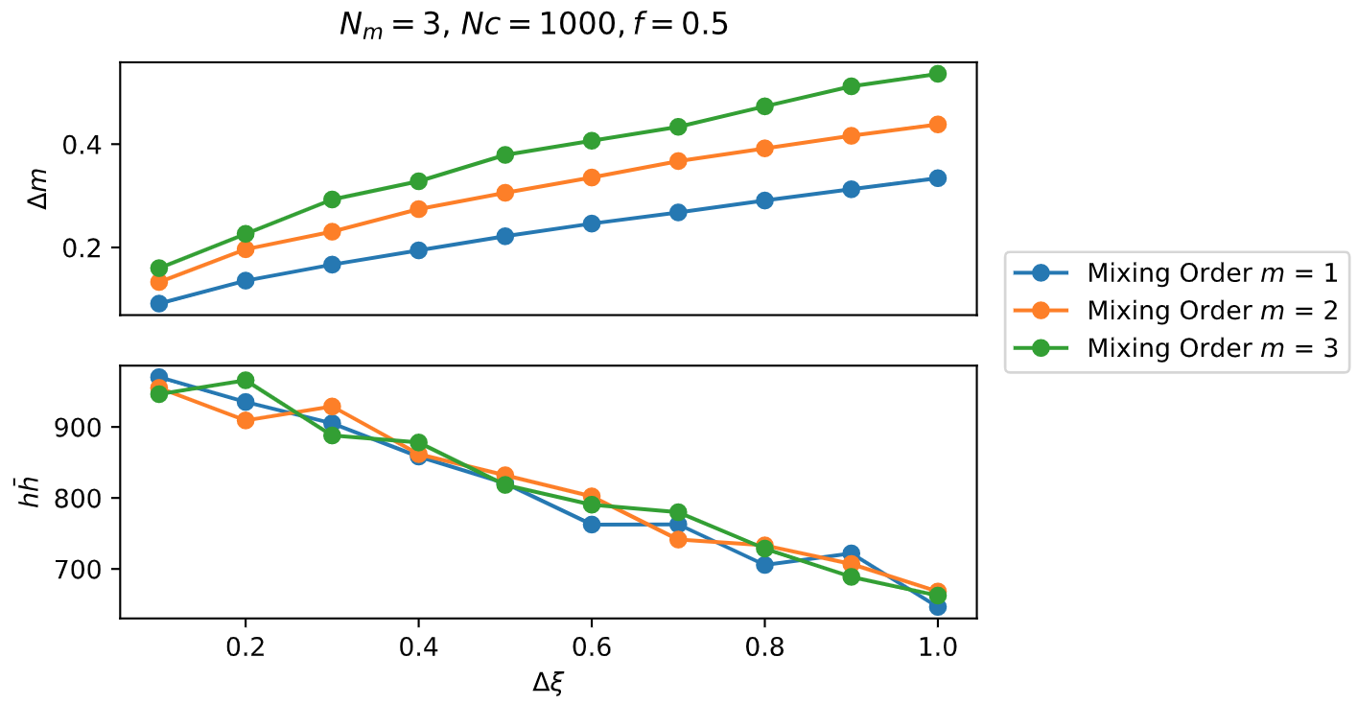
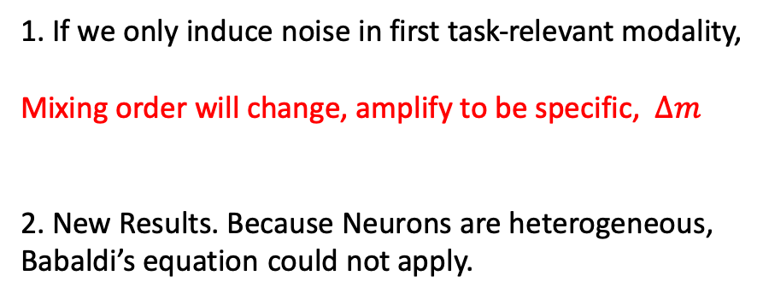
1. About $∆m$
Only Add Noise to First modality
1. If we only induce noise in first task-relevant modality,
Mixing order will change, amplify to be specific, $∆m$
2. New Results. Because Neurons are heterogeneous,
Babaldi’s equation could not apply.

Slide 4
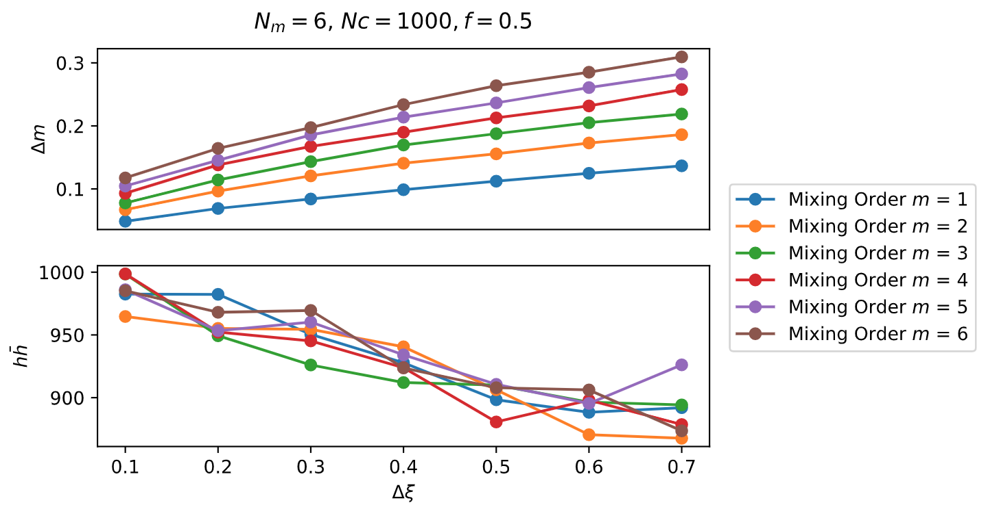

1. About $∆m$
Only Add Noise to First modality
Same results for 6 Modalities
1. If we only induce noise in first task-relevant modality,
Mixing order will change, amplify to be specific, $∆m$
2. New Results. Because Neurons are heterogeneous,
Babaldi’s equation could not apply.

Slide 5
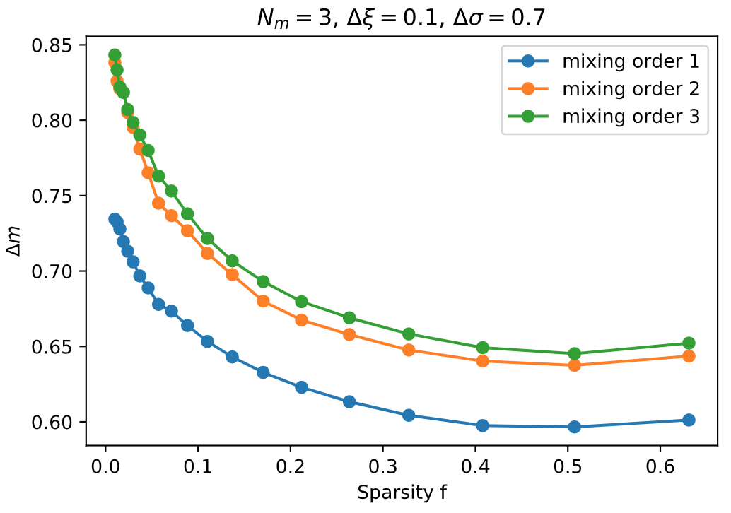
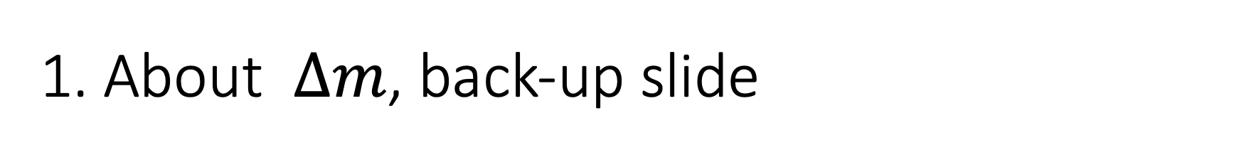
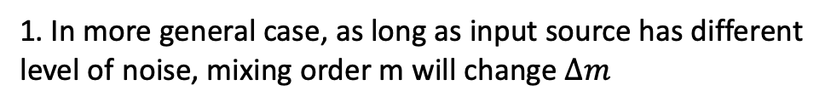
1. About $∆m$, back-up slide
Add different Noise to different modalities
1. In more general case, as long as input source has different
level of noise, mixing order m will change $∆m$

Slide 6
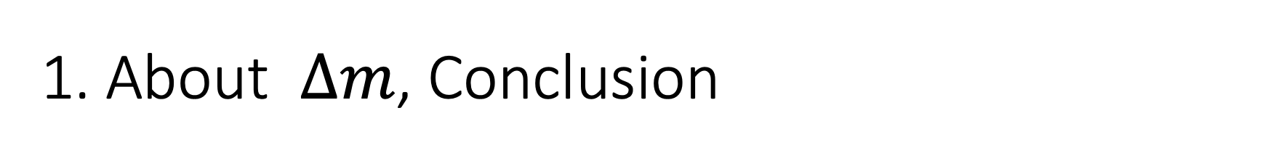
1. About $∆m$, Conclusion
1. If all Input source has same level of noise, Mixing order will not change $∆m$
1.1 Babaldi’s Equation doesn’t apply when neurons has heterogeneous noise.
2. When heterogeneous noise in different source, Mixing order will affect $∆m.$
If we only has noise at first modality, the mixing order will monotonically amplify $∆m$

Slide 7
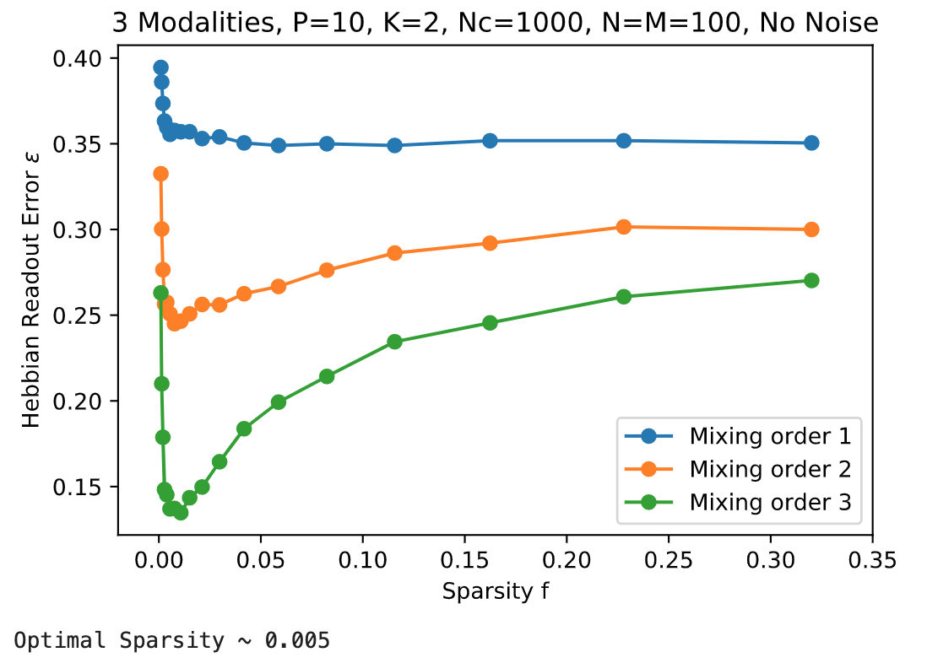
2. About Readout Error
Relation to Sparsity f

Slide 8
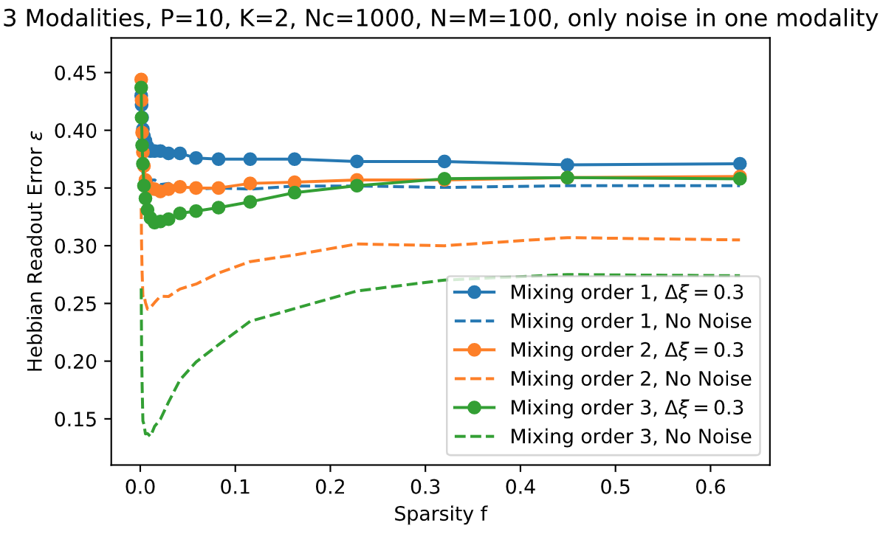
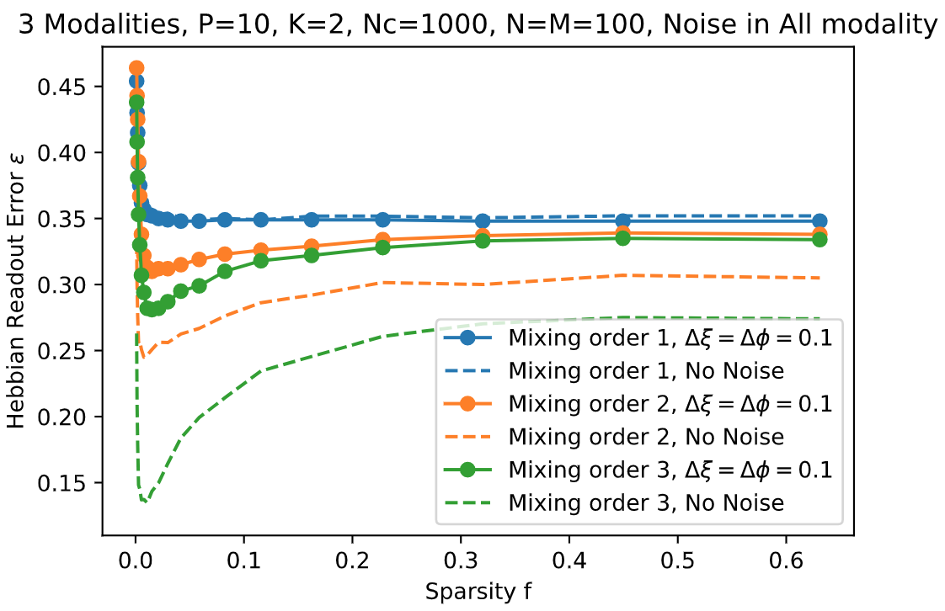
2. About Readout Error
Relation to Sparsity f, Add Noise

Slide 9
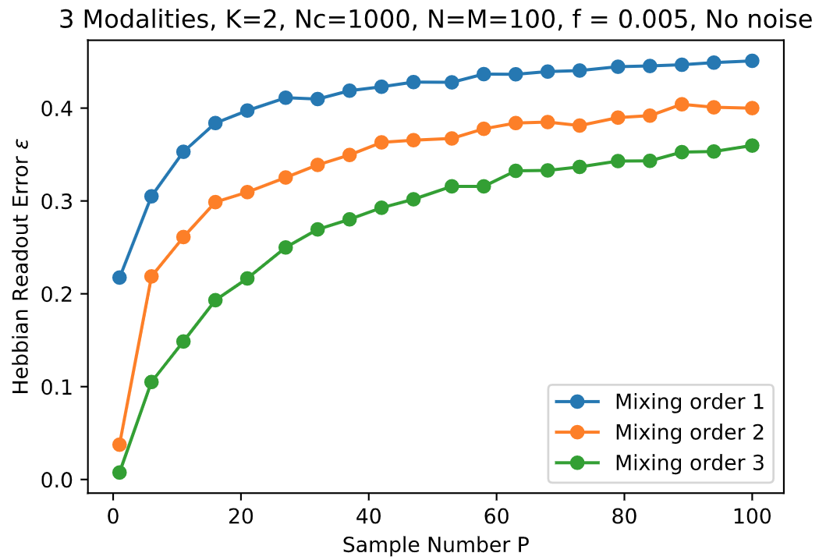
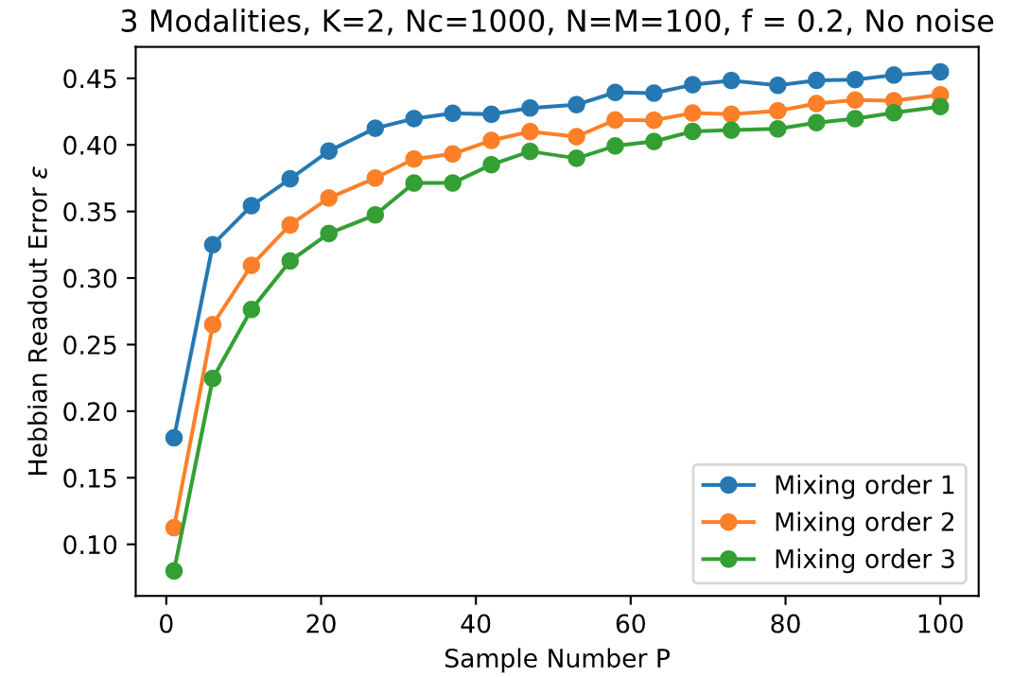
2. About Readout Error
Relation to Sample numbers P, No noise

Slide 10
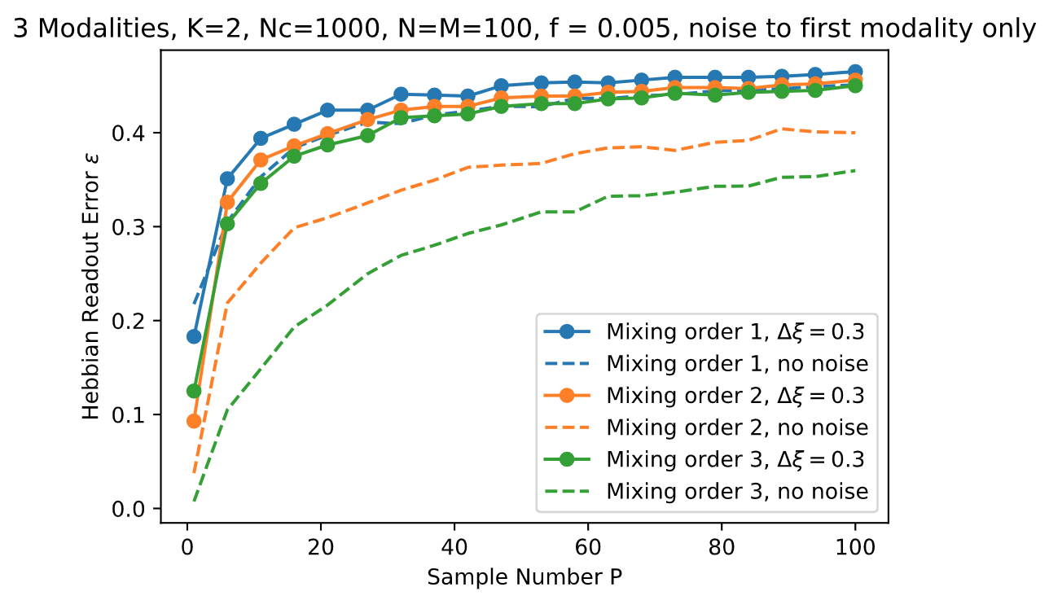
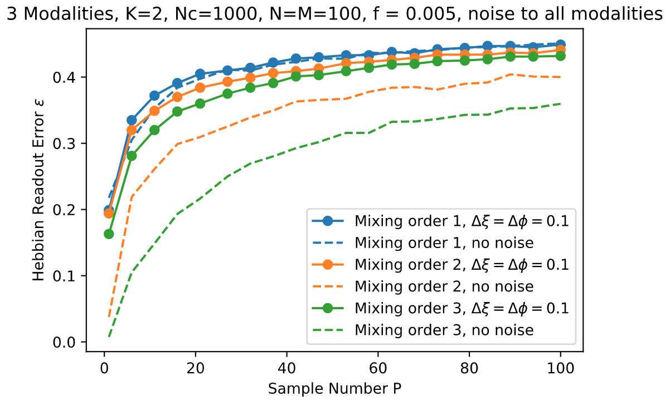
2. About Readout Error
Relation to Sample numbers P, Add noise

Slide 11
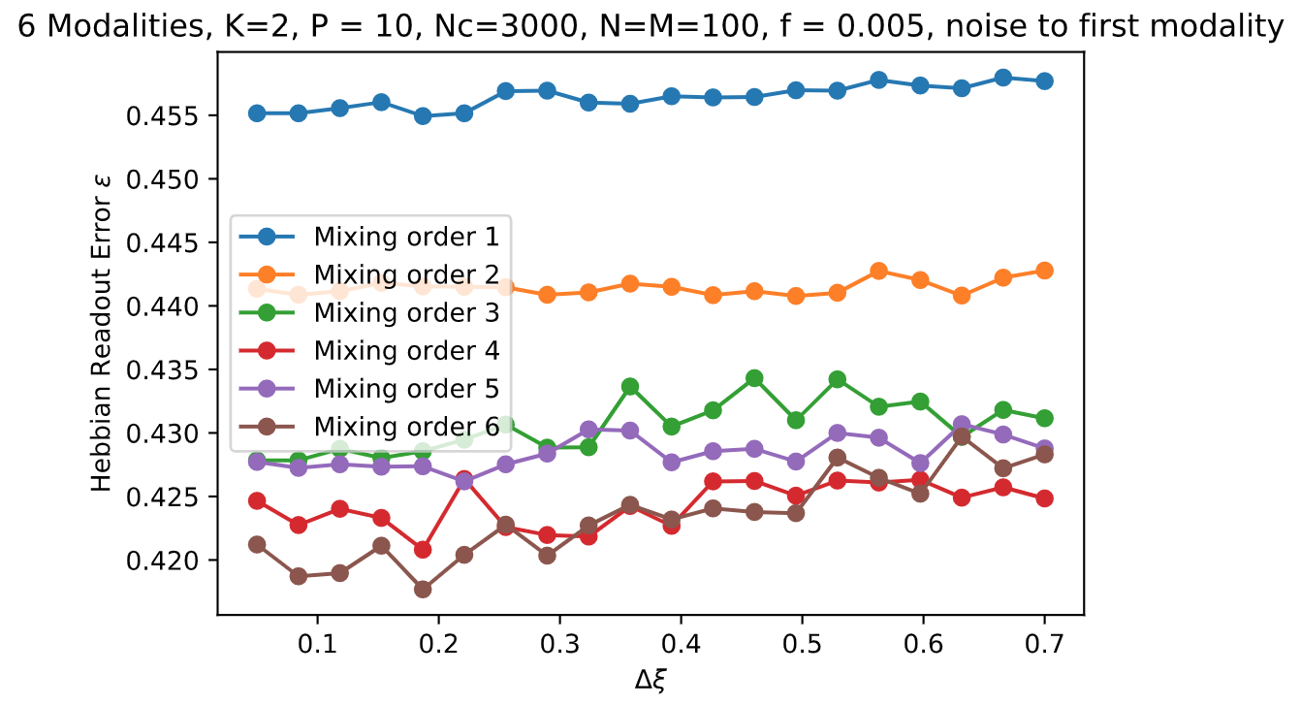
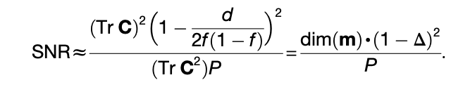
2. About Readout error

