Slide 1
Computational properties of nonlinear mixed selectivity in multimodal information source
Minhuan Li, Applied Physics PhD, Harvard SEAS
With Arvin Subramaniam, Cengiz Pehlevan
May 6th, 2020

Slide 2
Outline
Introduction
Background, framework and motivation
Computational Model details
3. Results
Capacity-Related Rank, Rank deficiency, Mixing-order related cluster size, …
Conclusion and Future Directions
Biological evidence? Optimal Mixing order? Heterogeneous Mixing?

Slide 3
Introduction: Mixed Selectivity
How could brain cooperate different kind of stimuli and perform multiple tasks?
Different neurons specified for different things
Neurons can do more than one things
Fact:
training monkeys on one cognitive-demanding task engages ~40% of randomly sample neurons in PFC (Prefrontal Cortex)¹
Mixed Selectivity
Why?
1. Fusi S, Miller E K, Rigotti M. Current opinion in neurobiology, 2016, 37: 66-74.

Slide 4

Introduction: Framework
Hebbian readout
Cortical Layer
Modality 1
Modality 2
…
Modality $N_{m}$
Information source

Slide 5
Introduction: Framework
Hebbian readout
Purely selective
Modality 1
Modality 2
…
Modality $N_{m}$
Information source

Slide 6
Introduction: Framework
Hebbian readout
Mixed selective
Modality 1
Modality 2
…
Modality $N_{m}$
Information source

Slide 7
Introduction: Framework
Hebbian readout
Increase the Capacity?
More robust under noise?
Modality 1
Modality 2
…
Modality $N_{m}$
Information source

Slide 8



Details: Parameters, binary input
Modality 1
Modality 2
Modality 3
Dimension: N
Independent Sample number: P
Dimension: M
Independent Sample number: K
Dimension: M
Independent Sample number: K
(task-relevant)
N + 2M
Input Matrix
PK²

Slide 9



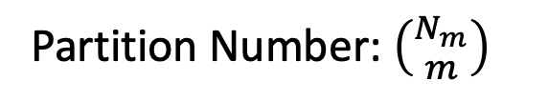
Details: Parameters, Partition schemes
Mixing Order $m$ --- Number of Modalities each neuron can talk to
Nc
Nc
Nc
m = 1
m = 2
m = 3
Partition Number: $\left({N_{m} \atop m}\right)$

Slide 10
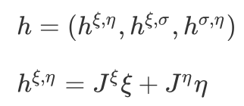


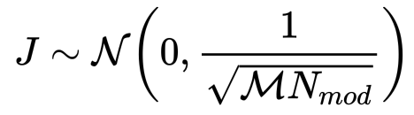

Details: Parameters, Connection Weights
$h,$ effective input matrix, before nonlinearity
m = 1
m = 2
m = 3
Then apply a threshold onto h to make it sparse

Slide 11




Details: Feed Forward
With Sparsity f
N + 2M
Nc
Nc
$$J$$
Heaviside step function
PK²
$$\{−1,1\}$$
PK²
$$ℝ$$
PK²
$$\{0,1\}$$
Input Matrix
Effective input matrix h
Cortical layer matrix m
Hebbian Readout

Slide 12
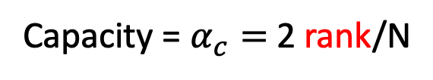
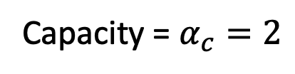
Results: capacity of linear readout
Data matrix is the matrix just before linear separation
From Gardner’s calculation
From ShK’ Calculation¹
In an uncorrelated data matrix
In correlated matrix:
Capacity = $α_{c}=2$
Capacity = $α_{c}=$2 rank/N
So we could discuss the capacity by calculating the rank of m
1. Takashi Shinzato and Yoshiyuki Kabashima. In: Journal of Physics A: Mathematical and Theoretical 41.32 (2008), p. 324013.

Slide 13
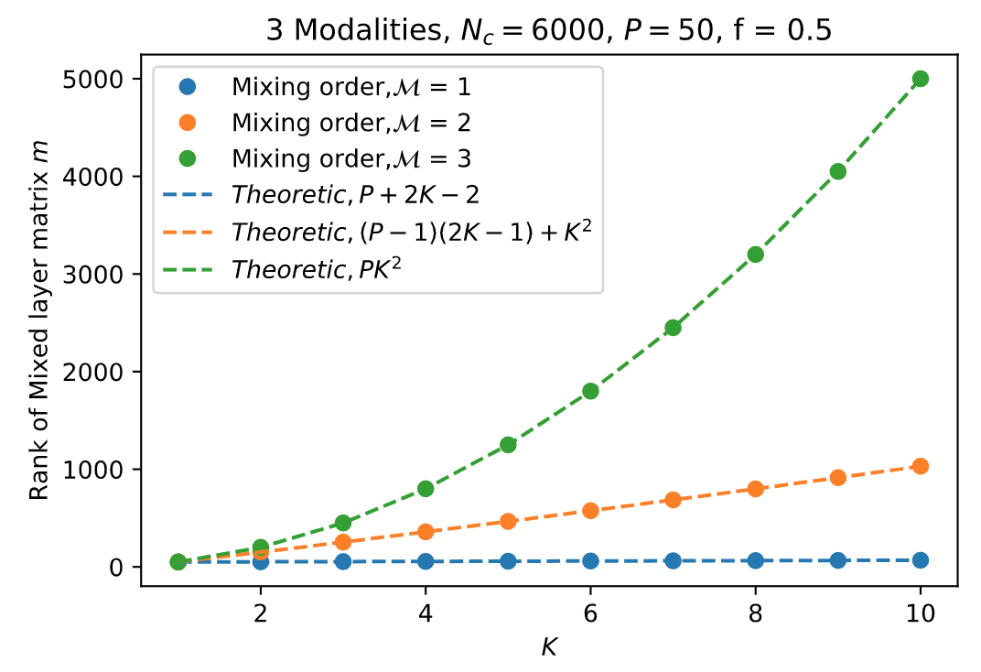
Results: Capacity-related Rank
Mixing Selectivity greatly increase the rank of m,
So the capacity, good for linear separation.

Slide 14
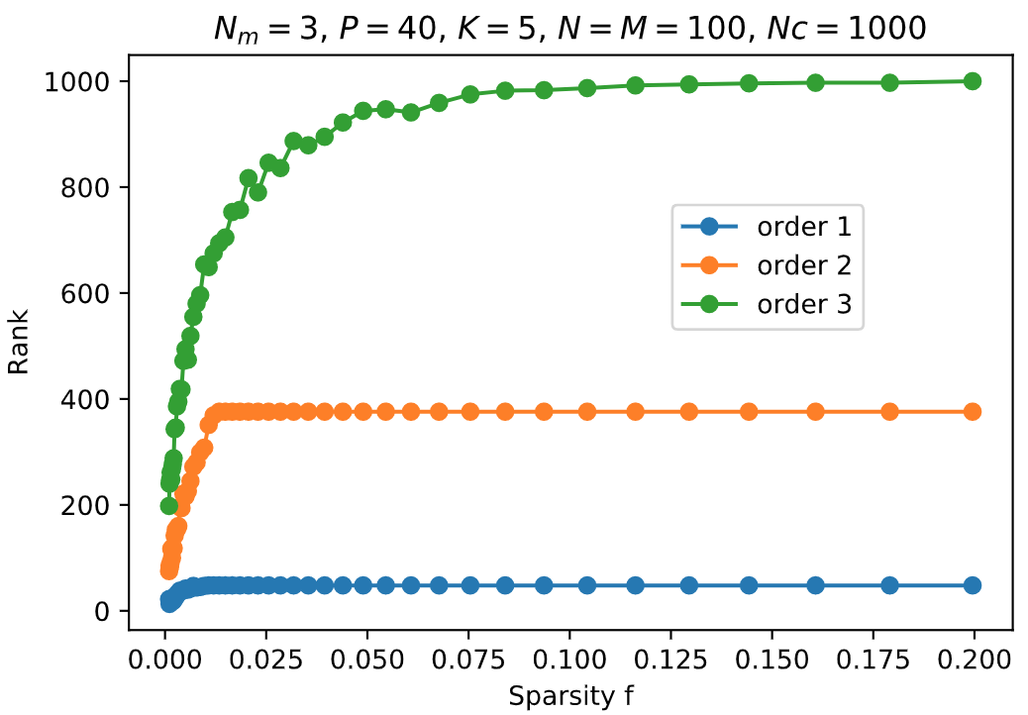
Results: Rank Deficiency --- as function of sparsity
1. As the matrix m become more and more sparse,
rank deficiency happen.
2. With larger mixing order, the effect become stronger.

Slide 15
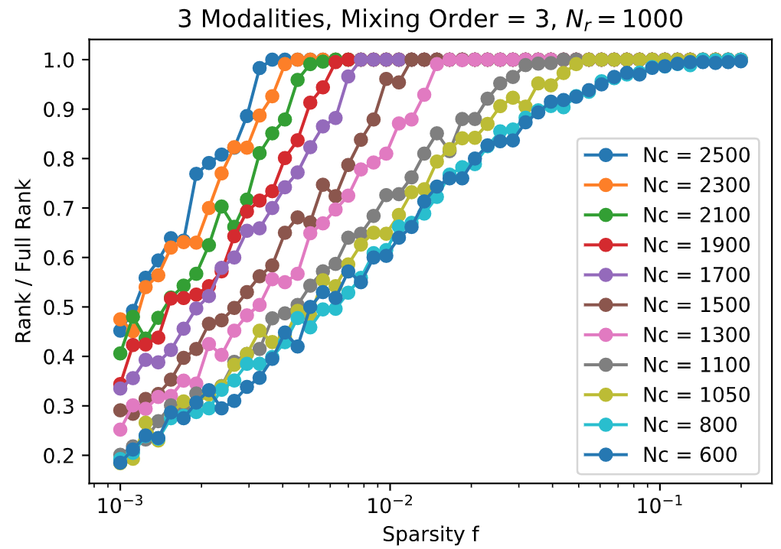
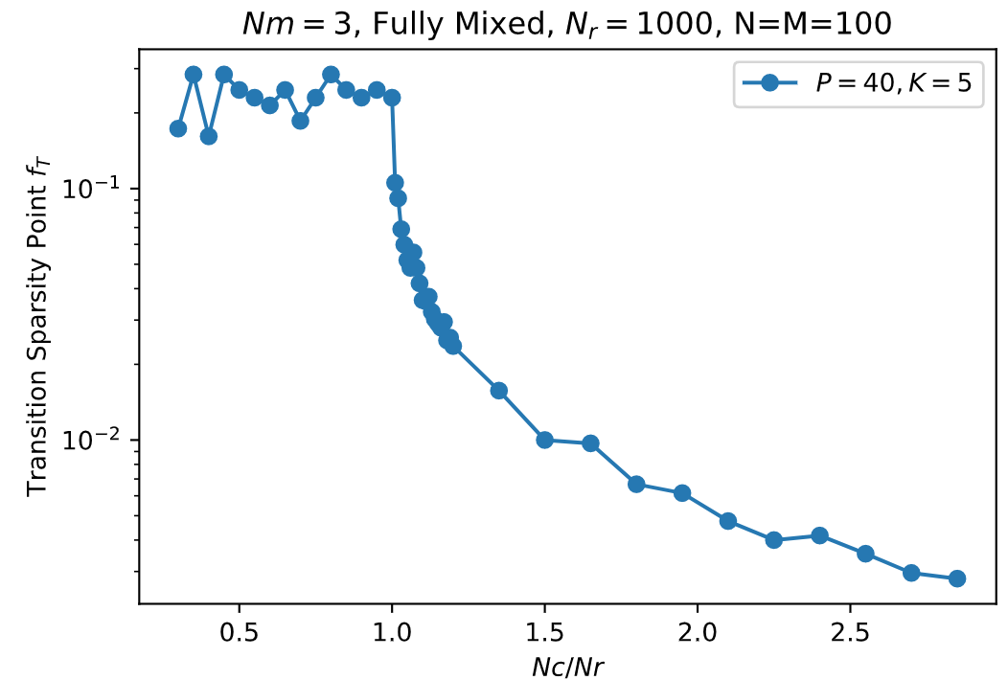

Results: Rank Deficiency
Nc
Nr
$$\{0,1\}$$
Cortical layer matrix m
As Nc becomes smaller, the transition point $f_{T}$ becomes larger; When Nc < Nr, data collapse.

Slide 16

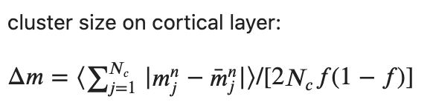
Results: Add some noise to input modality
Mixing forward

Slide 17
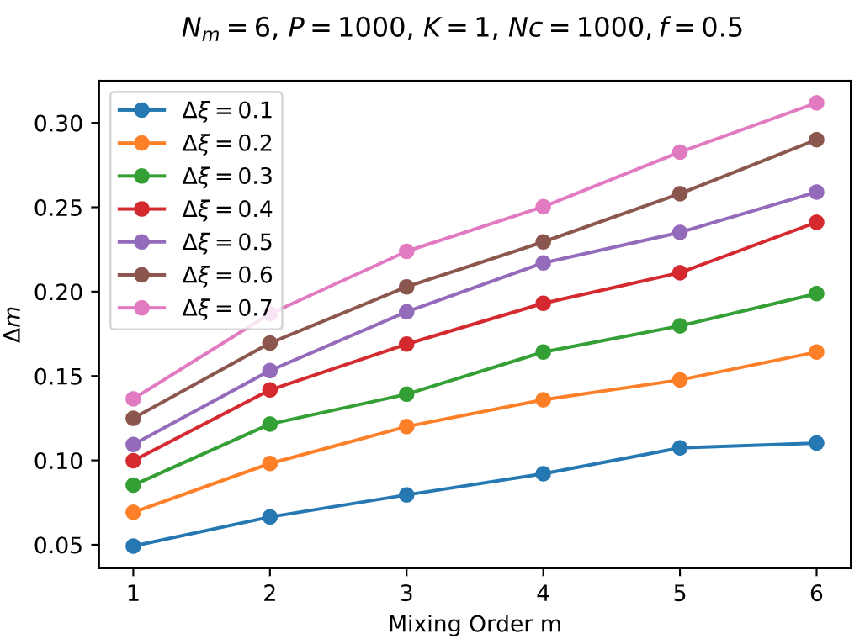
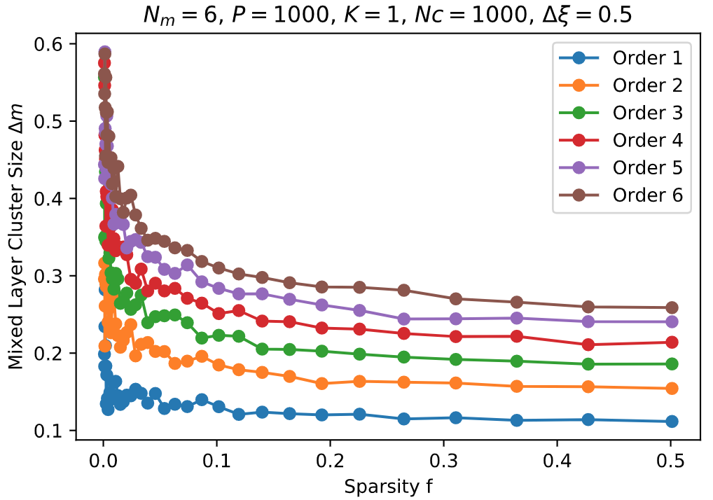
Results: Cortical Layer Cluster Size
Increase the mixing order m, the noise will be larger on cortical layer, bad for further separation
As sparsity becomes smaller,

Slide 18
Summarize
Increasing the mixing order will:
Greatly increase the rank, so the capacity. (good)
Make it vulnerable to rank deficiency. (bad)
Increase the noise size (bad)
A possible optimal mixing order m

Slide 19
Future Directions
1. Optimal Mixing order, in computational models
2. Can we tell the mixing order from biological evidence? Or can we provide some methods to
experimentally verify it?
3. Heterogeneous Neuros

Slide 20
Thank you!

Slide 21
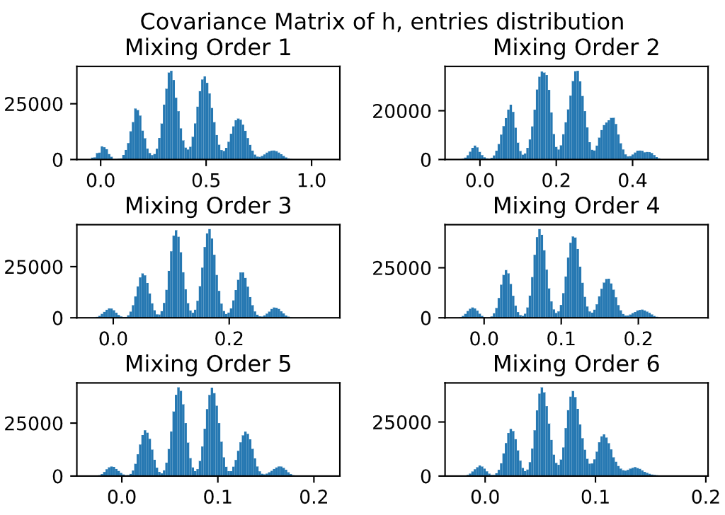
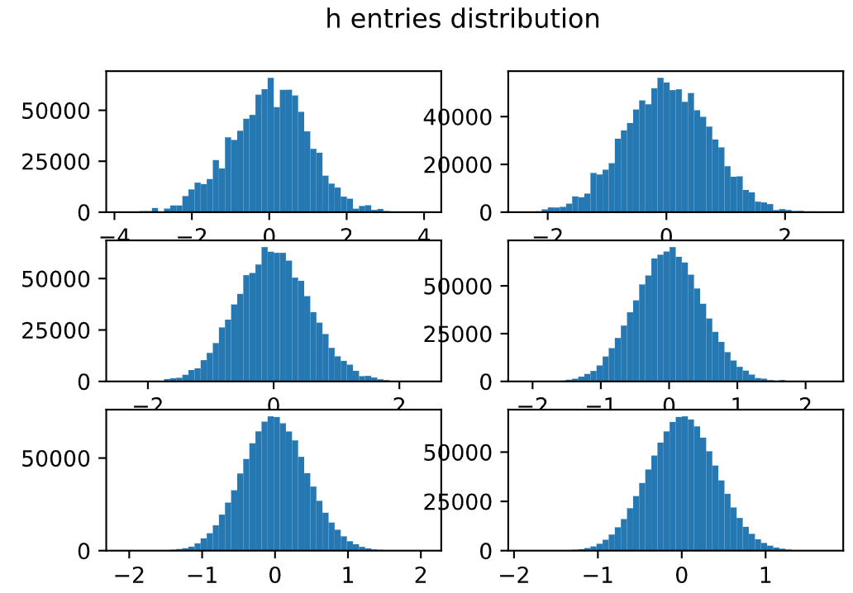
Backup Slides:
6 Modalities, same input, mixing order from 1 to 6

Slide 22
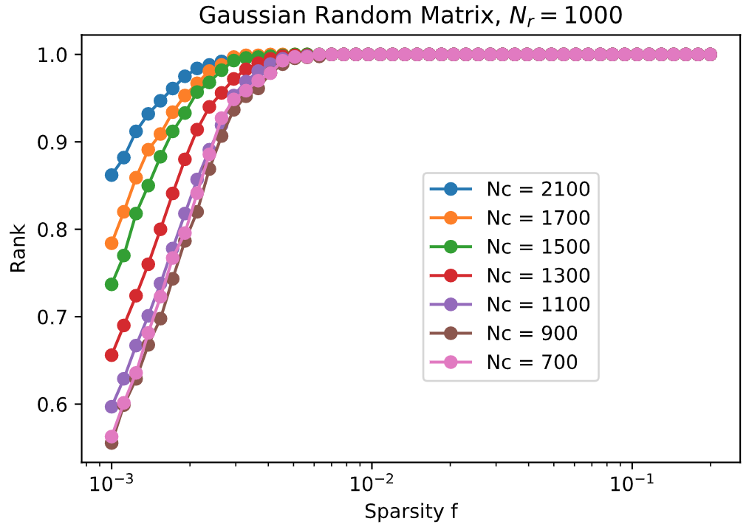
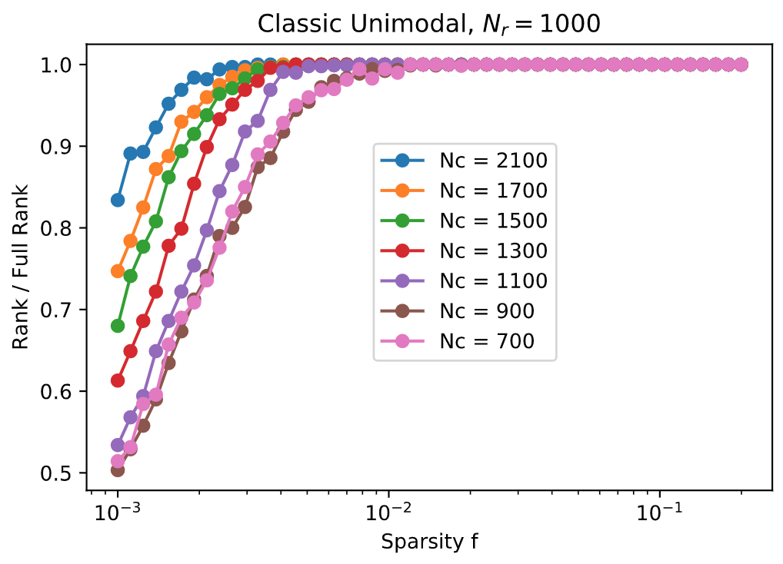
Backup Slides:

