Slide 1
DESIGN OF AUTOMATIC RFID TAG LABELLING MACHINE
Name: Nguyen Tran Duy Anh
ID: 1852239
Instructor: Asc.prof Vo Tuong Quan

Slide 2
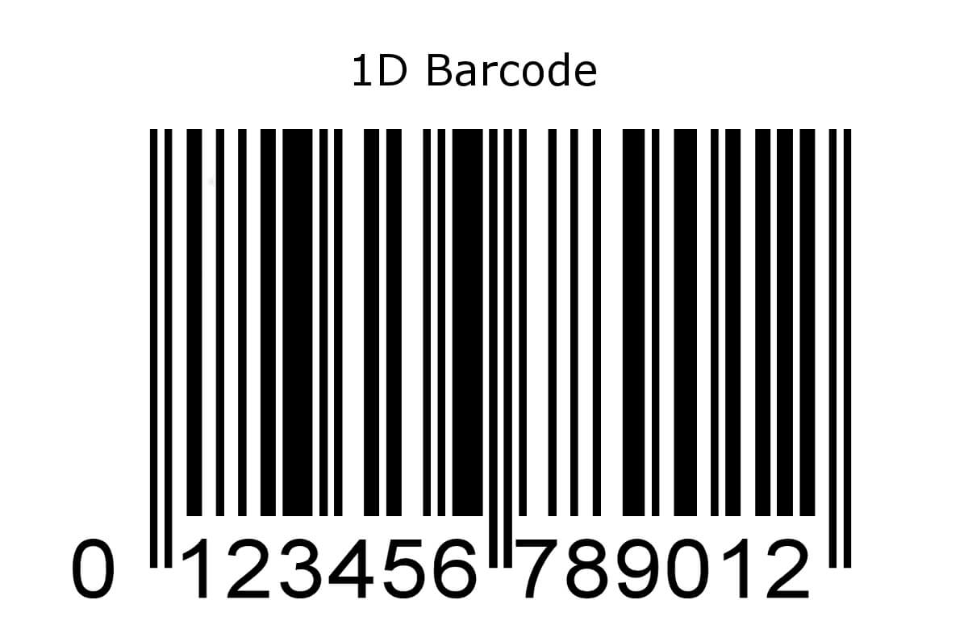
1. Overview
1.1 The technology implemented in warehouse item tracking
1.1.1 Barcode
Present data in visual, machine-readable form.
Present data by varying the widths, spacings and sizes of parallel lines.
Can be scanned by optical scanners or camera

Slide 3

1. Overview
1.1 The technology implemented in warehouse item tracking
1.1.2 QR code
Present data in geometric patterns like dots, rectangles, hexagons..
Can present more data per unit area compared to barcode
Can be scanned by optical scanners or camera

Slide 4
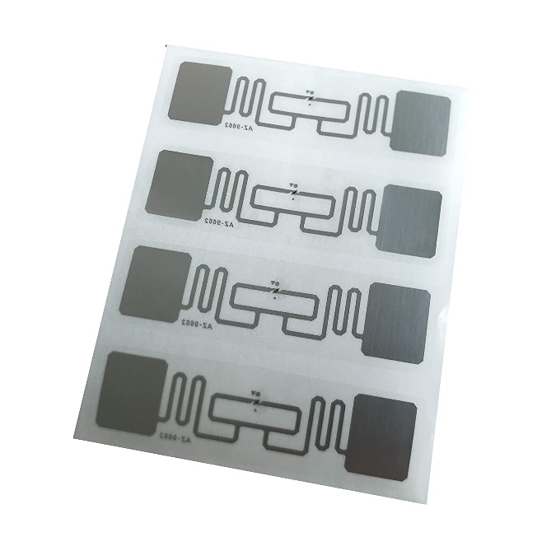
1. Overview
1.1 The technology implemented in warehouse item tracking
1.1.3 RFID
Tag transmits data to reader via radio waves
Each tag contain a sensor that has unique identifier
An RFID reader can simultaneously scan more than 100 tags without sight visibility
3 main type of RFID: Low frequency, High frequency, Ultra – high frequency

Slide 5
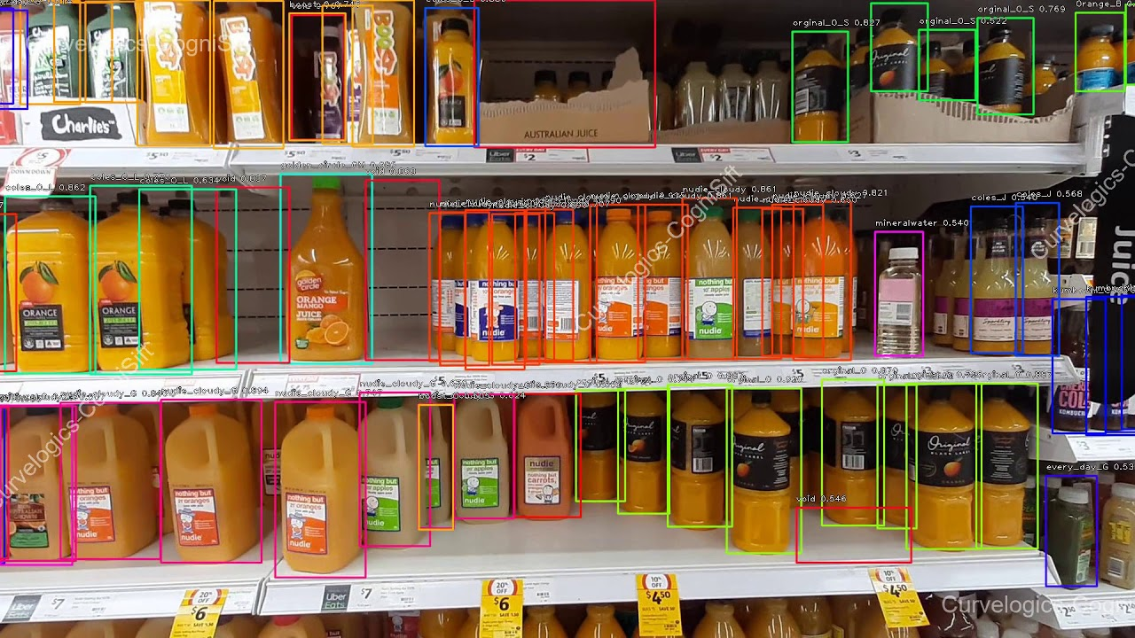
1. Overview
1.1 The technology implemented in warehouse item tracking
1.1.4 Computer vision
Real – time data collection via images and video collected by camera
Detect damaged or mislabeled items

Slide 6
1. Overview
1.1 The technology implemented in warehouse item tracking
1.1.5 Comparison
 | Pros | Cons
Barcode QR code | Low setup cost | Scan single item at once Store small amount of data Require sight visibility Tag can be dirty or blur
RFID | Scan multiple items at once Can handle exposure to sun and rain Not require sight visibility Real – time management | Higher cost compared to barcode and QR code reader Metal and liquid could affect the signal from tag
Computer vision | Real – time management Scan multiple items at once | Expensive setup cost Require object sight visibility

Slide 7
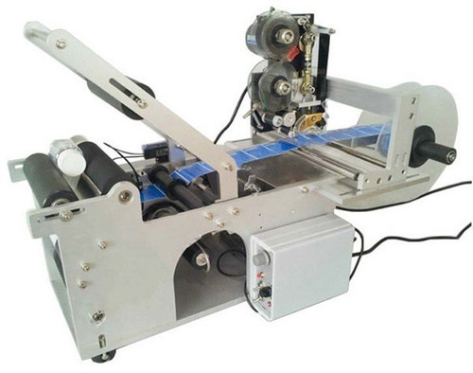
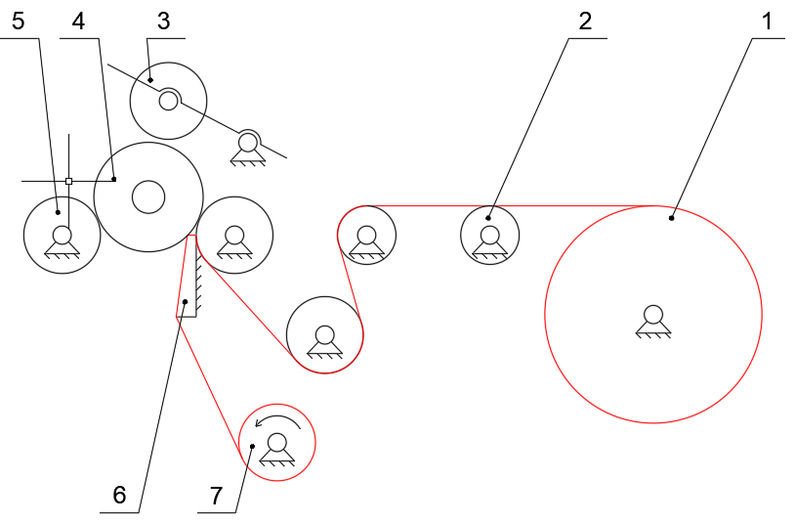
1. Overview
1.2 Labelling machine
1.2.1 Semi automatic bottle labelling machine
Note: 1 – Tag roll, 2 – Support roller, 3 – Lever, 4 – Bottle, 5 – Clamping roller, 6 – Tag dispenser, 7 – Active roller

Slide 8
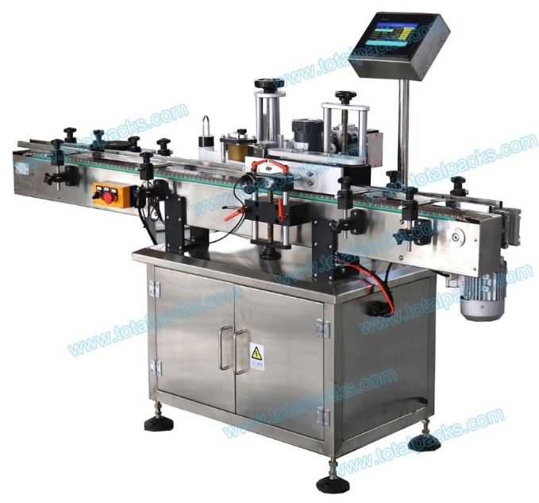
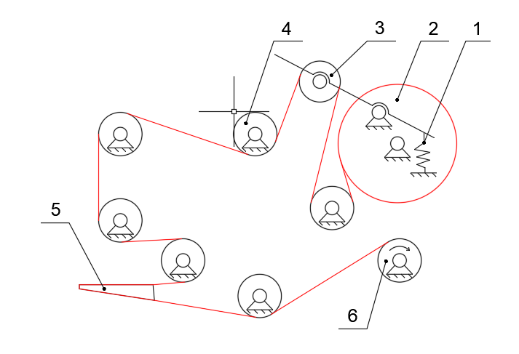
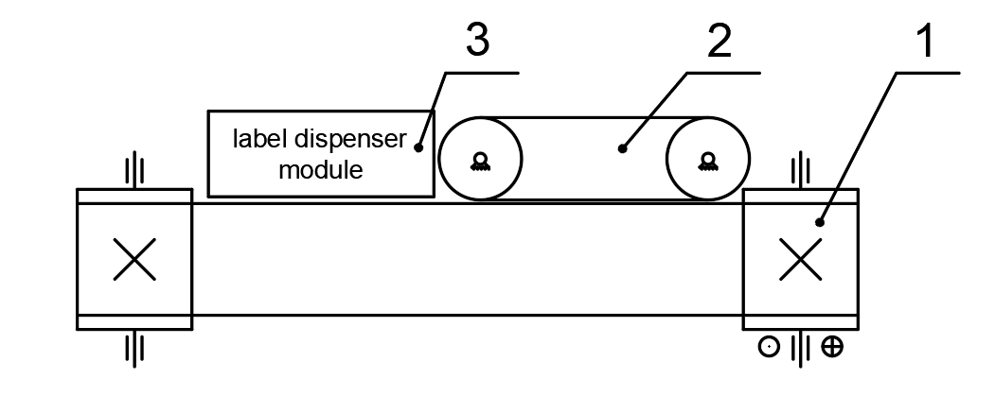
1. Overview
1.2 Labelling machine
1.2.2 Automatic bottle labelling machine
Note: 1 - Spring, 2 - Tag roll, 3 - Tensioner, 4 - Support roller, 5 - Tag dispenser, 6 - Active roller

Slide 9
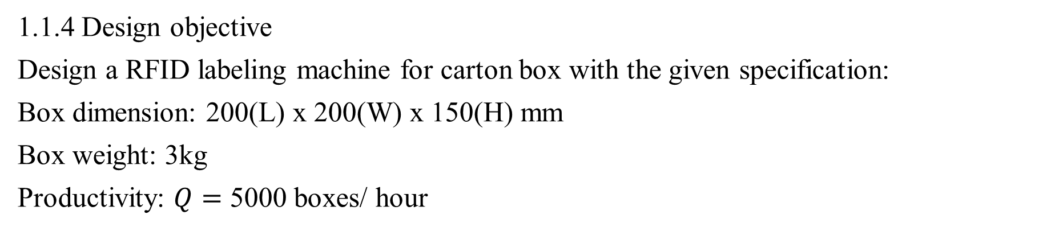
1. Overview
1.1 The technology implemented in warehouse item tracking
1.1.4 Design objective
Design a RFID labeling machine for carton box with the given specification:
Box dimension: 200(L) x 200(W) x 150(H) mm
Box weight: 3kg
Productivity: $Q=$ 5000 boxes/ hour

Slide 10
2. Approaches
2.1 Conveyor selection
 | Pros | Cons
Belt conveyor | Lowest cost Smooth operation and noiseless Suitable for products that need gentle care Can operate at high speed | Low efficiency Not suitable for heavy load
Chain conveyor | Able to carry heavy load High efficiency | Low speed Noisy Not suitable for fragile product
Choose belt conveyor

Slide 11
2. Approaches
2.2 Motor selection
 | Pros | Cons
Stepper motor | Lowest cost High torque at low speed | Lose torque at high speed High vibration level Produce high amount of heat
Servo motor | High torque at high speed High efficiency Low vibration level and resonant issue | High cost
Choose stepper motor

Slide 12
2. Approaches
2.3 Proximity sensor selection
 | Pros | Cons
Limit switch | Not affected by noise High current capability | Contact bounce Required physical contact with object Long response time
Photoelectric sensor | Fast response time Sensing all kind of material | Object color could affect sensibility Noised by light source Len subject to contamination
Ultrasonic sensor | Sensing all kind of material Not affected by object color | Long response time Sensitive to temperature variation
Choose photoelectric sensor

Slide 13
2. Approaches
2.4 Controller selection
 | Pros | Cons
Microcontroller unit (MCU) | Lowest cost Small and easily installed | Affected by noise in industrial environment Cannot withstand harsh environment condition
Single-board computer (SBC) | High computing speed Small and easily installed | Expensive compared to MCU Cannot withstand harsh environment condition
Programmable logic controller (PLC) | Withstand harsh environment Hardly affected by industrial noise | Expensive Bigger size compared to MCU
Choose MCU

Slide 14
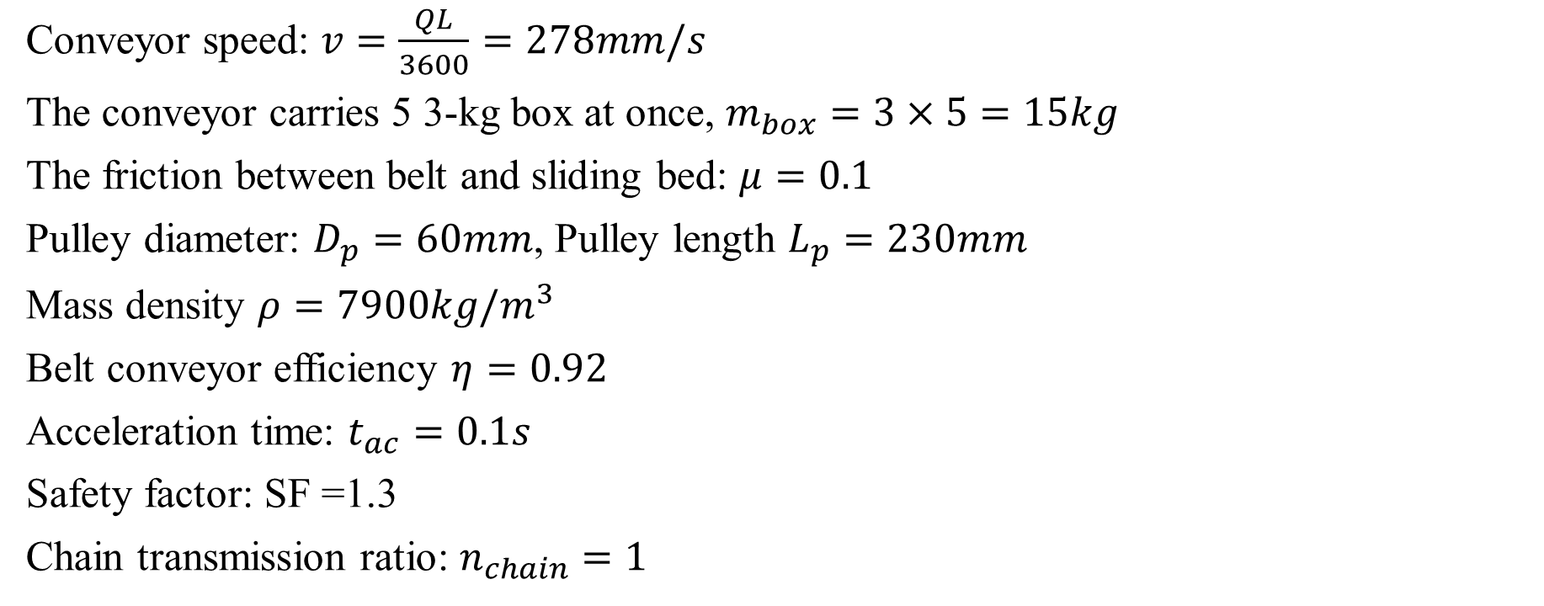
3. Mechanical design
3.1 Given data
Conveyor speed: $v=\frac{QL}{3600}=278mm/s$
The conveyor carries 5 3-kg box at once, $m_{box}=3×5=15kg$
The friction between belt and sliding bed: $μ=0.1$
Pulley diameter: $D_{p}=60mm$, Pulley length $L_{p}=230mm$
Mass density $ρ=7900kg/m^{3}$
Belt conveyor efficiency $η=0.92$
Acceleration time: $t_{ac}=0.1s$
Safety factor: SF =1.3
Chain transmission ratio: $n_{chain}=1$

Slide 15
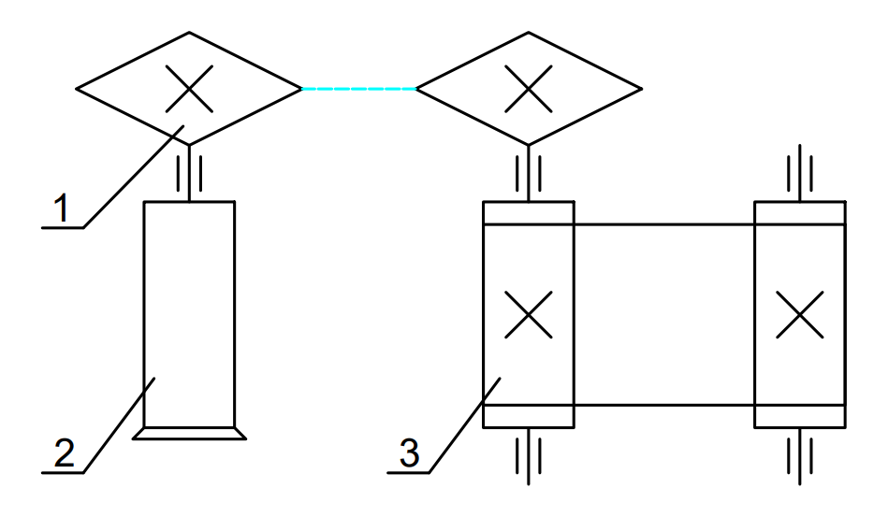
3. Mechanical design
3.1 Given data
Diagram of belt conveyor system
Note: 1 – Chain drive, 2 – Gearbox and motor, 3 – Belt conveyor

Slide 16
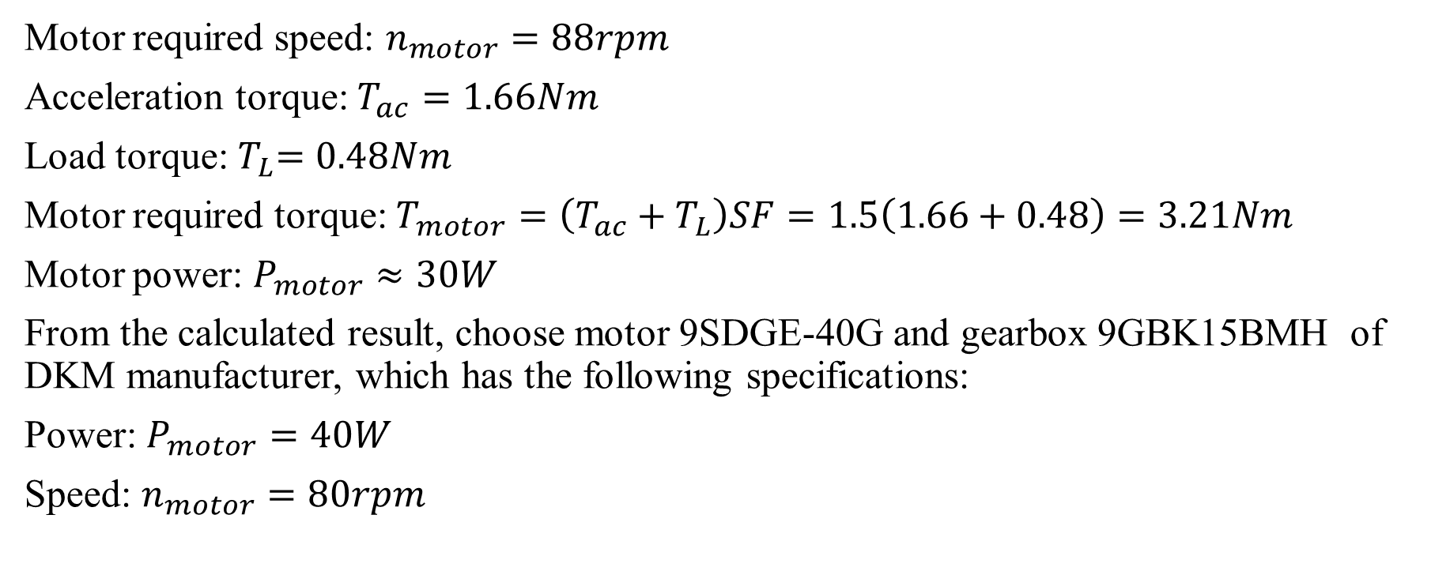
3. Mechanical design
3.1 Conveyor motor selection
Motor required speed: $n_{motor}=88rpm$
Acceleration torque: $T_{ac}=1.66Nm$
Load torque:${ T}_{L}=0.48Nm$
Motor required torque: $T_{motor}=\left(T_{ac}+T_{L}\right)SF=1.5\left(1.66+0.48\right)=3.21Nm$
Motor power: $P_{motor}≈30W$
From the calculated result, choose motor 9SDGE-40G and gearbox 9GBK15BMH of DKM manufacturer, which has the following specifications:
Power: $P_{motor}=40W$
Speed: $n_{motor}=80rpm$

Slide 17
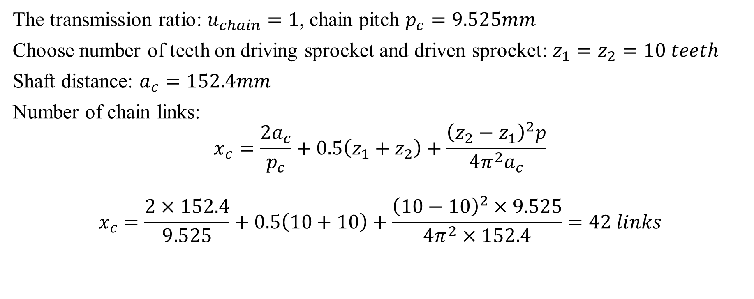
3. Mechanical design
3.2 Chain drive calculation
The transmission ratio: $u_{chain}=1$, chain pitch $p_{c}=9.525mm$
Choose number of teeth on driving sprocket and driven sprocket: $z_{1}=z_{2}=10 teeth$
Shaft distance: $a_{c}=152.4mm$
Number of chain links:
$$x_{c}=\frac{2a_{c}}{p_{c}}+0.5\left(z_{1}+z_{2}\right)+\frac{{\left(z_{2}−z_{1}\right)}^{2}p}{4π^{2}a_{c}}$$
$$x_{c}=\frac{2×152.4}{9.525}+0.5\left(10+10\right)+\frac{{\left(10−10\right)}^{2}×9.525}{4π^{2}×152.4}=42 links$$

Slide 18
3. Mechanical design
3.2 Chain drive calculation
Sprocket specification is shown in the table below
 | Driving sprocket | Driven sprocket
Type | SP35B13 – D10 | SP35B13 – D20
Pitch diameter | 30.82mm | 30.82mm
Outer diameter | 34.08mm | 34.08mm
Chain pitch | 9.525mm | 9.525mm

Slide 19
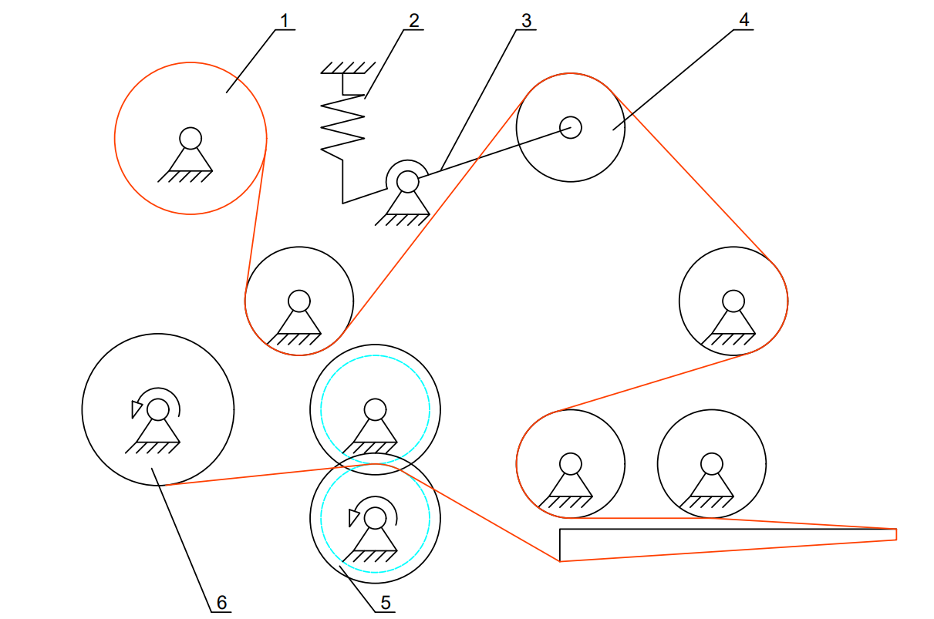
3. Mechanical design
3.3 Tag labelling module motor selection
Diagram of belt conveyor system
Note: 1 – Tag roll, 2 – Retract spring, 3 – Tensing arm, 4 – Idle roller, 5 – Active roller, 6 – Retract roller.

Slide 20
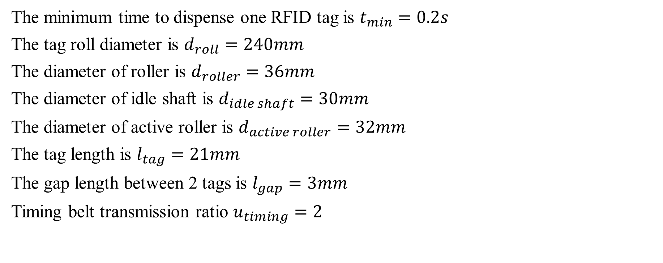
3. Mechanical design
3.3 Tag labelling module motor selection
The minimum time to dispense one RFID tag is $t_{min}=0.2s$
The tag roll diameter is $d_{roll}=240mm$
The diameter of roller is $d_{roller}=36mm$
The diameter of idle shaft is $d_{idle shaft}=30mm$
The diameter of active roller is $d_{active roller}=32mm$
The tag length is $l_{tag}=21mm$
The gap length between 2 tags is $l_{gap}=3mm$
Timing belt transmission ratio $u_{timing}=2$

Slide 21
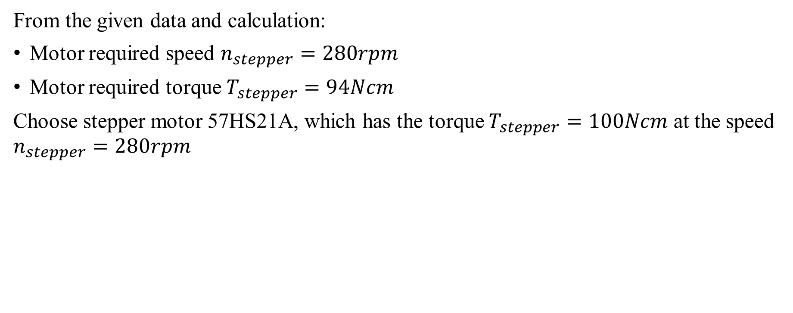
3. Mechanical design
3.3 Tag labelling module motor selection
From the given data and calculation:
Motor required speed $n_{stepper}=280rpm$
Motor required torque $T_{stepper}=94Ncm$
Choose stepper motor 57HS21A, which has the torque $T_{stepper}=100Ncm$ at the speed $n_{stepper}=280rpm$

Slide 22
4. Electrical design
4.1 Microcontroller
Choose ESP32 to receive and update data via WiFi,
Choose ESP8266 to control the labelling process.
The ESP32 has sufficient number of pins to do all the tasks. However, when running multiple tasks like Wifi connection, SPI protocol, I2C protocol, the read value on ADC pin of ESP32 is not accurate. Therefore, 1 ESP8266 is added to the project to prevent the ADC incorrect read. The two MCUs communicate via UART protocol.

Slide 23
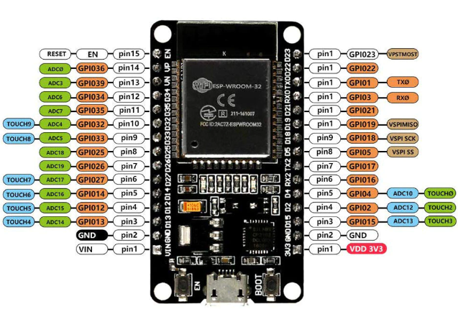
4. Electrical design
4.1 Microcontroller
ESP32 DOIT dev kit V1 pinout

Slide 24
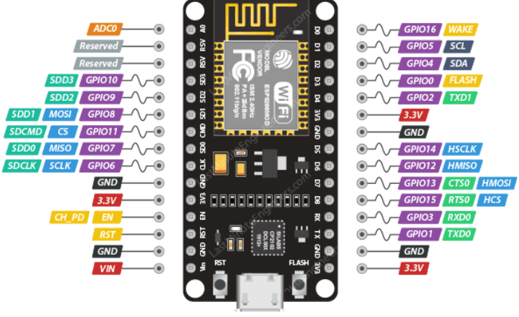
4. Electrical design
4.1 Microcontroller
ESP8266 NodeMCU pinout

Slide 25
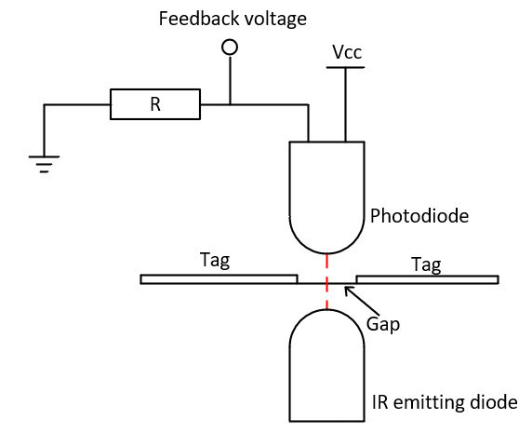
4. Electrical design
4.2 Labelling sensor
The fabricated sensor use a photodiode and an infrared light emitting diode face to each other, and the tag is placed between them. Depend on the feedback voltage value, we can determine the gap between the two consecutive tags.
Labelling sensor working principle

Slide 26
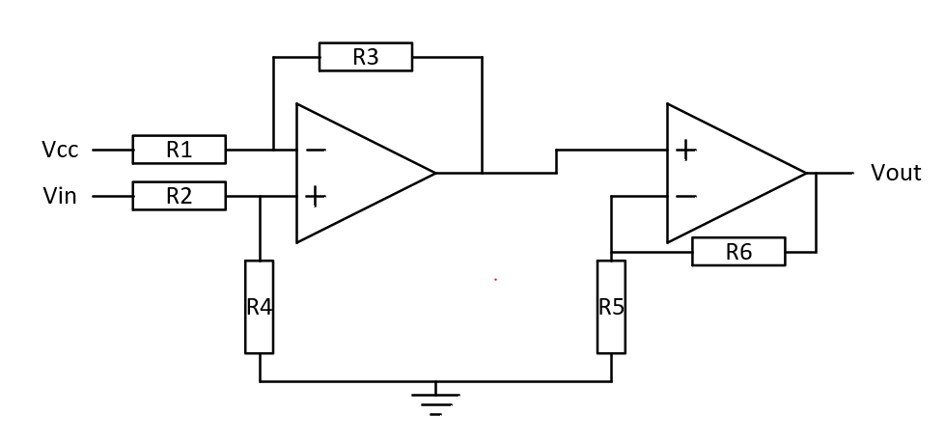
4. Electrical design
4.2 Labelling sensor
The feedback voltage is from V_(in min)=600mV to V_(in max)=1600mV when I do experiment. Therefore, I decided to amplify this voltage using a subtractor and non – inverting amplifier OPAMP configuration as show below:
Subtractor and amplifier circuit for labelling sensor

Slide 27
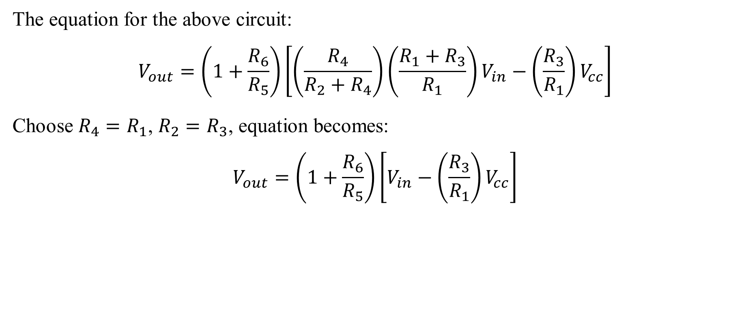
4. Electrical design
4.2 Labelling sensor
The equation for the above circuit:
$$V_{out}=\left(1+\frac{R_{6}}{R_{5}}\right)\left[\left(\frac{R_{4}}{R_{2}+R_{4}}\right)\left(\frac{R_{1}+R_{3}}{R_{1}}\right)V_{in}−\left(\frac{R_{3}}{R_{1}}\right)V_{cc}\right]$$
Choose $R_{4}=R_{1}$, $R_{2}=R_{3}$, equation becomes:
$$V_{out}=\left(1+\frac{R_{6}}{R_{5}}\right)\left[V_{in}−\left(\frac{R_{3}}{R_{1}}\right)V_{cc}\right]$$

Slide 28
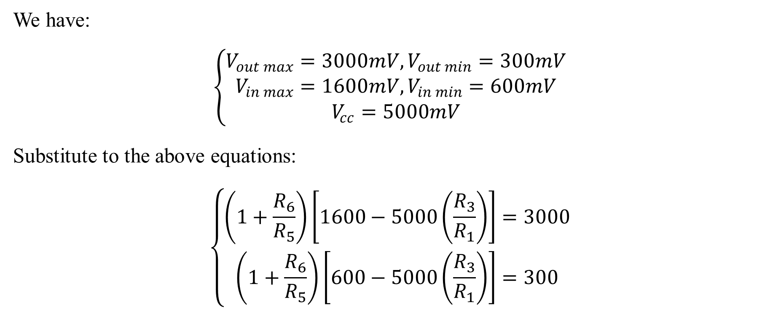
4. Electrical design
4.2 Labelling sensor
We have:
$$\left\{\begin{matrix}V_{out max}=3000mV,V_{out min}=300mV \\ V_{in max}=1600mV,V_{in min}=600mV \\ V_{cc}=5000mV\end{matrix}\right.$$
Substitute to the above equations:
$$\left\{\begin{aligned}\left(1+\frac{R_{6}}{R_{5}}\right)\left[1600−5000\left(\frac{R_{3}}{R_{1}}\right)\right]=3000 \\ \left(1+\frac{R_{6}}{R_{5}}\right)\left[600−5000\left(\frac{R_{3}}{R_{1}}\right)\right]=300\end{aligned}\right.$$

Slide 29

4. Electrical design
4.2 Labelling sensor
$$→\left\{\begin{aligned}\frac{R_{6}}{R_{5}}=1.7 \\ \frac{R_{3}}{R_{1}}=0.1\end{aligned}\right.$$
Choose $R_{6}=3.6kΩ$, $R_{5}=2k$, $R_{3}=R_{2}=1kΩ$, $R_{1}=R_{4}=10kΩ$.

Slide 30
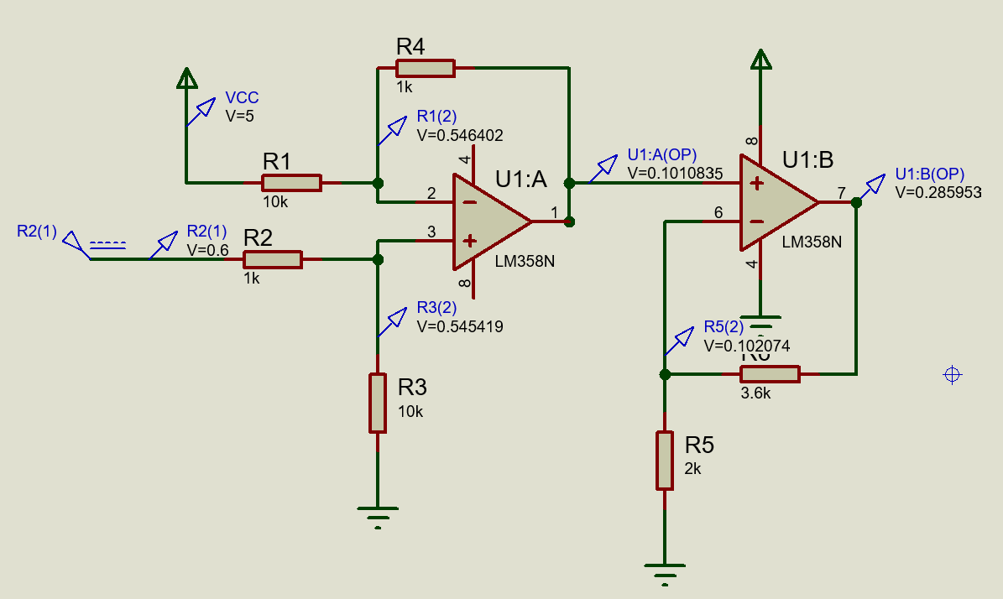
4. Electrical design
4.2 Labelling sensor
Simulation result using Proteus software:
Simulation with Vin = 0.6V

Slide 31
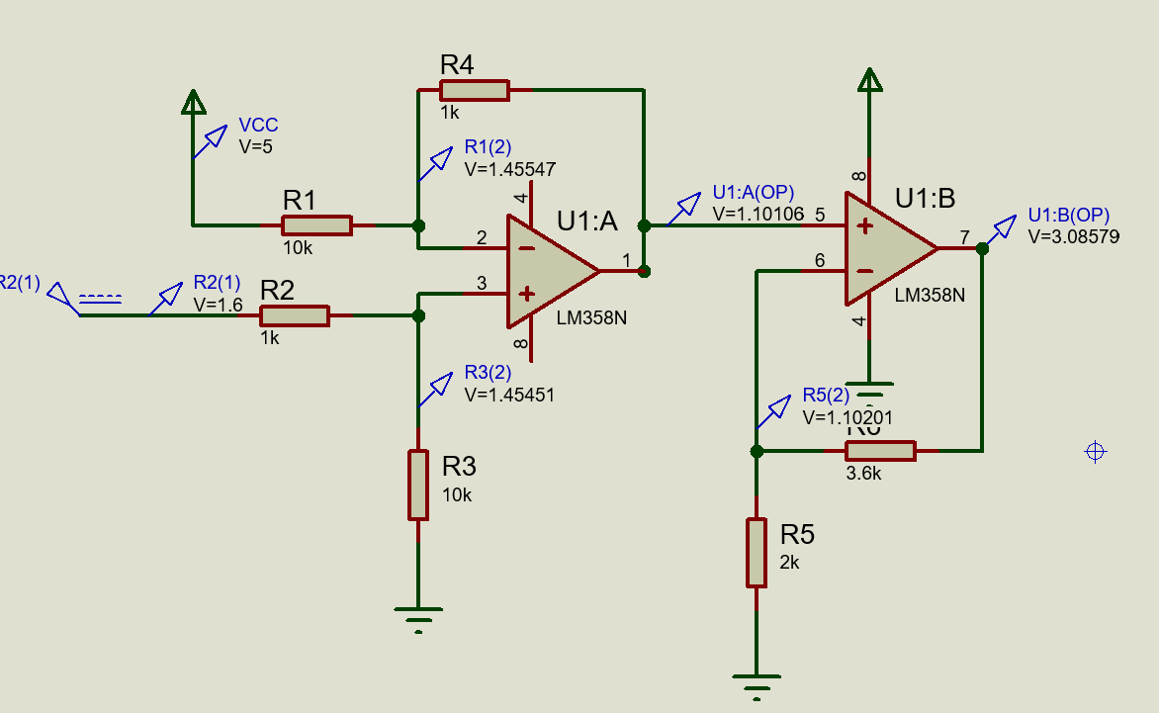
4. Electrical design
4.2 Labelling sensor
Simulation result using Proteus software:
Simulation with Vin = 1.6V

Slide 32
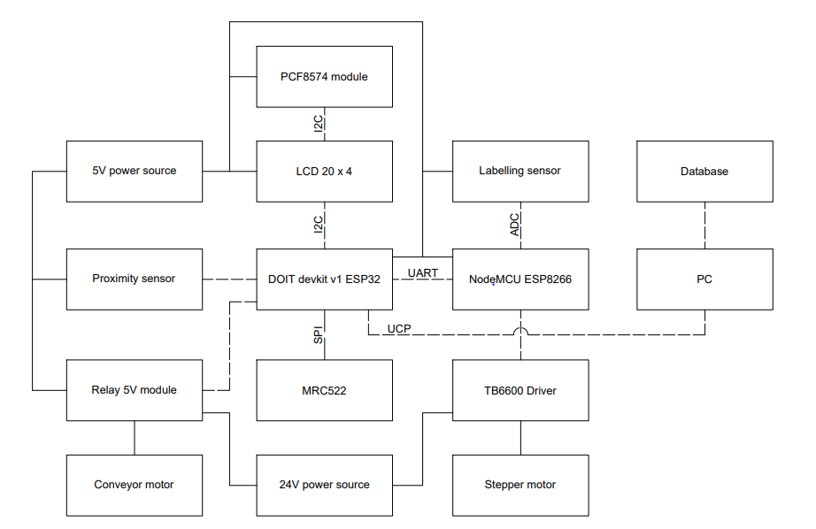
4. Electrical design
4.3 Electrical diagram of system

Slide 33
5. Controller design
5.1 Main program

Slide 34
5. Controller design
5.2 Labelling tag subprogram

Slide 35
5. Controller design
5.3 Labelling tag subprogram

Slide 36
5. Controller design
5.4 Read RFID subprogram
Read RFID
New RFID tag detect?
No
Yes
Read RFID and send to database
Return

Slide 37
6. Practical testing

