Slide 1


Development of an AI-Powered Job Search and Recommendation System
Student:
Doan Tien Dat
Vo Binh Minh
Class:
22SE1B - 22SE2B - Software Engineering
Supervisor:
Dr. Tran Van Dai

Slide 2
PRESENTATION OUTLINE
Context & Problem Statement
Technologies Used
System Analysis and Design
AI Technologies
Conclusion & Demo

Slide 3
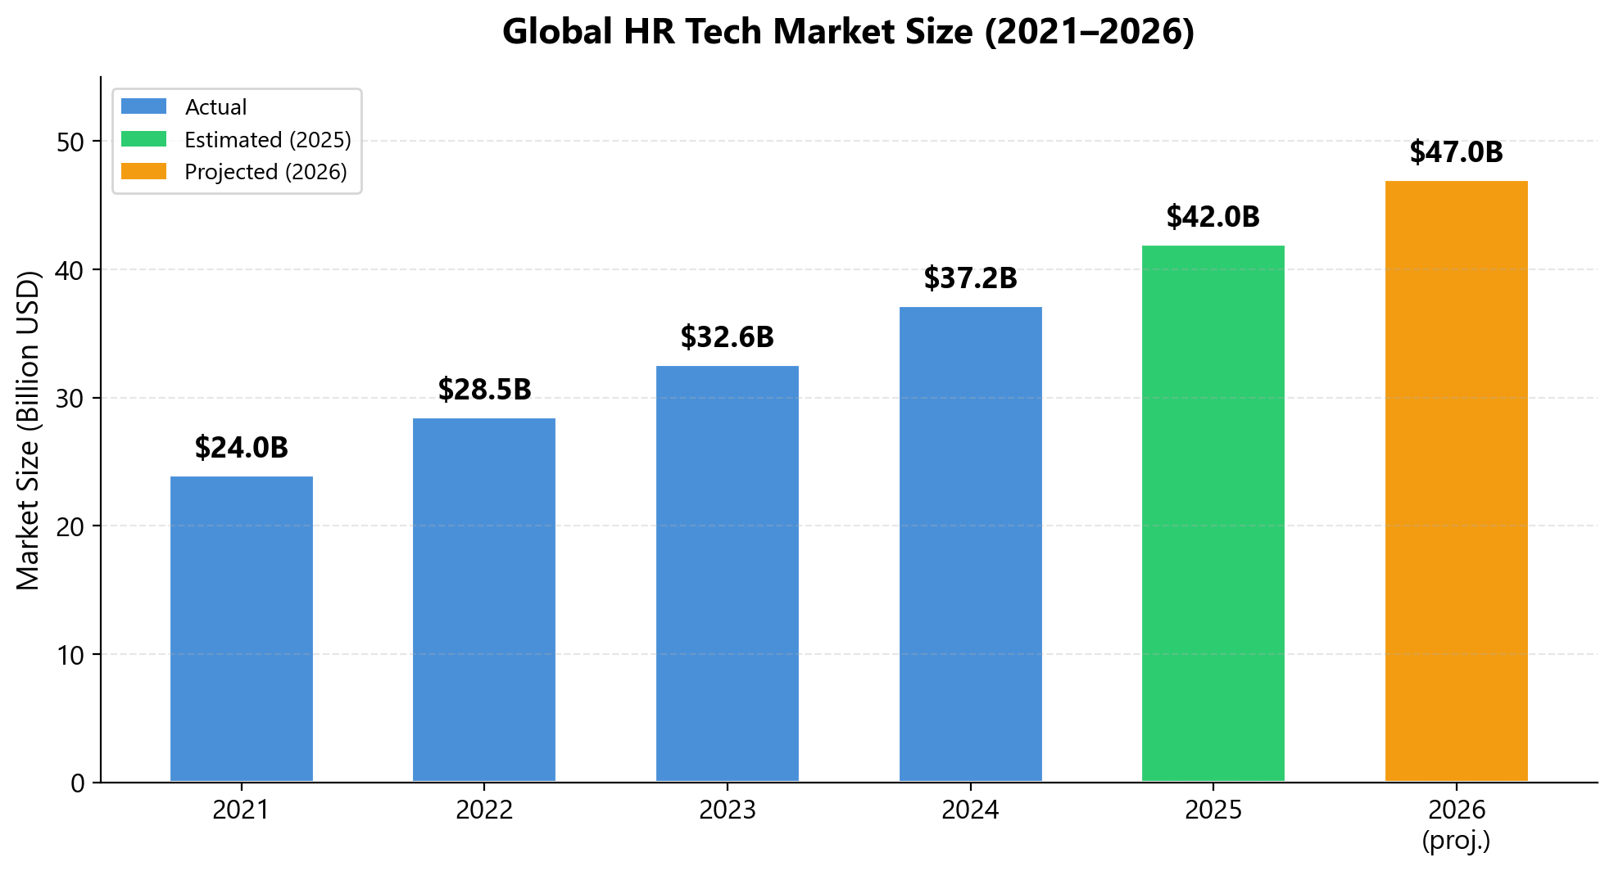
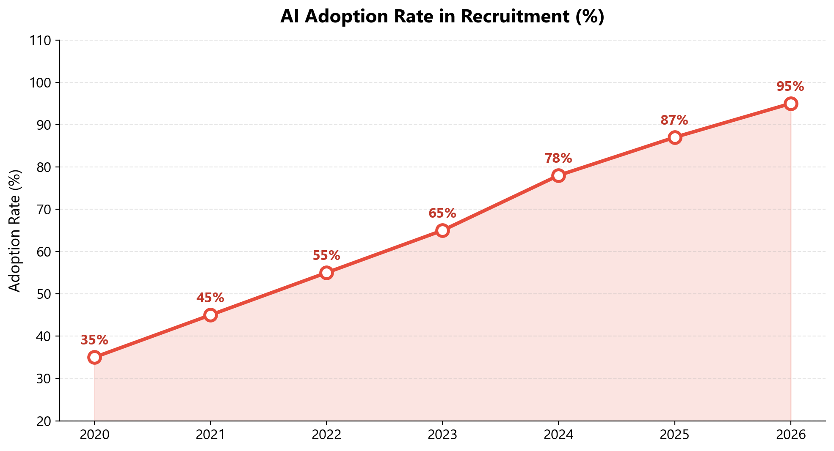
1. Context & Problem Statement
Digital Transformation in Recruitment
Global
HR Tech market: ~$42B (2025) → ~$47B (2026)
87–99% of enterprises have adopted AI in recruitment
AI reduces hiring time by 25–75% and improves candidate quality by 25–35%
66% of candidates want to be informed when AI is evaluating them → driving demand for Explainable AI
Viet Nam
83% of job seekers use online platforms
Projected GDP growth of ~6.2% in 2026, boosting recruitment activity in H2
AI has become a mandatory component in resume screening
TopCV and VietnamWorks still rely on keyword matching — semantic matching has yet to be adopted

Slide 4
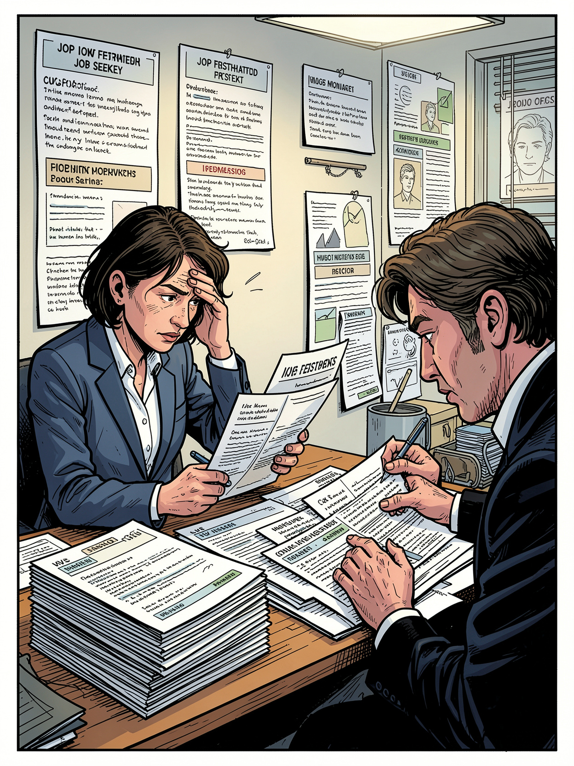
1. Context & Problem Statement
Problem Statement
Candidate side:
Manual browsing: 50–100 postings/week, low efficiency
No visibility into actual fit level for any position
No skill gap analysis — cannot improve strategically
Keyword search misses semantic equivalences
Recruiter side:
Manual CV screening: 50–250 CVs/position, 5–10 min each
No automated candidate ranking system
Mismatch rate > 60% (VietnamWorks, 2024)

Slide 5
1. Context & Problem Statement
Objectives & Solutions
# | Objective | Outcome
1 | Market research, SWOT / PESTEL / Porter's Five Forces analysis | ✅
2 | Full-stack system design (12 database tables, 30 APIs) | ✅
3 | AI Engine development: Hybrid BM25 + SBERT | ✅
4 | MVP development: FastAPI + Flutter (Web & Mobile) | ✅
5 | Testing & evaluation (21 test cases, TF-IDF vs Hybrid comparison) | ✅
6 | Business model proposal (BMC, Lean Startup) | ✅
AI Job Match — Our Solution
Upload CV (PDF / DOCX / Image)
→ AI performs semantic matching analysis
→ Transparent scoring breakdown (Cosine % + Keyword + Industry)
→ Top-10 best-fit jobs + Missing Skills report

Slide 6
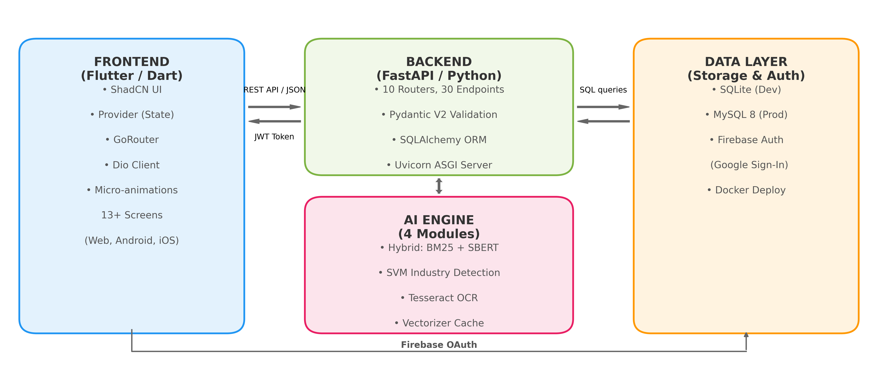
2. Technologies Used

Slide 7
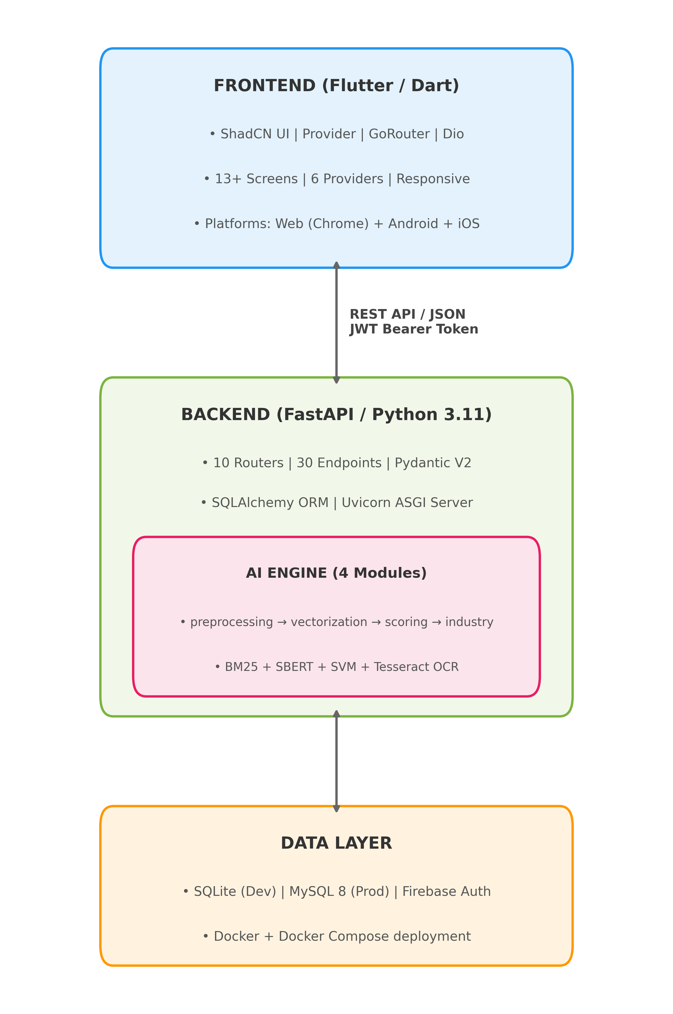
3. System Analysis and Design
System Architecture

Slide 8
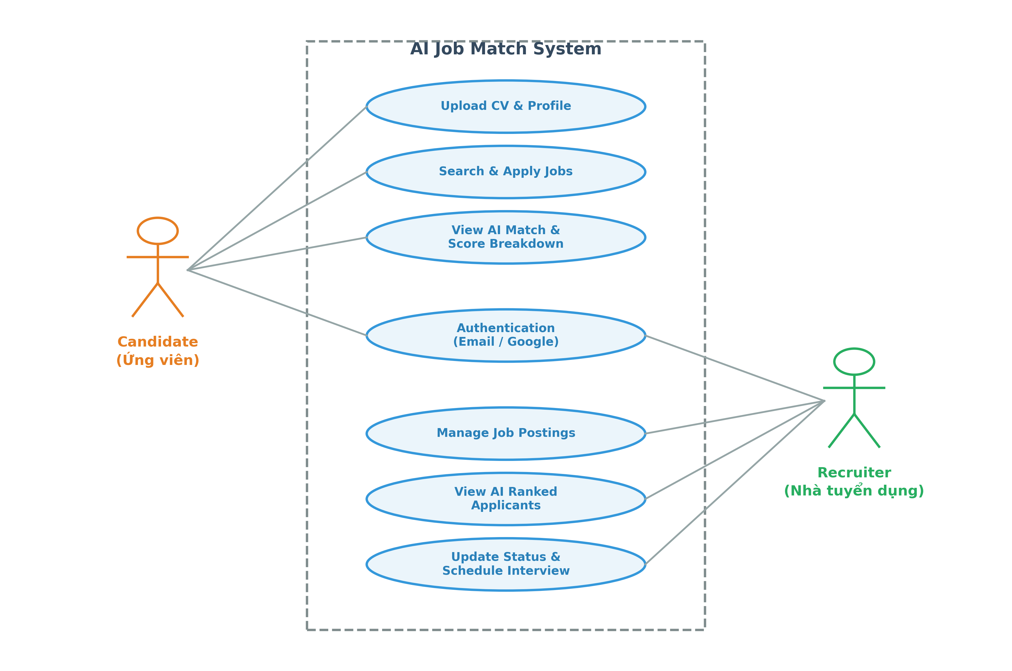
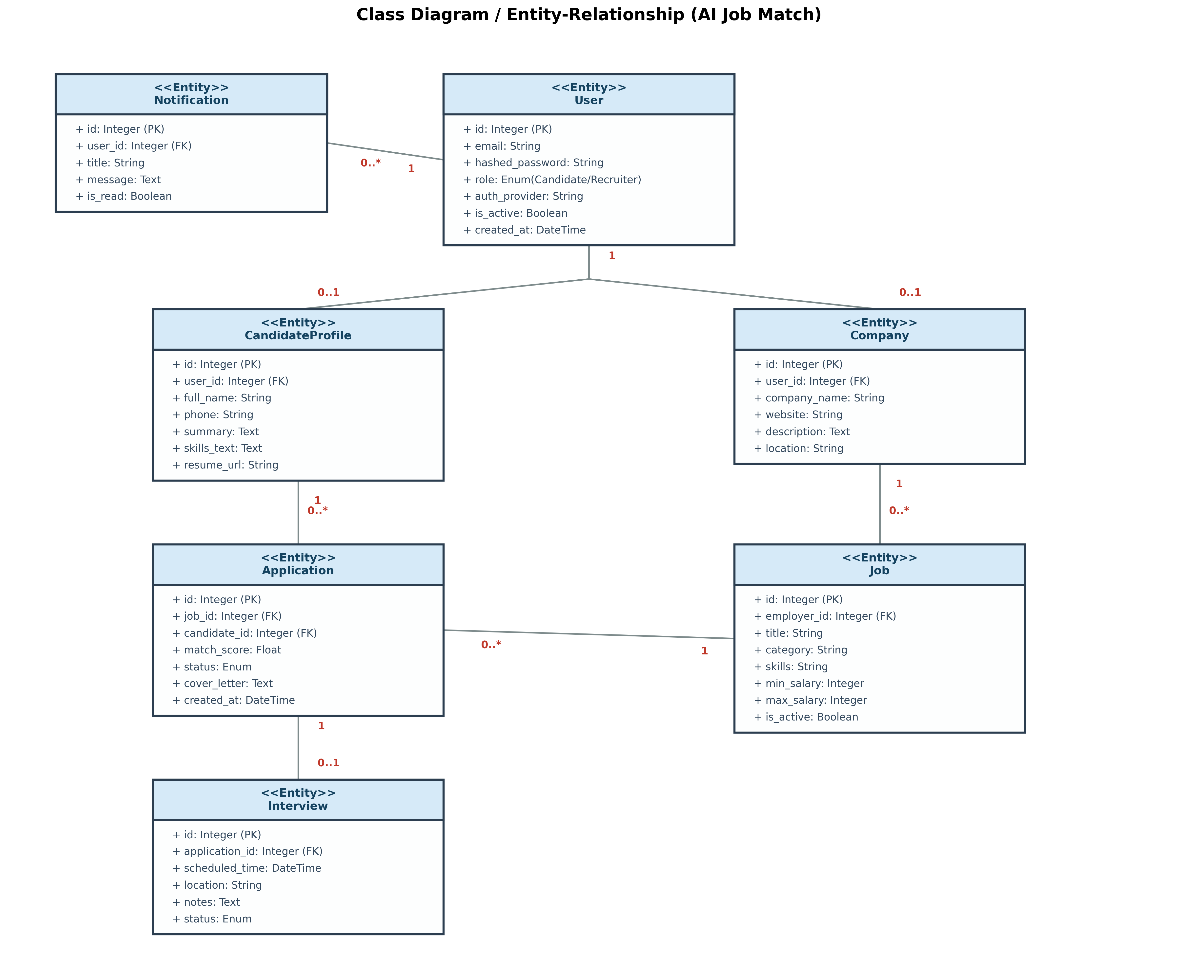
3. System Analysis and Design
Use case Diagram
Class Diagram

Slide 9
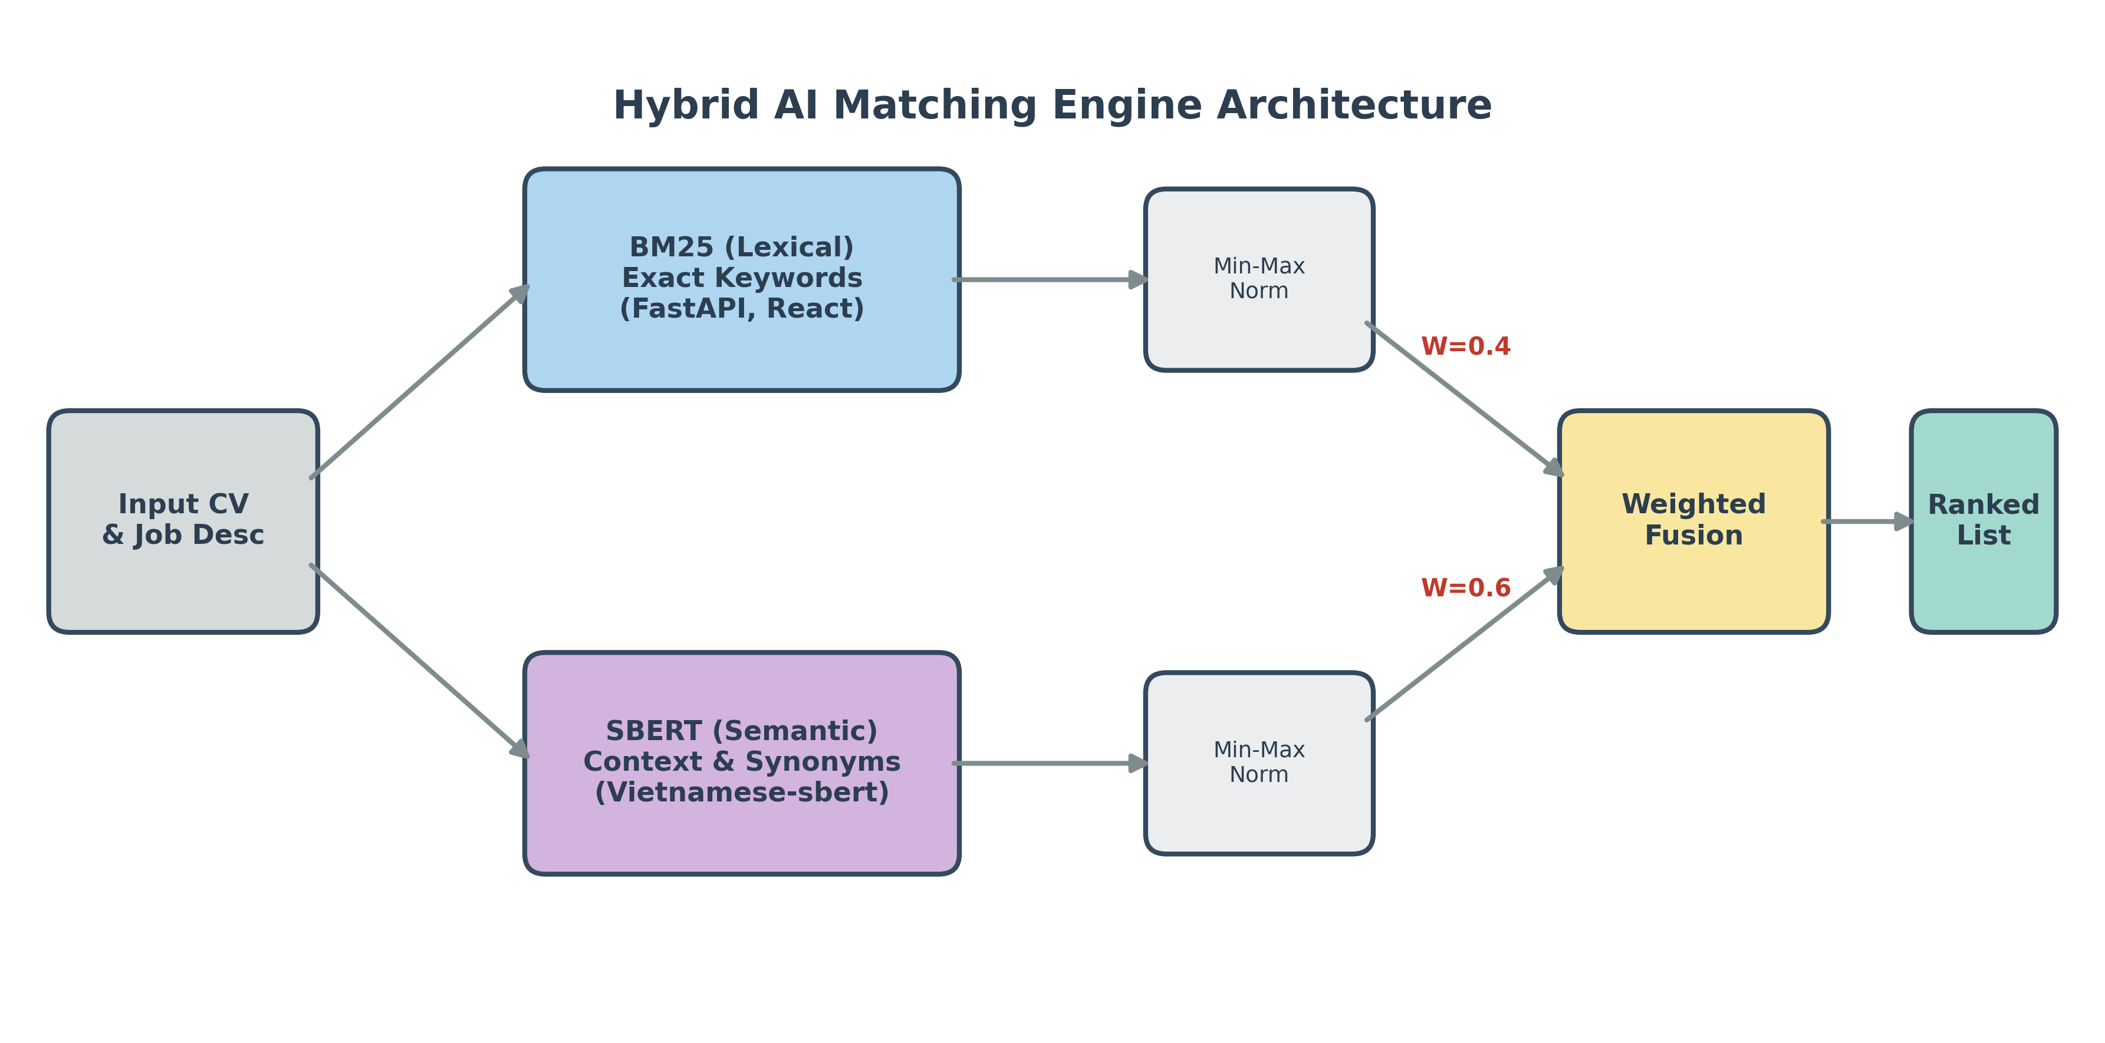
4. AI Technologies
BM25 (Lexical Match)
Precisely matches hard-skill keywords.
Example: FastAPI, React, Docker.
SBERT (Semantic Match)
Uses the vietnamese-sbert model to understand Vietnamese semantics.
Captures synonyms and contextual meaning.
Example: Lập trình viên = Developer.
Weighted FusionHybrid Score =(BM25×0.4)+(SBERT×0.6).

Slide 10
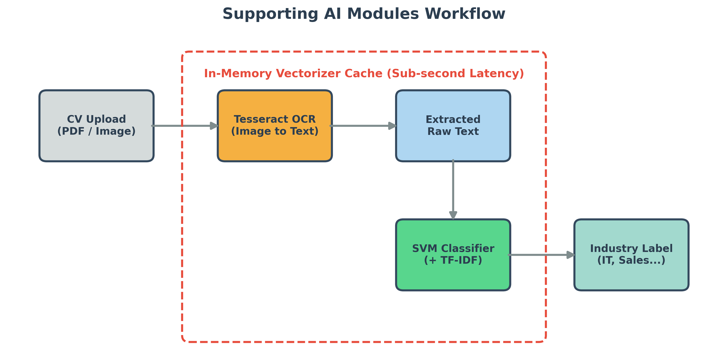
4. AI Technologies
Supporting AI Modules
Resume Parsing (Tesseract OCR)
Recognizes text from image and PDF-based CVs.
Converts raw file data into readable text for AI processing.
Industry Classification (SVM)
Uses Machine Learning (TF-IDF + SVM) for ultra-fast classification.
Automatically labels industry categories (IT, Marketing, Sales, etc.) for both jobs and CVs.
System Optimization
Vectorizer Cache: Keeps the AI model preloaded in RAM.
Sub-second latency for scanning thousands of CVs per request.

Slide 11
5. Conclusion & Demo
✅ ACHIEVEMENTS:
🖥 BACKEND:
30+ REST API endpoints
7 core database tables
Uvicorn ASGI Server
📱 FRONTEND APP (Flutter):
13+ complete screens
Cross-platform: Web, Android, iOS
🤖 AI MODULES:
Hybrid Engine: BM25 + SBERT
SVM Industry Classification
Tesseract OCR for CV parsing
Vector Cache (Sub-second latency)
💳 INTEGRATIONS:
Firebase Auth (Google Sign-In) ️
ShadCN UI + GoRouter ✔️
Docker + Docker Compose ✔️

Slide 12
5. Conclusion & Demo
⚠ LIMITATIONS:
Not yet deployed to cloud production (AWS/GCP)
Lack of A/B testing on large-scale real user data
Cover letter generation is not yet supported
🚀 FUTURE DEVELOPMENT:
Deploy to cloud (AWS/GCP) with CI/CD pipeline
A/B Testing to optimize BM25 vs SBERT weights (0.4 / 0.6)
Integrate Generative AI (LLMs) for automated cover letters
Implement Collaborative Filtering for behavior-based suggestions

Slide 13
PROJECT DEMO

Slide 14
THANK YOU
Q&A SESSION

