Slide 1
Minh Vu

Slide 2

Barebone Structure
1. Feature Engineering
2. Categorical Features Encoding
3. Apply ML algorithms

Slide 3
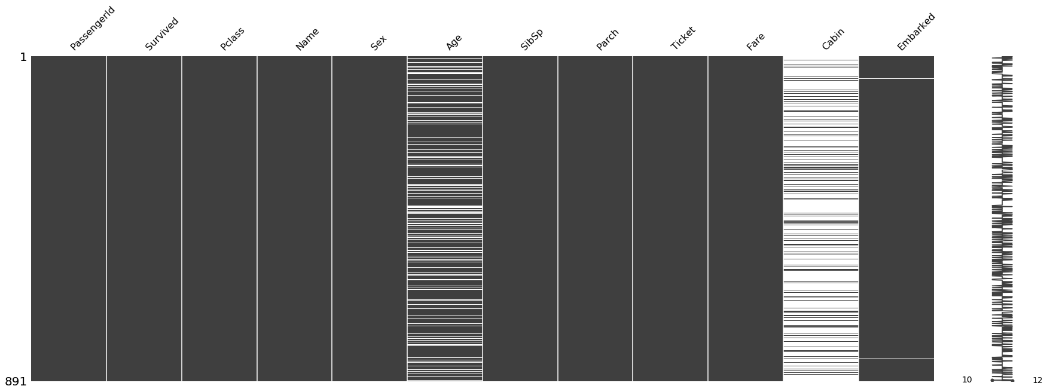
Features Engineering

Slide 4
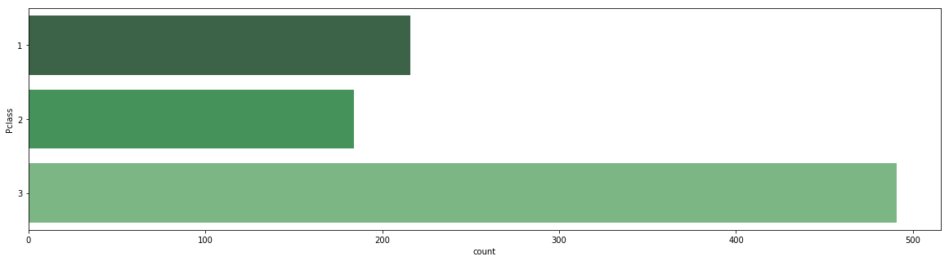
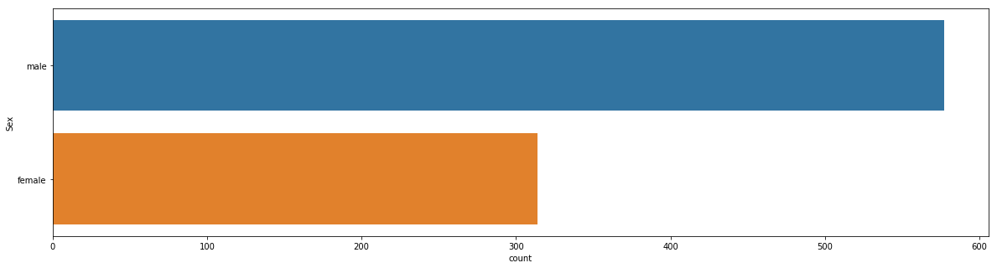
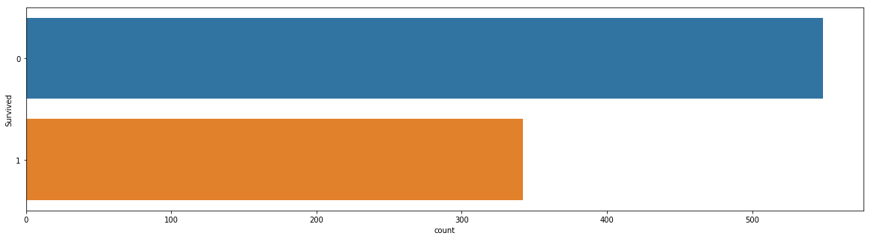
Features Engineering
Passenger class
Sex
Survived

Slide 5
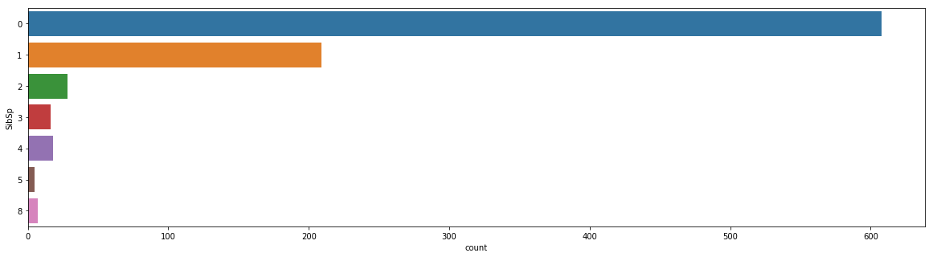
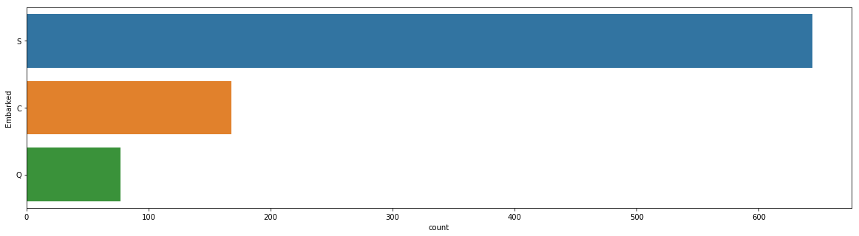
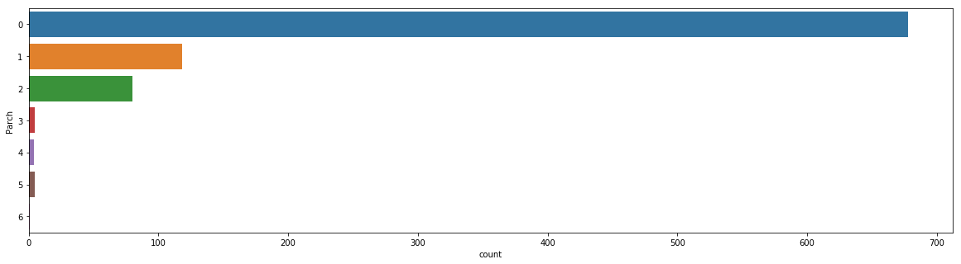
Features Engineering
SibSp
Embarked
Parch

Slide 6
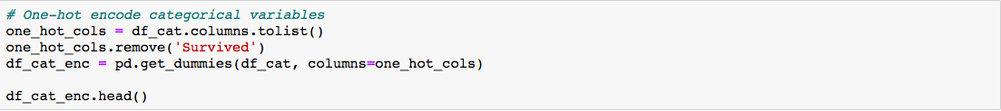
Categorical Features Encoding

Slide 7
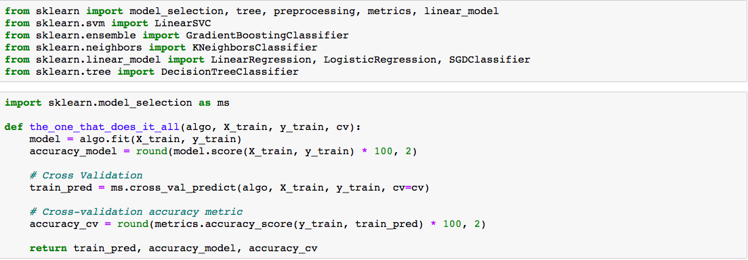
Apply ML algorithms

Slide 8
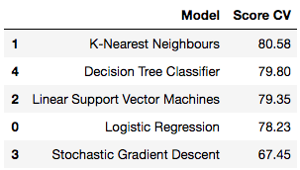
Apply ML algorithms

Slide 9
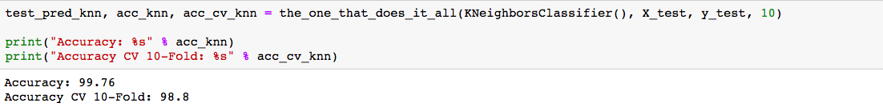
Apply ML algorithms
We apply KNN

