Slide 1
DESIGN PRINCIPLE & PROCESS
Human Computer Interaction
By: Nguyễn Công Hoan

Slide 2
Reference
DonaldNorman, The Design of Everyday Things, MITPress, 23 Dec 2013
Tutorial Teaching of Prof. Dr. Keith Andrews, Graz University of Technology
Tutorial Teaching of Lecture Nguyen Van Vu, University of Sciences

Slide 3
Agenda
What is Interface?
Interface Hall of Shame
User Centered Design
Principles of UI design
Shneiderman’s Eight Golden Rules
Design process

Slide 4
Interface Design and Usability Engineering
Articulate:
who users are
their key tasks
Brainstorm designs
Refined designs
Completed designs
Goals:
Task centered system design
Participatory design
User-centered design
Psychology of everyday things
User involvement
Representation & metaphors
Participatory interaction
Task scenario walk- through
Graphical screen design
Interface guidelines
Style guides
Evaluate tasks
Usability testing
Heuristic evaluation
Field testing
Methods:
low fidelity prototyping methods
high fidelity prototyping methods
Products:
User and task descriptions
Throw-away paper prototypes
Testable prototypes
Alpha/beta systems or complete specification

Slide 5
What is Interface?
Interface is made up of a set of hardware devices and software tools from the computer side and a system of sensory, motor and cognitive processes from the human side.
Interaction takes place at the Interface,

Slide 6
Donald Norman’s model
Norman’s model concentrates on user’s view of the interface
Seven stages
User establishes the goal
Formulates intention
Specifies actions at interface
Executes action
Perceives system state
Interprets system state
Evaluates system state with respect to goal
Notes:
Note: Donald Norman; a professor emeritus of cognitive science at University of California, San Diego and a Professor of Computer Science at Northwestern University. Donald Norman is an academic in the field of cognitive science, design and usability engineering and a co-founder and consultant with the Nielsen Norman Group.

Slide 7
Execution/Evaluation Loop
goal
User establishes the goal
Formulates intention
Specifies actions at interface
Executes action
Perceives system state
Interprets system state
Evaluates system state with respect to goal
execution
evaluation
system

Slide 8
Execution/Evaluation Loop
goal
User establishes the goal
Formulates intention
Specifies actions at interface
Executes action
Perceives system state
Interprets system state
Evaluates system state with respect to goal
execution
evaluation
system

Slide 9
Execution/Evaluation Loop
goal
User establishes the goal
Formulates intention
Specifies actions at interface
Executes action
Perceives system state
Interprets system state
Evaluates system state with respect to goal
execution
evaluation
system

Slide 10
Execution/Evaluation Loop
goal
User establishes the goal
Formulates intention
Specifies actions at interface
Executes action
Perceives system state
Interprets system state
Evaluates system state with respect to goal
execution
evaluation
system

Slide 11
User interface (UI)
User interface: User interfaces mediate the interaction (dialog) between humans and computers.
The User Interface today is often one of the most critical factors regarding the success or failure of a computer system
[[
Good UI design:
Increases efficiency
Improves productivity
Reduces errors
Reduces training
Improves acceptance

Slide 12
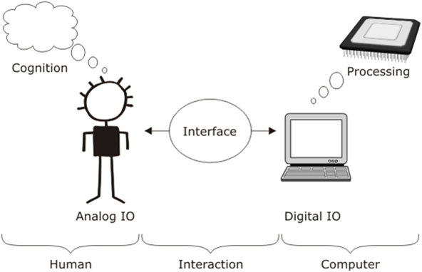

Slide 13
User Interface
“Today, user needs are recognized to be important in designing interactive computer systems, but as recently as 1980, they received little emphasis.”
J. Grudin
A balance of two key features is needed for an effective user interface
Expressive: ability to achieve specific tasks efficiently
Intuitive: ease of use, degree of effort required to learn

Slide 14
Basic user interface styles
Five commonly encountered user interface paradigms:
Interface style
Command entry Menu Forms WIMP Natural language
Expressive
Intuitive

Slide 15
System-Centered Design
What can be built easily on this platform?
What can I create from the tools available?
What do I as a developer find interesting to work on?
What do I as a developer think users need?

Slide 16
User-Centered Design
Also known as Participatory Design
The design is based upon a user’s:
Abilities and Needs
Context
Work
Tasks

Slide 17
User-Centered Design (cont.)
How to do?
Focusing on users and tasks
User analysis: who uses the system
Task analysis: what users need to do
Getting users involved in the process
Users as evaluators, consultants and designers (sometimes)
Constant evaluation
Users evaluate prototypes and releases

Slide 18
User-Centered Design (cont.)
Advantages
Accurate information and useful suggestions
Opportunity to argue over design decisions
Increased ego involvement in system success
Potential problems
Users are not always available to participate
Their time maybe expensive
Users are not UI designers
Users have strong ego and preferences
UI designers overly obey users’ preference

Slide 19
Principles of UI design
Simple and natural dialogue
Speak the user’s language
Minimize user’s memory load
Provide feedback
Provide clearly marked exits
Provide shortcuts
Deal with errors in a positive manner
Provide help

Slide 20
Principles of UI design (cont.)
How to apply?
Determine users’ skill levels
Novice/first-time users
Knowledgeable intermittent users
Experts and frequent users
Identify the tasks
Frequent actions
Less frequent actions
Infrequent action

Slide 21
Principles of UI design (cont.)
How to apply?
Choose appropriate interaction styles
Direct manipulation
Menu selection
Form fill in
Command language
Natural language
Use Shneiderman’s eight golden rules of interface design

Slide 22
Principles of UI design (cont.)
How to apply?
Prevent errors
Constructive and informative error messages
Organizing screens and menus functionally
Providing feedback about the state of the interface
Correct actions
E.g., grayed menu items
Complete sequences
E.g., wizard windows often have both Next and Finish buttons
Increase automation while preserving human control
Auto suggestion
Auto completion
Allowing users to change

Slide 23
Shneiderman’s Eight Golden Rules
Strive for consistency
Cater to universal usability
Offer informative feedback
Design dialogs to yield closure
Prevent errors, rapid recovery
Permit easy reversal of actions
support user control
Reduce memory load

Slide 24
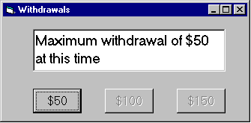
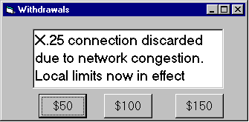
Example: Speak the users’ language
Terminology based on users’ language for task
e.g. withdrawing money from a bank machine
Use meaningful mnemonics, icons & abbreviations
e.g File / Save

Slide 25
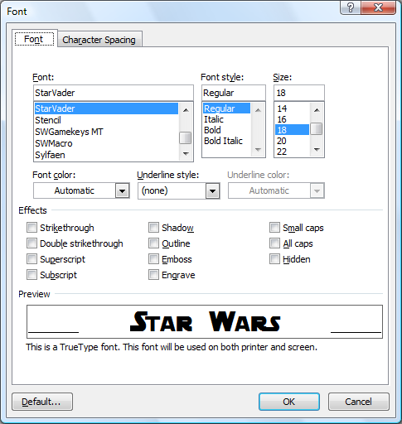
Example: Minimize user’s memory load
Computers good at remembering, people are not!
Promote Recognition over Recall
menus, icons, choice dialog boxes vs. commands, field formats
relies on visibility of objects to the user (but less is more!)

Slide 26
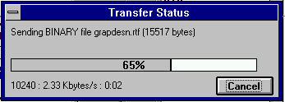
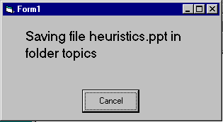
Example : Provide feedback
Continuously inform the user about
what it is doing
how it is interpreting the user’s input
user should always be aware of what is going on
Multiple files being copied, but feedback is file by file.

Slide 27
Tips for Interface Designs
HCI has traditionally been about designing efficient and effective systems.
Well-designed interfaces can elicit good feelings in users.
Expressive interfaces can provide comforting feedback.
Badly designed interfaces make people angry and frustrated.
Emotional interaction is concerned with how we feel and react when interacting with technologies.
Emotional interaction is concerned with how interactive systems make people respond in emotional ways.
Relaxed users will be more forgiving of shortcomings in design.
Aesthetically pleasing and rewarding interfaces will increase positive affect.

Slide 28
Tips for Interface Designs (cont.)
User interfaces should be designed to match the skills, experience and expectations of its anticipated users.
System users often judge a system by its interface rather than its functionality.
A poorly designed interface can cause a user to make terrible errors.
Poor user interface design is the reason why so many software systems are never used.
Designers should be aware of people’s physical and mental limitations (e.g. limited short-term memory) and should recognise that people make mistakes.

Slide 29
USABILITY
Basic Goal of HCI
One of the key concepts in HCI.
It is concerned with making systems easy to learn and use
A Usable system is:
Easy to learn
Easy to remember how to use
Effective to use
Efficient to use
Safe to use
Enjoyable to use

Slide 30
In order to produce computer system with good usability;
Developers must attempt to
Understand
The factors that determine how people use technology
Develop
Tools and techniques to enable building suitable systems
Achieve
Put People 1st
Their needs, capabilities and preferences for conducting various tasks should direct developers in the way that they design systems
Efficient, effective, and safe interaction
People should not change their way they use the system to fit with it, instead system should match their requirements
The long term goal:
To design systems that minimize the barrier between the human’s cognitive model of what they want to accomplish and the computer’s understanding of the user’s task

Slide 31
Why is usability important?
Poor usability results in
anger and frustration
decreased productivity in the workplace
higher error rates
physical and emotional injury
equipment damage
loss of customer loyalty
costs money

Slide 32
Principles of UI design (cont.)
How to apply?
Choose appropriate interaction styles
Direct manipulation
Menu selection
Form fill in
Command language
Natural language
Use Shneiderman’s eight golden rules of interface design

Slide 33
Design Process
Waterfall model
Iterative design
Spiral model
What to choose?

Slide 34
Waterfall model
Requirements
definition
System and Software Design
Implementation and Unit Testing
Integration and System Testing
Operation and Maintenance

Slide 35
Waterfall model (cont.)
Requirements
definition
System and Software Design
Implementation and Unit Testing
Integration and System Testing
Operation and Maintenance

Slide 36
Waterfall model (cont.)
Requirements
definition
Disadvantage: difficult to handle changes
System and Software Design
Implementation and Unit Testing
Integration and System Testing
Operation and Maintenance

Slide 37
Waterfall Model Problems
Users are not involved in evaluation until acceptance testing
UI problems result in changes in requirements and design
Waste of effort spent earlier
Inflexible partitioning of the project into distinct stages
It is difficult to respond to changing customer requirements
It is only appropriate when the requirements are well understood
Few business systems have stable requirements

Slide 38
Shneiderman’s Interactive Systems Lifecycle
Software development lifecycle for interactive systems:
Collect Information
Define Requirements and Semantics
Design Syntax and Support Facilities
Specify Physical Devices
Develop Software
Integrate System and Disseminate to Users
Nurture the User Community
Prepare Evolutionary Plan

Slide 39
Collect Information
Organize the design team
Obtain management and customer participation
Conduct interviews with users
Submit written questionnaires to users
Estimate development, training, usage, maintenance costs
Prepare a schedule with observable milestones and reviews

Slide 40
Define requirements and semantics
Define high-level goals and middle-level requirements
Consider task flow sequencing alternatives
Create task objects and actions
Obtain management and customer agreement on goals,
requirements, and semantic design

Slide 41
Design syntax and support facilities
Compare alternative display formats
Design informative feedback for each operation
Review, evaluate, and revise design specifications
Carry out paper-and-pencil pilot tests or field studies with an
online mock-up or prototype

Slide 42
Specify physical devices
Choose hard- or softcopy devices
Select audio, graphics, or peripheral devices
Consider work environment noise, lighting, table space, etc.
Carry out further pilot tests and revise design

Slide 43
Develop software
Use appropriate development tools
Develop code
Perform unit test

Slide 44
Integrate system and disseminate to users
Assure user involvement at every stage
Conduct acceptance tests and fine tune the system
User documentation and training

Slide 45
Nurture the user community
User support
Monitor usage and measurement

Slide 46
Iterative Design
Design
Evaluate
Implement

Slide 47
Iterative Design (cont.)
Each round is one iteration
Release is produced at the end of each iteration
Customer’s feedback and evaluations can be
incorporated into next release
Advantages:
Simple
Problems
It’s expensive to use customer’s time to test
Customers may not be available
Customers don’t like ➔ they don’t buy

Slide 48
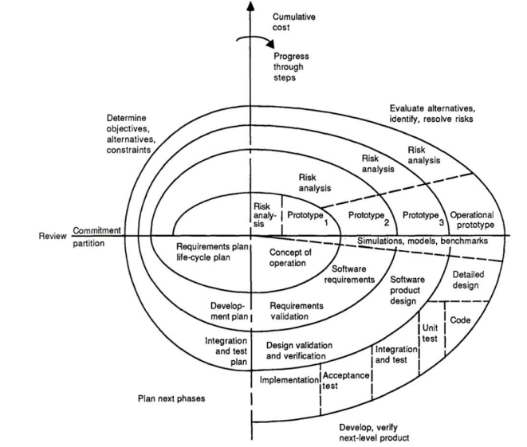
Spiral Model
(Boehm 1988)

Slide 49
Spiral Model (cont.)
Process is represented as a spiral rather than as a sequence of activities with backtracking
Each loop in the spiral represents a phase in the process
No fixed phases such as specification or design loops in the spiral are chosen depending on what is required
Risks are explicitly assessed and resolved throughout the process

Slide 50
Increment Model
Increment Model = Iterative Design + Spiral Model
Design
Prototype
Implement
Evaluate

Slide 51
Increment Model for UI Design
Early cycles use cheap prototypes
Paper prototypes
Sketches on computer
Quick prototyping tools
Providing multiple prototype alternatives
Parallel prototyping
Later cycles should be better than early ones
Only mature releases of later cycles can be distributed to users
Easy to integrate with Software Development process Scum

