Slide 1
CULTURE vs DESIGN
Human Computer Interaction
By: Nguyễn Công Hoan

Slide 2
Reference
DonaldNorman, The Design of Everyday Things, MITPress, 23 Dec 2013
Tutorial Teaching of Prof. Dr. Keith Andrews, Graz University of Technology

Slide 3
Agenda
Internationalization
Localization
Text direction
Text translation
Foreign Language
Sort order
Formatting
Color conventions

Slide 4
Internationalization
The process of making software ready for translation or adaptation into different languages and cultures
Often called as i18n – 18 characters between ‘I’ and ‘n’ in the word “internationalization‟
modification of a software or related technologies so that a software can potentially handle multiple languages, customs, and so on in the world.

Slide 5
Internationalization generally involves
Design and development in a way that removes barriers to localization or international deployment. This includes in particular the authorization to use Unicode, or the fact of ensuring the correct handling of the inherited character encodings, if necessary, of being careful with the concatenation of strings, of avoiding dependency in the encoding of UI string values, etc.
To provide support for features that may not be used prior to localization. For example, adding markup in your DTD to support bidirectional text or to identify a language. Or enrich a CSS to support vertical texts or the typographical characteristics of non-Latin letters.
To allow the code to support local, regional, language or cultural preferences. Typically, this involves the incorporation of predefined location data and functions derived from existing libraries or user preferences. For example, date and time formats, local calendars, number formats and numbering systems, list sorting and presentation, management of names and address formats, etc.
Separate localizable elements from source code or content, so that localized alternatives can be loaded or selected based on the user's international preferences, as needed.

Slide 6
Internationalization models
L10N (localization) model
This model is to support two languages or character codes, English (ASCII) and another specific one.
I18N (internationalization) model
This model is to support many languages but only two of them, English (ASCII) and another one, at the same time. One have to specify the 'another' language, usually by LANG environmental variable.
M17N (multilingualization) model
This model is to support many languages at the same tim

Slide 7
Implementations
Implementation without knowledge of each language
This approach is done by utilizing standardized methods supplied by the kernel or libraries
Implementation using knowledge of each language
This approach is to directly implement information about each language based on the knowledge of programmers and contributors.

Slide 8
Localization
The process making software to a specific language and culture
More than just translate, find, and replace words
In digital, date and time formats
To the use of foreign currency
For keyboard use
Collection and sorting
With symbols, icons and colors
To texts and images containing references to objects, actions or ideas which, in a particular culture, may be subject to misinterpretation or perceived as something offensive
To different legal requirements

Slide 9
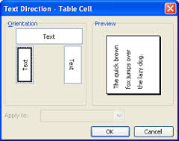
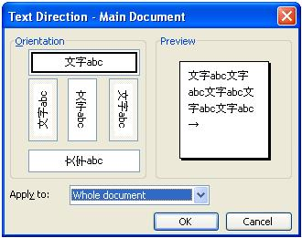
Text direction

Slide 10
Text direction
Left-to-right
English, Vietnamese, French, etc.
Right-to-left
Arabic, Hebrew
To-down, left-to-right, right-to-left
Chinese, Korean, Japanese
Text direction affects drawing, screen layout, editing, etc.

Slide 11
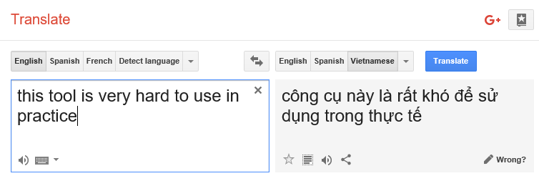
Text translation
All user-visible text has to be translated, including error messages
Text in code
Text in images
Text in data files
Translation results in the change of text length

Slide 12
Foreign Language
1. One of his family members is dead. 2. My brother's all the books have been stolen. 3. For what you are here ? 4. Tell me why did you go there ? 5. I, you and he will go together. 6. Exercise is good both for work as well as health
1.A member of his family is dead. 2. All my brother's books have been stolen 3. What are you here for? 4. Tell me why you went there. 5. He, you and I will go together. 6. Exercise is good for both work and health.

Slide 13
Abbreviations
Đại học Quốc gia TPHCM
(Vietnam National University - Ho Chi Minh City)
Vietnam Natl Univ Ho Chi Minh City
Natl Univ Ho Chi Minh City
Natl Univ Hochiminh City
Hochiminh City Natl Univ
Đại học Bách khoa TPHCM
(University of Technology - Ho Chi Minh City)
Hochiminh City Univ Technol
Ho Chi Minh City Univ Technol
Đại học Khoa học Tự nhiên
Univ Nat Sci
Univ Nat Sci Hochiminh City

Slide 14
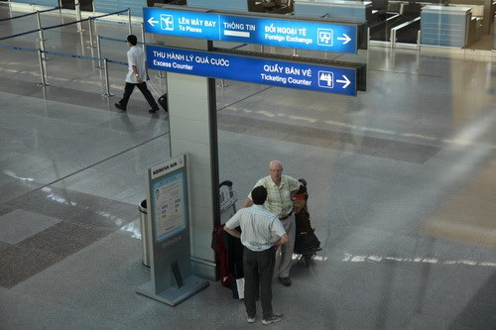
Translation Problem
Notes:
"Đổi ngoại tệ" - "Foreign Exchange" không hẳn là một cách dịch sai. Song người ta thường dùng "Currency Exchange" hơn là "Foreign Exchange" tại các sân bay quốc tế. Trong khi đó, "Quầy bán vé" - "Ticketing Counter" cũng là một cách dịch đầy "sáng tạo" của đơn vị chịu trách nhiệm lắp đặt các biển hướng dẫn. Quầy bán vé chỉ đơn giản là "Ticket Counter"

Slide 15
Sort order
Natural Sort Order
Unicode is often used
It is not always ordered according to a language
Upper/lowercase affects order
Java‟s String.compareTo() does not work as expected all the times

Slide 16
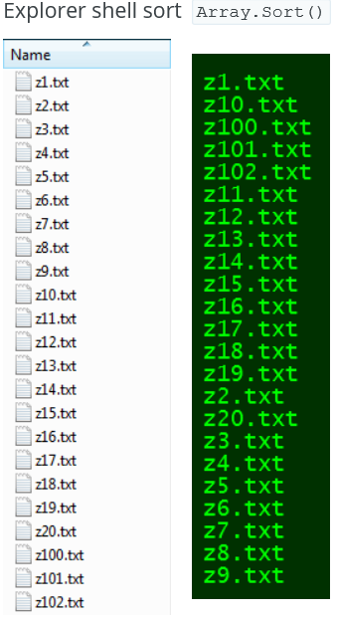
Sorting for Humans

Slide 17
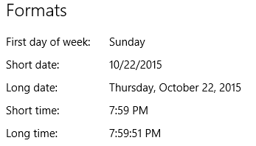
Formatting
Date
US: 5/10/2012 (M/D/Y)
VN and others: 10/5/2012 (D/M/Y)
Time
US: 12:30 PM (H:M)
VN: 12.30 chiều
Numbers
US/UK: 10,000.9 (ten thousands point nine)
Vietnam, Germany: 10.000,9
France: 10 000,9

Slide 18
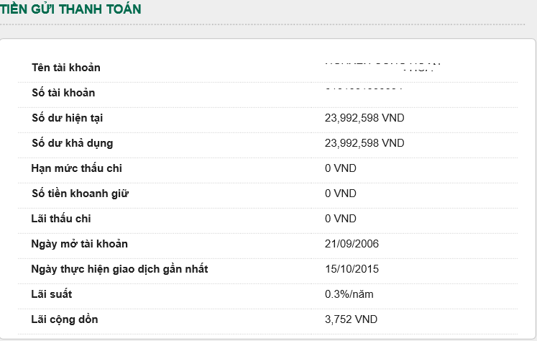
Number on Domain

Slide 19
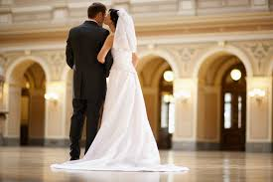
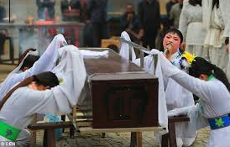
Color conventions
Red
East Asia (China, Vietnam, etc.): luck, on new year celebrations
US: sometimes red refers to danger, e.g. stop sign
White
East Asia (China, Vietnam, etc.): death, used in funeral
US: purity, used in wedding

Slide 20
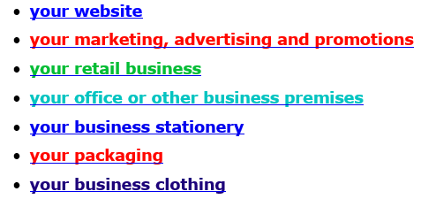
Business Color

Slide 21
Cultural Color
Western:
energy, excitement, action
danger
love, passion
a warning to stop
anger
Christmas combined with green
Valentine's Day
Eastern:
prosperity
good fortune
worn by brides
symbol of joy when combined with white
Hebrew:
sacrifice, sin
Christian:
sacrifice, passion, love
China
the color of good luck and celebration
vitality, happiness, long life
used as a wedding color
Japan:
life
anger and danger
Western:
brides and weddings
angels
hospitals, doctors
peace - the white dove
purity and cleanliness
Eastern:
death, mourning and funerals
sadness
China
death and mourning
virginity and purity
humility
age
misfortune
Japan:
White carnation symbolizes death
Western:
power, control, intimidation
funerals, death, mourning
rebellion
Valentine's Day
Eastern:
wealth, health and prosperity
China
color for young boys
Japan:
color of mystery and the night
may be associated with feminine energy - either evil and a threat or provocative and alluring
http://www.empower-yourself-with-color-psychology.com/cultural-color.html

Slide 22
Guidelines for Using
Resource file
Use UI toolkits provided in the language

