Slide 1
KNOW THE USER
Human Computer Interaction
By: Nguyễn Công Hoan

Slide 2
Reference
DonaldNorman, The Design of Everyday Things, MITPress, 23 Dec 2013
Tutorial Teaching of Prof. Dr. Keith Andrews, Graz University of Technology

Slide 3
Know the User
“ I’m a very selﬁsh designer: when I design software, I design it for me. And so my ﬁrst task is to become you. ”
[ Bruce Tognazzini, The Front Desk, BBC Video, 1996. [BBC, 1996, 00:21:28] ]
Qualitative research is used to determine user characteristics, goals, and context of use.

Slide 4
Agenda
Classifying Users
Categories of User Experience
Research the Frames of Reference
Research the End User

Slide 5
Classifying Users
Users can be classiﬁed according to their:
experience
educational level
age
amount of prior training, etc.

Slide 6
Discussion
User vs. Customer

Slide 7
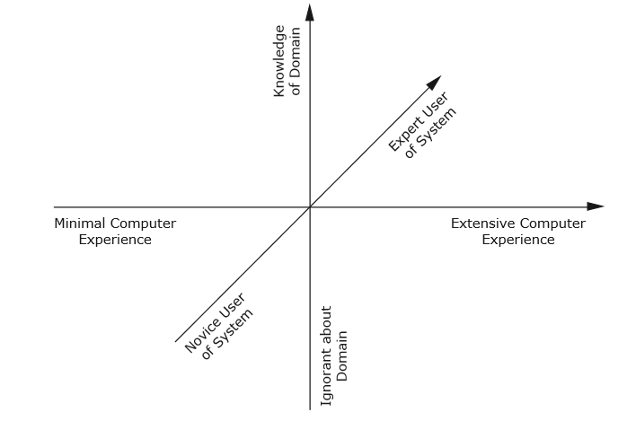
Categories of User Experience
The three main dimensions on which user experience varies: experience of computers in general
,understanding of the task domain,and expertise in using the speciﬁc system. From Figure 3 of [Nielsen, 1993b].

Slide 8
Learning Curves
Learning Curves
Some systems are designed to focus on learnability.
Others emphasise eﬃciency for proﬁcient users.
Some support both ease of learning and an “expert mode” (for example rich menus and dialogues plus a command/scripting language), and thus attempt to ride the top of the curves

Slide 9
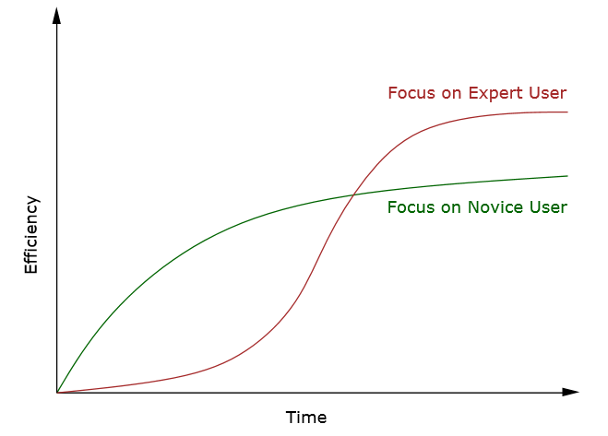
Learning Curves (cont.)
Learning curves for hypothetical systems focusing on the novice user (easy to learn, but less eﬃcient to use)
and the expert user (harder to learn, but then highly eﬃcient). From Figure 2 of [Nielsen, 1993b].

Slide 10
Perpetual Intermediates
The experience level of people using computer software tends, like most population distributions, to follow the classical statistical bell curve (normal distribution).
In terms of using a software interface, the bell curve represents a snapshot in time:
Beginners do not remain beginners for long.
The diﬃculty of maintaining a high level of expertise means that experts fade over time.
Most users gravitate over time towards intermediacy.
Most users are neither beginners nor experts: they are perpetual intermediates.

Slide 11
Research the Frames of Reference
Conduct interviews with:
Project staﬀ (managers, programmers, marketing people) who are in charge of developing the software.
Subject matter and domain experts.
Customers (the purchaser of the product, not necessarily the same as the end user) to determine values, expectations, issues, and constraints.

Slide 12
Interviewing Project Staff
Interviewing Project Staff
One-on-one interviews.
Try to discover:
vision of the product.
budget and schedule.
technical constraints.
perceptions of who users might be.

Slide 13
Interviewing Subject Matter Experts (SMEs)
Often hired externally by project manager.
Provide knowledge of complex domains, regulations, industry best practice.
Often lean towards expert user perspective (rather than intermediate).

Slide 14
Interviewing Customers
Customers are the people who make the decision to purchase.
For consumer products, customers are often the same as users.
For business settings, customers are rarely actually the users of a product.
Try to discover the customer’s:
goals in purchasing the product
frustrations with current solutions
decision process for purchasing
role in installation and maintenance

Slide 15
Research the End User
The actual users of a product should always be the main focus of the design eﬀort.
Most people are incapable of accurately assessing their own behaviour [Pinker, 1999].
Rather than talk to users about how they think they behave, it is better to observe their behaviour ﬁrst-hand.
And then ask clarifying questions in the context of use.

Slide 16
Ethnographic Interviews
A combination of immersive observation and directed interview techniques.
Observe the user using their current tools in their normal environment.
Interviewer assumes the role of an apprentice learning from the master craftsman (user).
Alternate between observation of work and discussion of its structure and details.
Notes:
/ˌeTHnəˈɡrafik/ nhan chung hoc5 /əˈpren.tɪs/

Slide 17
Identifying Candidate Users
Designers must capture the range of user behaviours regarding a product.
What sorts of people might use this product?
How might their needs vary?
What ranges of behaviour might be involved?
Which kinds of environment might be involved?
Try to interview some people from each diﬀerent group.

Slide 18
Examples
Whom would you interview if you were designing:
An in-ﬂight entertainment system?
A corporate help desk?
A complete hospital management system?
A mobile phone with email capability?

Slide 19
Conducting an Ethnographic Interview
In actual workplace/environment.
45-60 minutes.
No third parties (supervisors or clients).
Focus on understanding:
Overall goal
Current tasks
Constraints and exceptions
Problems needing solution (where does it hurt?)
Broader context
Domain issues
Vocabulary
Ask permission to take a few photographs of the user and their workplace (for creating personas).

Slide 20
Patterns of Use
When interviewing users, we are trying to discover patterns of use:
Business products: Patterns of use are generally based on job responsibilities.
Consumer products: Patterns of use are generally based on lifestyle (age, gender, occupation, etc).

Slide 21
Being an Active Listener
A good interviewer is an active listener:
Use open body language: lean forward, hand under chin, arms open, eye contact.
Use minimal encouragers: brief verbal cues (hmmm, uh-huh, oh?), nodding, tilting head sideways.
Ask open-ended questions (how, when, what, why) to encourage elaboration.
Use closed questions (can you, will you, do you) with yes/no or simple fact answer to clarify your understanding.
Summarise to check you understand the important points: “So it sounds like the key points are...”.

Slide 22
General Flow of Interview for Business Product
Introductions.
Why we’re here: We’ve been asked to design/improve X.
What we’ll ask: your day, your background, your frustrations.
Tell us about your responsibilities and your typical workday.
Drill into speciﬁc tasks.
How is existing product (if any) involved in those tasks.
Relationships with other people and processes.
Goals.
Follow up on interesting points.
Wrap-up.

Slide 23
Good General Questions
What do you spend most of your time on? [task priority]
What things waste your time? [opportunity]
Where does it hurt? [opportunity]
What makes a good work day? A bad one? [goals]
What kind of training do you have? [support to provide]
What are the most important things you do? [priorities, goals]
What information helps you make decisions? [info to provide]

Slide 24
Different?
User vs Customer
Actual
Candidate
Anonymous

