Slide 1
An Overview of
Tensorflow + Deep learning
沒一村

Slide 2
About me
邱弘毅（沒一村）
交通大學電資學士班 3 年級
沒一村前端筆記 & 沒一村生活點滴
JavaScript lover, R language, python
Full stack developer, React Native
目前專注於 Deep learning 相關應用
https://www.facebook.com/noootown

Slide 3
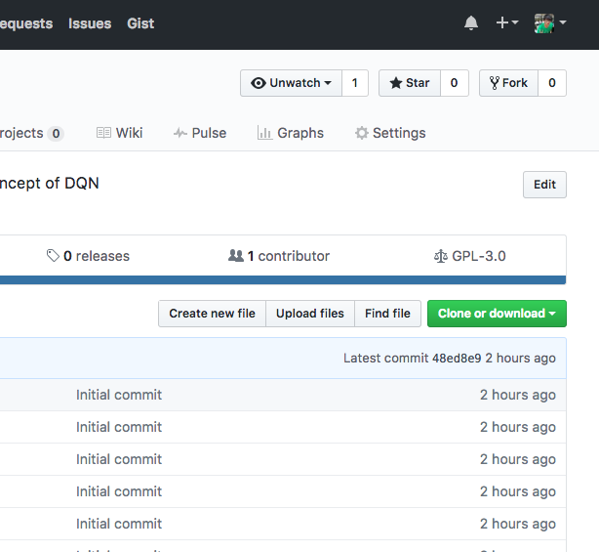
Before we start
程式碼：
https://github.com/noootown/Forex-DQN
受用的話，請給我一顆 star :P
Notes:
git clone https://github.com/noootown/Forex-DQN

Slide 4
Outline
What is Machine Learning?
What is Deep learning?
What is Tensorflow?
Do it!
Summary

Slide 5
What is Machine learning ？

Slide 6
What is Machine learning ？
Field of study that gives computers the ability to learn
without being explicitly programmed
Arthur Lee Samuel, 1959

Slide 7
Machine Learning
實踐 AI 的一種手段
透過各種 Machine learning 演算法，從少量或大量的資料中學出一個 rule。藉這個 rule 對未來做預測。
問題分類：cluster, regression, classification
常見演算法: KNN, SVM……
AI
ML

Slide 8
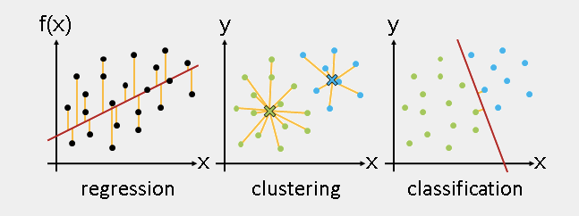
pic from: http://www.csie.ntnu.edu.tw/~u91029/Classification.html
Notes:
Classification 有事先標籤好要分類
Clustering 無事先標籤好

Slide 9
問題
評估
修正

Slide 10
Outline
What is Machine Learning?
What is Deep learning?
What is Tensorflow?
Do it!
Summary

Slide 11
What is Deep learning ？

Slide 12
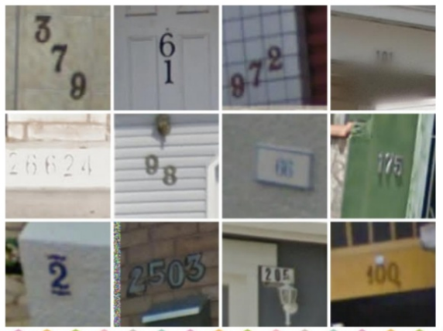

Slide 13
Deep Learning
也是實踐 AI 的一種手段
讓機器自己提取特徵，自己試誤，自己學習
各種不同的 Model
Ex: CNN, RNN, LSTM
AI
ML
DL

Slide 14
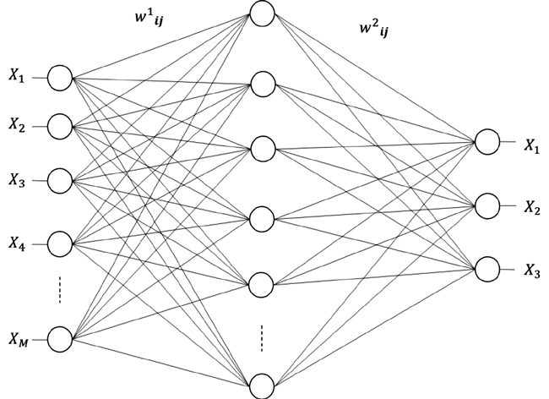
Deep Learning vs 類神經網路
模擬人類神經傳導機制

Slide 15
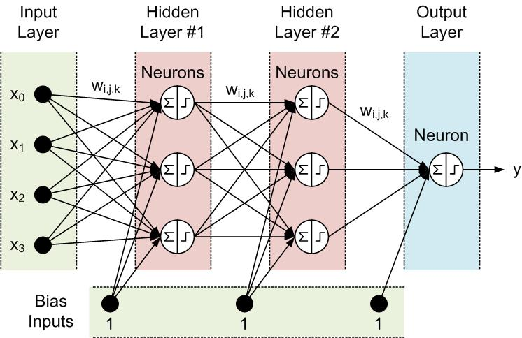
How Neuron works?
Control weight and bias

Slide 16
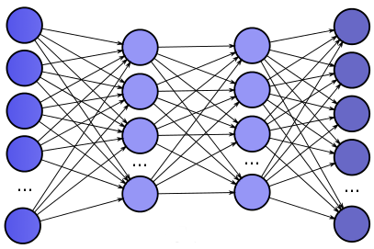
Fully connected

Slide 17
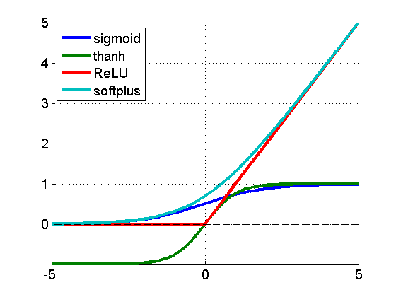
They need activation!!!
Ex: relu, sigmoid……

Slide 18
Target: Minimize loss
1
2
網路
3
4
1
3
Loss function
Ex: Cross entropy, mean square
f( ) =
3
5

Slide 19
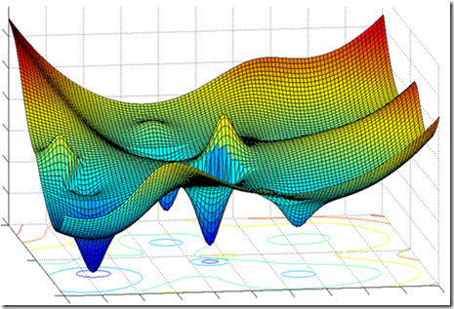
How ? Gradient Decent

Slide 20
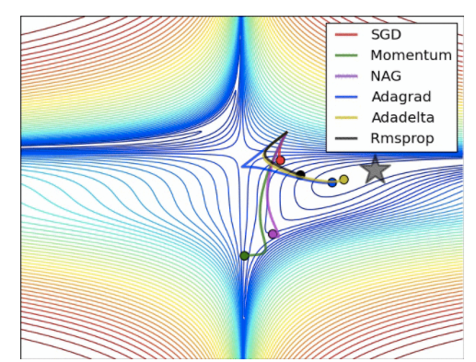
Optimize function

Slide 21
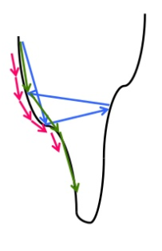
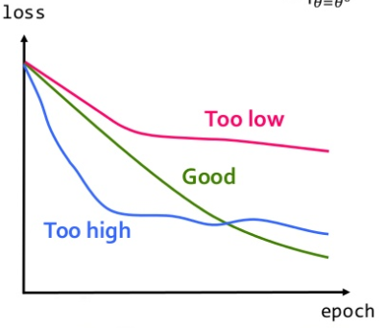
Learning rate
0<lr<1
影響收斂的速度
影響結果的好壞

Slide 22
Review
Gradient 受下列因素影響
Loss function
Learning rate
Opitimize function

Slide 23
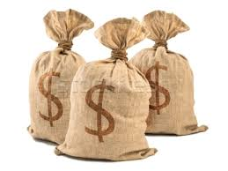
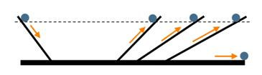
Gradient descent 問題
Speed up?
Mini-batch
Stuck in Local minimum?
Momentum

Slide 24
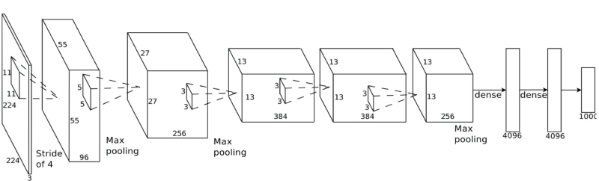
Network structure
到底要幾層？每層要開多大？
依照 input 的大小和特性決定
一般來說第一層大一點，越來越小

Slide 25
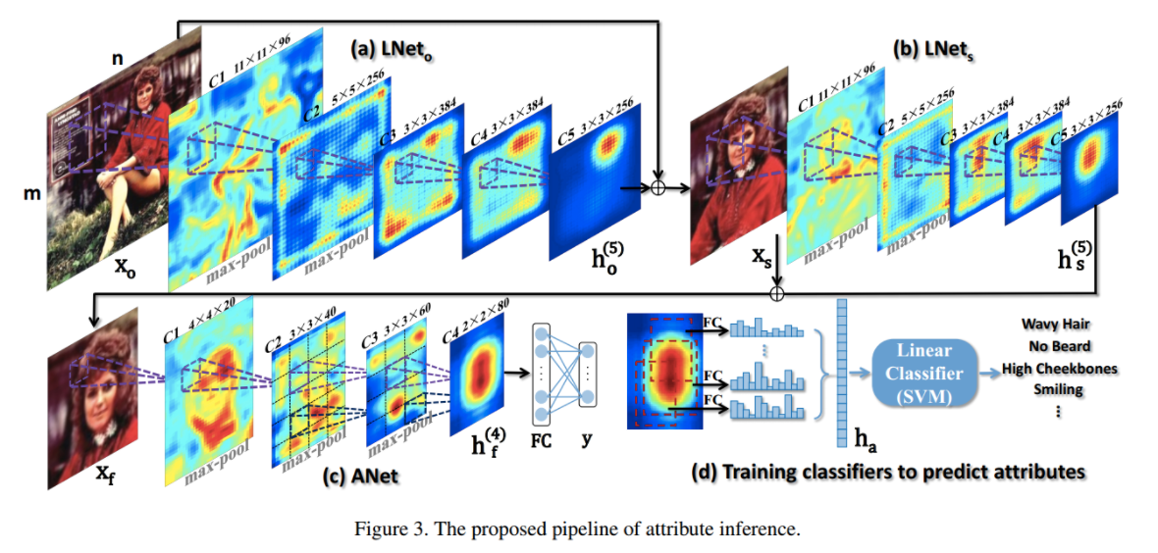

Slide 26
Outline
What is Machine Learning?
What is Deep learning?
What is Tensorflow?
Do it!
Summary

Slide 27
Tensorflow
Google 釋出內部使用的 library
快速建造需要的神經網路
You need Python!
Maybe you demand a nice GPU like 1080Ti

Slide 28
Tensorboard
Scalars
Graphs
Distribution
Histogram

Slide 29
Outline
What is Machine Learning?
What is Deep learning?
What is Tensorflow?
Do it!
Summary

Slide 30
Outline
What is Machine Learning?
What is Deep learning?
What is Tensorflow?
Do it!
Summary

Slide 31
Summary & Way to go
Mathemetics
Hyperparameter 的過程
克服 overfitting 的方法
Vanish Gradient
……
Training data
Testing data
Loss Function
Learning Rate
Activation Function
Optimize Function
Early Stopping
Regularization
Dropout

